Slide 1
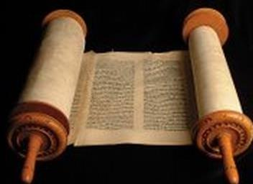
A CHRISTMAS CONVERGENCE:
FIVE CHRISTMAS PROPHECIES
Dr. Andrew M. Woods

Slide 2

Luke 24:27
“Then beginning with Moses and with all the prophets, He explained to them the things concerning Himself in all the Scriptures.”

Slide 3
Luke 24:44
“Now He said to them, “These are My words which I spoke to you while I was still with you, that all things which are written about Me in the Law of Moses and the Prophets and the Psalms must be fulfilled.”

Slide 4
John 5:39, 46
“³⁹ You search the Scriptures because you think that in them you have eternal life; it is these that testify about Me…⁴⁶ For if you believed Moses, you would believe Me, for he wrote about Me.”

Slide 5
Acts 17:1-3
“Now when they had traveled through Amphipolis and Apollonia, they came to Thessalonica, where there was a synagogue of the Jews. ² And according to Paul’s custom, he went to them, and for three Sabbaths reasoned with them from the Scriptures, ³ explaining and giving evidence that the Christ had to suffer and rise again from the dead, and saying, ‘This Jesus whom I am proclaiming to you is the Christ.’”

Slide 6
Matthew 16:1-3
¹ The Pharisees and Sadducees came up, and testing Jesus, they asked Him to show them a sign from heaven. ² But He replied to them, “When it is evening, you say, ‘It will be fair weather, for the sky is red.’ ³ And in the morning, ‘There will be a storm today, for the sky is red and threatening.’ Do you know how to discern the appearance of the sky, but cannot discern the signs of the times?”

Slide 7
Galatians 4:4
“But when the fullness of the time came, God sent forth His Son, born of a woman, born under the Law.”

Slide 8
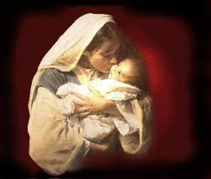
Messiah Must Be:
  A man (Gen 3:15)
  From Jacob’s line (Num 24:17)
  Appear prior to A.D. 70 (Mal 3:1)
  Be born of a virgin (Isa 7:13-14)
  Be born in Bethlehem (Micah 5:2)

Slide 9
Messiah Must Be:
  A man (Gen 3:15)
  From Jacob’s line (Num 24:17)
  Appear prior to A.D. 70 (Mal 3:1)
  Be born of a virgin (Isa 7:13-14)
  Be born in Bethlehem (Micah 5:2)

Slide 10
Messiah must be a man
Genesis 3:15

Slide 11

Genesis 3:15
“And I will put enmity Between you and the woman, And between your seed and her seed; He shall bruise you on the head, And you shall bruise him on the heel.”

Slide 12

1. Four Issues (Gen. 3:15)
A messianic prophecy?
Gender of the Messiah?
A Virgin Birth Prophecy?
Importance of the Virgin Birth?

Slide 13
1. Four Issues (Gen. 3:15)
A messianic prophecy?
Gender of the Messiah?
A Virgin Birth Prophecy?
Importance of the Virgin Birth?

Slide 14
Genesis 4:1
“Now the man had relations with his wife Eve, and she conceived and gave birth to Cain, and she said, ‘I have gotten a manchild with the help of the Lord.’”

Slide 15
Genesis 4:1
“Now the man had relations with his wife Eve, and she conceived and gave birth to Cain, and she said, ‘I have gotten a manchild with the help of the Lord.’”

Slide 16
Genesis 5:29
“Now he called his name Noah, saying, ‘This one will give us rest from our work and from the toil of our hands arising from the ground which the Lord has cursed.’”

Slide 17
Genesis 3:17
“Then to Adam He said, ‘Because you have listened to the voice of your wife, and have eaten from the tree about which I commanded you, saying, ‘You shall not eat from it’; Cursed is the ground because of you; In toil you will eat of it All the days of your life.’”

Slide 18
Daniel 11:37
“He will show no regard for the gods of his fathers or for the desire of women, nor will he show regard for any other god; for he will magnify himself above them all.”

Slide 19
1. Four Issues (Gen. 3:15)
A messianic prophecy?
Gender of the Messiah?
A Virgin Birth Prophecy?
Importance of the Virgin Birth?

Slide 20
Genesis 3:15
“And I will put enmity Between you and the woman, And between your seed and her seed; He shall bruise you on the head, And you shall bruise him on the heel.”

Slide 21
1. Four Issues (Gen. 3:15)
A messianic prophecy?
Gender of the Messiah?
A Virgin Birth Prophecy?
Importance of the Virgin Birth?

Slide 22
Genesis 3:15
“And I will put enmity Between you and the woman, And between your seed and her seed; He shall bruise you on the head, And you shall bruise him on the heel.”

Slide 23

Arnold Fruchtenbaum
Messianic Christology, Page 14, 36-37
“The fact that Moses traced this genealogy through the woman tells us that there will be something very different about the Messiah, something that necessitates tracing His ancestry through His mother, not His Father. Moses gives no explanation here, and none will be given for several centuries until the time of the Prophet Isaiah—when he will prophesy (in chapter 7) that Messiah is to be born of a virgin and have no human father...Contrary to the biblical norm, the Messiah would be reckoned after the Seed of the Woman. Why? Because He would have no human father; His would be a virgin conception and birth.”

Slide 24
1. Four Issues (Gen. 3:15)
A messianic prophecy?
Gender of the Messiah?
A Virgin Birth Prophecy?
Importance of the Virgin Birth?

Slide 25
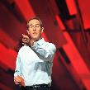
Andy Stanley
https://christianindex.org/andy-stanleys-approach-to-the-virgin-birth/
“One of the challenging things about the Christmas season and one of the challenging things about the Christmas story is, in fact, the Christmas story – the Christmas story as it relates to the birth of Jesus. Because there is so much miraculous, there is so much amazing, there is so much that’s really unbelievable about it and a whole lot of people just don’t believe; and I understand that. Maybe the thought is that they had to come up with some myth about the birth of Jesus to give him street cred later on. It is interesting because Matthew gives us a version of the birth of Jesus. Luke does, but Mark and John don’t even mention it; and a lot has been made of that. And you have heard me say some version of this a million times, but if somebody can predict their own death and resurrection, I’m not all that concerned about how they got into the world, because the whole resurrection thing is so amazing and, in fact, you should know this. Christianity does not hinge on the truth or even the stories about the birth of Jesus, it really hinges on the resurrection of Jesus.”

Slide 26

Brian McLaren
https://juicyecumenism.com/2018/12/11/virgin-birth-not-literal-symbol-vs-patriarchy-brian-mclaren/
“Pastor Brian McLaren meditates on the virgin birth in the “Be Still and Go” podcast of The Riverside Church in New York City. In a segment titled “A Post-Patriarchal Christmas,” McLaren took issue with the virgin birth as a “science-defying miracle that proved something about Jesus.” He protested, “This approach never really worked for me. How can you use something you can’t prove—a virgin birth long ago—to prove something else—the unique identity of Jesus?” McLaren draws a different conclusion. He says the virgin birth’s “greatest value isn’t in proving something, but in meaning something.” McLaren said God got so tired of men “messing things up” that he said, “I’m going to work directly with women for a change. I’m taking a step to overthrow the patriarchy.” Whether you believe the “virgin birth story” or not, McLaren said, its “literal factuality” is “not the point.” McLaren concluded the virgin birth is “about a profound rejection of violence,” the notion that peace can never come through the old, blood-stained path of patriarchy.”

Slide 27
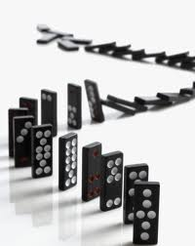

Slide 28

Why the Virgin Birth?
To fulfill OT prophecy
To emphasize Christ’s humanity and deity
To emphasize Christ’s eternality
To maintain Christ’s sinlessness
To protect the bodily atonement
To circumvent the curse of Jeconiah
To maintain Scripture’s inerrant record

Slide 29
Messiah Must Be:
  A man (Gen 3:15)
  From Jacob’s line (Num 24:17)
  Appear prior to A.D. 70 (Mal 3:1)
  Be born of a virgin (Isa 7:13-14)
  Be born in Bethlehem (Micah 5:2)

Slide 30
2. Messiah must be Jewish or from the line of Jacob
Numbers 24:17

Slide 31
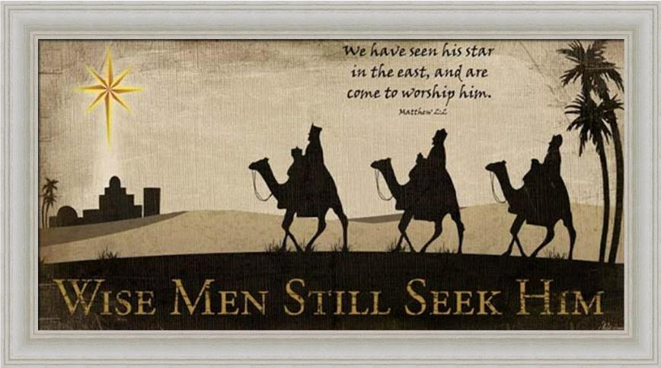

Slide 32
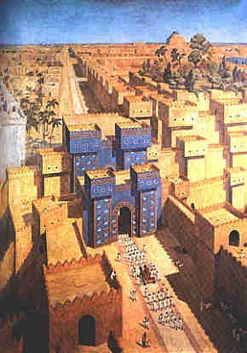
East = Babylon
Genesis 2:8
Genesis 11:2
Matthew 2:2

Slide 33


Slide 34


Slide 35
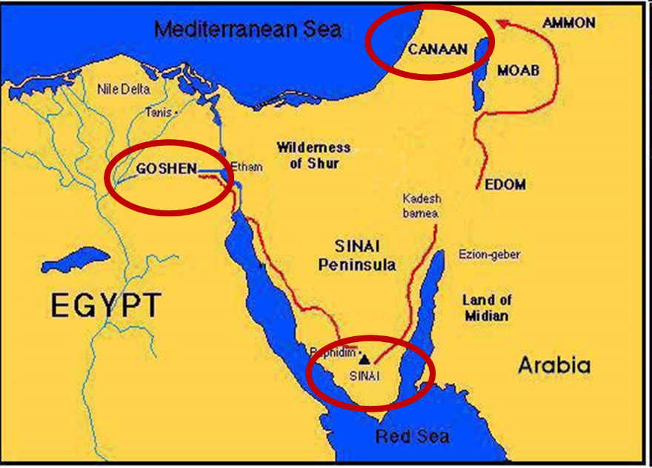

Slide 36
Balaam's 7 Oracles Blessing Israel (23-24)
First oracle (23:1-12), Balaam explained that God’s blessings upon Israel were irrevocable.
Second oracle (23:13-26), Balaam explained that the source of Israel’s blessing was her unique relationship to Yahweh
Third oracle (23:27–24:14), Balaam extolled Israel’s beauty.
Fourth oracle (24:15-19), Balaam explained that a future messianic deliverer (Gen 49:10) would spring forth and exercise dominion from Israel.

Slide 37
Balaam's 7 Oracles Blessing Israel (23-24)
Fifth oracle (Num 24:20) predicts Amalek’s destruction. Amalek was the first foe that Israel had to fight against after leaving Egypt (Exod 17).
Sixth oracle (24:21-22) predicts the destruction of the Midianite group known as the Kenites as well as Assyria.
The nations of the seventh oracle are difficult to identify (24:23-24).

Slide 38
Balaam's 7 Oracles Blessing Israel (23-24)
First oracle (23:1-12), Balaam explained that God’s blessings upon Israel were irrevocable.
Second oracle (23:13-26), Balaam explained that the source of Israel’s blessing was her unique relationship to Yahweh
Third oracle (23:27–24:14), Balaam extolled Israel’s beauty.
Fourth oracle (24:15-19), Balaam explained that a future messianic deliverer (Gen 49:10) would spring forth and exercise dominion from Israel.

Slide 39
Numbers 24:17
“I see him, but not now; I behold him, but not near; A star shall come forth from Jacob, A scepter shall rise from Israel, And shall crush through the forehead of Moab, And tear down all the sons of Sheth.”

Slide 40
Numbers 24:17
“I see him, but not now; I behold him, but not near; A star shall come forth from Jacob, A scepter shall rise from Israel, And shall crush through the forehead of Moab, And tear down all the sons of Sheth.”

Slide 41
Numbers 24:17
“I see him, but not now; I behold him, but not near; A star shall come forth from Jacob, A scepter shall rise from Israel, And shall crush through the forehead of Moab, And tear down all the sons of Sheth.”

Slide 42
Numbers 24:17
“I see him, but not now; I behold him, but not near; A star shall come forth from Jacob, A scepter shall rise from Israel, And shall crush through the forehead of Moab, And tear down all the sons of Sheth.”

Slide 43
Deuteronomy 23:4
“because they did not meet you with food and water on the way when you came out of Egypt, and because they hired against you Balaam the son of Beor from Pethor of Mesopotamia, to curse you.”

Slide 44
Daniel 1:2
“The Lord gave Jehoiakim king of Judah into his hand, along with some of the vessels of the house of God; and he brought them to the land of Shinar, to the house of his god, and he brought the vessels into the treasury of his god.”

Slide 46


Statue
&
Stone

Slide 47
Daniel 2:48
“Then the king promoted Daniel and gave him many great gifts, and he made him ruler over the whole province of Babylon and chief prefect over all the wise men of Babylon.”

Slide 48

Messiah must present Himself to Israel on March 30, A.D. 33
Daniel 9:25

Slide 49

Luke 19:42-44
^{“42} saying, ‘If you had known in this day, even you, the things which make for peace! But now they have been hidden from your eyes. ⁴³ For the days will come upon you when your enemies will throw up a barricade against you, and surround you and hem you in on every side, ⁴⁴ and they will level you to the ground and your children within you, and they will not leave in you one stone upon another, because you did not recognize the time of your visitation.’”

Slide 51
Messiah Must Be:
  A man (Gen 3:15)
  From Jacob’s line (Num 24:17)
  Appear prior to A.D. 70 (Mal 3:1)
  Be born of a virgin (Isa 7:13-14)
  Be born in Bethlehem (Micah 5:2)

Slide 52
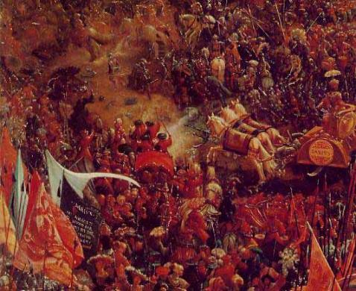
3. Messiah must come before A.D. 70
Malachi 3:1

Slide 53
Malachi 3:1
“Behold, I am going to send My messenger, and he will clear the way before Me. And the Lord, whom you seek, will suddenly come to His temple; and the messenger of the covenant, in whom you delight, behold, He is coming,” says the Lord of hosts.”

Slide 54
Malachi 3:1
“Behold, I am going to send My messenger, and he will clear the way before Me. And the Lord, whom you seek, will suddenly come to His temple; and the messenger of the covenant, in whom you delight, behold, He is coming,” says the Lord of hosts.”

Slide 55
ISRAEL’S FOUR TEMPLES
Solomon’s pre exilic temple (Kings and Chronicles)
Zerubbabel’s post exilic temple (Ezra 1-6; John 2:20)
Antichrist's temple (Dan 9:27; Matt 24:15; 2 Thess 2:4; Rev 11:1-2)
Millennial temple (Ezek 40-48)

Slide 56
Matthew 24:1-2
“¹ Jesus came out from the temple and was going away when His disciples came up to point out the temple buildings to Him. ² And He said to them, “Do you not see all these things? Truly I say to you, not one stone here will be left upon another, which will not be torn down.”

Slide 57
Luke 19:42-44
^{“42} saying, ‘If you had known in this day, even you, the things which make for peace! But now they have been hidden from your eyes. ⁴³ For the days will come upon you when your enemies will throw up a barricade against you, and surround you and hem you in on every side, ⁴⁴ and they will level you to the ground and your children within you, and they will not leave in you one stone upon another, because you did not recognize the time of your visitation.’”

Slide 58
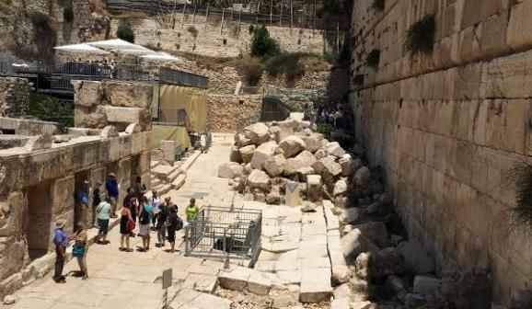
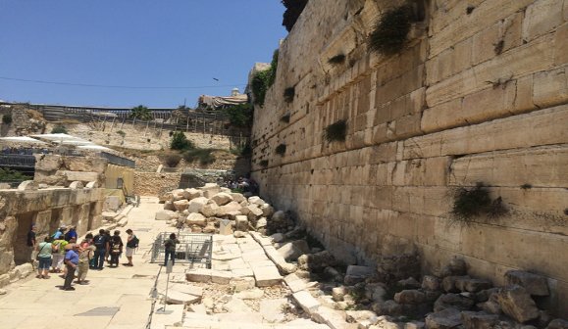

Slide 59
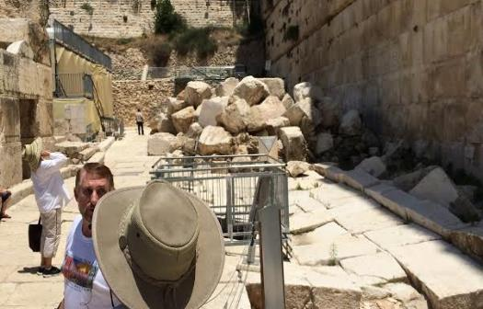
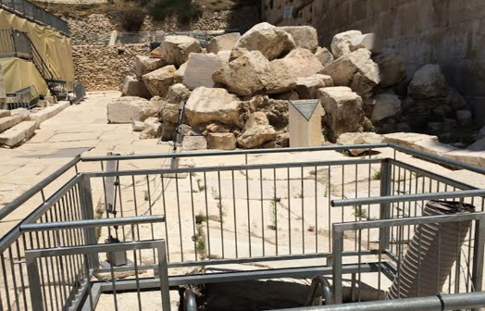

Slide 60


Slide 61
Messiah Must Be:
  A man (Gen 3:15)
  From Jacob’s line (Num 24:17)
  Appear prior to A.D. 70 (Mal 3:1)
  Be born of a virgin (Isa 7:13-14)
  Be born in Bethlehem (Micah 5:2)

Slide 62
4. Messiah must be born of a virgin
Isaiah 7:13-14

Slide 63
Isaiah 7:13-14
“Then he said, “Listen now, O house of David! Is it too slight a thing for you to try the patience of men, that you will try the patience of my God as well? ¹⁴ Therefore the Lord Himself will give you a sign: Behold, a virgin will be with child and bear a son, and she will call His name Immanuel.”

Slide 64
Isaiah 7:13-14
“Then he said, “Listen now, O house of David! Is it too slight a thing for you to try the patience of men, that you will try the patience of my God as well? ¹⁴ Therefore the Lord Himself will give you a sign: Behold, a virgin will be with child and bear a son, and she will call His name Immanuel.”

Slide 65
Three Arguments Against the Virgin Birth (Isa. 7:13-14)
The Hebrew word is Betulah and not Almah (Joel 1:8)!
The Hebrew word Almah does not mean virgin!
No relevance to Isaiah’s day!

Slide 66
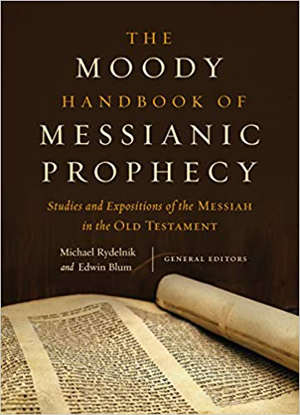

Slide 67
Three Arguments Against the Virgin Birth (Isa. 7:13-14)
The Hebrew word is Betulah and not Almah (Joel 1:8)!
The Hebrew word Almah does not mean virgin!
No relevance to Isaiah’s day!

Slide 68
Three Arguments Against the Virgin Birth (Isa. 7:13-14)
The Hebrew word is Betulah and not Almah (Joel 1:8)
The Hebrew word Almah does not mean virgin
No relevance to Isaiah’s day

Slide 69
To Fulfill Old Testament Prophecy
Almah
  OT uses (Gen 24:43; Exod 2:8; Ps 68:25; Song of Solomon 1:3; 6:8; Prov 30:18-19)
  LXX
  Matt 1:23

Slide 70
To Fulfill Old Testament Prophecy
Almah
  OT uses (Gen 24:43; Exod 2:8; Ps 68:25; Song of Solomon 1:3; 6:8; Prov 30:18-19)
  LXX
  Matt 1:23

Slide 71
Arnold Fruchtenbaum
Messianic Christology, Page 64
“Almah means ‘a virgin,’ ‘a young virgin,’ a ‘virgin of marriageable age.’ This word is used seven times in the Hebrew Scriptures and not once is it used to describe a married woman; this point is not debated...Since all of the above six verses mean ‘a virgin,’ what reason is there for making Isaiah 7:14 the only exception?”

Slide 72
To Fulfill Old Testament Prophecy
Almah
  OT uses (Gen 24:43; Exod 2:8; Ps 68:25; Song of Solomon 1:3; 6:8; Prov 30:18-19)
  LXX
  Matt 1:23

Slide 73
To Fulfill Old Testament Prophecy
Almah
  OT uses (Gen 24:43; Exod 2:8; Ps 68:25; Song of Solomon 1:3; 6:8; Prov 30:18-19)
  LXX
  Matt 1:23

Slide 74


Matthew 1:23
“Behold, the virgin [Parthenos] shall be with child and shall bear a Son, and they shall call His name Immanuel,” which translated means, ‘God with us.’”

Slide 75

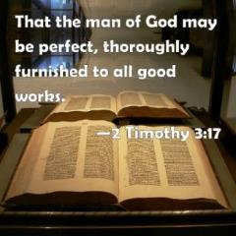
2 Timothy 3:16-17
“All Scripture is inspired by God [theopneustos] and profitable for teaching, for reproof, for correction, for training in righteousness; so that the man of God may be adequate, equipped for every good work.”

Slide 76
INSPIRATION OF SCRIPTURE
2 Peter 1:20-21
Men Wrote as they were inspired by Holy Spirit
  “phero” = to carry
    Acts 27:15,17
Opposite of Knowledge of False Teachers
  Which is their own imagination
    Jer. 23:16

Slide 77
Matthew 5:18
“For truly I say to you, until heaven and earth pass away, not the smallest letter or stroke shall pass from the Law until all is accomplished.”

Slide 78
Three Arguments Against the Virgin Birth (Isa. 7:13-14)
The Hebrew word is Betulah and not Almah (Joel 1:8)!
The Hebrew word Almah does not mean virgin!
No relevance to Isaiah’s day!

Slide 79
Isaiah 7:13-14
Ahaz’ Day?
  Isaiah 53 in Acts 8:31-35
  Sign (Isa 7:14)
  Two threats (Isa. 7:1-2)
    Shear Jashub (Isa. 7:3)
    David (Isa 7:13)
    From the singular to the plural “you”
  Extended context (Isa 9:6; 11:1-5)

Slide 80
Isaiah 7:13-14
Ahaz’ Day?
  Isaiah 53 in Acts 8:31-35
  Sign (Isa 7:14)
  Two threats (Isa. 7:1-2)
    Shear Jashub (Isa. 7:3)
    David (Isa 7:13)
    From the singular to the plural “you”
  Extended context (Isa 9:6; 11:1-5)

Slide 81
Isaiah 7:13-14
Ahaz’ Day?
  Isaiah 53 in Acts 8:31-35
  Sign (Isa 7:14)
  Two threats (Isa. 7:1-2)
    Shear Jashub (Isa. 7:3)
    David (Isa 7:13)
    From the singular to the plural “you”
  Extended context (Isa 9:6; 11:1-5)

Slide 82
Isaiah 7:13-14
“Then he said, “Listen now, O house of David! Is it too slight a thing for you to try the patience of men, that you will try the patience of my God as well? ¹⁴ Therefore the Lord Himself will give you a sign: Behold, a virgin will be with child and bear a son, and she will call His name Immanuel.”

Slide 83

ISAIAH 7 AND 8 DIFFERENCES
Isaiah 7 | Isaiah 8
Immanuel | Maher-shalal-hash-baz
Blessing | Judgment
Born to a virgin | Born to Isaiah's wife
Age 12 | Age 1-2
Assyrian judgment upon Judah | Assyrian judgment upon Syria and Israel

Slide 84
Isaiah 7:13-14
Ahaz’ Day?
  Isaiah 53 in Acts 8:31-35
  Sign (Isa 7:14)
  Two threats (Isa. 7:1-2)
    Shear Jashub (Isa. 7:3)
    David (Isa 7:13)
    From the singular to the plural “you”
  Extended context (Isa 9:6; 11:1-5)

Slide 85
Isaiah 7:1-2 (NASB)
“¹ Now it came about in the days of Ahaz, the son of Jotham, the son of Uzziah, king of Judah, that Rezin the king of Aram and Pekah the son of Remaliah, king of Israel, went up to Jerusalem to wage war against it, but could not conquer it. ² When it was reported to the house of David, saying, “The Arameans have camped in Ephraim,” his heart and the hearts of his people shook as the trees of the forest shake with the wind.”

Slide 86
Isaiah 7:13-14
Ahaz’ Day?
  Isaiah 53 in Acts 8:31-35
  Sign (Isa 7:14)
  Two threats (Isa. 7:1-2)
    Shear Jashub (Isa. 7:3)
    David (Isa 7:13)
    From the singular to the plural “you”
  Extended context (Isa 9:6; 11:1-5)

Slide 87
Isaiah 7:3
“Then the Lord said to Isaiah, ‘Go out now to meet Ahaz, you and your son Shear-jashub, at the end of the conduit of the upper pool, on the highway to the fuller’s field.’”

Slide 88
Isaiah 7:13-14
Ahaz’ Day?
  Isaiah 53 in Acts 8:31-35
  Sign (Isa 7:14)
  Two threats (Isa. 7:1-2)
    Shear Jashub (Isa. 7:3)
    David (Isa 7:13)
    From the singular to the plural “you”
  Extended context (Isa 9:6; 11:1-5)

Slide 89
Isaiah 7:13-14
“Then he said, “Listen now, O house of David! Is it too slight a thing for you to try the patience of men, that you will try the patience of my God as well? ¹⁴ Therefore the Lord Himself will give you a sign: Behold, a virgin will be with child and bear a son, and she will call His name Immanuel.”

Slide 90
Isaiah 7:13-14
Ahaz’ Day?
  Isaiah 53 in Acts 8:31-35
  Sign (Isa 7:14)
  Two threats (Isa. 7:1-2)
    Shear Jashub (Isa. 7:3)
    David (Isa 7:13)
    From the singular to the plural “you”
  Extended context (Isa 9:6; 11:1-5)

Slide 91
Arnold Fruchtenbaum
Messianic Christology, Page 36
“In verse 13, Isaiah turns from addressing Ahaz as an individual and addresses the entire House of David. The English language does not distinguish between ‘you’ addressed to one person and ‘you’ addressed to many people. In Hebrew there is a difference, and there is a clear change between the singular ‘you’ of verses 9, 11, 16, 17 and the plural ‘you’ of verses 13–14. The sign therefore is not just for Ahaz, but for the whole House of David. This becomes clearer if we state the passage again with the singular [s] and plural [pl] words indicated:”

Slide 92

Isaiah 7:9–17 (NASB95)
⁹ “… and the head of Ephraim is Samaria and the head of Samaria is the son of Remaliah. If you [s] will not believe, you [s] surely shall not last.”’” ¹⁰ Then the Lord spoke again to Ahaz, saying, ¹¹ “Ask a sign for yourself [s] from the Lord your God; make it deep as Sheol or high as heaven.” ¹² But Ahaz said, “I will not ask, nor will I test the Lord!” ¹³ Then he said, “Listen now, O house of David! Is it too slight a thing for you [pl] to try the patience of men, that you [pl] will try the patience of my God as well? ¹⁴ “Therefore the Lord Himself will give you [pl] a sign: Behold, a virgin will be with child and bear a son, and she will call His name Immanuel. ¹⁵ “He will eat curds and honey at the time He knows enough to refuse evil and choose good. ¹⁶ “For before the boy will know enough to refuse evil and choose good, the land whose two kings you [s] dread will be forsaken. ¹⁷ “The Lord will bring on you [s], on your people, and on your father’s house such days as have never come since the day that Ephraim separated from Judah, the king of Assyria.”

Slide 93
Isaiah 7:13-14
Ahaz’ Day?
  Isaiah 53 in Acts 8:31-35
  Sign (Isa 7:14)
  Two threats (Isa. 7:1-2)
    Shear Jashub (Isa. 7:3)
    David (Isa 7:13)
    From the singular to the plural “you”
  Extended context (Isa 9:6; 11:1-5)

Slide 94
Isaiah 7:13-14
“Then he said, “Listen now, O house of David! Is it too slight a thing for you to try the patience of men, that you will try the patience of my God as well? ¹⁴ Therefore the Lord Himself will give you a sign: Behold, a virgin will be with child and bear a son, and she will call His name Immanuel.”

Slide 95
Isaiah 9:6-7
⁶ For a child will be born to us, a son will be given to us; And the government will rest on His shoulders; And His name will be called Wonderful Counselor, Mighty God, Eternal Father, Prince of Peace.⁷ There will be no end to the increase of His government or of peace, On the throne of David and over his kingdom, To establish it and to uphold it with justice and righteousness From then on and forevermore. The zeal of the Lord of hosts will accomplish this.

Slide 96
Isaiah 11:1-5
“¹Then a shoot will spring from the stem of Jesse, And a branch from his roots will bear fruit.² The Spirit of the Lord will rest on Him, The spirit of wisdom and understanding, The spirit of counsel and strength, The spirit of knowledge and the fear of the Lord.³ And He will delight in the fear of the Lord, And He will not judge by what His eyes see, Nor make a decision by what His ears hear.”

Slide 97
Isaiah 11:1-5
“⁴ But with righteousness He will judge the poor, And decide with fairness for the afflicted of the earth; And He will strike the earth with the rod of His mouth, And with the breath of His lips He will slay the wicked. ⁵ Also righteousness will be the belt about His loins, And faithfulness the belt about His waist.”

Slide 98
Messiah Must Be:
  A man (Gen 3:15)
  From Jacob’s line (Num 24:17)
  Appear prior to A.D. 70 (Mal 3:1)
  Be born of a virgin (Isa 7:13-14)
  Be born in Bethlehem (Micah 5:2)

Slide 99
5. Messiah must be born in Bethlehem
Micah 5:2

Slide 100
Micah 5:2
“But as for you, Bethlehem Ephrathah, Too little to be among the clans of Judah, From you One will go forth for Me to be ruler in Israel. His goings forth are from long ago, From the days of eternity.”

Slide 101
Micah 5:2
“But as for you, Bethlehem Ephrathah, Too little to be among the clans of Judah, From you One will go forth for Me to be ruler in Israel. His goings forth are from long ago, From the days of eternity.”

Slide 102

Psalm 90:2
“Before the mountains were born Or You gave birth to the earth and the world, Even from everlasting (olam) to everlasting (olam), You are God.”

Slide 103
Arnold Fruchtenbaum
Messianic Christology, Page 64
“As regards His human origin, He is to be born in Bethlehem, but regarding His divine origin, He is said to be ‘from long ago, from the days of eternity.’ The Hebrew words for ‘from long ago, from the days of eternity’ are the strongest Hebrew words ever used for eternity past. They are used of God the Father in Psalm 90:2. What is true of God the Father is also said to be true of this One who is to be born in Bethlehem.”

Slide 104
Birth of the Messiah
(Micah 5:2)
The exact nation: Israel
The exact tribe: Judah
The exact city: Bethlehem

Slide 105
Birth of the Messiah
(Micah 5:2)
The exact nation: Israel
The exact tribe: Judah
The exact city: Bethlehem

Slide 106
Micah 5:2
“But as for you, Bethlehem Ephrathah, Too little to be among the clans of Judah, From you One will go forth for Me to be ruler in Israel. His goings forth are from long ago, From the days of eternity.”

Slide 107
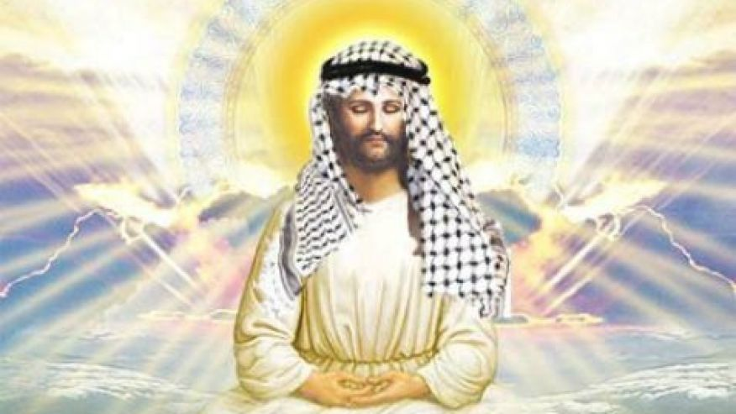

Slide 108
Birth of the Messiah
(Micah 5:2)
The exact nation: Israel
The exact tribe: Judah
The exact city: Bethlehem

Slide 109
Micah 5:2
“But as for you, Bethlehem Ephrathah, Too little to be among the clans of Judah, From you One will go forth for Me to be ruler in Israel. His goings forth are from long ago, From the days of eternity.”

Slide 110
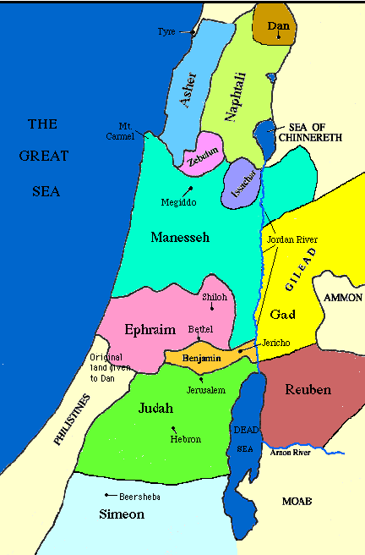

Slide 111
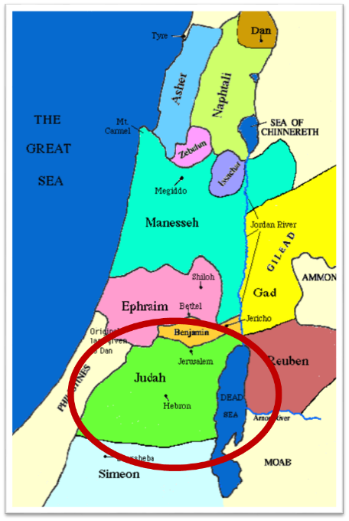

Slide 112
Messiah must be from the tribe of Judah
Genesis 49:10
Revelation 5:5

Slide 113
Birth of the Messiah
(Micah 5:2)
The exact nation: Israel
The exact tribe: Judah
The exact city: Bethlehem

Slide 114
Micah 5:2
“But as for you, Bethlehem Ephrathah, Too little to be among the clans of Judah, From you One will go forth for Me to be ruler in Israel. His goings forth are from long ago, From the days of eternity.”

Slide 115
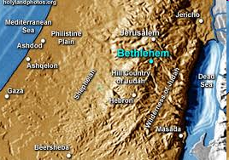

Slide 116
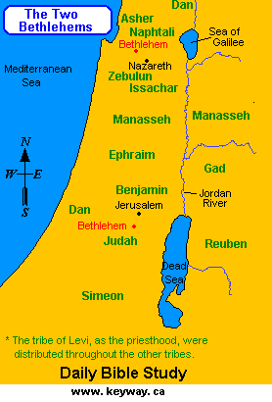

Slide 117
Micah 5:2
“But as for you, Bethlehem Ephrathah, Too little to be among the clans of Judah, From you One will go forth for Me to be ruler in Israel. His goings forth are from long ago, From the days of eternity.”

Slide 118
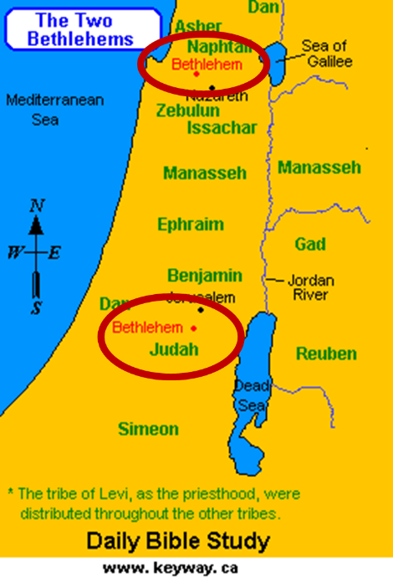

Slide 119
Arnold Fruchtenbaum
Messianic Christology, Page 64
“Messiah is to be born, not in Jerusalem as might have been expected, but in Bethlehem... This is Bethlehem Ephrathah, as distinguished from another Bethlehem in Galilee. This Bethlehem is the Bethlehem of David and of Judah, situated south of Jerusalem.”

Slide 120
Matthew 2:4-6
“⁴ Gathering together all the chief priests and scribes of the people, he inquired of them where the Messiah was to be born. ⁵ They said to him, “In Bethlehem of Judea; for this is what has been written by the prophet: ⁶ ‘AND YOU, BETHLEHEM, LAND OF JUDAH, ARE BY NO MEANS LEAST AMONG THE LEADERS OF JUDAH; FOR OUT OF YOU SHALL COME FORTH A RULER WHO WILL SHEPHERD MY PEOPLE ISRAEL.’”

Slide 121
Conclusion

Slide 122
Messiah Must Be:
  A man (Gen 3:15)
  From Jacob’s line (Num 24:17)
  Appear prior to A.D. 70 (Mal 3:1)
  Be born of a virgin (Isa 7:13-14)
  Be born in Bethlehem (Micah 5:2)

Slide 123
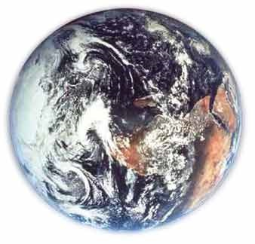
Modern Example
Hemisphere
Country
State
County
City
Zip code
Street name
Street address
Person

Slide 124

“The Lord bless you and keep you; the Lord make his face shine on you and be gracious to you; the Lord turn his face toward you and give you peace.” (NIV)

