Slide 1
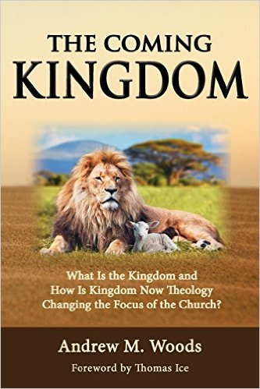

Slide 2

Kingdom Study Outline
What does the Bible Says About the Kingdom?
Why do some believe that we are in the kingdom now?
Why does it matter?

Slide 3

9 Ways Kingdom Now Theology
Impacts the Church
Loss of “pilgrim” status
Social Gospel
Ecumenical & interfaith alliances
Rejection or marginalization of Bible prophecy
Building the wrong kingdom
Charismatic theology
Prosperity Gospel
Anti-Israelism
Lordship Salvation

Slide 4
9 Ways Kingdom Now Theology
Impacts the Church
Loss of “pilgrim” status
Social Gospel
Ecumenical & interfaith alliances
Rejection or marginalization of Bible prophecy
Building the wrong kingdom
Charismatic theology
Prosperity Gospel
Anti-Israelism
Lordship Salvation

Slide 5

Lewis Sperry Chafer
vol. 5, Systematic Theology (Grand Rapids, MI: Kregel Publications, 1993), 350.
“So the church was fully warned from the beginning about the nature of this age, and taught concerning her pilgrim character while here and her holy calling and separateness from the ‘evil age.’”

Slide 6
9 Ways Kingdom Now Theology
Impacts the Church
Loss of “pilgrim” status
Social Gospel
Ecumenical & interfaith alliances
Rejection or marginalization of Bible prophecy
Building the wrong kingdom
Charismatic theology
Prosperity Gospel
Anti-Israelism
Lordship Salvation

Slide 7

Reweaving the Community?
Timothy Keller, Generous Justice: How God's Grace Makes Us Just (NY: Penguin Books, 2012), 174, 177.
“In general, to ‘do justice’ means to live in a way that generates a strong community where human beings can flourish. Specifically, however, to ‘do justice’ means to go to places where the fabric of shalom has broken down, where the weaker members of societies are falling through the fabric, and to repair it. This happens when we concentrate on and meet the needs of the poor…The only way to reweave and strengthen the fabric is by weaving yourself into it…The strong must disadvantage themselves for the weak, the majority for the minority, or the community frays and the fabric breaks.”
Notes:
WRONG!!!

Slide 8
9 Ways Kingdom Now Theology
Impacts the Church
Loss of “pilgrim” status
Social Gospel
Ecumenical & interfaith alliances
Rejection or marginalization of Bible prophecy
Building the wrong kingdom
Charismatic theology
Prosperity Gospel
Anti-Israelism
Lordship Salvation

Slide 9
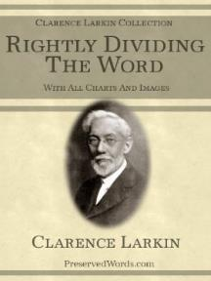
Clarence Larkin
Rightly Dividing the Word, 48.
“The great mistake the Church has made is in appropriating to herself in this Dispensation the promises of earthly conquest and glory which belong exclusively to Israel in the ‘Millennial Age.’ As soon as the Church enters into an ‘Alliance with the World,’ and seeks the help of Parliaments, Congresses, Legislatures, Federations and Reform Societies, largely made up of ungodly men and women, she loses her spiritual power and becomes helpless as a redeeming force.”

Slide 10

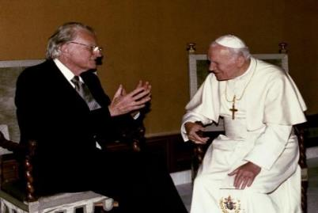
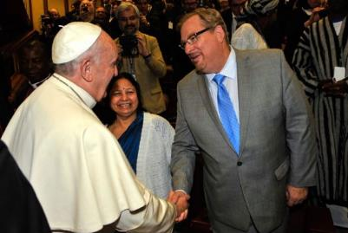
Evangelicals and Catholics Together

Slide 11
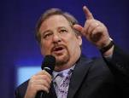
Ecumenisim
Matt Slick, “Rick Warren’s Comments on Roman Catholicism,” accessed July 20, 2015, http://www.carm.org.
“We have far more in common than what divides us. When you talk about Pentecostals, charismatics, evangelicals, fundamentalists, Catholics, Methodists, Baptists, Presbyterians, on and on and on and on. Well, they would all say we believe in the trinity; we believe in the Bible; we believe in the resurrection; we believe salvation is through Jesus Christ. These are the big issues. Sometimes Protestants think that Catholics worship Mary like she’s another god. But that’s not exactly catholic doctrine. . . . and people say well what are the saints all about? Why are you praying to the saints? And when you understand what they mean by what they’re saying there’s a whole lot more commonality.”

Slide 12
Ecumenisim
Matt Slick, “Rick Warren’s Comments on Roman Catholicism,” accessed July 20, 2015, http://www.carm.org.
“Now there are still real differences, no doubt about that. But the most important thing is if you love Jesus, we’re on the same team. The unity that I think we would see realistically is not a structural unity but a unity of mission. And so, when it comes to the family, we are co-workers in the field on this for the protection of what we call the sanctity of life, the sanctity of sex, and the sanctity of marriage. So there’s a great commonality and there’s no division on any of those three. Many times people have been beaten down for taking a biblical stance. And they start to feel, “Well, maybe I’m out here all by yourself.” No, you’re not (italics added)”

Slide 13
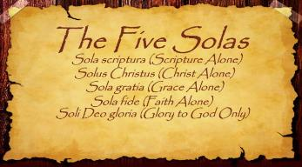
The Five Solas (Alone or By Itself)
Solus Christus-Christ alone
Sola Fide-faith alone
Sola Gratia-grace alone
Sola Scriptura-Scripture alone
Soli Deo Gloria-To the glory of God alone

Slide 14
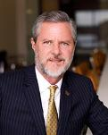
Ecumenisim
Glenn Interviews Jerry Falwell Jr., June 25, 2010, posted at: http://www.glennbeck.com/content/articles/article/198/42325/
“If we don’t hang together, we’ll hang separately. I mean that’s what my father believed when he formed the Moral Majority, an organization of Mormons, Catholics, Protestants, Jews, people of no faith. And there are bigger issues now. We can argue about theology later, after we save the country.”

Slide 15
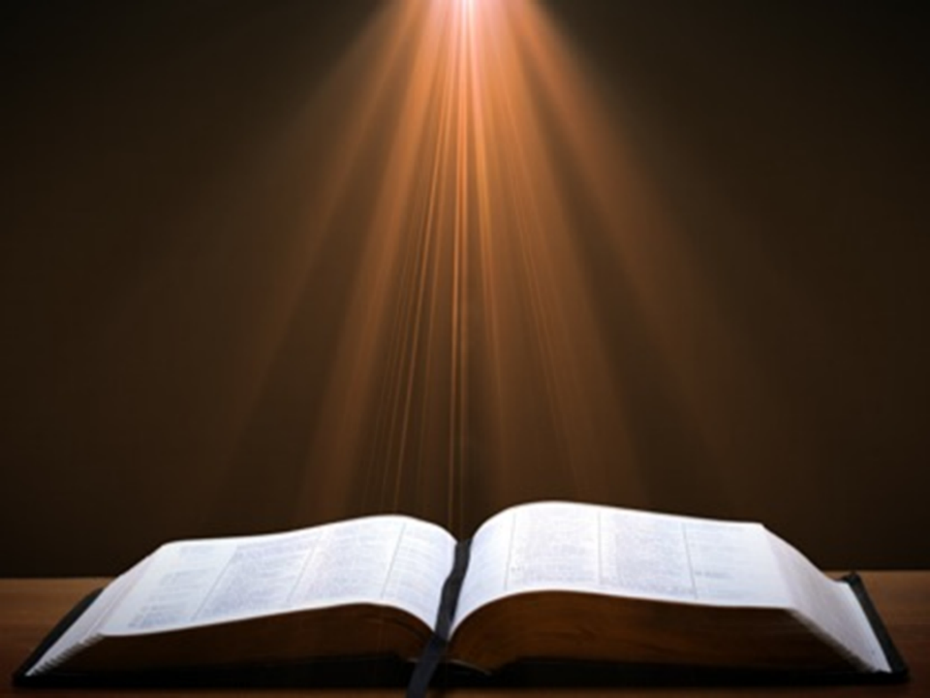

Acts 2:42
“ They were continually devoting themselves to the apostles’ teaching and to fellowship, to the breaking of bread and to prayer.”

Slide 16

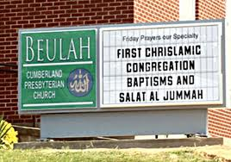

Slide 17
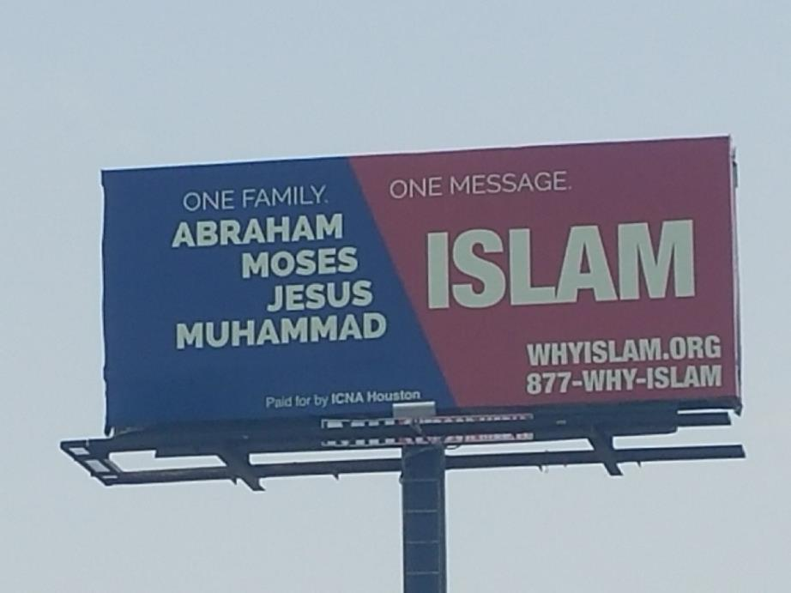

Slide 18
Ecumenisim
http://m.youtube.com/watch?v=nu7_rtUQiE0
“To my Islamic brother here from Italy, I would say I’m not really interested in inter-faith dialogue; I’m interested in inter-faith projects. We’ve got enough talk. So . . . a few weeks ago, at Georgetown University, we brought in three imams, we brought in three Catholic priests, we brought in three evangelical pastors, and we brought in three Rabbis and we said, ‘What can we do about AIDS?’ And we started on some common ground on those issues; what can we do that we all care about?”

Slide 19

Ecumenisim
https://www.youtube.com/watch?feature=player_detailpage&v=tJeNsPIC3vE
“I humbly ask this in the name of the one who changed my life, Yeshua, Isa, Jesus [Spanish pronunciation], Jesus, who taught us to pray.”

Slide 20
Ecumenisim
Eric Barger, “Rick Warren Invokes the Name of Islamic Jesus at Obama Inauguration” (January 2009), accessed January 4, 2015,
http://www.ericbarger.com/emailers/2009/update1-21-2009.htm.
“‘Isa’ in no way represents the Jesus of the Bible but is instead the false Jesus of the Qur’an (Koran) and the Muslim Hadith. ‘Isa’ (pronounced ‘eee-sa’) is the Islamic Jesus who was but a prophet and who certainly did not experience a sacrificial death on a cross let alone resurrect from the dead. In fact, in Islam the prophet Isa is actually the destroyer of Christianity—not it’s Savior. Obviously, this is simply NOT the same Jesus as is Yeshua.”

Slide 21
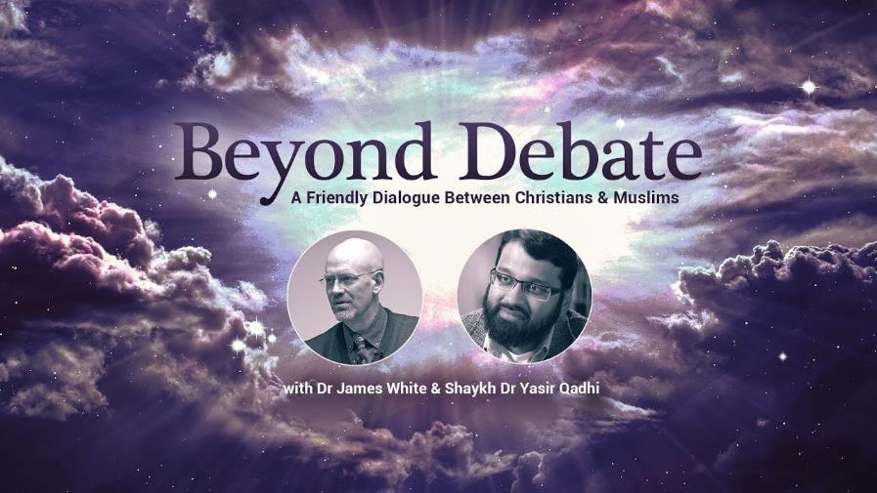

Slide 22

Seyyid Qutb
Milestones, Salimiah (Kuwait: International Islamic Federation of Student Organizations, 1978 [written 1966]), 263.
The Muslim Brotherhood’s senior theoretician, Seyyid Qutb, was transparent in the true agenda behind Islamic participation in interfaith dialogue, when he wrote, “The chasm between Islam and the Jahiliyyah [the society of unbelievers] is great, and a bridge is not to be built across it so that the people on the two sides may mix with each other, but only so that the people of the Jahiliyyah [the society of unbelievers] may come over to Islam."

Slide 23


The First Interfaith Dialogue
2 Cor 11:3
“But I fear, lest somehow, as the serpent deceived Eve by his craftiness, so your minds may be corrupted by from the simplicity that is in Christ.” (Italics mine)
Gen 3:1
“Now the serpent was more crafty than any beast of the field which the Lord God had made. And he said to the woman, ‘Indeed, has God said, ‘You shall not eat from any tree of the garden’?”

Slide 24

2 John 9-11
“⁹ Anyone who goes too far and does not abide in the teaching of Christ, does not have God; the one who abides in the teaching, he has both the Father and the Son. ¹⁰ If anyone comes to you and does not bring this teaching, do not receive him into your house, and do not give him a greeting; ¹¹ for the one who gives him a greeting participates in his evil deeds.”

Slide 25
Acts 2:46
“ Day by day continuing with one mind in the temple, and breaking bread from house to house, they were taking their meals together with gladness and sincerity of heart.”

Slide 26
9 Ways Kingdom Now Theology
Impacts the Church
Loss of “pilgrim” status
Social Gospel
Ecumenical & interfaith alliances
Rejection or marginalization of Bible prophecy
Building the wrong kingdom
Charismatic theology
Prosperity Gospel
Anti-Israelism
Lordship Salvation

Slide 27
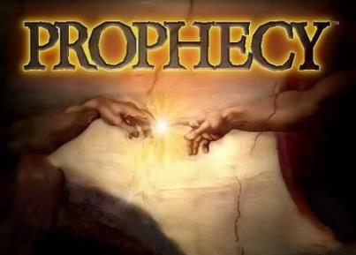
Biblical Prophecy: Importance
27% of Scripture was prophetic at the time it was written
2 Pet 1:19

Slide 28
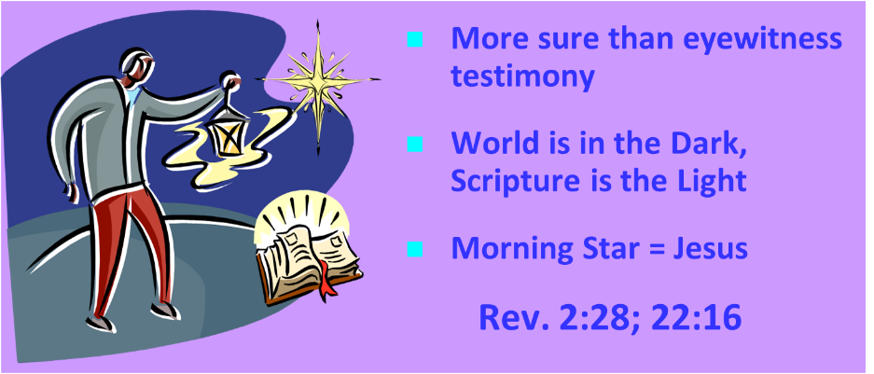
AUTHORITY OF SCRIPTURE
V. 19

Slide 29

J. Dwight Pentecost
Prophecy For Today, Page 20
“A short time ago, I took occasion to go through the New Testament to mark each reference to the coming of the Lord Jesus Christ and to observe the use made of that teaching about His coming. I was struck a new with the fact that almost without exception, when the coming of Christ is mentioned in the New Testament, it is followed by an exhortation to godliness and holy living.”

Slide 30
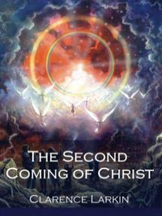
Clarence Larkin
The Second Coming of Christ, 51.
“The ‘Kingdom Idea’ has robbed the Church of her ‘UPWARD LOOK,’ and of the ‘BLESSED HOPE.’ There cannot be any ‘Imminent Coming’ to those who are seeking to ‘Set up the Kingdom.’”

Slide 31
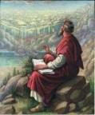
John 14:1–3
¹ “Do not let your heart be troubled; believe in God, believe also in Me. ² “In My Father’s house are many dwelling places; if it were not so, I would have told you; for I go to prepare a place for you. ³ “If I go and prepare a place for you, I will come again and receive you to Myself, that where I am, there you may be also. ⁴ “And you know the way where I am going.”

Slide 32

Ante-Nicene Fathers: “Heavenly and Eschatological" Interpretation of John 14:1-3
“Interestingly, references to John 14:1-3 virtually disappear when perusing the writings of the Nicene and Post-Nicene fathers. This is a bit surprising, given the abundance of material in these later writers when compared with the Ante-Nicenes. I would assume that with the rise of Augustinian amillennialism and its optimistic interpretation regarding the present arrival of the Kingdom of God, the kind of hope held out in John 14:1-3 ceased to hold relevance.”
George A. Gunn, “Jesus and the Rapture: John 14,” in Evidence for the Rapture: A Biblical Case for Pretribulationism, ed. John F. Hart (Chicago: Moody, 2015), 119, n. 22.

Slide 33
Rick Warren
Purpose Driven Life, 285-86.
“When the disciples wanted to talk about prophecy, Jesus quickly switched the conversation to evangelism. He wanted them to concentrate on their mission in the world. He said in essence, ‘The details of my return are none of your business. What is your business is the mission I have given you. Focus on that!’ If you want Jesus to come back sooner, focus on fulfilling your mission, not figuring out prophecy. Speculating on the exact timing of Christ’s return is futile, because Jesus said, ‘No one knows about that day or hour, not even the angels in heaven, nor the Son, but only the Father.’ Since Jesus said He didn’t know the day or hour, why should you try to figure it out? What we do know for sure is this: Jesus will not return until everyone God wants to hear the Good News has heard it.”

Slide 34
Rick Warren
Purpose Driven Life, 285-86.
“Jesus said, ‘The Good News about God’s kingdom will be preached in all the world, to every nation. Then the end will come.’ If you want Jesus to come back sooner, focus on fulfilling your mission, not figuring out prophecy. It is easy to get distracted and sidetracked from your mission because Satan would rather have you do anything besides sharing your faith. He will let you do all kinds of good things as long as you don’t take anyone to heaven with you. But the moment you become serious about your mission, expect the Devil to throw all kinds of diversions at you. When that happens, remember the words of Jesus: ‘Anyone who lets himself be distracted from the work I plan for him is not fit for the Kingdom of God.’”

Slide 35
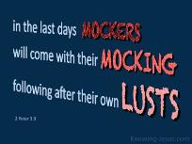
2 Peter 3:3-4
“³ Know this first of all, that in the last days mockers will come with their mocking, following after their own lusts, ⁴ and saying, ‘Where is the promise of His coming? For ever since the fathers fell asleep, all continues just as it was from the beginning of creation.’”

Slide 36
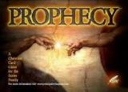
Emergent Eschatology and Genre
“The book of Revelation is an example of popular literary genre of ancient Judaism, known today as Jewish apocalyptic. Trying to read it without understanding its genre would be like watching Star Trek or some other science fiction show thinking it was a historical documentary…instead of being a book about the distant future, it becomes a way of talking about the challenges of the immediate present.”
Brian McLaren, The Secret Message of Jesus, 175-76

Slide 37

Eschatology A Sin?
Justin Taylor, “Dever: ‘You Are in Sin If You Lead Your Congregation to Have a Statement of Faith that Requires a Particular Millennial View,’” online: https://www.thegospelcoalition.org/blogs/justin-taylor/dever-you-are-in-sin-if-you-lead-your/, July 14 2009, accessed May 28, 2019.
“I think that millennial views need not be among those doctrines that divide us. . . . I am suggesting that what you believe about the millennium—how you interpret these thousand years—is not something that it is necessary for us to agree upon in order to have a congregation together. The Lord Jesus Christ prayed in John 17:21 that we Christians might be one. Of course all true Christians are one in that we have his Spirit, we share his Spirit, we desire to live out that unity. But that unity is supposed to be evident as a testimony to the world around us. Therefore, I conclude that we should end our cooperations together with other Christians …only with the greatest of care, lest we rend the body of Christ for whose unity he’s prayed and given himself.”
Notes:
WRONG!!!

Slide 38
Eschatology A Sin?
Justin Taylor, “Dever: ‘You Are in Sin If You Lead Your Congregation to Have a Statement of Faith that Requires a Particular Millennial View,’” online: https://www.thegospelcoalition.org/blogs/justin-taylor/dever-you-are-in-sin-if-you-lead-your/, July 14 2009, accessed May 28, 2019.
“Therefore, I conclude that it is sin to divide the body of Christ—to divide the body that he prayed would be united. Therefore for us to conclude that we must agree upon a certain view of alcohol, or a certain view of schooling, or a certain view of meat sacrificed to idols, or a certain view of the millennium in order to have fellowship together is, I think, not only unnecessary for the body of Christ, but it is therefore both unwarranted and therefore condemned by scripture. So if you’re a pastor and you’re listening to me, you understand me correctly if you think I’m saying you are in sin if you lead your congregation to have a statement of faith that requires a particular millennial view. I do not understand why that has to be a matter of uniformity in order to have Christian unity in a local congregation.”
Notes:
WRONG!!!

Slide 39

Justin Martyr
Dialogue with Trypho, 80.
“But I and every other completely orthodox Christian feel certain that there will be a resurrection of the flesh, followed by a thousand years in the rebuilt, embellished, and enlarged city of Jerusalem as was announced by the prophets Ezekiel, Isaiah, and the others.”

Slide 40

Darrell Bock
Darrell Bock, “The Reign of the Lord Christ,” in Dispensationalism, Israel and the Church, ed. Craig A. Blaising and Darrell L. Bock (Grand Rapids: Zondervan, 1992), 49–50.
“Being seated on David’s throne is linked to being seated at God’s right hand. In other words, Jesus’ resurrection-ascension to God’s right hand is put forward by Peter as a fulfillment of the Davidic covenant, just as the allusion to Joel fulfills the new covenant. To say that Peter is only interested to argue that the Messiah must be raised misses the point of the connection in these verses and ignores entirely the allusion to Psalm 132 in the Davidic covenant. This passage and Luke 1:68–79 also counter the claim that no New Testament text asserts the present work of Jesus’ as a reigning Davidite sitting on David’s Throne. The throne on which Jesus is said to sit is the one promised to David’s descendent through the Davidic promise of 2 Samuel, which was initially passed on through Solomon. Jesus sits here as David’s promised Son on David’s promised Throne. This fits Old Testament imagery as well. The idea of sitting describes the idea of rule, as the parallelism of Jeremiah 22:30 shows. As the Davidic heir, Jesus sits in and rules from heaven.”

Slide 41

Charles Ryrie
Dispensationalism, Page 176-177
“…ignoring the great prophecy of the seventy weeks in Daniel 9:24–27. Nowhere in the progressives’ writings to date have I found any discussion of the passage, only very brief and occasional citations of the reference itself. . . . While not denying the pre-tribulation Rapture or the literal tribulation period, revisionists do not give much attention to these aspects of eschatology. Blaising and Bock do not take obvious opportunities to mention the Rapture, and in one place (discussing 1 Thessalonians 5) they say only that the rapture ‘would appear to be pre-tribulational.’ They decry (as do many of us normative dispensationalists) the sensationalism of some interpreters of prophecy. But abuse of a doctrine is no reason for playing down the truth of that doctrine.”

Slide 42
Charles Ryrie
Dispensationalism, Page 176-177
“Rather, it ought to make us more zealous to present it accurately and in a balanced fashion. Furthermore, there exists already in the writings of progressives a thrust towards positioning the Revelation as a book that is ‘difficult’ to interpret. Playing up the imagery in the book, as some revisionists do, seems to play down a plain interpretation of it. The locusts in chapter 9 and Babylon in chapters 17 and 18 are examples of such ‘literal/symbolic difficulty’ in interpreting the book.”

Slide 43
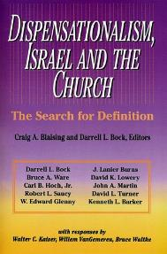
David L. Turner
“The New Jerusalem in Revelation 21:1-22:5; Consummation of a Biblical Continuum,” Dispensationalism, Israel, and the Church, ed., Craig A. Blaising and Darrell L. Bock (Grand Rapids: Zondervan, 1992), 277.
“Perhaps the absence of oysters large enough to produce such pearls in the absence of sufficient gold to pave such as city (do you just literally 1380 miles squared and high) is viewed as sufficient reason not to take these images as fully literal!… The preceding discussion serves to warn against a ‘hyper-literal’ approach to apocalyptic imagery….”

Slide 44
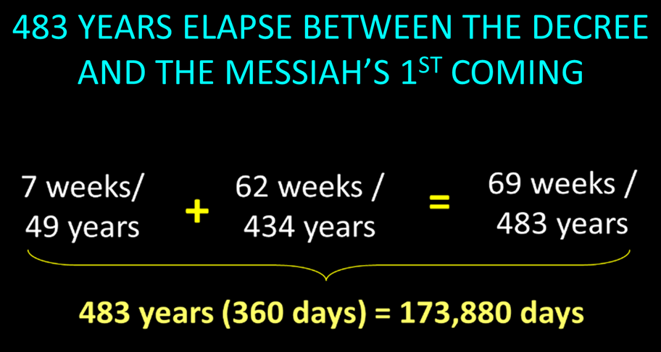

Slide 45
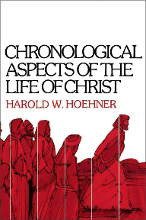
BIBLICAL MATHEMATICS
444 B.C. – (Artaxerxes decree of Nehemiah 2)
+33 A.D. – (Triumphal entry of Luke 19:28-44)
= 477 years
-1 – (1 B.C. to A.D. 1 = 1 year, not 2 years)
= 476 years
x 365 days
= 173, 740 days
+ 25 days – (March 5 to March 30)
= 173, 765 days
+115 days – (leap years)
= 173, 880 days

Slide 46
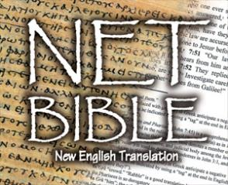
The NET Bible
New English Translation, Beta ed. (Biblical Studies Press, 2001), 1604.
The NET Bible, by contrast, denies such an interpretation even going so far as to say that the details of the text “make a messianic interpretation of the passage difficult, if not impossible.”

Slide 47
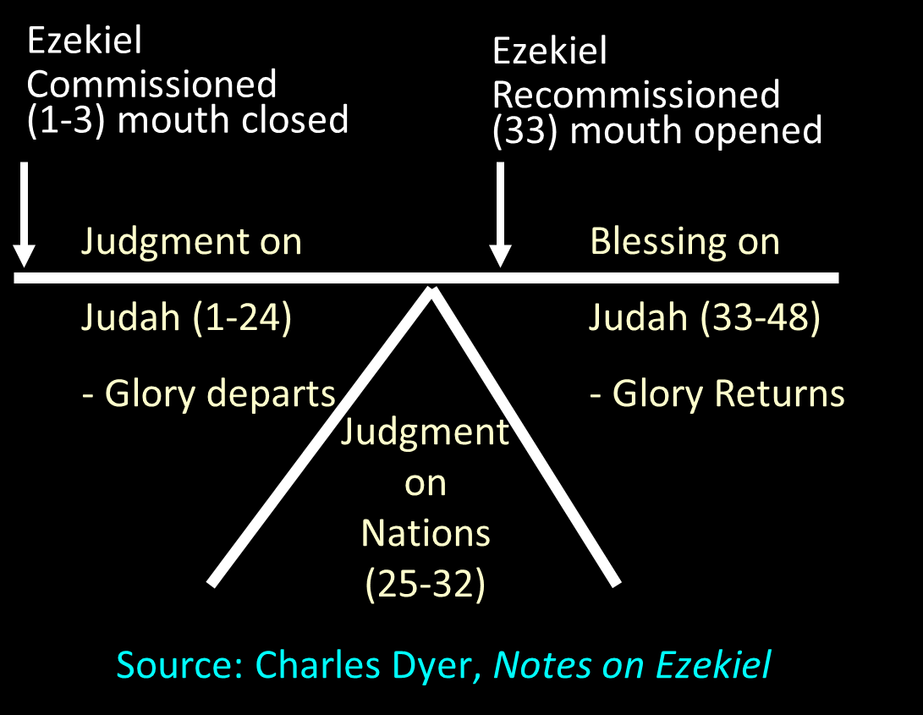

Slide 48
Mark F. Rooker
Mark F. Rooker, “Evidences from Ezekiel,” in A Case for Premillennialism, ed. Donald K. Campbell and Jeffrey L. Townsend (Chicago: Moody, 1992), 133.
“…does not take the sacrifices in a literal sense but views Ezekiel writing in the 6th century B.C. describing worship from his unique perspective. . . . Ezekiel in referring to the literal worship of Yahweh in the millennium would be forced to use terms and concepts with which his audience was familiar.” Because Ezekiel’s audience would understand restoration in terms of the restoration of sacrifices, Ezekiel merely described restoration in these terms. Thus, Ezekiel’s vision must not be understood as predicting the literal restoration of sacrifices in the millennium.

Slide 49


Robert Chisholm
Handbook on the Prophets, 285-86.
“Ezekiel’s vision of a Temple and a restored nation was not fulfilled in the postexilic period. How then should we expect the vision to be fulfilled? Scholars have answered this question in a variety of ways. On one end of the interpretive spectrum are those who see the vision as purely symbolic and as fulfilled in the New Testament church. On the opposite end are the hyper-literalists, who contend that the vision will be fulfilled exactly as described during the millennial age. In attempting to answer the question, one must first recognize that Ezekiel’s vision is contextualized for his sixth-century B.C. audience. He describes the reconciliation of God and his people in terms that would be meaningful to his audience.”

Slide 50
Robert Chisholm
Handbook on the Prophets, 285-86.
“They would naturally conceive of such reconciliation as involving the rebuilding of the temple, the reinstitution of the sacrificial system, the renewal of the Davidic dynasty, and the return and reunification of the twelve exiled tribes. Since the fulfillment of the vision transcends these culturally conditioned boundaries, we should probably view it as idealized to some extent and look for an essential, rather than an exact fulfillment of many of its features. . . . The inclusion of so many minute details suggests that the temple described here will be a literal reality iobsoleten the Jerusalem of the future. . . . However, the final sacrifice of Jesus Christ has made the Levitical system obsolete. . . . To return to this system, with its sin offerings and such, would be a serious retrogression.”

Slide 51
Robert Chisholm
Handbook on the Prophets, 285-86.
“Ezekiel’s audience would have found it impossible to conceive of a restored covenant community apart from the sacrificial system. Now that the fulfillment of the vision transcends that cultural context, we can expect it to be essentially fulfilled when the Israel of the future celebrates the redemptive work of their savior in their new temple. . . . Ezekiel’s audience would have found this portrayal quite natural. However, Jesus, the one who fulfills the vision, will have no need to offer such sacrifices, nor will he institute a dynasty.”

Slide 52

“This passage is explained in various ways. I pass by the dreams of the Jews, who apply all passages of this kind to the temporal reign of the Messiah, which they have contrived by their own imagination.... I willingly view this passage as referring to Judea, and afterwards to other parts of the world.... Let us now see when this prophecy was fulfilled, or shall be fulfilled. The Lord began some kind of restoration when he brought his people out of Babylon: but that was only a foretaste, and, therefore, I have no hesitation in saying that this passage, as well as others of a similar kind, must refer to the kingdom of Christ; and in no other light could it be viewed, if we compare it with other prophecies.”
John Calvin
Commentary on Isaiah 35:1
Isaiah 35:1— “The wilderness and the solitary place shall be glad.”

Slide 53
“Here the Prophet describes the felicity which shall be under the reign of Christ: and we know that whenever the Prophets set forth promises of a happy and prosperous state to God’s people, they adopt metaphorical expressions, and say, that abundance of all good things shall flow, that there shall be the most fruitful produce, that provisions shall be bountifully supplied; for they accommodated their mode of speaking to the notions of that ancient people; it is therefore no wonder if they sometimes speak to them as to children. At the same time, the Spirit under these figurative expressions declares, that the kingdom of Christ shall in every way be happy and blessed, or that the Church of God, which means the same thing, shall be blessed, when Christ shall begin to reign.”
John Calvin
Commentary on Amos 9:13
Amos 9:13—“Behold the days come, saith the LORD, that the plowman shall overtake the reaper, and the treader of grapes him that soweth seed: and the mountains shall drop sweet wine, and all the hills shall melt.”

Slide 54
“For as we are dull and entangled in earthly thoughts, our minds can hardly rise up to heaven, though the Lord with a clear voice invites us to himself. The Prophet then, in order to aid our weakness, adds a vivid representation, as though God stood before their eyes. Stand, he says, shall his feet on the mount of Olives. He does not here promise a miracle, such as even the ignorant might conceive to be literal; nor does he do this in what follows, when he says, The mount shall be rent…half…to the east and half to the west. This has never happened, that mount has never been rent: but as the Prophet could not, under those grievous trials, which might have overwhelmed the minds of the godly a hundred times, have extolled the power of God…without employing a highly figurative language, he therefore accommodates himself, as I have said, to the capacity of our flesh.”
John Calvin
Commentary on Zechariah 14:4
Zechariah 14:4—“And his feet shall stand in that day upon the mount of Olives…and the mount of Olives shall cleave in the midst thereof toward the east and toward the west….”

Slide 55
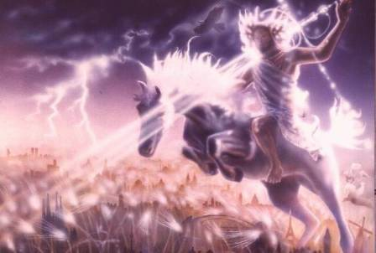
Isaiah 13-14
Day of the Lord (13:6-9)
Cosmic disturbances (13:10-13)
Global judgment (13:11-12)
Sodom and Gomorrah (13:19)
Complete and final desolation (13:20-22)
Universal peace and rest (14:5-8)
Israel’s regeneration (14:1-4)
Morris, Revelation Record, 348.

Slide 56
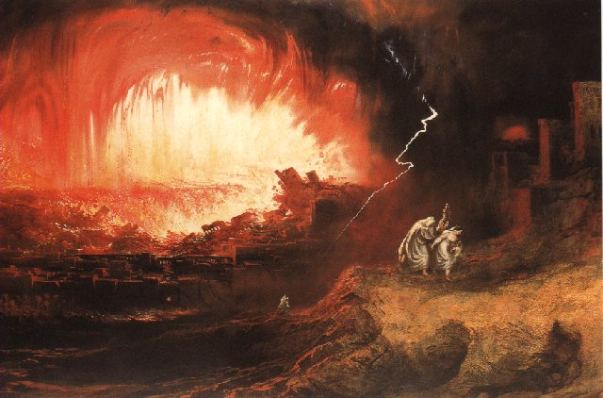
Jeremiah 50-51
Sudden destruction (51:8)
Complete destruction (50:3, 13, 26, 39-40; 51:29, 43, 62)
No reuse of building materials (51:26)
Believers flee (50:8; 51:6, 45)
Israel’s regeneration (50:2, 4-5, 20; 51:50)
Dyer, "The Identity of Babylon in Revelation 17–18 (Part 2)," 443-49.

Slide 57
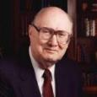
Dr. John Walvoord
The Nations in Prophecy, 63-64
“As far as the historic fulfillment is concerned, it is obvious from both Scripture and history that these verses have not been literally fulfilled. The city of Babylon continued to flourish after the Medes conquered it, and though its glory dwindled, especially after the control of the Medes and the Persians ended in 323 B.C., the city continued in some form or substance until A.D. 1000 and did not experience a sudden termination such as anticipated in this prophecy.”

Slide 58
Parallels Between Jeremiah 50-51 & Revelation 17-18
 | Jeremiah | Revelation
Associated with a Golden cup | 51:7a | 17:3-4; 18:6
Dwelling on many waters | 51:13 | 17:1
Intoxicating the nations | 51:7b | 17:2
Same name | 50:1 | 17:5
Stone sinking into Euphrates | 51:63-64 | 18:21
Sudden destruction | 51:8 | 18:8
Destroyed by fire | 51:30 | 17:16
Final, uninhabitable | 50:39 | 18:21
Deserved | 50:29 | 18:6
God’s people flee | 51:6, 45 | 18:4
Heaven rejoices | 51:48 | 18:20
Dyer, "The Identity of Babylon in Revelation 17–18 (Part 2)," 441-43.

Slide 59
Larkin, The Book of Revelation, 158.
“…and this is in exact harmony with the words of Isa. 13:19. ‘And Babylon, the glory of kingdoms, the beauty of the Chaldees’ excellency, shall be as when God overthrew Sodom and Gomorrah;’ and the Prophet Jeremiah makes the same statement. Jer. 50:40. The destruction of Sodom and Gomorrah was not protracted through many centuries, their glory disappeared in a few hours (Gen. 19:24–28), and as ancient Babylon was not thus destroyed, the prophecies of Isaiah and Jeremiah cannot be fulfilled unless there is to be a future Babylon that shall be thus destroyed. In Rev. 16:17–19, we are told that Babylon shall be destroyed by an Earthquake, attended with most vivid and incessant lightning and awful thunder.”

Slide 60
Homer Heater
"Do the Prophets Teach That Babylonia Will Rebuilt in the Eschaton?," Journal of the Evangelical Theological Society 41 (March 1998): 31-36; Robert B. Chisholm, Handbook on the Prophets (Grand Rapids: Baker, 2002), 53, 213
A similar approach is seen in Old Testament studies. Many view Isaiah 13-14 and Jeremiah 50-51 as describing Babylon's past fall in 539 B.C. rather than her future fall. The interpretation is held in spite of the fact that the details of these texts go far beyond the historic fall of Babylon. This interpretation is justified on the grounds that Ancient Near Eastern extra biblical writings often describe the destruction of foes in hyperbolic terms. Because Isaiah and Jeremiah incorporated a similar "destruction genre" in their description of Babylon's fall, the language of Babylon's destruction in Isaiah 13-14 and Jeremiah 50-51 can be applied to her historic fall rather than her future fall. Chisholm calls such language “stylized and exaggerated” and therefore argues that these texts were “essentially fulfilled” with the historic defeat of Babylon.

Slide 61
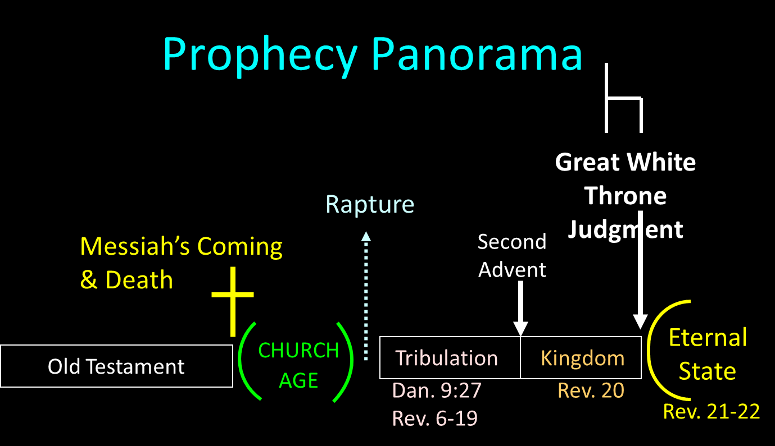

Slide 62
Reasons for Understanding 1000 Literally
John’s use of indefinite concepts elsewhere
  Revelation 20:8, 20:3
Exception to the “# of years” examples?
Other numbers are taken literally
  Two witnesses (11:3), 7000 people (11:13), 4 Angels (7:1) 7 Angels (8:6),144,000 Jews (7:4), 42 months (11:2), 1260 days (11:3)
Not always a symbolic interpretation
  (Rev. 17:18)

Slide 63
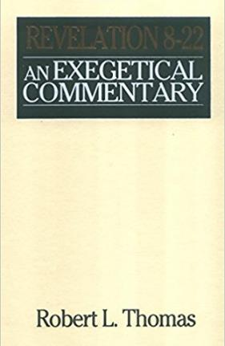
Robert Thomas
Revelation 8 to 22: An Exegetical Commentary (Chicago: Moody Press, 1992), 408.
Robert Thomas observes that, "no number in Revelation is verifiably a symbolic number.”

Slide 64
Darrell Bock
Darrell Bock; quoted in Ken Sidey, “For the Love of Zion,” Christianity Today, 9 March 1992, 50.
This minimization of the millennium is represented in the admission that Progressive Dispensationalism is less “land centered” and less “future centered” than traditional Dispensationalism.

Slide 65
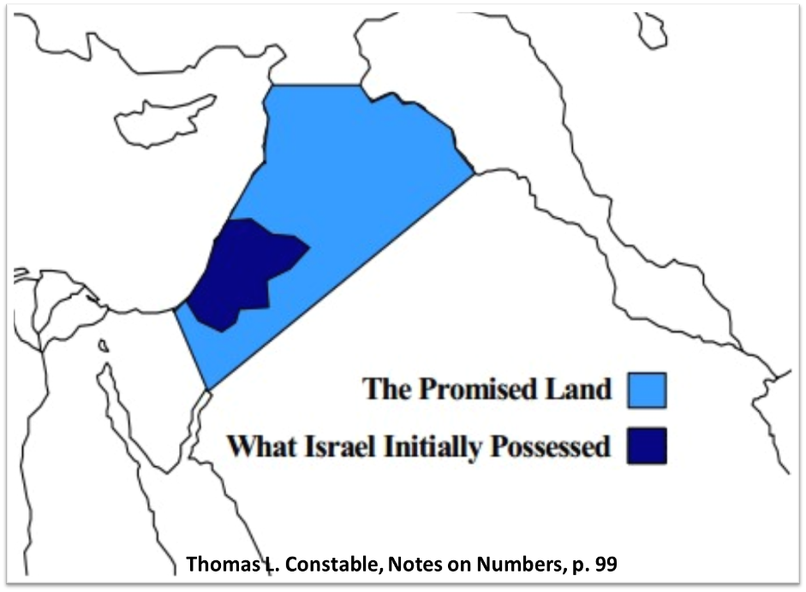

Slide 66
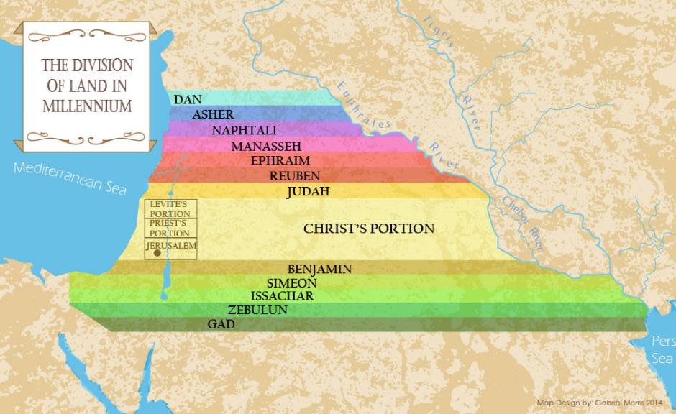

Slide 67
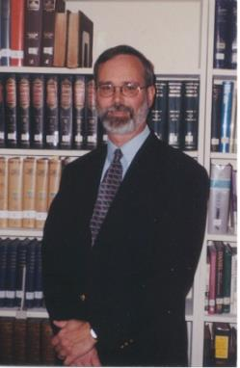
Kenneth L. Gentry
He Shall Have Dominion: A Post Millennial Eschatology (Tyler, Texas: Institute for Christian economics, 1992), page 335.
“The proper understanding of the thousand-year time frame in Revelation 20 is that it is representative of a long and glorious era and is not limited to a literal 365,000 days. The figure represents a perfect cube of 10, which is the number of quantitative perfection.”

Slide 68
John Calvin
Institutes of the Christian Religion, III, xxv, 5.
“But Satan has not only befuddled men’s senses to make them bury with the corpses the memory of resurrection; he has also attempted to corrupt this part of the doctrine with various falsifications…Now their fiction is too childish either to need or to be worth a refutation. And the Apocalypse, from which they undoubtedly drew a pretext for their error, does not support them. For the number ‘one thousand’ [Rev. 20:4] does not apply to the eternal blessedness of the church but only to the various disturbances that awaited the church, while still toiling on earth…Those who assign the children of God a thousand years in which to enjoy the inheritance of the life to come do not realize how much reproach they are casting upon Christ and his Kingdom.”

Slide 69

Paul Lee Tan
The Interpretation of Prophecy, 276-77
“Evangelicals who spiritualize Bible prophecy cannot logically forbid liberals and modernists from spiritualizing selected areas of Christology and Soteriology. If evangelicals can spiritualize Christ's earthly kingdom, may not liberals spiritualize the earthly ministry of Christ, including His miracles and resurrection? The same hermeneutical principles used to spiritualize Bible prophecy can be used to spiritualize Christ's first advent. Christians who spiritualize parts of the Scriptures, such as it's prophetic portions, have forfeited a major element of their defense against liberalism.”

Slide 70
9 Ways Kingdom Now Theology
Impacts the Church
Loss of “pilgrim” status
Social Gospel
Ecumenical & interfaith alliances
Rejection or marginalization of Bible prophecy
Building the wrong kingdom
Charismatic theology
Prosperity Gospel
Anti-Israelism
Lordship Salvation

Slide 71
Clarence Larkin
The Second Coming of Christ, 51.
“When the Church enters into an ‘Alliance with the World,’. . . the end of such an ‘Alliance’ will be a ‘Religious Political Regime’ that will pave the way for the revelation of Satan’s great ‘Religious Political Leader’ and ‘Superman’—the ANTICHRIST.”

Slide 72
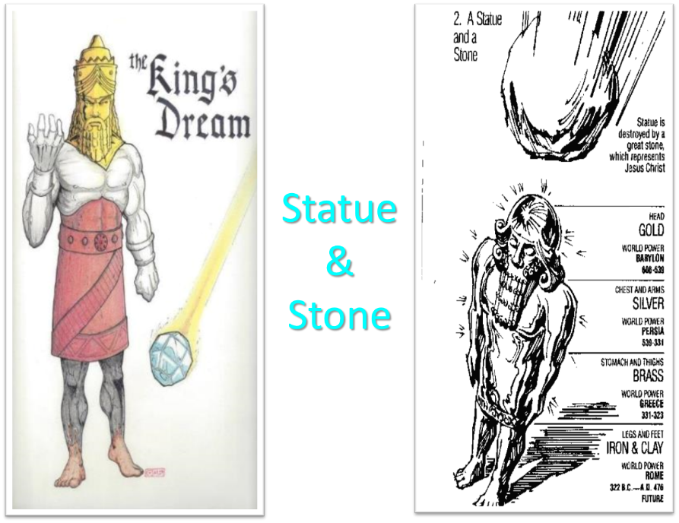

Slide 73
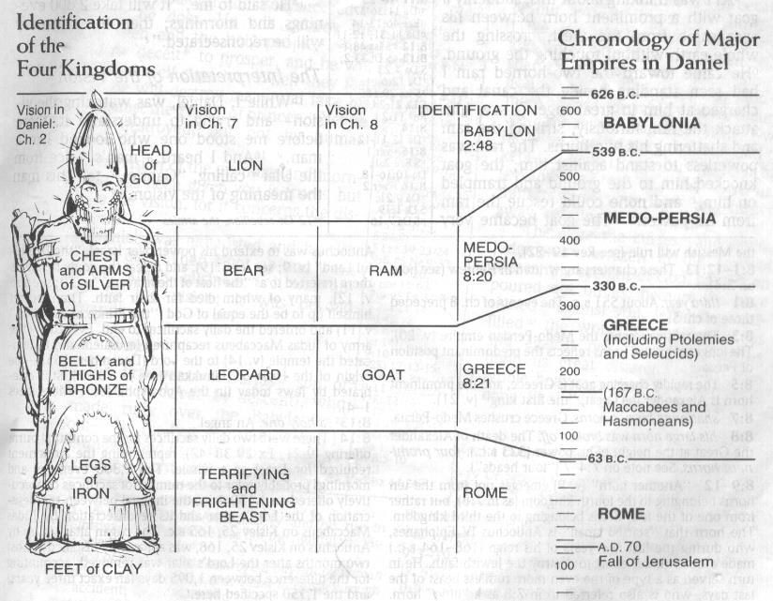

Slide 74
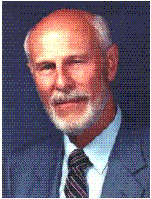
Dave Hunt
“Kingdom/Dominion Theology – Part 1” (February 1, 1987), accessed July 12, 2015, https://www.thebereancall.org/content/kingdomdominion-theology-part-i.
“There are many factors that make up the growing apostasy and seduction of the church. One of the most alarming, least understood, and fastest spreading errors is the teaching that earth instead of heaven is the ultimate home for the church, and that her goal is to take over the world and establish the kingdom of God. Only then, it is said, can Christ return—not, however, to take us to His Father’s house as He promised His disciples in John 14, but to reign over the Kingdom which we have established for Him. . . . [I]f the real Jesus Christ is going to catch His bride up from earth to meet Him in the air (1 Thess. 4:17), then those who work to build a kingdom for a ‘Christ’ whom they will meet with their feet planted on earth have been under heavy delusion indeed! They have been working for the Antichrist!”

Slide 75

Hal Lindsey
The Road to Holocaust, 269
Bestselling author Hal Lindsey warned what could happen to the church in the last days if she began to see herself as the establisher of God's kingdom: “The last days of the church on the earth may be largely wasted seeking to accomplish a task that only the LORD Himself can and will do directly.”

Slide 76
9 Ways Kingdom Now Theology
Impacts the Church
Loss of “pilgrim” status
Social Gospel
Ecumenical & interfaith alliances
Rejection or marginalization of Bible prophecy
Building the wrong kingdom
Charismatic theology
Prosperity Gospel
Anti-Israelism
Lordship Salvation

Slide 77
Conclusion

Slide 78
9 Ways Kingdom Now Theology
Impacts the Church
Loss of “pilgrim” status
Social Gospel
Ecumenical & interfaith alliances
Rejection or marginalization of Bible prophecy
Building the wrong kingdom
Charismatic theology
Prosperity Gospel
Anti-Israelism
Lordship Salvation

