Slide 1
SATANOLOGY
Dr. Andy Woods
Senior Pastor – Sugar Land Bible Church
President – Chafer Theological Seminary

Slide 2
Preview of Angelology
Good angels
Satanology
Demonology
Gen. 6:1-4 controversy

Slide 3
Preview
Existence
Personhood
Names and titles
Original state and first sin
Works

Slide 4
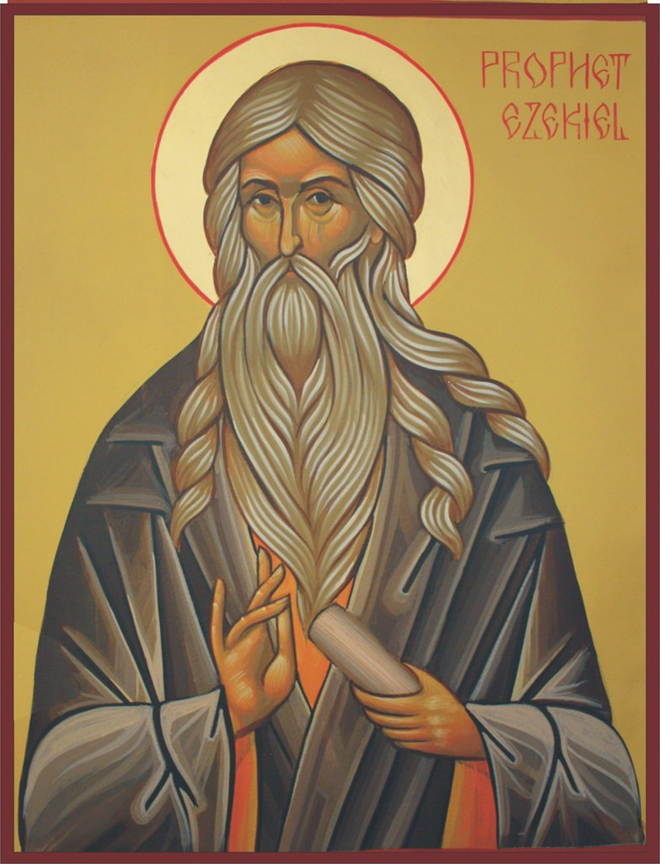
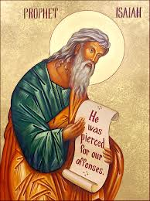
Satan’s Original State and First Sin
Ezekiel 28:12-17
Isaiah 14:12-15

Slide 5
Original State and First Sin (cont’d)
Time of Satan’s fall
In eternity past
In between Gen. 1:1-2 (gap theory?)
After Gen 1:31 but before Gen 3

Slide 6
Gap Theory Preview
Definition of the Gap Theory
Evidence Favoring the Gap Theory
Response to Evidence Favoring the Gap Theory
Remaining Problems with the Gap Theory
Correct View of Gen. 1:1-2

Slide 7
Genesis 1:1-3
“¹ In the beginning God created the heavens and the earth. ² The earth was formless and void, and darkness was over the surface of the deep, and the Spirit of God was moving over the surface of the waters. ³ Then God said, ‘Let there be light’; and there was light.”

Slide 8
Gap Theory?
Original creation brought into existence (1:1)
Billions of years & Satan's fall in between verses 1 & 2
Chaotic conditions and fossil record (1:2)
Re-creation or Renovation (1:3-31)

Slide 9
Gap Theory Preview
Definition of the Gap Theory
Evidence Favoring the Gap Theory
Response to Evidence Favoring the Gap Theory
Remaining Problems with the Gap Theory
Correct View of Gen. 1:1-2

Slide 10
Gap Theory Preview
Definition of the Gap Theory
Evidence Favoring the Gap Theory
Response to Evidence Favoring the Gap Theory
Remaining Problems with the Gap Theory
Correct View of Gen. 1:1-2

Slide 11
The Gap Theory
NO. | Gen 1 | Evidence | Response
1. | vs. 2 | Conjunction = “but” | Conjunction = “and”
2. | vs. 2 | Hāyāh = “became” | Hāyāh = “was”
3. | vs. 2 | Tohu & Bohu = judgment | Tohu & Bohu = incompletion
4. | vs. 2 | Darkness = evil | Darkness = absence of light
5. | vs. 1, 3 | Bara & āsāh distinction | Bara & āsāh overlap
6. | vs. 2 | Lo tohu (Isa. 45:18) = God did not create the Earth desolate | Lo tohu (Isa. 45:18) = Original creation was good
7. | vs. 2 | Spirit = brooding (Eph. 4:30) | Spirit = moving

Slide 12
Genesis 1:1-3
“¹ In the beginning God created the heavens and the earth. ² The earth was [hāyāh; became] formless and void, and darkness was over the surface of the deep, and the Spirit of God was moving over the surface of the waters. ³ Then God said, ‘Let there be light’; and there was light.”

Slide 13
Jonah 3:3
“So Jonah arose and went to Nineveh according to the word of the Lord. Now Nineveh was [hāyāh] an exceedingly great city, a three days’ walk.”
Waw + noun + hayah (qal perfect 3rd person) = “was” and not “became” in rest of OT (Judges 8:11; Jonah 3:3)

Slide 14
Judges 8:11
“Gideon went up by the way of those who lived in tents on the east of Nobah and Jogbehah, and attacked the camp when the camp was [hāyāh] unsuspecting.”
Waw + noun + hayah (qal perfect 3rd person) = “was” and not “became” in rest of OT (Judges 8:11; Jonah 3:3)

Slide 15
Gap Theory Preview
Definition of the Gap Theory
Evidence Favoring the Gap Theory
Response to Evidence Favoring the Gap Theory
Remaining Problems with the Gap Theory
Correct View of Gen. 1:1-2

Slide 16
4. Remaining Gap Theory Problems
Only one verse describing original creation?
Lack of information on what transpired in the gap
No supporting verses describing the angelic rebellion & judgment in the gap
Late 19th century accommodation attempt to explain the fossil record
God created (rather than renovated) during the creation week (Gen. 2:3-4; Exod. 20:8-11)

Slide 17
4. Remaining Gap Theory Problems
Only one verse describing original creation?
Lack of information on what transpired in the gap
No supporting verses describing the angelic rebellion & judgment in the gap
Late 19th century accommodation attempt to explain the fossil record
God created (rather than renovated) during the creation week (Gen. 2:3-4; Exod. 20:8-11)

Slide 18
Genesis 2:3-4
“³ Then God blessed the seventh day and sanctified it, because in it He rested from all His work which God had created and made. ⁴ This is the account of the heavens and the earth when they were created, in the day that the Lord God made earth and heaven.”

Slide 19
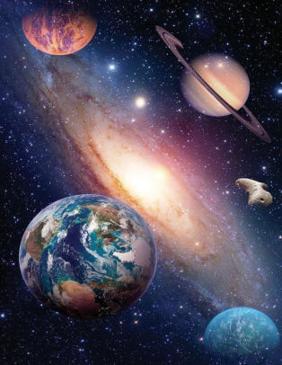
Exodus 20:11
“For in six days the Lord made the heavens and the earth, the sea and all that is in them, and rested on the seventh day; therefore the Lord blessed the sabbath day and made it holy.”

Slide 20
4. Remaining Gap Theory Problems
Scripture traces all death & chaos from Adam’s sin & not before Adam’s sin (Rom 5:12; 8:19-22)
“Good” (Gen 1:4, 9, 12, 18, 21, 25) & “very good” (Gen 1:31) after ruin?
Adam created at the beginning of creation (Matt. 19:4) & not after most of Earth’s history had already transpired
Lucifer’s instantaneous rebellion would not explain long ages in the fossil record

Slide 21
4. Remaining Gap Theory Problems
Scripture traces all death & chaos from Adam’s sin & not before Adam’s sin (Rom 5:12; 8:19-22)
“Good” (Gen 1:4, 9, 12, 18, 21, 25) & “very good” (Gen 1:31) after ruin?
Adam created at the beginning of creation (Matt. 19:4) & not after most of Earth’s history had already transpired
Lucifer’s instantaneous rebellion would not explain long ages in the fossil record

Slide 22
1 Corinthians 15:21-22
“²¹ For since by a man came death, by a man also came the resurrection of the dead. ²² For as in Adam all die, so also in Christ all will be made alive.”

Slide 23
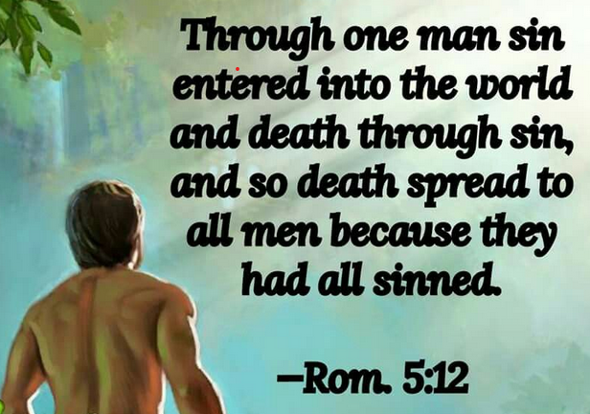
Romans 5:12
“Therefore, just as through one man sin entered into the world, and death through sin, and so death spread to all men, because all sinned—.”

Slide 24
Genesis 1:29-30
“²⁹ Then God said, ‘Behold, I have given you every plant yielding seed that is on the surface of all the earth, and every tree which has fruit yielding seed; it shall be food for you; ³⁰ and to every beast of the earth and to every bird of the sky and to every thing that moves on the earth which has life, I have given every green plant for food’; and it was so.”

Slide 25
Genesis 9:3
“³ Every moving thing that is alive shall be food for you; I give all to you, as I gave the green plant.”

Slide 26
Genesis 2:16-17
“¹⁶ The Lord God commanded the man, saying, ‘From any tree of the garden you may eat freely; ¹⁷ but from the tree of the knowledge of good and evil you shall not eat, for in the day that you eat from it you will surely die (muwth).’”

Slide 27
Genesis 3:19
“By the sweat of your face You will eat bread, Till you return to the ground, Because from it you were taken; For you are dust, And to dust you shall return.”

Slide 28
Romans 8:19-22
¹⁹ For the anxious longing of the creation waits eagerly for the revealing of the sons of God. ²⁰ For the creation was subjected to futility, not willingly, but because of Him who subjected it, in hope ²¹ that the creation itself also will be set free from its slavery to corruption into the freedom of the glory of the children of God. ²² For we know that the whole creation groans and suffers the pains of childbirth together until now.

Slide 29
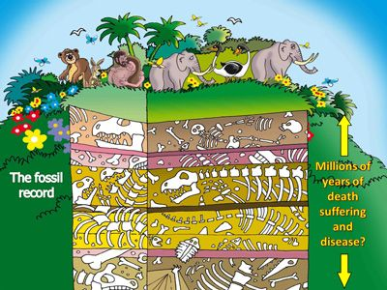

Slide 30
4. Remaining Gap Theory Problems
Scripture traces all death & chaos from Adam’s sin & not before Adam’s sin (Rom 5:12; 8:19-22)
“Good” (Gen 1:4, 9, 12, 18, 21, 25) & “very good” (Gen 1:31) after ruin?
Adam created at the beginning of creation (Matt. 19:4) & not after most of Earth’s history had already transpired
Lucifer’s instantaneous rebellion would not explain long ages in the fossil record

Slide 31
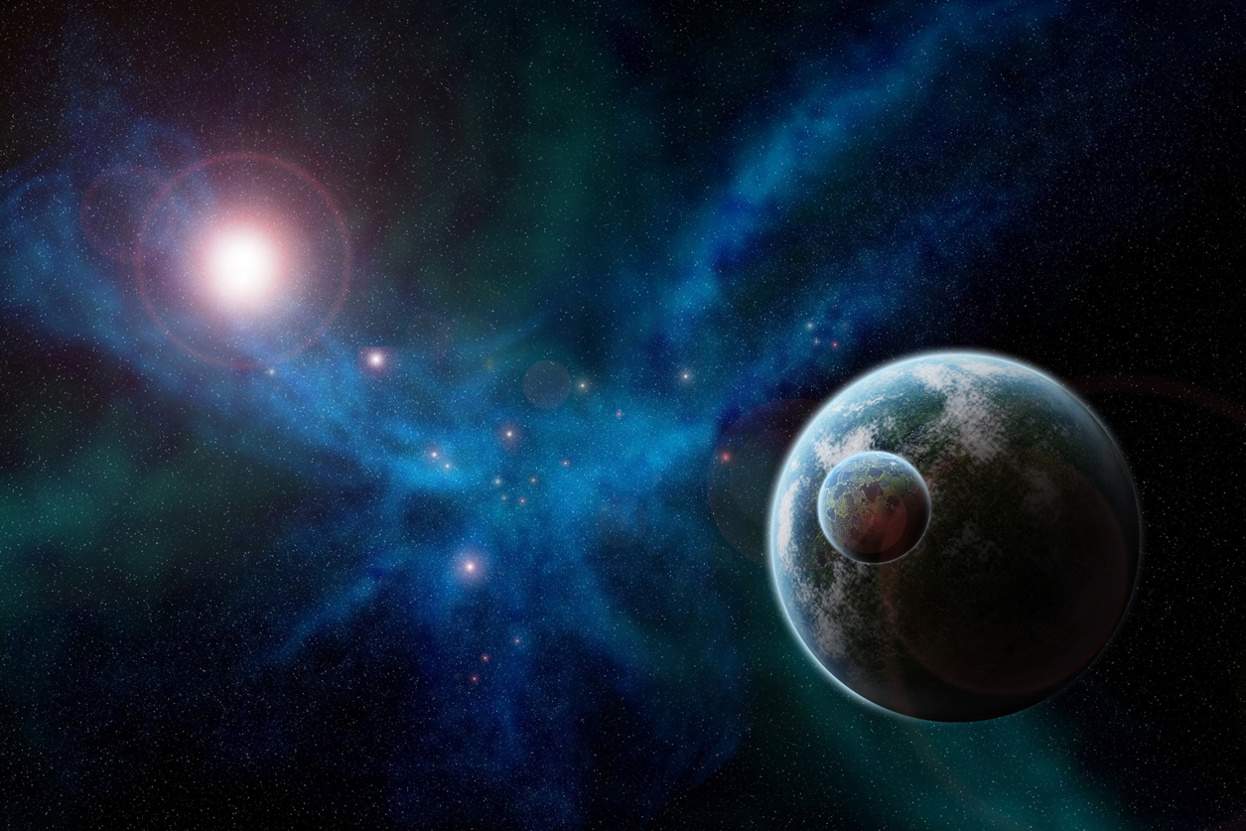
Genesis 1:31
“God saw all that He had made, and behold, it was very good. And there was evening and there was morning, the sixth day.”

Slide 33
4. Remaining Gap Theory Problems
Scripture traces all death & chaos from Adam’s sin & not before Adam’s sin (Rom 5:12; 8:19-22)
“Good” (Gen 1:4, 9, 12, 18, 21, 25) & “very good” (Gen 1:31) after ruin?
Adam created at the beginning of creation (Matt. 19:4) & not after most of Earth’s history had already transpired
Lucifer’s instantaneous rebellion would not explain long ages in the fossil record

Slide 34
Matthew 19:4-6
“³ Some Pharisees came to Jesus, testing Him and asking, “Is it lawful for a man to divorce his wife for any reason at all?” ⁴ And He answered and said, “Have you not read that He who created them from the beginning made them male and female, ⁵ and said, ‘For this reason a man shall leave his father and mother and be…

Slide 35
Matthew 19:4-6
…joined to his wife, and the two shall become one flesh’? ⁶ So they are no longer two, but one flesh. What therefore God has joined together, let no man separate.”

Slide 36
Mark 10:6
“But from the beginning of creation, God made them male and female.”

Slide 37
Mark 13:19
“For those days will be a time of tribulation such as has not occurred since the beginning of the creation (ap archēs kisteōs) which God created until now, and never will.”
(apo de archēs kisteōs)

Slide 38
2 Peter 3:4
“and saying, “Where is the promise of His coming? For ever since the fathers fell asleep, all continues just as it was from the beginning of creation (ap archēs kisteōs).”
(apo de archēs kisteōs)

Slide 39
Luke 11:50-51
“⁵⁰ so that the blood of all the prophets, shed since the foundation of the world, may be charged against this generation, ⁵¹ from the blood of Abel to the blood of Zechariah, who was killed between the altar and the house of God; yes, I tell you, it shall be charged against this generation.

Slide 40
Romans 1:20
“For since the creation of the world His invisible attributes, His eternal power and divine nature, have been clearly seen, being understood through what has been made, so that they are without excuse.”

Slide 41
4. Remaining Gap Theory Problems
Scripture traces all death & chaos from Adam’s sin & not before Adam’s sin (Rom 5:12; 8:19-22)
“Good” (Gen 1:4, 9, 12, 18, 21, 25) & “very good” (Gen 1:31) after ruin?
Adam created at the beginning of creation (Matt. 19:4) & not after most of Earth’s history had already transpired
Lucifer’s instantaneous rebellion would not explain long ages in the fossil record

Slide 42
4. Remaining Gap Theory Problems
Only one biblical flood (Matt. 24:38-39; 1 Pet. 3:18-21; 2 Pet. 2:4-5)
Why would God judge the entire earth because of the sin of one angel?

Slide 43
4. Remaining Gap Theory Problems
Only one biblical flood (Matt. 24:38-39; 1 Pet. 3:18-21; 2 Pet. 2:4-5)
Why would God judge the entire earth because of the sin of one angel?

Slide 44
2 Peter 3:5-7
“⁵ For when they maintain this, it escapes their notice that by the word of God the heavens existed long ago and the earth was formed out of water and by water, ⁶ through which the world at that time was destroyed, being flooded with water. ⁷ But by His word the present heavens and earth are being reserved for fire, kept for the day of judgment and destruction of ungodly men.”

Slide 45
2 Peter 2:5
“and did not spare the ancient world, but preserved Noah, a preacher of righteousness, with seven others, when He brought a flood upon the world of the ungodly.”

Slide 46
1 Peter 3:18-21
“¹⁸ For Christ also died for sins once for all, the just for the unjust, so that He might bring us to God, having been put to death in the flesh, but made alive in the spirit; ¹⁹ in which also He went and made proclamation to the spirits now in prison, ²⁰ who once were disobedient, when the patience of God kept waiting in the days of Noah, during the construction of the ark, in which a few, that is . . .

Slide 47
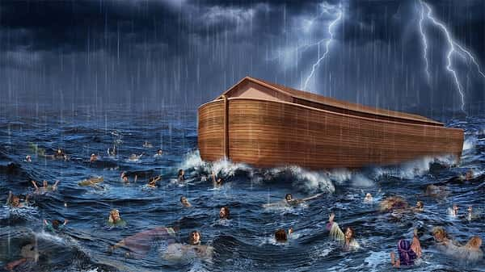
1 Peter 3:18-21
…eight persons, were brought safely through the water. ²¹ Corresponding to that, baptism now saves you—not the removal of dirt from the flesh, but an appeal to God for a good conscience—through the resurrection of Jesus Christ,

Slide 48
Mathew 24:38-39
“³⁸ For as in those days before the flood they were eating and drinking, marrying and giving in marriage, until the day that Noah entered the ark, ³⁹ and they did not understand until the flood came and took them all away; so will the coming of the Son of Man be.”

Slide 49
4. Remaining Gap Theory Problems
Only one biblical flood (Matt. 24:38-39; 1 Pet. 3:18-21; 2 Pet. 2:4-5)
Why would God judge the entire earth because of the sin of one angel?

Slide 50
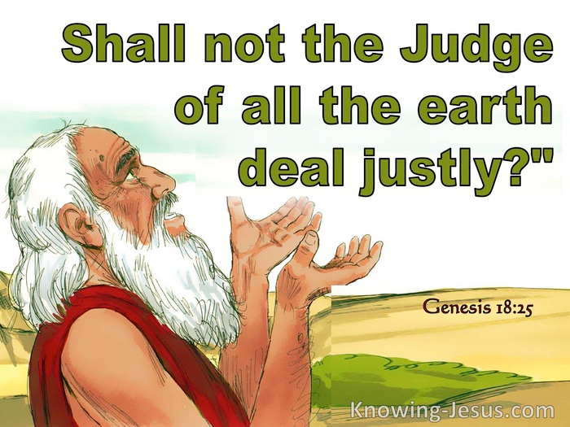
Genesis 18:25
“Far be it from You to do such a thing, to slay the righteous with the wicked, so that the righteous and the wicked are treated alike. Far be it from You! Shall not the Judge of all the earth deal justly?”

Slide 51
Gap Theory Preview
Definition of the Gap Theory
Evidence Favoring the Gap Theory
Response to Evidence Favoring the Gap Theory
Remaining Problems with the Gap Theory
Correct View of Gen. 1:1-2

Slide 52
Genesis 1:1-3
“¹ In the beginning God created the heavens and the earth. ² The earth was formless and void, and darkness was over the surface of the deep, and the Spirit of God was moving over the surface of the waters. ³ Then God said, ‘Let there be light’; and there was light.”

Slide 53
Gen 1:2
Original creation view = no creation before creation
1:1 God’s original creation on the first day
1:2 Description of this original creation in its unfilled and unformed state (tohu and bohu) and described through the use of three circumstantial participles
1:3-31 Filling and forming process

Slide 54
Gen 1:2
Original creation view = no creation before creation
1:1 God’s original creation on the first day
1:2 Description of this original creation in its unfilled and unformed state (tohu and bohu) and described through the use of three circumstantial participles
1:3-31 Filling and forming process

Slide 55
Genesis 1:1-3
“¹ In the beginning God created the heavens and the earth. ² The earth was formless and void, and darkness was over the surface of the deep, and the Spirit of God was moving over the surface of the waters. ³ Then God said, ‘Let there be light’; and there was light.”

Slide 56
Gen 1:2
Original creation view = no creation before creation
1:1 God’s original creation on the first day
1:2 Description of this original creation in its unfilled and unformed state (tohu and bohu) and described through the use of three circumstantial participles
1:3-31 Filling and forming process

Slide 57
Genesis 1:1-3
“¹ In the beginning God created the heavens and the earth. ² The earth was formless and void, and darkness was over the surface of the deep, and the Spirit of God was moving over the surface of the waters. ³ Then God said, ‘Let there be light’; and there was light.”

Slide 58
“In the case of tohu and bohu…it is equally admissible to consider these words as referring to the unformed nature of the earth before God impressed upon it His creative will. A marble block and a crumbled statue are both formless. The former is in a state which awaits a form and from that formlessness emerges the image. When God made the earth He made it like a marble block out of which He would bring the beauty of the world.”
Bernard Ramm
The Christian View of Science and Scripture (Grand Rapids: Eerdmans, 1954), 203.

Slide 59
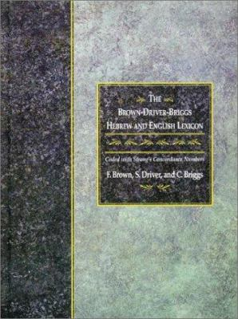
“תֹּהוּ n.m. formlessness, confusion, unreality, emptiness — 1. formlessness, of primaeval earth, of land reduced to primaeval chaos (both + וָבֹהוּ and voidness), ˊקִרְיַת־תּ‍ city of chaos (of ruined city); = nothingness, empty space; of empty, trackless waste. 2. fig. of what is empty, unreal, as idols (coll. of idolmakers), groundless arguments or considerations, moral unreality or falsehood; = a thing of nought, worthlessness; as adv. acc. I said not, תֹּהוּ בַקְּשׁוּנִי seek me emptily, to no purpose.”
Tohu & Bohu
Francis Brown, S. R. Driver, and Charles A. Briggs, eds., A Hebrew and English Lexicon of the Old Testament: With an Appendix Containing the Biblical Aramaic (Oxford: Clarendon Press, 1907), 1062.

Slide 60
בֹּהוn.[m.] emptiness, alw. c. תֹּהוּ q.v.; תֹּהוּ וָבֹהוּ of primaeval earth; of earth under judgment of ˊי‍; קַו־תֹהוּ וְאבְנֵי בֹהוּ the line of wasteness and the stones of emptiness, i.e. plummets, employed, not as usual for building, but for destroying walls; v. sub אבן6.
Tohu & Bohu
Francis Brown, S. R. Driver, and Charles A. Briggs, eds., A Hebrew and English Lexicon of the Old Testament: With an Appendix Containing the Biblical Aramaic (Oxford: Clarendon Press, 1907), 96.

Slide 61
Gen 1:2
Original creation view = no creation before creation
1:1 God’s original creation on the first day
1:2 Description of this original creation in its unfilled and unformed state (tohu and bohu) and described through the use of three circumstantial participles
1:3-31 Filling and forming process

Slide 62
Genesis 1:1-3
“¹ In the beginning God created the heavens and the earth. ² The earth was formless and void, and darkness was over the surface of the deep, and the Spirit of God was moving over the surface of the waters. ³ Then God said, ‘Let there be light’; and there was light.”

Slide 63
Shaping and Populating
(Gen 1:1)
Day 1: Light
Day 2: Water, sky
Day 3: Land, vegetation
Day 4: Luminaries
Day 5: Sea animals, birds
Day 6: Land animals, man

Slide 64
Original State and First Sin (cont’d)
Time of Satan’s fall
In eternity past
In between Gen. 1:1-2 (gap theory?)
After Gen 1:31 but before Gen 3

Slide 65
Genesis 1:31
“God saw all that He had made, and behold, it was very good. And there was evening and there was morning, the sixth day.”

Slide 66
Renald Showers
Renald Showers, Those Invisible Spirits Called Angels (Bellmawr, NJ: Friends of Israel, 1997), 82-83.
“When did Satan fall away from God? We noted earlier that sin was nonexistent in every part of God‘s creation, including the angels, through the end of the sixth or final day of creation (Gen. 1:31). Satan‘s fall therefore took place after the end of creation. However, Satan was evil by the time he came to earth to tempt man to fall away from God (Gen. 3). These things prompt the conclusion that Satan‘s fall took place in the interval between the end of creation and the fall of man. How long was the interval? It must have been quite short because when God created the first man and woman, he commanded them to be fruitful and multiply through procreation (Gen. 1:27–28), but there was no human conception until after the fall of man (Gen. 4:1).”

Slide 67
CONCLUSION

Slide 68
Gap Theory Preview
Definition of the Gap Theory
Evidence Favoring the Gap Theory
Response to Evidence Favoring the Gap Theory
Remaining Problems with the Gap Theory
Correct View of Gen. 1:1-2

