Slide 1
Dr. Andy Woods
Senior Pastor – Sugar Land Bible Church
President – Chafer Theological Seminary

Slide 3
Seven Trumpets (Revelation 8‒11)
1st Trumpet (8:7) – 1/3 vegetation destroyed
2nd Trumpet (8:8-9) – 1/3 ocean destroyed
3rd Trumpet (8:10-11) – 1/3 water destroyed
4th Trumpet (8:12-13) – 1/3 luminaries darkened
5th Trumpet (9:1-12) – Demons released
6th Trumpet (9:13-21) – 1/3 humanity destroyed
7th Trumpet (11:14-19) – Legal transfer announced

Slide 4
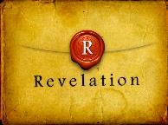
Revelation 11:15
“Then the seventh angel sounded; and there were loud voices in heaven, saying, ‘The kingdom of the world has become the kingdom of our Lord and of His Christ; and He will reign (basileuō) forever and ever.’” (cf. Matt. 6:10)

Slide 6
5 Non-Chronological Parenthetical Insertions
Rev 7 – 144,000 Jews
Rev 10:1-11:13 – Announcement of no more delay and the two witnesses
Rev 12-14 – Israel’s flight, two beasts, six scenes of hope
Rev 16:13-16 – Gathering of the nations to Armageddon
Rev 17:1-19:6 – Babylon’s fall

Slide 7
Revelation 12‒14
Rev 12 – Israel’s flight
Rev 13 – Two beasts
Rev 14 – Six scenes of hope

Slide 8
Revelation 12‒14
Rev 12 – Israel’s flight
Rev 13 – Two beasts
Rev 14 – Six scenes of hope

Slide 9
Revelation 12‒14
Rev 12 – Israel’s flight
Rev 13 – Two beasts
Rev 14 – Six scenes of hope

Slide 10
Revelation 12‒14
Rev 12 – Israel’s flight
Rev 13 – Two beasts
Rev 14 – Six scenes of hope

Slide 11
C. Six Scenes of Hope Revelation 14:1-20
The Destiny of the 144,000 (1-5)
The Proclamation of the Eternal Gospel (6-7)
The Prediction of the Destruction of Babylon (8)
The Doom of the Beast’s Worshippers (9-12)
The Blessing Upon the Tribulation’s Martyrs (13)
The Judgment Harvest of Armageddon (14-20)

Slide 12
C. Six Scenes of Hope Revelation 14:1-20
The Destiny of the 144,000 (1-5)
The Proclamation of the Eternal Gospel (6-7)
The Prediction of the Destruction of Babylon (8)
The Doom of the Beast’s Worshippers (9-12)
The Blessing Upon the Tribulation’s Martyrs (13)
The Judgment Harvest of Armageddon (14-20)

Slide 13
C. Six Scenes of Hope Revelation 14:1-20
The Destiny of the 144,000 (1-5)
The Proclamation of the Eternal Gospel (6-7)
The Prediction of the Destruction of Babylon (8)
The Doom of the Beast’s Worshippers (9-12)
The Blessing Upon the Tribulation’s Martyrs (13)
The Judgment Harvest of Armageddon (14-20)

Slide 14
C. Six Scenes of Hope Revelation 14:1-20
The Destiny of the 144,000 (1-5)
The Proclamation of the Eternal Gospel (6-7)
The Prediction of the Destruction of Babylon (8)
The Doom of the Beast’s Worshippers (9-12)
The Blessing Upon the Tribulation’s Martyrs (13)
The Judgment Harvest of Armageddon (14-20)

Slide 15
C. Six Scenes of Hope Revelation 14:1-20
The Destiny of the 144,000 (1-5)
The Proclamation of the Eternal Gospel (6-7)
The Prediction of the Destruction of Babylon (8)
The Doom of the Beast’s Worshippers (9-12)
The Blessing Upon the Tribulation’s Martyrs (13)
The Judgment Harvest of Armageddon (14-20)

Slide 16
C. Six Scenes of Hope Revelation 14:1-20
The Destiny of the 144,000 (1-5)
The Proclamation of the Eternal Gospel (6-7)
The Prediction of the Destruction of Babylon (8)
The Doom of the Beast’s Worshippers (9-12)
The Blessing Upon the Tribulation’s Martyrs (13)
The Judgment Harvest of Armageddon (14-20)

Slide 17
C. Six Scenes of Hope Revelation 14:1-20
The Destiny of the 144,000 (1-5)
The Proclamation of the Eternal Gospel (6-7)
The Prediction of the Destruction of Babylon (8)
The Doom of the Beast’s Worshippers (9-12)
The Blessing Upon the Tribulation’s Martyrs (13)
The Judgment Harvest of Armageddon (14-20)

Slide 18
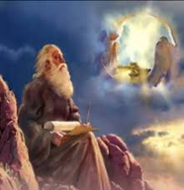
6. The Armageddon Judgment Harvest (Revelation 14:14-20)
The Judge (14-18a)
The Judged (18b)
The Judgment (19-20)

Slide 19
6. The Armageddon Judgment Harvest (Revelation 14:14-20)
The Judge (14-18a)
The Judged (18b)
The Judgment (19-20)

Slide 20
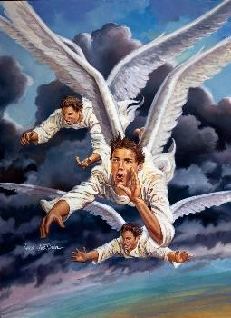
A. The Judge (Revelation 14:14-18a)
The Son of Man (14)
The First Angel (15-16)
The Second Angel (17)
The Third Angel (18a)

Slide 21
A. The Judge (Revelation 14:14-18a)
The Son of Man (14)
The First Angel (15-16)
The Second Angel (17)
The Third Angel (18a)

Slide 22
A. The Judge (Revelation 14:14-18a)
The Son of Man (14)
The First Angel (15-16)
The Second Angel (17)
The Third Angel (18a)

Slide 23
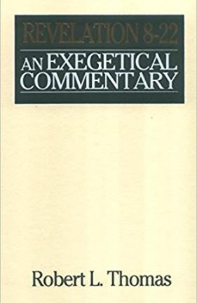
Dr. Robert Thomas
Revelation 8 to 22: An Exegetical Commentary (Chicago: Moody Press, 1995), 221.
Dr. Robert Thomas observes that, "The brevity of the statement dramatizes the suddenness of the judgment.”

Slide 24
A. The Judge (Revelation 14:14-18a)
The Son of Man (14)
The First Angel (15-16)
The Second Angel (17)
The Third Angel (18a)

Slide 25
A. The Judge (Revelation 14:14-18a)
The Son of Man (14)
The First Angel (15-16)
The Second Angel (17)
The Third Angel (18a)

Slide 26
6. The Armageddon Judgment Harvest (Revelation 14:14-20)
The Judge (14-18a)
The Judged (18b)
The Judgment (19-20)

Slide 27
6. The Armageddon Judgment Harvest (Revelation 14:14-20)
The Judge (14-18a)
The Judged (18b)
The Judgment (19-20)

Slide 29
C. The Judgment (Revelation 14:19-20)
Figurative language (19)
Plain language (20)

Slide 30
C. The Judgment (Revelation 14:19-20)
Figurative language (19)
Plain language (20)

Slide 31
Promised Exemption from Divine Wrath
The promise (1 Thess 1:10; 5:9; Rom 5:9; 8:1; Rev 3:10)
Tribulation = divine wrath (Rev 6:16-17; 11:18; 14:19; 15:1, 7; 16:1, 19)

Slide 32
C. The Judgment (Revelation 14:19-20)
Figurative language (19)
Plain language (20)

Slide 33
Conclusion

Slide 34
6. The Armageddon Judgment Harvest (Revelation 14:14-20)
The Judge (14-18a)
The Judged (18b)
The Judgment (19-20)

Slide 35
C. Six Scenes of Hope Revelation 14:1-20
The Destiny of the 144,000 (1-5)
The Proclamation of the Eternal Gospel (6-7)
The Prediction of the Destruction of Babylon (8)
The Doom of the Beast’s Worshippers (9-12)
The Blessing Upon the Tribulation’s Martyrs (13)
The Judgment Harvest of Armageddon (14-20)

Slide 36
“The Lord bless you and keep you; the Lord make his face shine on you and be gracious to you; the Lord turn his face toward you and give you peace.” (NIV)

