Slide 1


Dr. Andy Woods
Senior Pastor – Sugar Land Bible Church
President – Chafer Theological Seminary

Slide 2


Slide 3


Seven Trumpets
(Revelation 8‒11)
1st Trumpet (8:7) – 1/3 vegetation destroyed
2nd Trumpet (8:8-9) – 1/3 ocean destroyed
3rd Trumpet (8:10-11) – 1/3 water destroyed
4th Trumpet (8:12-13) – 1/3 luminaries darkened
5th Trumpet (9:1-12) – Demons released
6th Trumpet (9:13-21) – 1/3 humanity destroyed
7th Trumpet (11:14-19) – Legal transfer announced

Slide 4


Revelation 11:15
“Then the seventh angel sounded; and there were loud voices in heaven, saying, ‘The kingdom of the world has become the kingdom of our Lord and of His Christ; and He will reign (basileuō) forever and ever.’” (cf. Matt. 6:10)

Slide 5
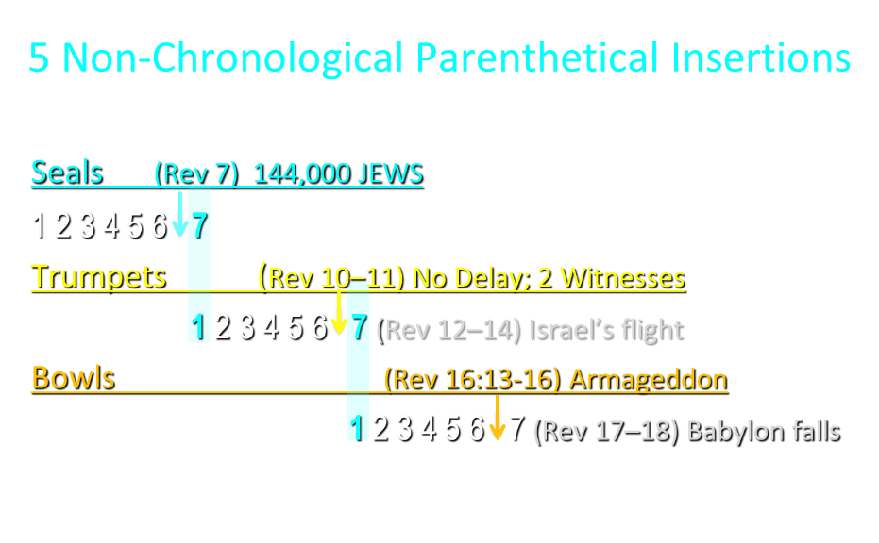

Slide 6
5 Non-Chronological Parenthetical Insertions
Rev 7 – 144,000 Jews
Rev 10:1-11:13 – Announcement of no more delay and the two witnesses
Rev 12-14 – Israel’s flight, two beasts, six scenes of hope
Rev 16:13-16 – Gathering of the nations to Armageddon
Rev 17:1-19:6 – Babylon’s fall

Slide 7
Revelation 12‒14
Rev 12 – Israel’s flight
Rev 13 – Two beasts
Rev 14 – Six scenes of hope

Slide 8
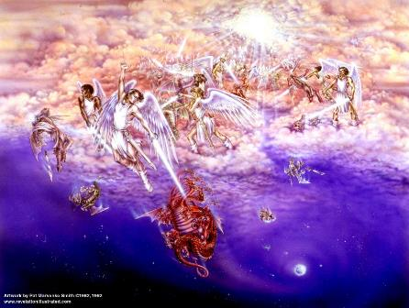
Biblical Reality of the Angelic World
Job 1:12
2 Kings 6:15-17
1 Chron 21:1
Dan 10:12-13, 20
Matt 16:21-23
Luke 22:31-32
Eph 6:12

Slide 9
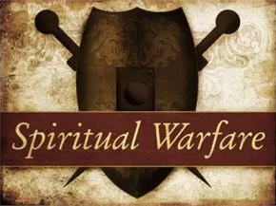
2 Corinthians 2:11
“so that no advantage would be taken of us by Satan, for we are not ignorant of his schemes.”

Slide 10
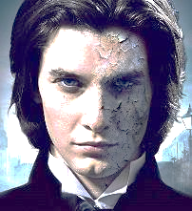
Ezekiel 28:17
“Your heart was lifted up because of your beauty; You corrupted your wisdom by reason of your splendor.”

Slide 11

Satan’s Two Strategies
Rev 12:1-5 – Past failed strategy
Rev 12:6-17 – Present & future strategy

Slide 12
Satan’s Two Strategies
Rev 12:1-5 – Past failed strategy
Rev 12:6-17 – Present & future strategy

Slide 13
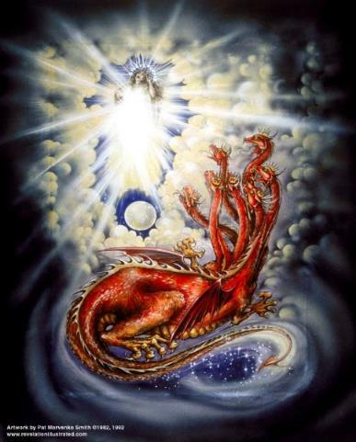
CAST OF 3 CHARACTERS
Revelation 12:1-5
SON = MESSIAH
  Ps. 2:9; Acts 1:9
DRAGON = SATAN
  Rev. 12:9; 20:2
WOMAN = ISRAEL
  Gen. 37:9-10

Slide 14

Revelation 12:4-5 (KJV)
⁴And his tail drew a third part of the stars of heaven, and did cast them to the earth: and the dragon stood before the woman that is about to give birth, so that when she gave birth he may devour her child. ⁵And she gave birth to a son, a man child, who is to rule all the nations with a rod of iron: and her child was caught up unto God, and to his throne.

Slide 15
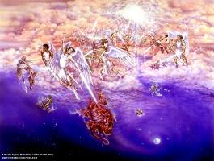
Different Perspectives – Same Event
Matt 2 – Physical World
Rev 12:1-5 – Spiritual World

Slide 16


Genesis 3:15
“And I will put enmity between you and the woman, and between your seed and her seed; He shall bruise you on the head, and you shall bruise him on the heel.”

Slide 17
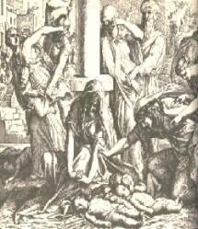
Satanic Attempts to Stop Messiah
Cain; Gen. 4, 1 Jn. 3:12
Sons of God; Gen. 6:1-4
Pharaoh; Ex. 1
Athaliah; 2 Chron. 22
Haman; Esther
Matt 4:5-7; John 8:59
Herod; Mt.2

Slide 18
Satan’s Two Strategies
Rev 12:1-5 – Past failed strategy
Rev 12:6-17 – Present & future strategy

Slide 19

Names & Titles Demonstrating Satan’s Post-Fall, Earthly Authority
(Job 1:7; 2:2; Luke 4:5-8; Rom. 8:19-22)
Prince of this world (John 12:31; 14:30; 16:11)
God of this age (2 Cor. 4:4)
Prince and power of the air (Eph. 2:2)
Who the believer wrestles with (Eph. 6:12)
Roaring lion (1 Pet. 5:8)
Whole world lies in his power (1 John 5:19)

Slide 20

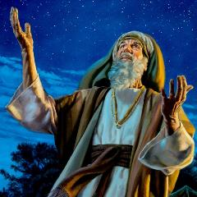
Genesis 12:3
“And I will bless those who bless you, And the one who curses you I will curse. And in you all the families of the earth will be blessed.”

Slide 21
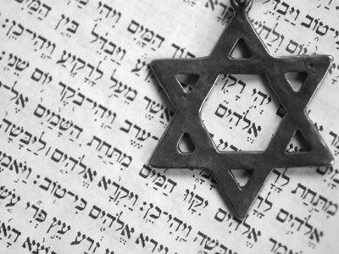
Israel’s Three Blessings to the World
(Gen 12:3b)
Scripture (Rom 3:2)
Savior (John 4:22)
Kingdom (Isa 2:2-3)

Slide 22
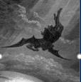
Satan’s Progressive Defeat
Initial eviction from heaven (Isa 14:12-15; Ezek 28:12-17)
Eden (Gen 3:15)
Pre-diluvian world (1 Pet 3:19-20)
Cross (John 12:31; 16:11; Col 2:15; Heb 2:14; 1 John 3:8)
Mid point of the Tribulation (Rev 12:9)
Beginning of millennium (Rev 20:2-3)
End of millennium (Rev 20:10)

Slide 23
Revelation 11:15
“Then the seventh angel sounded; and there were loud voices in heaven, saying, ‘The kingdom of the world has become the kingdom of our Lord and of His Christ; and He will reign (basileuō) forever and ever.’” (cf. Matt. 6:10)

Slide 24

WHAT MOTIVATES ANTI-SEMITISM?
Fallen angelic world

Slide 25
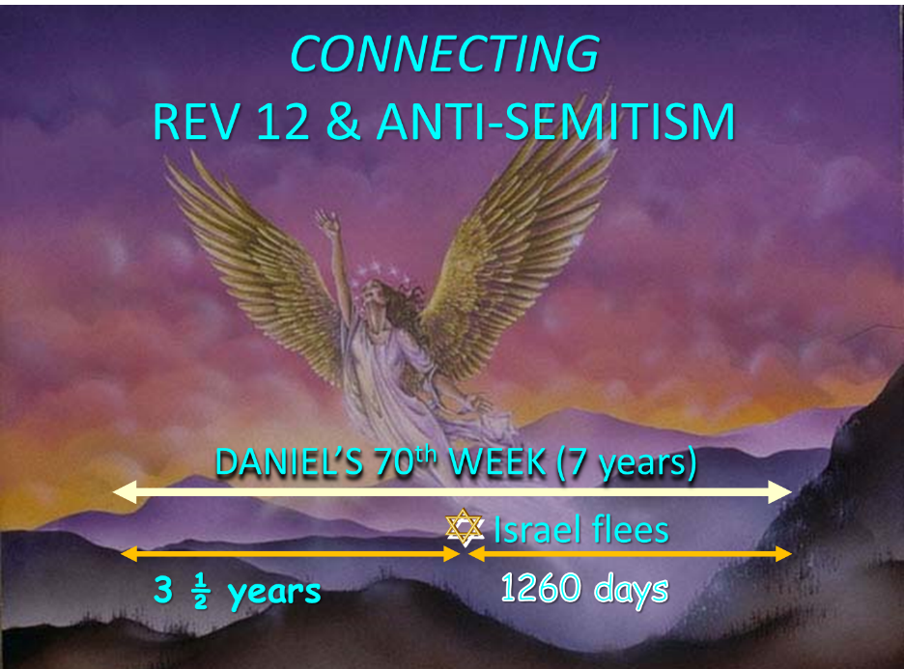

Slide 26
Satan Now Retains Heavenly Access
Job 1:6
Job 2:1
Zech. 3:1
Luke 22:31
Rev. 12:10

Slide 27
Satan’s Progressive Defeat
Initial eviction from heaven (Isa 14:12-15; Ezek 28:12-17)
Eden (Gen 3:15)
Pre-diluvian world (1 Pet 3:19-20)
Cross (John 12:31; 16:11; Col 2:15; Heb 2:14; 1 John 3:8)
Mid point of the Tribulation (Rev 12:9)
Beginning of millennium (Rev 20:2-3)
End of millennium (Rev 20:10)

Slide 28
Different Perspectives – Same Event
Matt 24:15-22 – Physical World
Rev 12:6-17 – Spiritual World

Slide 29
3 WARS
Revelation 12
WAR = PAST
  Rev. 12:1-5
WAR = HEAVEN
  Rev. 12:6-12
WAR = EARTH
  Rev. 12:13-17

Slide 30
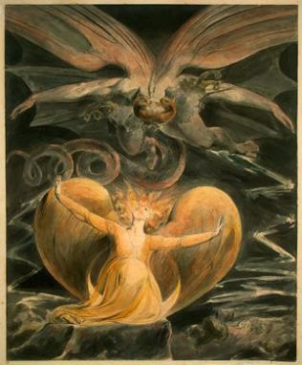
2 CYCLES OF SATANIC PERSECUTION
“Pursues the woman” = persecution of Israel 12:13-14
“Flood from his mouth” = tries to destroy Israel 12:15-16

Slide 31
2 CYCLES OF SATANIC PERSECUTION
“Pursues the woman” = persecution of Israel 12:13-14
“Flood from his mouth” = tries to destroy Israel 12:15-16

Slide 32
CAST OF 3 CHARACTERS
Revelation 12:1-5
SON = MESSIAH
  Ps. 2:9; Acts 1:9
DRAGON = SATAN
  Rev. 12:9; 20:2
WOMAN = ISRAEL
  Gen. 37:9-10

Slide 33
Place of Hebrew Refuge:
Petra in Mt. Seir in S. Jordan
Prepared by God (Rev. 12:6)
Divine provision of food & water (Isa. 33:16; Rev. 12:6)
Wilderness (Rev. 12:6, 14)
Mountains (Isa. 33:16; Matt. 24:16)
Defensible (Isa. 33:16)
Jordan (Dan. 11:41)
Bozrah (Micah 2:12)
Fruchtenbaum, Footsteps of the Messiah, 294-97

Slide 34
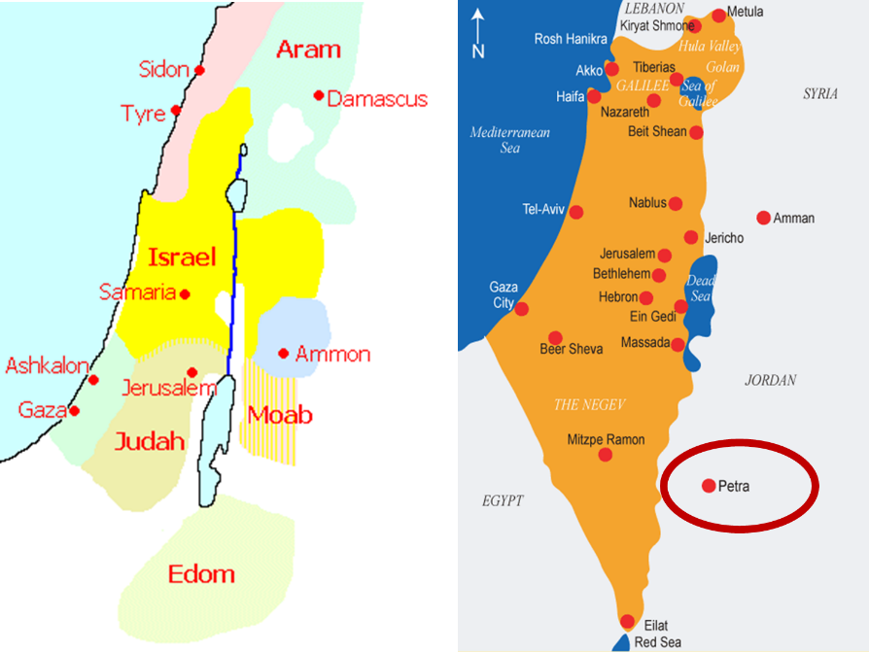

Slide 35
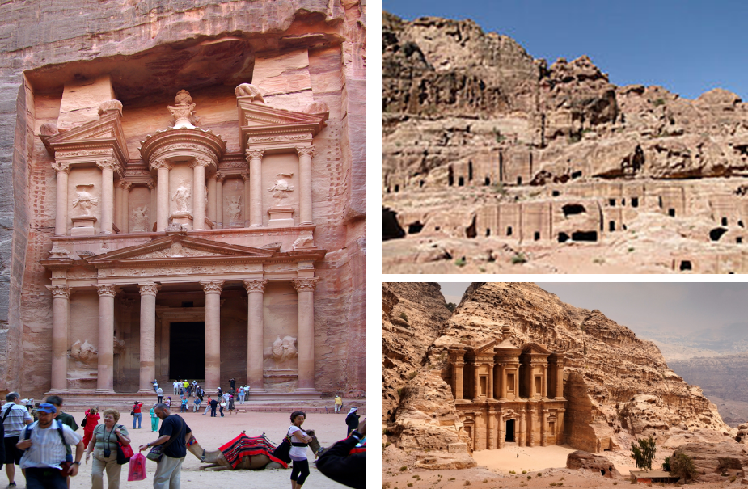

Slide 36

Arnold Fruchtenbaum
Footseps of the Messiah, Page 296-97
“Another suggestion is the city now known as Petra…this author prefers the identification with Petra. Petra is located in a basin within Mount Seir, and is totally surrounded by mountains and cliffs. The only way in and out of the city is through a narrow passageway that extends for about a mile and can only be negotiated by foot or by horseback. This makes the city easy to defend, and its surrounding high cliffs give added meaning and confirmation to Isaiah 33:16. Only a few abreast can enter through this passage at any one time, giving this city even greater defensibility.”

Slide 37
Arnold Fruchtenbaum
Footseps of the Messiah, Page 296-97
“The name Bozrah means ‘sheepfold.’ An ancient sheepfold had a narrow entrance so that the shepherd could count his sheep. Once inside the fold, the sheep had more room to move around. Petra is shaped like a giant sheepfold, with its narrow passage opening up to a spacious circle surrounded by cliffs. This is not true of the town of Buseira. Furthermore, by modern Petra is a site known as Butzeira, which retains the Hebrew Botzrah...It will be a very defensible city located in Mount Seir...Furthermore, as they flee and while they are living there, food and water will be miraculously provided.”

Slide 38
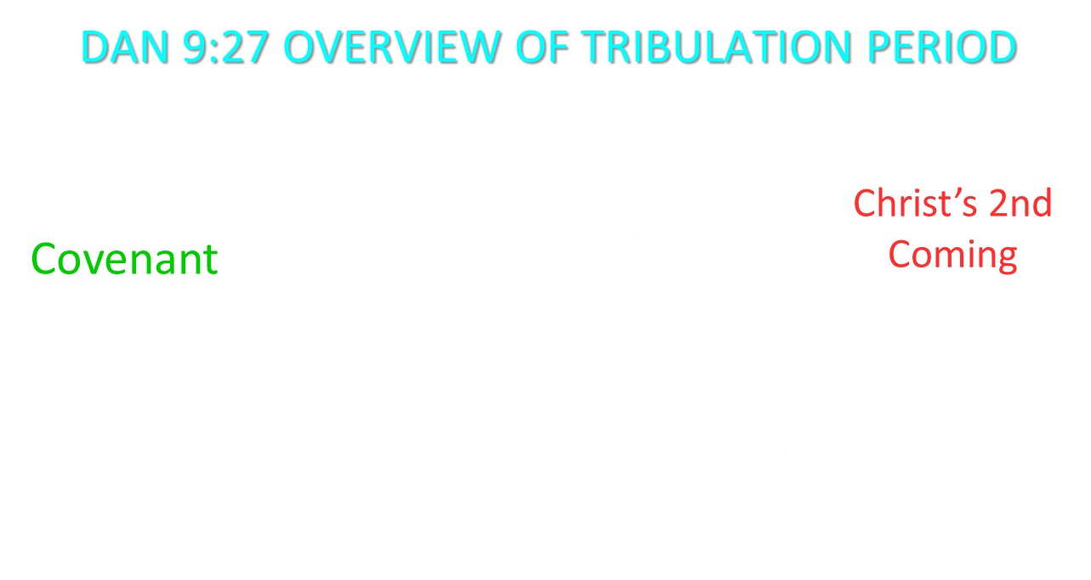

Slide 39
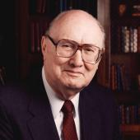
Two Rules of Interpretation
Search the immediate context
  Walvoord: 26X
Search the remote context
  Old Testament
  Thomas: 278 / 404 verses

Slide 40


Slide 41
2 CYCLES OF SATANIC PERSECUTION
“Pursues the woman” = persecution of Israel 12:13-14
“Flood from his mouth” = tries to destroy Israel 12:15-16

Slide 42
Daniel 9:26
Then after the sixty-two weeks the Messiah will be cut off and have nothing, and the people of the prince who is to come will destroy the city and the sanctuary. And its end will come with a flood; even to the end there will be war; desolations are determined.

Slide 43
Descriptions of Satanic Hatred
Wrath 12:12
Persecution (diōkō) 12:13
Sweep away 12:15
Enraged (orgizō) 12:17
War (polemos) 12:17

Slide 44

How Israel Has Blessed the World (Gen 12:3; Rom 9:4-5)
Patriarchs | Biblical writers
Law | Early church
Prophets | Early Christian martyrs
Messiah (Jn 4:22; Rom 9:5) | Paul
Apostles | Future kingdom

Slide 45
Matthew 23:37-39
³⁷ “Jerusalem, Jerusalem, who kills the prophets and stones those who are sent to her! How often I wanted to gather your children together, the way a hen gathers her chicks under her wings, and you were unwilling. ³⁸ Behold, your house is being left to you desolate! ³⁹ For I say to you, from now on you will not see Me until you say, ‘Blessed is He who comes in the name of the Lord!’”

Slide 46
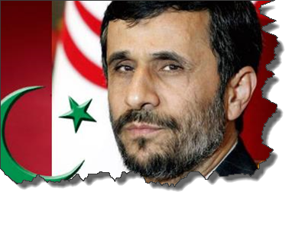
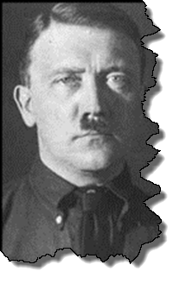
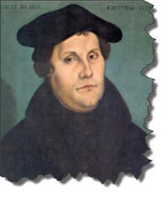
MODERN TRENDS IN ANTISEMITISM
Revelation 12

Slide 47

Christian Anti-Semitism
  “First, their synagogues should be set on fire…Secondly, their homes should likewise be broken down and destroyed…Thirdly, they should be deprived of their prayer books and Talmuds…”
Martin Luther, Concerning the Jews and Their Lies, cited in Michael Brown’s Our Hands Are Stained with Blood, pp. 14-15.

Slide 48
Christian Anti-Semitism
  “…Fourthly, their rabbis must be forbidden under threat of death to teach any more…Fifthly, passport and traveling privileges should be absolutely forbidden to the Jews…Sixthly, they ought to be stopped from usury (charging interest on loans…”
Martin Luther, Concerning the Jews and Their Lies, cited in Michael Brown’s Our Hands Are Stained with Blood, pp. 14-15.

Slide 49
Christian Anti-Semitism
“Seventhly, let the young and strong Jews and Jewesses be given the flail, the ax, the hoe, the spade, the distaff, and spindle, and let the earn their bread by the sweat of their noses…We ought to drive the rascally lazy bones out of our system...”
Martin Luther, Concerning the Jews and Their Lies, cited in Michael Brown’s Our Hands Are Stained with Blood, pp. 14-15.

Slide 50
Christian Anti-Semitism
“…Therefore away with them… To sum up, dear princes and nobles who have Jews in your domains, if this advice of mine does not suit you, then find a better one so that you and we may all be free of this insufferable devilish burden–the Jews.”
Martin Luther, Concerning the Jews and Their Lies, cited in Michael Brown’s Our Hands Are Stained with Blood, pp. 14-15.

Slide 51
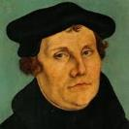
The Encyclopaedia Judaica says “Short of the Auschwitz oven and the extermination, the whole Nazi holocaust is pre-outlined here.”
Martin Luther
“Luther, Martin,” in Encyclopaedia Judaica, Vol. 8, 693.

Slide 52
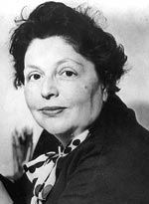
“…both Luther and Hitler were obsessed by the ‘demonologized universe’ inhabited by the Jews.”
Lucy Dawidowicz
“Luther, Martin,” in Encyclopaedia Judaica, Vol. 8, 693.

Slide 53
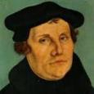
Lutheran Statement https://www.ccjr.us/dialogika-resources/documents-and-statements/interreligious/759-lwfijcic1983
  “We Lutherans take our name and much of our understanding of Christianity from Martin Luther. But we cannot accept or condone the violent verbal attacks that the Reformer made against the Jews…The sins of Luther’s anti-Jewish remarks, the violence of his attacks on the Jews, must be acknowledged with deep distress. And all occasions for similar sin in the present or the future must be removed from our churches…Lutherans of today refuse to be bound by all of Luther’s utterances on the Jews.”

Slide 54

John Calvin
Commentary on the Prophet Daniel (Vol 1, p. 185). Bellingham, WA: Logos Bible Software. Commentary on Daniel 2:44-45. (2010).
  “But here he [the rabbi] not only betrays his ignorance, but his utter stupidity, since God so blinded the whole people that they were like restive dogs. I have had much conversation with many Jews: I have never seen either a drop of piety or a grain of truth or ingenuousness—nay, I have never found common sense in any Jew. But this fellow, who seems so sharp and ingenious, displays his own impudence to his great disgrace.”

Slide 55
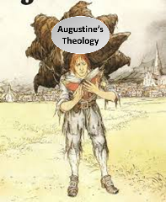
  Calvin repeatedly refers to the Jews as “profane unholy sacrilegious dogs,” describing them as “a barbarous nation” and “the people of Israel rejected by God.”
John Calvin
1. John Calvin, Ioannis Calvini opera quae supersunt Omnia, 50, 307; Sermon on Gal. 1:6–8; quoted in Selderhuis, Calvin Handbook, 145; 2. John Calvin, Supplementa Calviniana, V, 145, 10; Sermon on Mic. 40b–11; quoted in Selderhuis, Calvin Handbook, 145; 3. John Calvin, Ioannis Calvini opera quae supersunt Omnia, 27, 6; Sermon on Deut. 10:1–8; quoted in Selderhuis, Calvin Handbook, 145.

Slide 56

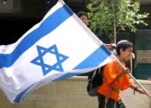
Zechariah 12:3
“³ It will come about in that day that I will make Jerusalem a heavy stone for all the peoples; all who lift it will be severely injured. And all the nations of the earth will be gathered against it.”

Slide 57
Zechariah 14:2
“² For I will gather all the nations against Jerusalem to battle, and the city will be captured, the houses plundered, the women ravished and half of the city exiled, but the rest of the people will not be cut off from the city.”

Slide 58
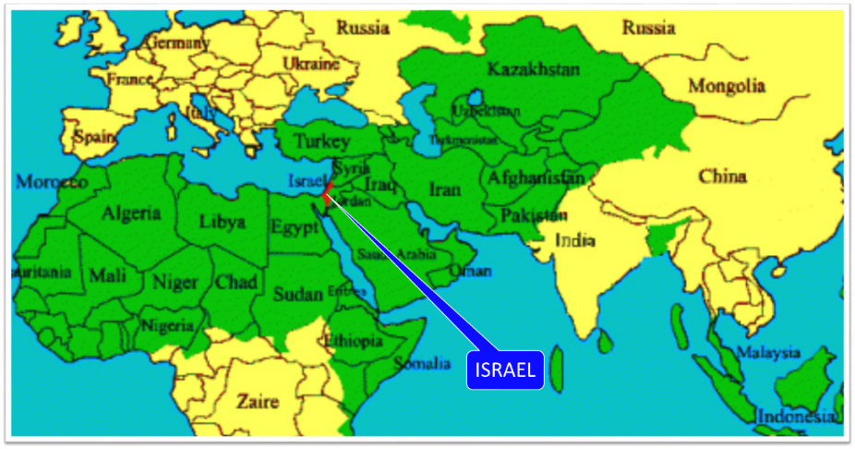

Slide 59
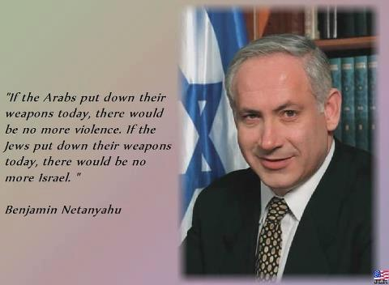

Slide 60
Conclusion

Slide 61
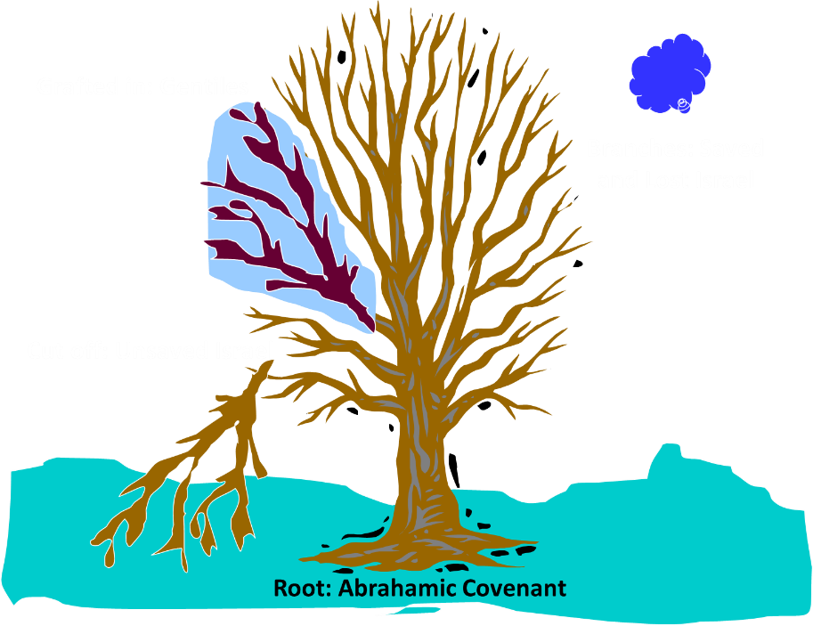
Notes:
61

Slide 62
Romans 11:13, 17-21
“But I am speaking to you who are Gentiles. Inasmuch then as I am an apostle of Gentiles, I magnify my ministry…But if some of the branches were broken off, and you, being a wild olive, were grafted in among them and became partaker with them of the rich root of the olive tree, ¹⁸ do not be arrogant toward the branches; but if you are arrogant, remember that it is not you who supports the root, but the root supports you. ¹⁹ You will say then, “Branches were broken off so that I might be grafted in.” ²⁰ Quite right, they were broken off for their unbelief, but you stand by your faith. Do not be conceited, but fear; ²¹ for if God did not spare the natural branches, He will not spare you, either.”

Slide 63
Romans 11:28-29
“From the standpoint of the gospel they are enemies for your sake, but from the standpoint of God’s choice they are beloved for the sake of the fathers; ²⁹ for the gifts and the calling of God are irrevocable.”

Slide 64
Application
Recognize Anti-Semitism and its source
Do not take part
Expose it (Eph. 5:11)
Do not be surprised by it

Slide 65

“The Lord bless you and keep you; the Lord make his face shine on you and be gracious to you; the Lord turn his face toward you and give you peace.” (NIV)

