Slide 1
Dr. Andy Woods
Senior Pastor – Sugar Land Bible Church
President – Chafer Theological Seminary

Slide 2
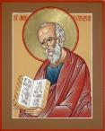
Answering Ten Questions
What is the title – Revelation of Jesus Christ
Who wrote it? – John
Where was it written from? – Patmos
To Whom was it written? – The Seven Churches
When was it written? – A.D. 95
How is it organized (outline)? – 3 part outline
How was it delivered – Seven steps
Why was it written? – Encouragement and holiness
What is it about? – Jesus’ final victory
What makes the book different? – OT relationship

Slide 3
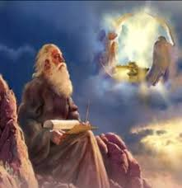
Prologue (Rev. 1:1-8)
Title (1a)
Chain of Communication (1b-2)
Blessing (3)
Author (4a)
Audience (4b)
Greeting (4c)
Source (4d-5a)
Subject (5b-8)

Slide 4
Revelation 1:19
“Therefore write the things which you have seen, and the things which are, and the things which will take place after these things [meta tauta].”

Slide 5
Revelation 1:19
Seen (Chapter 1)
Are (Chapters 2–3)
After these things (Chapters 4–22)

Slide 6
Revelation 1:19
Seen (Chapter 1)
Are (Chapters 2–3)
After these things (Chapters 4–22)

Slide 7
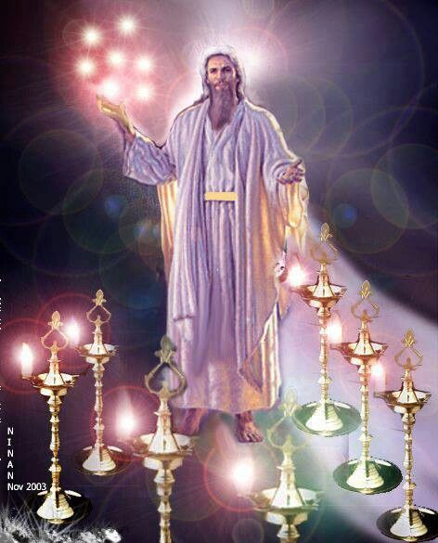

Slide 8
Revelation 1:19
Seen (Chapter 1)
Are (Chapters 2–3)
After these things (Chapters 4–22)

Slide 9
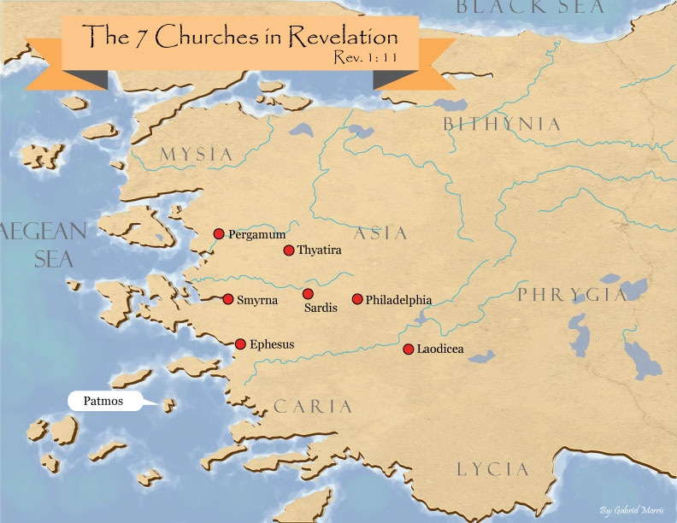

Slide 10
DESCRIPTION OF THE SEVEN CHURCHES Revelation 2‒3
CHURCH | SCRIPTURE | DESCRIPTION
Ephesus | 2:1-7 | Loveless
Smyrna | 2:8-11 | Persecuted
Pergamum | 2:12-17 | Compromised
Thyatira | 2:18-29 | Corrupt
Sardis | 3:1-6 | Dead
Philadelphia | 3:7-13 | Missionary
Laodicea | 3:14-22 | Man-centered

Slide 11
Revelation 1:19
Seen (Chapter 1)
Are (Chapters 2–3)
After these things (Chapters 4–22)

Slide 12
Revelation 1:19
“Therefore write the things which you have seen, and the things which are, and the things which will take place after these things [meta tauta].”

Slide 13
Revelation 4:1
“After these things [meta tauta] I looked, and behold, a door standing open in heaven, and the first voice which I had heard, like the sound of a trumpet speaking with me, said, ‘Come up here, and I will show you what must take place after these things [meta tauta].’”

Slide 14
“After These Things” (Rev. 4‒22)
Before the Tribulation (4‒5)
During the Tribulation (6‒19)
After the Tribulation (20‒22)
Kingdom (20:1-10)
Great White Throne Judgment (20:11-15)
Destruction of the Earth (21:1)
New Heaven and New Earth (21‒22)

Slide 15
“After These Things” (Rev. 4‒22)
Before the Tribulation (4‒5)
During the Tribulation (6‒19)
After the Tribulation (20‒22)
Kingdom (20:1-10)
Great White Throne Judgment (20:11-15)
Destruction of the Earth (21:1)
New Heaven and New Earth (21‒22)

Slide 16
Comparing Revelation 4 & 5
Chapter | Revelation 4 | Revelation 5
God-head Member | Father | Son
Role | Creator | Redeemer
Reason for Worship | Role in Creation (4:11) | Role in Redemption (5:9, 12)

Slide 17
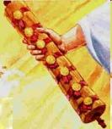
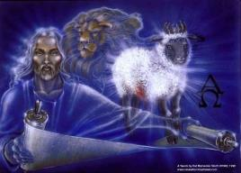
Revelation 5:1-14
An observation (5:1)
A question (5:2)
An investigation (5:3)
A lamentation (5:4)
A consolation (5:5a)
A manifestation (5:5b-6)
A reception (5:7)
A reaction (5:8-14)
Willmington. Outline Bible, 760

Slide 18
“After These Things” (Rev. 4‒22)
Before the Tribulation (4‒5)
During the Tribulation (6‒19)
After the Tribulation (20‒22)
Kingdom (20:1-10)
Great White Throne Judgment (20:11-15)
Destruction of the Earth (21:1)
New Heaven and New Earth (21‒22)

Slide 20
1st Six Seals (Revelation 6)
6:1-2 – Advent of antichrist
6:3-4 – War
6:5-6 – Famine
6:7-8 – Death
6:9-11 – Martyrdoms
6:12-17 – Cosmic disturbances

Slide 21
1st Six Seals (Revelation 6)
6:1-2 – Advent of antichrist
6:3-4 – War
6:5-6 – Famine
6:7-8 – Death
6:9-11 – Martyrdoms
6:12-17 – Cosmic disturbances

Slide 23
1st Six Seals (Revelation 6)
6:1-2 – Advent of antichrist
6:3-4 – War
6:5-6 – Famine
6:7-8 – Death
6:9-11 – Martyrdoms
6:12-17 – Cosmic disturbances

Slide 24
Isaiah 9:6-7
“⁶ For a child will be born to us, a son will be given to us; And the government will rest on His shoulders; And His name will be called Wonderful Counselor, Mighty God, Eternal Father, Prince of Peace.⁷ There will be no end to the increase of His government or of peace, On the throne of David and over his kingdom, To establish it and to uphold it with justice and righteousness From then on and forevermore. The zeal of the Lord of hosts will accomplish this.”

Slide 25
1st Six Seals (Revelation 6)
6:1-2 – Advent of antichrist
6:3-4 – War
6:5-6 – Famine
6:7-8 – Death
6:9-11 – Martyrdoms
6:12-17 – Cosmic disturbances

Slide 26
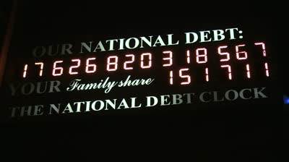
National Debt Clock

Slide 27
1st Six Seals (Revelation 6)
6:1-2 – Advent of antichrist
6:3-4 – War
6:5-6 – Famine
6:7-8 – Death
6:9-11 – Martyrdoms
6:12-17 – Cosmic disturbances

Slide 28
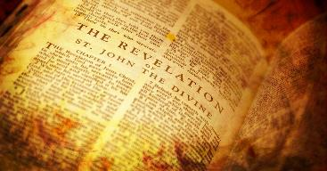
Methods of Interpreting Revelation
Preterism: past (AD 70)
Historicism: past (church history)
Idealism: recurring
Futurism: totally future

Slide 29
1st Six Seals (Revelation 6)
6:1-2 – Advent of antichrist
6:3-4 – War
6:5-6 – Famine
6:7-8 – Death
6:9-11 – Martyrdoms
6:12-17 – Cosmic disturbances

Slide 30
1st Six Seals (Revelation 6)
6:1-2 – Advent of antichrist
6:3-4 – War
6:5-6 – Famine
6:7-8 – Death
6:9-11 – Martyrdoms
6:12-17 – Cosmic disturbances

Slide 31
Comparing Revelation 4 & 5
Chapter | Revelation 4 | Revelation 5
God-head Member | Father | Son
Role | Creator | Redeemer
Reason for Worship | Role in Creation (4:11) | Role in Redemption (5:9, 12)

Slide 32
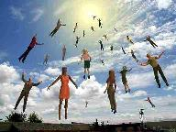
When Will the Rapture Take Place Relative to the Tribulation Period?
Pre-tribulation rapture theory
Mid-tribulation rapture theory
Post-tribulation rapture theory
Pre-wrath rapture theory
Partial rapture theory

Slide 34
Rev. 6:16-17 Robert L. Thomas, Revelation 1–7: An Exegetical Commentary, ed. Kenneth Barker (Chicago: Moody, 1992), 457-58.
"Mankind in his rebellion correctly analyzes the cosmic and terrestrial disturbances as a part of the great end-time day of wrath from the one sitting on the throne and from the Lamb. The verb ēlethen (‘has come’) is aorist indicative, referring to a previous arrival of wrath, not something that is about to take place. Men see the arrival of this day at least as early as the cosmic upheavals that characterize the sixth seal (6:12-14), but upon reflection they probably recognize that it was already in effect with the death of one-fourth of the population (6:7-8), the worldwide famine (6:5-6), and the global warfare (6:3-4). The rapid sequence of all of these events could not escape notice, but the light of their true explanation does not dawn upon human consciousness until the severe phenomena of the sixth seal arrive."

Slide 35
1st Six Seals (Revelation 6)
6:1-2 – Advent of antichrist
6:3-4 – War
6:5-6 – Famine
6:7-8 – Death
6:9-11 – Martyrdoms
6:12-17 – Cosmic disturbances

Slide 36
Conclusion

Slide 37
1st Six Seals (Revelation 6)
6:1-2 – Advent of antichrist
6:3-4 – War
6:5-6 – Famine
6:7-8 – Death
6:9-11 – Martyrdoms
6:12-17 – Cosmic disturbances

Slide 38
“The Lord bless you and keep you; the Lord make his face shine on you and be gracious to you; the Lord turn his face toward you and give you peace.” (NIV)

