Slide 1
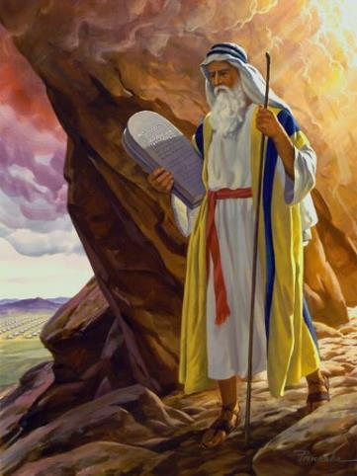
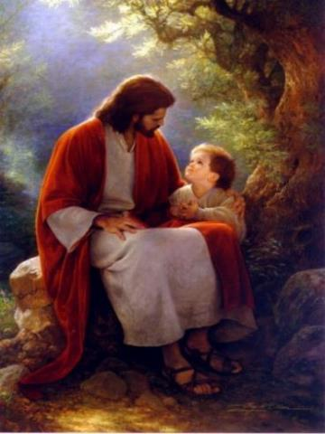
Law & Grace: An Overview Jim McGowan, Th.D. Sugar Land Bible Church 09-30-2018
…but grace & truth were realized through Jesus Christ - John 1:17
For the Law was given through Moses…
Special thanks to Dr. Vern Peterman for access to his insights and resources.

Slide 2
Session 12 Outline
Review
Purpose, Aim, and Objective
Session 11
The Law and Laws – The Whole Enchilada Part 2 (Galatians 5:2-4; James 2:10-11)
Comments & Commentary
Concluding Observations

Slide 3
Session 12 Outline
Review
Purpose, Aim, and Objective
Session 11
The Law and Laws – The Whole Enchilada Part 2 (Galatians 5:2-4; James 2:10-11)
Comments & Commentary
Concluding Observations

Slide 4
OUR PURPOSE, AIM AND OBJECTIVE
Law & Grace
…is to Compare and Contrast Law and Grace so as to properly understand these two important themes and how they are related to the life of the New Testament Believer.

Slide 5
C. I. SCOFIELD, D. D.
The Grace of God, The Fundamentals Vol. 3, Chapter VII, p. 98
We have, most of us, been reared and now live under the influence of Galatianism. Protestant theology, alas, is for the most part, thoroughly Galatianized, in that neither law nor grace are given their distinct and separated places, as in the counsels of God, but are mingled together in one incoherent system.
The law is no longer, as in the Divine intent, a ministration of death (2 Cor. 3:7), of cursing (Gal. 3:10), of conviction (Rom. 3:19), because we are taught that we must try to keep it, and that by Divine help we may.
Nor, on the other hand, does grace bring us blessed deliverance from the dominion of sin, for we are kept under the law as a rule of life despite the plain declaration, “Sin shall not have dominion over you: for ye are not under the law, but under grace” (Rom. 6:14). (emphasis mine)

Slide 6
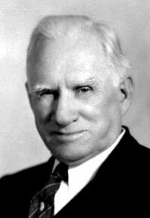
William R. Newell
Romans Verse-by-Verse (p. 274).
Grand Rapids, MI: Christian Classics Ethereal Library.
It is because Reformed theology has kept us Gentiles under the Law,—if not as a means of righteousness, then as “a rule of life,” that all the trouble has arisen. The Law is no more a rule of life than it is a means of righteousness. Walking in the Spirit has now taken the place of walking by ordinances. God has another principle under which He has put his saints: “Ye are not under law, but, under grace!” (italics mine)

Slide 7
Session 12 Outline
Review
Purpose, Aim, and Objective
Session 11
The Law and Laws – The Whole Enchilada Part 2 (Galatians 5:2-4; James 2:10-11)
Comments & Commentary
Concluding Observations

Slide 8
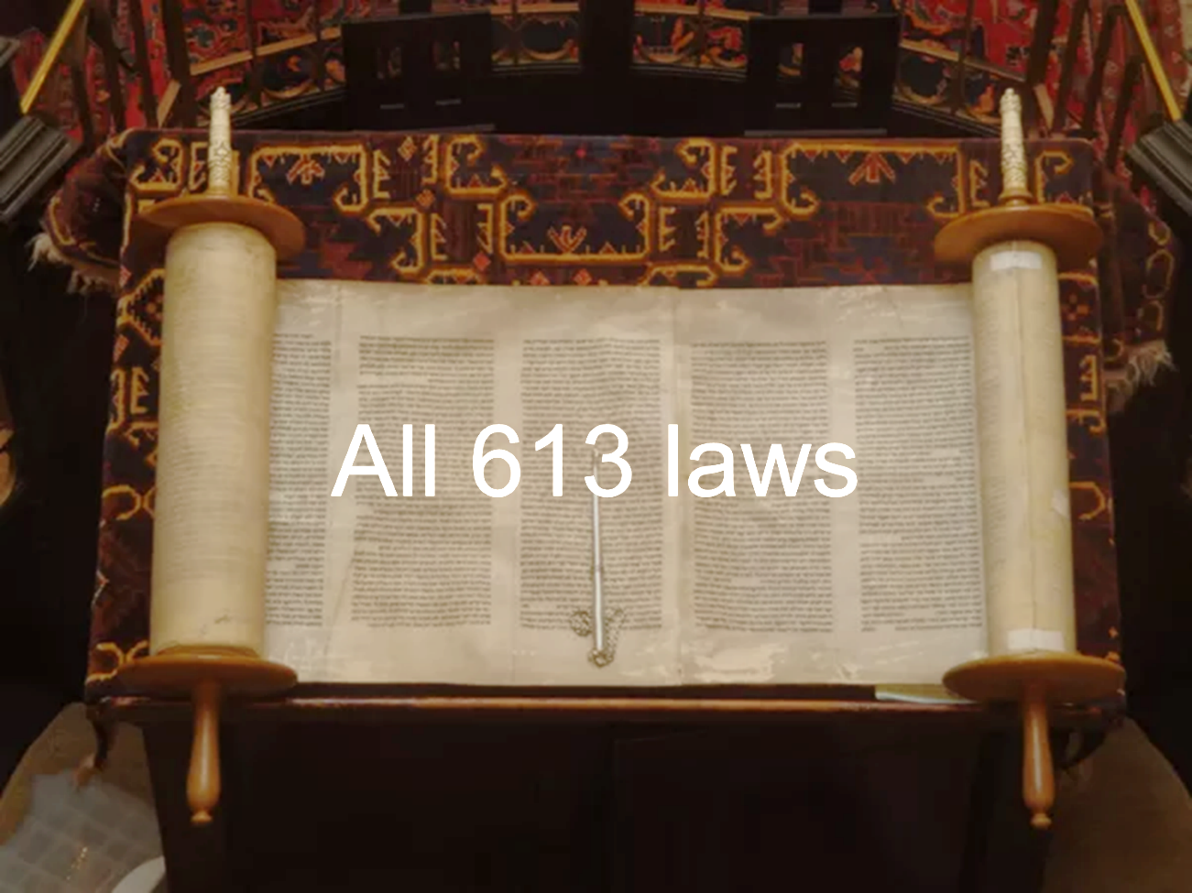
Law & Grace: Lesson 11 Review

Slide 9
Law & Grace: Lesson 11 Review
All 613 Laws!
The Law of Moses itself contains a number of statements that say that all of the Law of Moses is intended to be followed - every one, every day.
Numbers 15:39, 40 (“all, “all”)
Deuteronomy 4:6, 7, 8 (“all”, “the whole law”)
Deuteronomy 5:31, 33 (“all, “all”)
Deuteronomy 8:1 (“all”)
Deuteronomy 11:8, 32 (“Every”, “all”)

Slide 10
Leviticus 19:37
‘You shall thus observe all My statutes and all My ordinances and do them; I am the Lord.’ ”
Deuteronomy 6:24–25
²⁴ “So the Lord commanded us to observe all these statutes, to fear the Lord our God for our good always and for our survival, as it is today. ²⁵ “It will be righteousness for us if we are careful to observe all this commandment before the Lord our God, just as He commanded us.

Slide 11
Deuteronomy 13:18
if you will listen to the voice of the Lord your God, keeping all His commandments which I am commanding you today, and doing what is right in the sight of the Lord your God.
Deuteronomy 19:9
if you carefully observe all this commandment which I command you today, to love the Lord your God, and to walk in His ways always—then you shall add three more cities for yourself, besides these three.

Slide 12
Deuteronomy 26:18
“The Lord has today declared you to be His people, a treasured possession, as He promised you, and that you should keep all His commandments;
Deuteronomy 28:1
“Now it shall be, if you diligently obey the Lord your God, being careful to do all His commandments which I command you today, the Lord your God will set you high above all the nations of the earth.

Slide 13
Deuteronomy 28:15
¹⁵ “But it shall come about, if you do not obey the Lord your God, to observe to do all His commandments and His statutes with which I charge you today, that all these curses will come upon you and overtake you:
Deuteronomy 30:8
“And you shall again obey the Lord, and observe all His commandments which I command you today.

Slide 14
Deuteronomy 31:12
“Assemble the people, the men and the women and children and the alien who is in your town, so that they may hear and learn and fear the Lord your God, and be careful to observe all the words of this law.
Deuteronomy 32:46
he said to them, “Take to your heart all the words with which I am warning you today, which you shall command your sons to observe carefully, even all the words of this law.

Slide 15
Nehemiah 10:28-29
²⁸ Now the rest of the people,…and all those who had separated themselves…to the law of God,…all those who had knowledge and understanding, ²⁹ are joining with their kinsmen, their nobles, and are taking on themselves a curse and an oath to walk in God’s law, which was given through Moses, God’s servant, and to keep and to observe all the commandments of God our Lord, and His ordinances and His statutes;

Slide 16
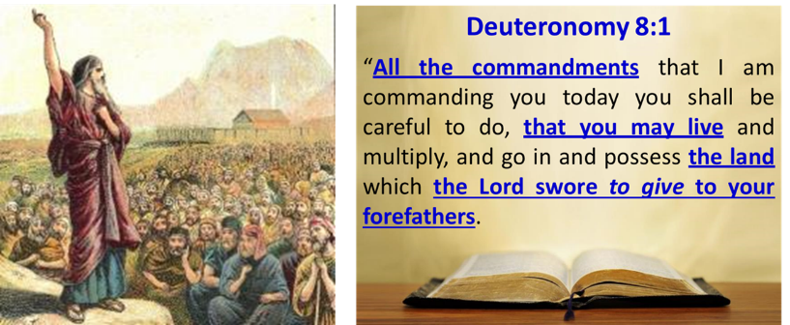
Law & Grace: Lesson 11 Review
The Law of Moses was given to Israel!
Deuteronomy 8:1
We also pointed out that many places in the Law of Moses state or imply that it was intended to be lived out only by the people of Israel, in the land of Israel, as first promised by God to Abraham.

Slide 17
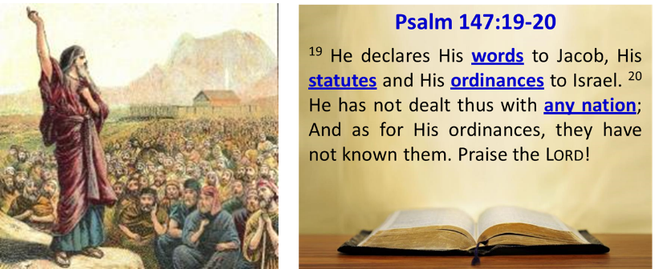
Law & Grace: Lesson 11 Review
The Law of Moses was given to Israel!
Psalm 147:19-20
The Law of Moses - all 613 of the laws, ordinances, statutes and judgments – was intended for the people of Israel and no one else! Their obedience would determine their blessings or curses.

Slide 18
Law & Grace: Lesson 11 Review
Picking and Choosing - no biblical basis!
The Law of Moses was never intended to be arbitrarily or haphazardly obeyed – not by Israel nor by any other person or group!
Numbers 15:39, 40 (“all, “all”)
Deuteronomy 4:6, 7, 8 (“all”, “the whole law”)
Deuteronomy 5:31, 33 (“all, “all”)
Deuteronomy 8:1 (“all”)
Deuteronomy 11:8, 32 (“Every”, “all”)

Slide 19
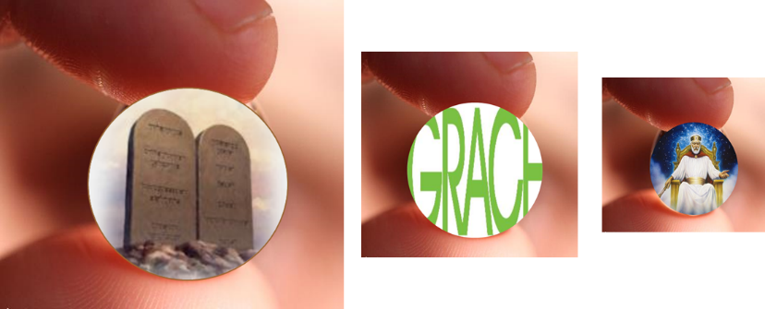
Law & Grace: Lesson 11 Review
Picking and Choosing - no biblical basis!
A paired down, Mini-Law leads to a paired down Mini-Grace and ultimately a paired down Mini-God, who is not the God of the Bible.

Slide 20
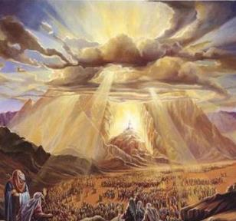
Law & Grace: Lesson 11 Review
What God intended
God intended for the Law of Moses to reflect His infinite moral character and that it should be so awesome and overwhelming that we would recognize our ultimate desperation for God’s even more amazing and very awesome grace!

Slide 21
Law & Grace: Lesson 11 Review

Slide 22
Session 12 Outline
Review
Purpose, Aim, and Objective
Session 11
The Law and Laws – The Whole Enchilada Part 2 (Galatians 5:2-4; James 2:10-11)
Comments & Commentary
Concluding Observations

Slide 23
Law & Grace: Lesson 12 The Law and Laws – The Whole Enchilada Part 2

Slide 24
Key insights from The New Testament Galatians 5:2-4; James 2:10-11
Law & Grace: Lesson 12 The Law and Laws – The Whole Enchilada Part 2
The New Testament not only supports what we have seen already in the Law of Moses, but it also provides astounding perspectives on the nature of the Law of Moses.

Slide 25
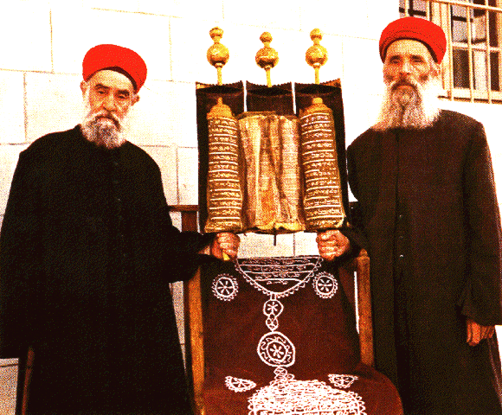
Key insights from The New Testament Galatians 5:2-4; James 2:10-11
Law & Grace: Lesson 12 The Law and Laws – The Whole Enchilada Part 2
In addition to the direct and repeated exhortation of the Old Testament to follow all the laws, the New Testament makes the Law of Moses a completely inseverable, indivisible, whole.

Slide 26
Galatians 5:2-4
² Behold I, Paul, say to you that if you receive circumcision, Christ will be of no benefit to you. ³ And I testify again to every man who receives circumcision, that he is under obligation to keep the whole Law. ⁴ You have been severed from Christ, you who are seeking to be justified by law; you have fallen from grace.

Slide 27
The Poetic Pattern in Galatians 5:2-4
Law & Grace: Lesson 12 The Law and Laws – The Whole Enchilada Part 2
² Behold I, Paul,
say to you that
if you receive circumcision,
Christ will be of no benefit to you.
³ And I testify again
to every man who receives circumcision, that
he is under obligation
to keep the whole Law.
⁴ You have been severed from Christ,
you who are seeking to be justified by law;
you have fallen from grace.

Slide 28
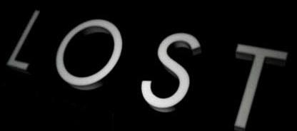
Galatians 5:2-4 is not a ‘loss of salvation’ passage
Law & Grace: Lesson 12 The Law and Laws – The Whole Enchilada Part 2
The Bible is very clear: A believer’s salvation cannot be lost.

Slide 29
N.T. Greek Emphatic Negation
Law & Grace: Lesson 12 The Law and Laws – The Whole Enchilada Part 2
John 10:28 – δίδωμι αὐτοῖς ζωὴν αἰώνιον καὶ οὐ μὴ ἀπόλωνται εἰς τὸν αἰῶνα
John 10:28 – I give them eternal life, and they will perish not at all.
Emphatic negation is indicated by οὐ μή plus the aorist subjunctive… This is the strongest way to negate something in Greek….“Oὐ μή is the most decisive way of negativing something in the future.”…a soteriological theme is frequently found in such statements, especially in John: what is negatived is the possibility of the loss of salvation.
Wallace, D. B. (1996). Greek Grammar beyond the Basics: An Exegetical Syntax of the New Testament (p. 468). Grand Rapids, MI: Zondervan.

Slide 30
Galatians 5:2-4 is not a ‘loss of salvation’ passage
Law & Grace: Lesson 12 The Law and Laws – The Whole Enchilada Part 2
Galatians 5:2-4 only addresses the daily condition of one who is already saved.
Paul calls his readers, “brethren” nine times in the letter to the Galatians, both before and after this passage (cf. Gal. 1:11; 2:4; 3:15; 4:12, 28, 31; 5:11, 13; 6:1, 18).

Slide 31
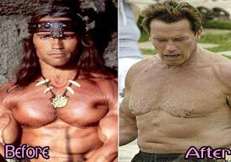
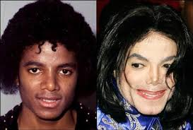
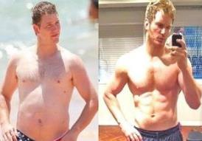
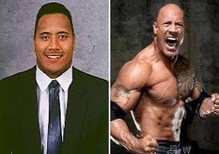
Law & Grace: Lesson 12 The Law and Laws – The Whole Enchilada Part 2
Before & After Galatians 5:2-4

Slide 32
Galatians 5:2-4 is not a ‘loss of salvation’ passage
Law & Grace: Lesson 12 The Law and Laws – The Whole Enchilada Part 2

Slide 33
Law & Grace: Lesson 12 The Law and Laws – The Whole Enchilada Part 2
Using circumcision as an example
Using circumcision as an example, the apostle Paul is here telling us that if any-one is intent on following one of the Laws of Moses, then he must follow every single law – the whole law!

Slide 34
Law & Grace: Lesson 12 The Law and Laws – The Whole Enchilada Part 2
Using circumcision as an example
There can be no mistake, the Apostle Paul makes it clear for us that a person cannot sign up to follow just one of or some select part of the Law of Moses.
Mix & Match

Slide 35
Law & Grace: Lesson 12 The Law and Laws – The Whole Enchilada Part 2
Using circumcision as an example
If we choose any part to follow, we are obligated to all.
This is principle #1

Slide 36
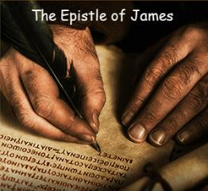
James 2:10-11
¹⁰ For whoever keeps the whole law and yet stumbles in one point, he has become guilty of all. ¹¹ For He who said, “Do not commit adultery,” also said, “Do not commit murder.” Now if you do not commit adultery, but do commit murder, you have become a transgressor of the law.

Slide 37
Law & Grace: Lesson 12 The Law and Laws – The Whole Enchilada Part 2
The poetic pattern in James 2:10-11
¹⁰ For whoever keeps the whole law
and yet stumbles in one point,
he has become guilty of all.
¹¹ For He who said,
"Do not commit adultery,“
also said,
"Do not commit murder."
Now if you
do not commit adultery, but
do commit murder,
you have become a transgressor of the law.

Slide 38
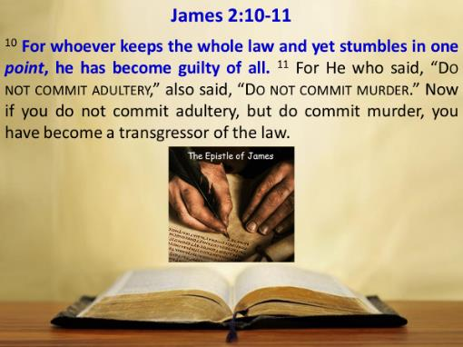
Law & Grace: Lesson 12 The Law and Laws – The Whole Enchilada Part 2
The Law of Moses offers no ‘partial credit’
James 2:10-11
James spells out principle # 2 in verse 10 - that those who wish to follow the Law of Moses must follow every single part of it - perfectly.

Slide 39
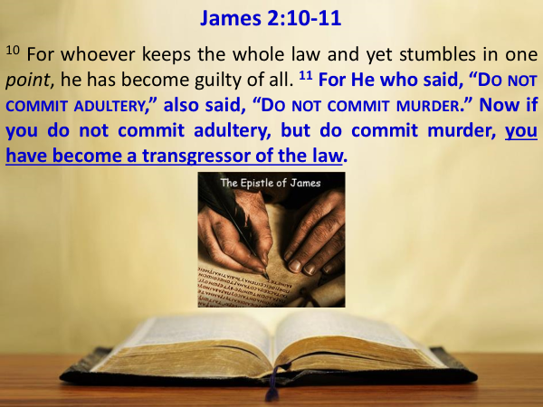
Law & Grace: Lesson 12 The Law and Laws – The Whole Enchilada Part 2
The Law of Moses offers no ‘partial credit’
James 2:10-11
Breaking any single part of the Law of Moses breaks the whole Law of Moses!

Slide 40
Law & Grace: Lesson 12 The Law and Laws – The Whole Enchilada Part 2
The Law of Moses offers no ‘partial credit’
James 2:10-11
Principle #1 – Once you’ve placed yourself under any portion of the Law, you’ve signed up for the whole thing.
Principle #2 – Once you’ve placed yourself under any portion of the Law, breaking even one, means you are guilty of breaking the entire Law!
The Law of Moses offers no partial credit! Under the Law of Moses 100% is an A, but anything less than 100% is an F!

Slide 41
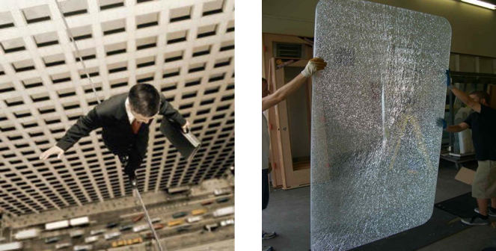
Law & Grace: Lesson 12 The Law and Laws – The Whole Enchilada Part 2
All perfection all the time
James 2:10-11
The Law of Moses requires absolute perfection on every point of the Law all the time to the end of one’s time.

Slide 42
Law & Grace: Lesson 12 The Law and Laws – The Whole Enchilada Part 2
All perfection all the time
James 2:10-11
I live by the 10 Commandments!
Anyone who picks which of the laws he will follow is deciding that he will break all of the ones he isn’t going to follow – the Law is broken.

Slide 43
Law & Grace: Lesson 12 The Law and Laws – The Whole Enchilada Part 2
All perfection all the time
James 2:10-11
The Seventh-day Adventist doctrinal statement – Living The Law of God
“The great principles of God’s law are embodied in the Ten Commandments and exemplified in the life of Christ. They express God’s love, will, and purposes concerning human conduct and relationships and are binding upon all people in every age.”
https://www.adventist.org/en/beliefs/living/the-law-of-god/

Slide 44
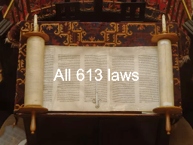
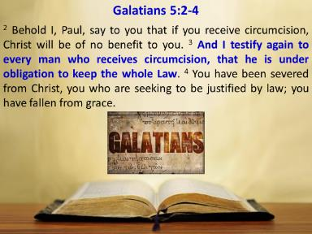
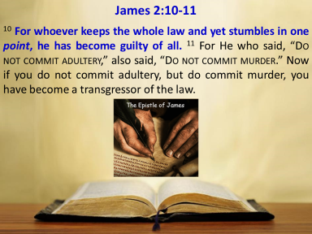
Law & Grace: Lesson 12 The Law and Laws – The Whole Enchilada Part 2
All perfection all the time
James 2:10-11

Slide 45
Law & Grace: Lesson 12 The Law and Laws – The Whole Enchilada Part 2
All perfection all the time
James 2:10-11
To summarize here, the Bible says:
to live by the law of Moses you’ve got to live out all of the law without fail!
If you sign up for one you have signed up for all of them! If you break one, you break all 613 laws!

Slide 46
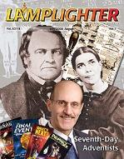
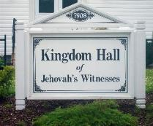
Law & Grace: Lesson 12 The Law and Laws – The Whole Enchilada Part 2
Tweaking the Law
What about those who want to tweak the law by adding to, or taking away, from the Law of Moses?

Slide 47
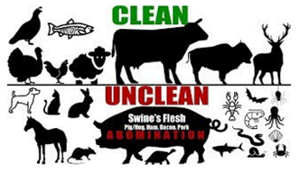
Mark 7:18–19
¹⁸ And He said to them, “Are you so lacking in understanding also? Do you not understand that whatever goes into the man from outside cannot defile him, ¹⁹ because it does not go into his heart, but into his stomach, and is eliminated?” (Thus He declared all foods clean.)

Slide 48
Romans 14:2–3, 17
² One person has faith that he may eat all things, but he who is weak eats vegetables only. ³ The one who eats is not to regard with contempt the one who does not eat, and the one who does not eat is not to judge the one who eats, for God has accepted him…. ¹⁷ for the kingdom of God is not eating and drinking, but righteousness and peace and joy in the Holy Spirit.

Slide 49
1 Timothy 4:1–5 (NKJV)
¹ Now the Spirit expressly says that in latter times some will depart from the faith, giving heed to deceiving spirits and doctrines of demons,…³ forbidding to marry, and commanding to abstain from foods which God created to be received with thanksgiving by those who believe and know the truth. ⁴ For every creature of God is good, and nothing is to be refused if it is received with thanksgiving; ⁵ for it is sanctified by the word of God and prayer.

Slide 50
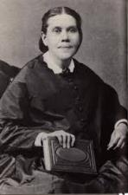
Law & Grace: Lesson 12 The Law and Laws – The Whole Enchilada Part 2
Tweaking the Law
Ellen G. White, founder of Seventh-day Adventistism writes:
“Adventists believe that unlike ceremonial or civil laws, the health laws of Deuteronomy and Leviticus are “natural laws” that are applicable for all ages and times. In other words, God told us not to eat particular foods for our own health and well-being, and we believe those foods are still unhealthy for us today.”
www.seventhdayadventistdiet.com

Slide 51
Deuteronomy 4:2
² “You shall not add to the word which I am commanding you, nor take away from it, that you may keep the commandments of the Lord your God which I command you.
Deuteronomy 12:32
“Whatever I command you, you shall be careful to do; you shall not add to nor take away from it.

Slide 52
The Law doesn’t have a problem – we do!
Law & Grace: Lesson 12 The Law and Laws – The Whole Enchilada Part 2
Some well-intentioned people who don’t understand God’s intent for the Law, will from time to time ‘badmouth’ the Law of Moses. That’s a huge mistake!
God Himself, gave the Law of Moses to Moses for the Children of Israel, and it is good and righteous and holy (cf. Rom. 7:12).

Slide 53
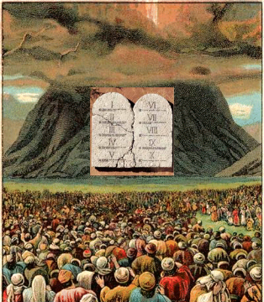
The Law doesn’t have a problem – we do!
Law & Grace: Lesson 12 The Law and Laws – The Whole Enchilada Part 2
The problem is not that the Law of Moses is deficient, but rather that human ability is insufficient to follow the Law of Moses.
The Law of Moses, which is good and righteous and holy, requires total compliance…but mankind is not up to the task of living it out.
Trying to live out the Law of Moses is a commitment to guaranteed failure.

Slide 54
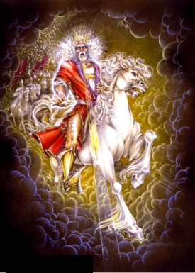
Law & Grace: Lesson 12 The Law and Laws – The Whole Enchilada Part 2
Kingdom Law will be known & lived…
God will give Millennial Israelites a new heart and put a new spirit within them, thus enabling them to live out Kingdom Law during Christ reign and Israel will be blessed as they live out Kingdom Law.

Slide 55
Ezekiel 36:27–28
²⁷ “I will put My Spirit within you and cause you to walk in My statutes, and you will be careful to observe My ordinances. ²⁸ “You will live in the land that I gave to your forefathers; so you will be My people, and I will be your God. (cf. Isa. 11:9; 54:13; Jer. 24:7; 31:34; Eze. 11:19-20; 37:14; Hab. 2:14)

Slide 56
Law & Grace: Lesson 12 The Law and Laws – The Whole Enchilada Part 2
Kingdom Law will be known & lived…
“…Kingdom Law is not a reinstitution of the Law of Moses, nor is it an intensification of the demands of the Law of Moses. On the contrary, the death of Christ has forever terminated the law so that it can never be reinstituted. In the Millennium, there will be a new body of law that can be called the Kingdom Law. Like the present Law of Christ, it will have both similarities and dissimilarities with the law of Moses. And, like the Law of Moses, it will be a product of God’s grace.”
Fruchtenbaum, A. G. (1994). Israelology: the missing link in systematic theology (Rev. ed., pp. 554–555). Tustin, CA: Ariel Ministries.

Slide 57
Law & Grace: Lesson 12 The Law and Laws – The Whole Enchilada Part 2
Kingdom Law will be known & lived…
“…These three chapters of Ezekiel (44-46) are concerned with the various laws regulating the millennial system of priesthood and sacrifice. To summarize, there will be a sacrificial system instituted in the Millennium that will have some features similar to the Mosaic system, along with some new laws. For that very reason, the sacrificial system of the Millennium must not be viewed as a reinstitution of the Mosaic system, because it is not. It will be a new system that will contain some things old and some things new and will be instituted for an entirely different purpose.
Fruchtenbaum, A. G. (1994). Israelology: the missing link in systematic theology (Rev. ed., p. 810). Tustin, CA: Ariel Ministries.

Slide 58
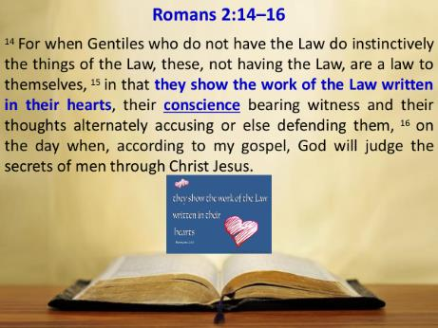
Law & Grace: Lesson 12 The Law and Laws – The Whole Enchilada Part 2
Christians have the law written on their hearts?

Slide 59
Law & Grace: Lesson 12 The Law and Laws – The Whole Enchilada Part 2
The law written on their hearts?
Romans 2:12–16
Note, first, that the {Gentiles} do not at all have law, that is, external Divine enactment. Next, they {Gentiles} are by their moral constitution, not by external enactments, [a]“law to their very selves.” Being such ones, as show out [by their actions] the work (of the law) written in their hearts—Here, note most carefully that it is not the Law that is written, for the word “written” agrees grammatically with “the work.” It is a work that is written by God in the constitution of these {Gentiles} whom He has “suffered to walk in their own ways” (Acts 14:16)…. God is describing how He has constituted all men: there is a “work” within them, making them morally conscious.
Newell, W. R. (n.d.). Romans Verse-by-Verse (p. 44). Grand Rapids, MI: Christian Classics Ethereal Library.

Slide 60
Law & Grace: Lesson 12 The Law and Laws – The Whole Enchilada Part 2
The law written on their hearts?
Romans 2:12–16
It is not the actual Mosaic Law which is written within the heart of [lost] Gentiles. It is rather an inner law that is written within the heart of every-man – a witness that guides [lost] Gentiles to know what is right and to know what is wrong…for we read that when [lost] Gentiles who don’t have the Law do instinctively the things that the Law commands – they demonstrate that they are a law to themselves – by following their conscience – for good or for evil.
http://www.knowing-jesus.com/romans-2-15/

Slide 61
Law & Grace: Lesson 12 The Law and Laws – The Whole Enchilada Part 2
The law written on their hearts?
Romans 2:12–16
Paul did not mean that Gentiles are indifferent to any law except what they invent in their own self-interest. He meant that they have a law that is instinctive, namely an intuitive perception of what is right and what is wrong. All people have this.
Constable, T. (2003). Tom Constable’s Expository Notes on the Bible (Ro 2:12). Galaxie Software.

Slide 62
Jeremiah 31:34
“They will not teach again, each man his neighbor and each man his brother, saying, ‘Know the Lord,’ for they will all know Me, from the least of them to the greatest of them,” declares the Lord, “for I will forgive their iniquity, and their sin I will remember no more.”

Slide 63
Session 12 Outline
Review
Purpose, Aim, and Objective
Session 11
The Law and Laws – The Whole Enchilada Part 2 (Galatians 5:2-4; James 2:10-11)
Comments & Commentary
Concluding Observations

Slide 64
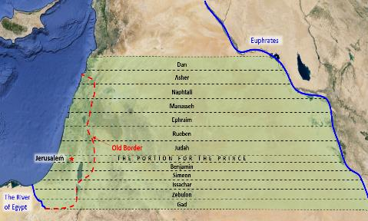
Law & Grace: Lesson 12 The Law and Laws – The Whole Enchilada Part 2
The law written on their hearts!
Jeremiah 31:33–34
God has solved the question of man’s inability to live out the good, and righteous, and holy law, by addressing it uniquely with reference to national Israel during the millennium, by enabling and empowering national Israel to know and live out Kingdom law.

Slide 65
Law & Grace: Lesson 12 The Law and Laws – The Whole Enchilada Part 2
But for us in the body of Christ…
God has solved the question of man’s inability to live out the good, and righteous, and holy law, by addressing it uniquely with reference to the Church.
Believers correctly believe and teach that when Christ died on the cross, He died for our sins, and that is very true, but that’s not all that happened that day…

Slide 66
Law & Grace: Lesson 12 The Law and Laws – The Whole Enchilada Part 2
But for us in the body of Christ…
…by faith God identified us with Christ in His death!
One result of our identification with Christ in His death, is that we died in relationship to the Law of Moses!
Another result of our identification with Christ in His death is that we are now enabled by the indwelling Holy Spirit, to live out, NOT THE LAW, but THE LIFE OF CHRIST.

Slide 67
Law & Grace: Lesson 12 The Law and Laws – The Whole Enchilada Part 2
But for us in the body of Christ…
Christ’s sacrifice of Himself on the Cross satisfied all the divine requirements of the Law of Moses and...
Christ’s imputed righteousness fulfilled all the divine requirements of the Law of Moses and…
It did so without placing us under the Law of Moses!

Slide 68
Law & Grace: Lesson 12 The Law and Laws – The Whole Enchilada Part 2
But for us in the body of Christ…
God’s design and intention presently for the Body of Christ, is that we would be blessed apart from any part of the Law of Moses, in Christ. (Eph. 1:3)

Slide 69
Ephesians 1:3; 4:25, 28
^{1:3} Blessed be the God and Father of our Lord Jesus Christ, who has blessed us with every spiritual blessing in the heavenly places in Christ… ^{4:25} Therefore, laying aside falsehood… ²⁸ He who steals must steal no longer…

Slide 70
Law & Grace: Lesson 12 The Law and Laws – The Whole Enchilada Part 2
But for us in the body of Christ…
It is by Christ’s life and His righteousness that we are to live out the life that God desires.
That life is not lived out by seeking in our own sufficiency, to live out any part of the Law of Moses. It’s all by grace.

Slide 71
Romans 5:18-21
¹⁸ So then as through one transgression there resulted condemnation to all men, even so through one act of righteousness there resulted justification of life to all men. ¹⁹ For as through the one man’s disobedience the many were made sinners, even so through the obedience of the One the many will be made righteous. ²⁰ The Law came in so that the transgression would increase; but where sin increased, grace abounded all the more, ²¹ so that, as sin reigned in death, even so grace would reign through righteousness to eternal life through Jesus Christ our Lord.

Slide 72
Law & Grace: Lesson 12 The Law and Laws – The Whole Enchilada Part 2
The bad/good news pattern: Romans 5:18-21
¹⁸ So then as through one transgression
there resulted condemnation to all men, even so
through one act of righteousness
there resulted justification of life to all men.
¹⁹ For as through the one man's disobedience
the many were made sinners, even so
through the obedience of the One
the many will be made righteous.
²⁰ The Law came in so that
the transgression would increase;
but where sin increased,
grace abounded all the more,
²¹ so that as sin reigned in death, even so
grace would reign through righteousness
to eternal life through Jesus Christ our Lord.

Slide 73
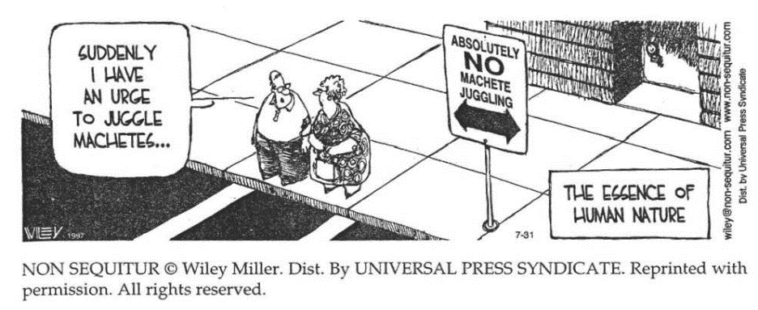
Law & Grace: Lesson 12 The Law and Laws – The Whole Enchilada Part 2
The bad/good news pattern: Romans 5:18-21

Slide 74
Law & Grace: Lesson 12 The Law and Laws – The Whole Enchilada Part 2
The bad/good news pattern: Romans 5:18-21
¹⁸ So then as through one transgression
there resulted condemnation to all men, even so
through one act of righteousness
there resulted justification of life to all men.
¹⁹ For as through the one man's disobedience
the many were made sinners, even so
through the obedience of the One
the many will be made righteous.
²⁰ The Law came in so that
the transgression would increase;
but where sin increased,
grace abounded all the more,
²¹ so that as sin reigned in death, even so
grace would reign through righteousness
to eternal life through Jesus Christ our Lord.

Slide 75
Law & Grace: An Overview Jim McGowan, Th.D. Sugar Land Bible Church 10-14-2018
…but grace & truth were realized through Jesus Christ - John 1:17
For the Law was given through Moses…
Special thanks to Dr. Vern Peterman for access to his insights and resources.

