Slide 1
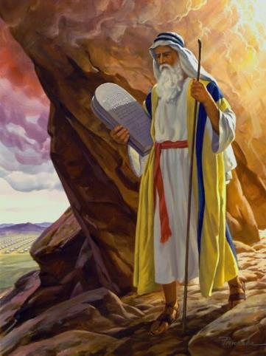
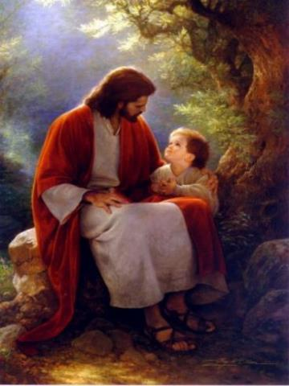
Law & Grace: An Overview Jim McGowan, Th.D. Sugar Land Bible Church 08-05-2018
…but grace & truth were realized through Jesus Christ - John 1:17
For the Law was given through Moses…
Special thanks to Dr. Vern Peterman for access to his insights and resources.

Slide 2
Session 10 Outline
Review
Purpose, Aim, and Objective
Session 9
Gods Talking to You but that’s Not Good - Part 2 (Numbers 22-24)
General Information
Comments & Commentary
Comparisons & Contrasts
Conclusion

Slide 3
Session 10 Outline
Review
Purpose, Aim, and Objective
Session 9
Gods Talking to You but that’s Not Good - Part 2 (Numbers 22-24)
General Information
Comments & Commentary
Comparisons & Contrasts.
Conclusion

Slide 4
OUR PURPOSE, AIM AND OBJECTIVE
Law & Grace
…is to Compare and Contrast Law and Grace so as to properly understand these two important themes and how they are related to the life of the New Testament Believer.

Slide 5
C. I. SCOFIELD, D. D.
The Grace of God, The Fundamentals Vol. 3, Chapter VII, p. 98
We have, most of us, been reared and now live under the influence of Galatianism. Protestant theology, alas, is for the most part, thoroughly Galatianized, in that neither law nor grace are given their distinct and separated places, as in the counsels of God, but are mingled together in one incoherent system.
The law is no longer, as in the Divine intent, a ministration of death (2 Cor. 3:7), of cursing (Gal. 3:10), of conviction (Rom. 3:19), because we are taught that we must try to keep it, and that by Divine help we may.
Nor, on the other hand, does grace bring us blessed deliverance from the dominion of sin, for we are kept under the law as a rule of life despite the plain declaration, “Sin shall not have dominion over you: for ye are not under the law, but under grace” (Rom. 6:14). (emphasis mine)

Slide 6
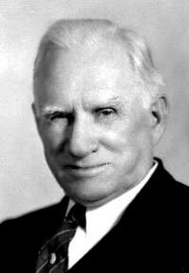
William R. Newell
Romans Verse-by-Verse (p. 274).
Grand Rapids, MI: Christian Classics Ethereal Library.
It is because Reformed theology has kept us Gentiles under the Law,—if not as a means of righteousness, then as “a rule of life,” that all the trouble has arisen. The Law is no more a rule of life than it is a means of righteousness. Walking in the Spirit has now taken the place of walking by ordinances. God has another principle under which He has put his saints: “Ye are not under law, but, under grace!” (italics mine)

Slide 7
Session 10 Outline
Review
Purpose, Aim, and Objective
Session 9
Gods Talking to You but that’s Not Good - Part 2 (Numbers 22-24)
General Information
Comments & Commentary
Comparisons & Contrasts.
Conclusion

Slide 8
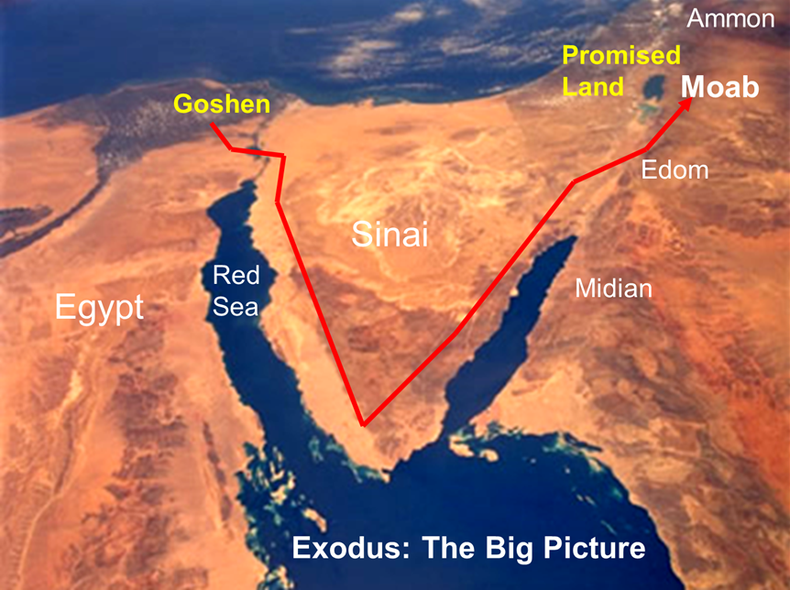
Law & Grace: Lesson 9 Review

Slide 9
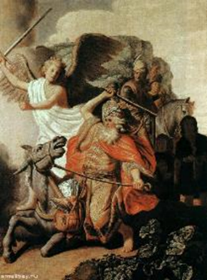
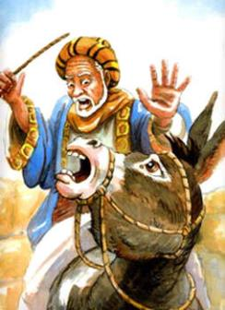
Numbers 22:28
…And the LORD opened the mouth of the donkey, and she said to Balaam, “What have I done to you, that you have struck me these three times?”

Slide 10
Law & Grace: Lesson 9 Review
Important Archaeological Discovery
An ancient text found at Tell Deir Alla, Jordan, in 1967 tells about the activities of a pagan soothsayer named Balaam. Three times in the first four lines he is referred to as "Balaam son of Beor," exactly as in the Bible.
It is clear that Balaam was a real person who operated on the east side of the Jordan River. He was known as a cursing pagan soothsayer and continued to be revered hundreds of years after his death.

Slide 11
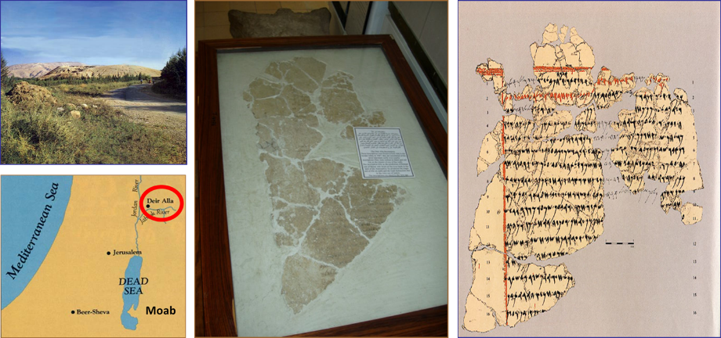
Law & Grace: Lesson 9 Review
Important Archaeological Discovery
Deir Alla, where the Balaam inscription was found in 1967
Three times: “Balaam, son of Beor”

Slide 12
Law & Grace: Lesson 9 Review
Balaam a distant relative of Abraham - Probably
Numbers 22:1-6
Because it seems a bit unlikely that the Moabite king Balak sent all the way to Assyria for a prophet, and that Balaam hence came all the way to Canaan on a donkey (although there was plenty traffic between these locations) scholars have been looking for ways to place him closer.
In 1989 a tablet was found at the same location (Tell Deir Alla), which seemed to bear the name Pethor. Many conclude that the Two Rivers mentioned in Deuteronomy 23:4 may very well refer to the Jabbok and the Jordan.
(http://www.abarim-publications.com/Meaning/Pethor.html#.Wy_NkSBOnD5)

Slide 14
Session 10 Outline
Review
Purpose, Aim, and Objective
Session 9
Gods Talking to You but that’s Not Good - Part 2 (Numbers 22-24)
General Information
Comments & Commentary
Comparisons & Contrasts.
Conclusion

Slide 15
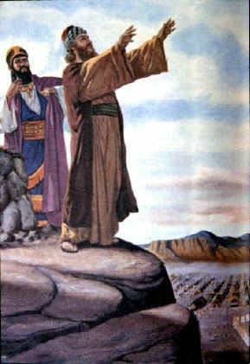
Law & Grace: Lesson 10 Gods Talking to You but that’s Not Good - Part 2
Passages addressing Balaam in the Old Testament
Numbers 22-24 – Balak king of Moab hires Balaam to curse Israel
Numbers 31:8, 16 – Balaam’s treachery revealed, and his death recorded
Deuteronomy 23:4-5 – Brief summary of Numbers 22-24.
Joshua 13:22; 24:9, 10 – Brief summary of Numbers 22-24

Slide 16
Law & Grace: Lesson 10 Gods Talking to You but that’s Not Good - Part 2
Passages addressing Balaam in the Old Testament
Micah 6:5 – A call to remember Numbers 22-24
Nehemiah 13:2 – Brief summary of Numbers 22-24

Slide 17
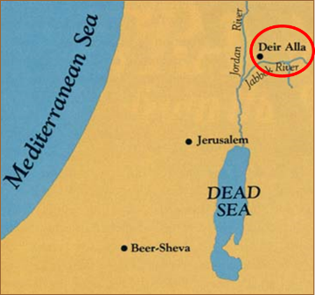
Law & Grace: Lesson 10 Gods Talking to You but that’s Not Good - Part 2
Balaam Scriptural Timeline
1500 1000 500 <BC 0 AD>
Micah 6:5
Deir Alla Inscription
Numbers 22-24
Numbers 31:8, 16 Deuteronomy 23:4, 5 Joshua 13:22
Joshua 24:9, 10

Slide 18
Law & Grace: Lesson 10 Gods Talking to You but that’s Not Good - Part 2
Balaam Scriptural Timeline
1500 1000 500 <BC 0 AD>
Micah 6:5
Deir Alla Inscription
Numbers 22-24
Numbers 31:8, 16 Deuteronomy 23:4, 5 Joshua 13:22
Joshua 24:9, 10
Nehemiah 13:2

Slide 19
Law & Grace: Lesson 10 Gods Talking to You but that’s Not Good - Part 2
Books addressing Balaam in the New Testament
2 Peter 2:15
Jude 11
Revelation 2:14

Slide 20
Law & Grace: Lesson 10 Gods Talking to You but that’s Not Good - Part 2
Balaam Scriptural Timeline
1500 1000 500 <BC 0 AD>
Micah 6:5
Deir Alla Inscription
Numbers 22-24
Numbers 31:8, 16 Deuteronomy 23:4, 5 Joshua 13:22
Joshua 24:9, 10
Nehemiah 13:2
2 Peter 2:15
Jude 11
Revelation 2:14

Slide 21
Session 10 Outline
Review
Purpose, Aim, and Objective
Session 9
Gods Talking to You but that’s Not Good - Part 2 (Numbers 22-24)
General Information
Comments & Commentary
Comparisons & Contrasts.
Conclusion

Slide 22
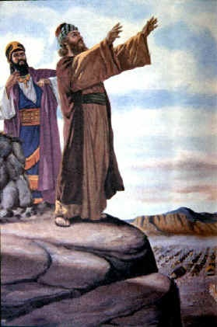
Applicable Principles under both Law and Grace
Law & Grace: Lesson 10 Gods Talking to You but that’s Not Good - Part 2
Though Law and Grace stand in contrast, the spiritual principles compare very well.
So the lessons involving Balaam, who came to the people of Israel, who were baptized into Moses and under a covenant of Law, apply to us, too!

Slide 23
Balaam’s errant spirituality is revealed
Law & Grace: Lesson 10 Gods Talking to You but that’s Not Good - Part 2
2 Peter 2:15, Jude 11 and Revelation 2:14 each bring a focus on some aspect of Balaam’s errant spirituality.

Slide 24
False teachers in 2 Peter 2:15
…forsaking the right way, they have gone astray, having followed the way of Balaam, the son of Beor, who loved the wages of unrighteousness…

Slide 25
The Way of Balaam 2 Peter 2:15
Law & Grace: Lesson 10 Gods Talking to You but that’s Not Good - Part 2
Balaam’s way was to hire himself out for ‘religious’ or ‘spiritual’ work, in this case to curse the Israelites, so as to override God’s own blessings of the people of Israel.

Slide 26
The Way of Balaam 2 Peter 2:15
Law & Grace: Lesson 10 Gods Talking to You but that’s Not Good - Part 2
God’s blessings and curses should not be thought of as something that can be manipulated for any price.
Money carried more weight with Balaam than spiritual principles.

Slide 27
So what was Balaam’s problem? 2 Peter 2:15
Law & Grace: Lesson 10 Gods Talking to You but that’s Not Good - Part 2
Balaam founded his faith in his own feelings: he was drawn by a love of money above all else. (cf. 1 Tim. 3:3; 6:10)
It was a heart attachment to money that really motivated him.

Slide 28
So what was Balaam’s problem? 2 Peter 2:15
Law & Grace: Lesson 10 Gods Talking to You but that’s Not Good - Part 2
Consistent spiritual growth, spiritual maturity, and spiritual victory is founded and grounded upon faith in the spiritual facts which have been revealed in God’s Word.
Feelings and/or values not founded and grounded upon the spiritual facts revealed in God’s Word hinder these things.

Slide 29
Our culture teaches us:
Law & Grace: Lesson 10 Gods Talking to You but that’s Not Good - Part 2
Faith (Belief, Trust)

Slide 30
Our culture teaches us:
Law & Grace: Lesson 10 Gods Talking to You but that’s Not Good - Part 2
Faith (Belief, Trust)
Feelings & Experiences

Slide 31
Biblical Faith is Founded in Facts:
Law & Grace: Lesson 10 Gods Talking to You but that’s Not Good - Part 2
Faith (Belief, Trust)

Slide 32
Biblical Faith is Founded in Facts:
Law & Grace: Lesson 10 Gods Talking to You but that’s Not Good - Part 2
Faith (Belief, Trust)
Spiritual Facts as Revealed

Slide 33
Biblical Faith is Founded in Facts:
Law & Grace: Lesson 10 Gods Talking to You but that’s Not Good - Part 2
Feelings
Faith (Belief, Trust)
Spiritual Facts as Revealed

Slide 34
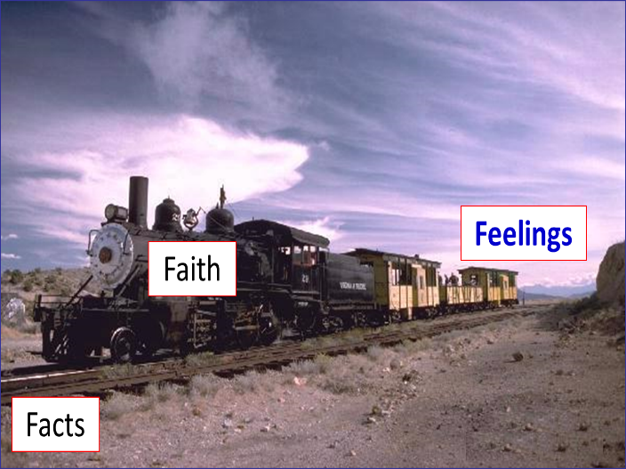
“Faith in the facts, is like the train on the tracks.”
Law & Grace: Lesson 10 Gods Talking to You but that’s Not Good - Part 2

Slide 35
Putting Feeling First leads to disaster!
Law & Grace: Lesson 10 Gods Talking to You but that’s Not Good - Part 2

Slide 36
Putting Feeling First leads to disaster!
Law & Grace: Lesson 10 Gods Talking to You but that’s Not Good - Part 2

Slide 37
False teachers in Jude 11
Woe to them! For they have gone the way of Cain, and for pay they have rushed headlong into the error of Balaam, and perished in the rebellion of Korah.

Slide 38
Law & Grace: Lesson 10 Gods Talking to You but that’s Not Good - Part 2
The Error of Balaam
Jude 11
Balaam not only had a way that was wrong, but he also had a twisted view of the relationship between people and God: he thought that God could be manipulated to fulfill human purposes.

Slide 39
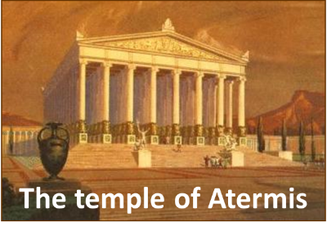
Law & Grace: Lesson 10 Gods Talking to You but that’s Not Good - Part 2
The Error of Balaam
Jude 11
In all of the pagan religions of biblical times it was quite common to think that the gods could be manipulated by sacrifices or other human favors to act and influence earthly events.

Slide 40
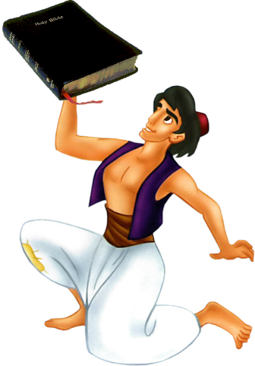
He is Lord – not me! Jude 11
Law & Grace: Lesson 10 Gods Talking to You but that’s Not Good - Part 2
Christians can get into a mindset of wanting God to do things for them or keep them out of trouble and problems, but we ought first to understand what it is God wants.

Slide 41
‘Getting Ready’ for somewhere else
Law & Grace: Lesson 10 Gods Talking to You but that’s Not Good - Part 2
As we have said before, this earth is a ‘getting ready’ kind of place.
So God is always doing things to get us ready for a life somewhere else, not based here.

Slide 42
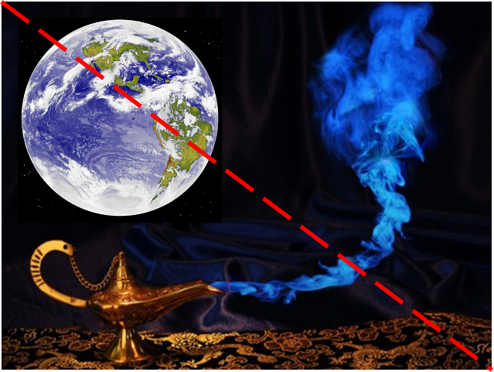
Law & Grace: Lesson 10 Gods Talking to You but that’s Not Good - Part 2
‘Getting Ready’ for somewhere else

Slide 43
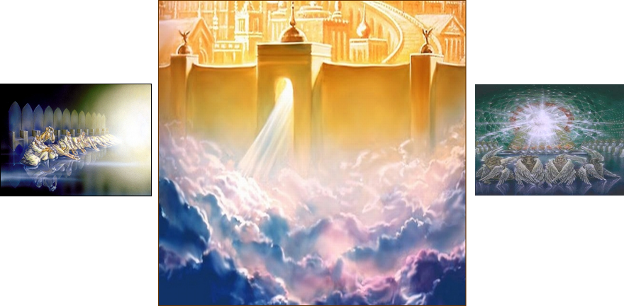
Law & Grace: Lesson 10 Gods Talking to You but that’s Not Good - Part 2
‘Getting Ready’ for somewhere else

Slide 44
Law & Grace: Lesson 10 Gods Talking to You but that’s Not Good - Part 2
He is a God of Character!
James 1:17
God is a God of infinite qualities that are not changeable.
Based on those qualities, God has done things, does things, and He will do things – including what He says He has done and will do.

Slide 45
John 3:16
“For God so loved the world, that He gave His only begotten Son, that whoever believes in Him* shall not perish, but have eternal life**.
Disclaimer:
* Evidence may or may not be supplied to support belief depending upon the Deity’s mood.
** Results are not typical. The Deity accepts no responsibility for unwanted side affects.

Slide 46
Malachi 3:6
“For I, the Lord, do not change; therefore you, O sons of Jacob, are not consumed.
Numbers 23:19
“God is not a man, that He should lie, Nor a son of man, that He should repent; Has He said, and will He not do it? Or has He spoken, and will He not make it good?
James 1:17
Every good thing given and every perfect gift is from above, coming down from the Father of lights, with whom there is no variation or shifting shadow.

Slide 47
Law & Grace: Lesson 10 Gods Talking to You but that’s Not Good - Part 2
He is a God of Character!
Ephesians 2:4-6
God loves us with a great love, and has determined to show His wealth of mercy and grace and has said so.
Any apprehension that He might do otherwise demonstrates an utter ignorance of His character and a lack of faith.

Slide 48
Ephesians 2:4-6
⁴ But God, being rich in mercy, because of His great love with which He loved us, ⁵ even when we were dead in our transgressions, made us alive together with Christ (by grace you have been saved), ⁶ and raised us up with Him, and seated us with Him in the heavenly places in Christ Jesus…

Slide 49
Law & Grace: Lesson 10 Gods Talking to You but that’s Not Good - Part 2
The Teaching of Balaam
Revelation 2:14
We have discussed the ‘Way of Balaam’ and the ‘Error of Balaam’, but the scriptures also mention the ‘Teaching of Balaam’ in Rev 2:14.

Slide 50
False teachers in Revelation 2:14
But I have a few things against you, because you have there some who hold the teaching of Balaam, who kept teaching Balak to put a stumbling block before the sons of Israel, to eat things sacrificed to idols and to commit acts of immorality.

Slide 51
Law & Grace: Lesson 10 Gods Talking to You but that’s Not Good - Part 2
The Teaching of Balaam
Revelation 2:14
As far as blessings or curses, Balaam was constrained by God to say only what God told him to say. But Balaam also told Balak how to bring the Israelites down!
Get them all to compromise with idolatry and immorality and you can gain the advantage you desire! This was the teaching of Balaam!

Slide 52
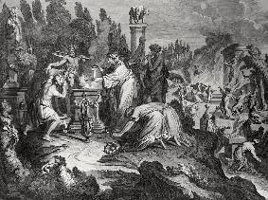
Numbers 25:1–3
¹ While Israel remained at Shittim, the people began to play the harlot with the daughters of Moab. ² For they invited the people to the sacrifices of their gods, and the people ate and bowed down to their gods. ³ So Israel joined themselves to Baal of Peor, and the Lord was angry against Israel.

Slide 53
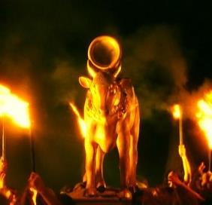
Law & Grace: Lesson 10 Gods Talking to You but that’s Not Good - Part 2
The Teaching of Balaam
Revelation 2:14
Even for us now, who are in Christ and under grace, any teaching that leads toward moral or spiritual compromise is false!
Anything that dictates how we should live or think contrary to what God has revealed in the Holy Scriptures is idolatry.

Slide 54
Law & Grace: Lesson 10 Gods Talking to You but that’s Not Good - Part 2
The Teaching of Balaam
Revelation 2:14
Physical (sexual) intimacy outside of marriage in any form is immorality (πορνεία porneía).
Worshipping other gods (like our feelings) is also immoral and spiritual compromise.

Slide 55
Session 10 Outline
Review
Purpose, Aim, and Objective
Session 9
Gods Talking to You but that’s Not Good - Part 2 (Numbers 22-24)
General Information
Comments & Commentary
Comparisons & Contrasts.
Conclusion

Slide 56
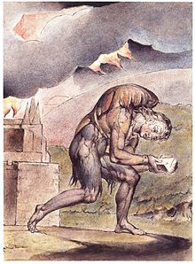
Law & Grace: Comparison & Contrast 1 MOTIVATED BY FEAR
Law & Grace: Lesson 10 Gods Talking to You but that’s Not Good - Part 2
Those living under the Principle of Law (as the Jews were under Moses) are blessed if they obey and are cursed if they don’t obey. (Deut. 28).

Slide 57
Blessings under the Law
Deuteronomy 28:1-3
¹ "Now it shall be, if you diligently obey the LORD your God, being careful to do all His commandments which I command you today, the LORD your God will set you high above all the nations of the earth. ² All these blessings will come upon you and overtake you if you obey the LORD your God: ³ Blessed shall you be in the city, and blessed shall you be in the country..."

Slide 58
Curses under the Law
Deuteronomy 28:15-16
¹⁵ "But it shall come about, if you do not obey the LORD your God, to observe to do all His commandments and His statutes with which I charge you today, that all these curses will come upon you and overtake you: ¹⁶ Cursed shall you be in the city, and cursed shall you be in the country…"

Slide 59
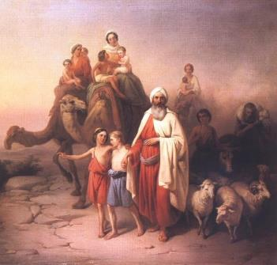
Law & Grace: Comparison & Contrast 1 MOTIVATED BY FEAR
Law & Grace: Lesson 10 Gods Talking to You but that’s Not Good - Part 2
Anyone trying to curse Israel will be cursed by God (Genesis 12:1-3).

Slide 60
Genesis 12:1-3
¹ Now the Lord said to Abram, "Go forth from your country, And from your relatives And from your father's house, To the land which I will show you; ² And I will make you a great nation, And I will bless you, And make your name great; And so you shall be a blessing; ³ And I will bless those who bless you, And the one who curses you I will curse. And in you all the families of the earth will be blessed."

Slide 61
Law & Grace: Comparison & Contrast 1 MOTIVATED BY GRACE
Law & Grace: Lesson 10 Gods Talking to You but that’s Not Good - Part 2
Believers living under the Principle of Grace are all blessed and motivated by Grace to be obedient …not out of a fear of being cursed! (Ephesians 1:1-3; 2:1-10).
Under the law you better not steal you had better not lie or you will not be blessed! But when it comes to motivation, earthly-based curses can’t touch heaven’s grace blessings.

Slide 62
Ephesians 1:3; 2:5-7
³ Blessed be the God and Father of our Lord Jesus Christ, who has blessed us with every spiritual blessing in the heavenly places in Christ,… ^{2:5} even when we were dead in our transgressions, made us alive together with Christ (by grace you have been saved), ⁶ and raised us up with Him, and seated us with Him in the heavenly places in Christ Jesus, ⁷ so that in the ages to come He might show the surpassing riches of His grace in kindness toward us in Christ Jesus.

Slide 63
Law & Grace: Lesson 10 Gods Talking to You but that’s Not Good - Part 2
Law & Grace: Comparison & Contrast 1
MOTIVATED BY GRACE
The Apostle Paul explains what our blessings are in chapters 1-3. In chapters 4-6 he deals with issues of progressive sanctification.

Slide 64
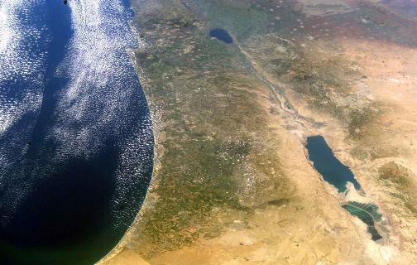
Law & Grace: Comparison & Contrast 2 EARTHLY SETTING
Law & Grace: Lesson 10 Gods Talking to You but that’s Not Good - Part 2
Under Law, the Israelites were blessed if they obeyed, and cursed if they didn’t, and the blessings and curses were all earthly.

Slide 65
Law & Grace: Comparison & Contrast 2 HEAVENLY SETTING
Law & Grace: Lesson 10 Gods Talking to You but that’s Not Good - Part 2
Under Grace, the Church is blessed whether they obey in faith or not, and the blessings are all heavenly in Christ – every single one.

Slide 66
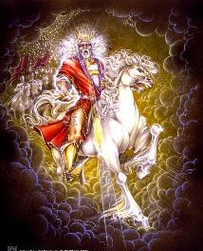
Law & Grace: Comparison & Contrast 3
Law & Grace: Lesson 10 Gods Talking to You but that’s Not Good - Part 2
The people of Israel were to live out the Mosaic Law, though they were given no enablement to do so.
However, the Holy Spirit will enable them to know and live out the kingdom law in the Millennial Kingdom.

Slide 67
Ezekiel 36:27–28
²⁷ “I will put My Spirit within you and cause you to walk in My statutes, and you will be careful to observe My ordinances. ²⁸ “You will live in the land that I gave to your forefathers; so you will be My people, and I will be your God.

Slide 68
Law & Grace: Comparison & Contrast 3
Law & Grace: Lesson 10 Gods Talking to You but that’s Not Good - Part 2
We in the body of Christ, however, are empowered to live by the life of Christ, apart from the Law, walking and living by faith in Christ and who we are in Him and who He is in us…by the Holy Spirit who indwells us (Gal. 2:19–20).

Slide 69
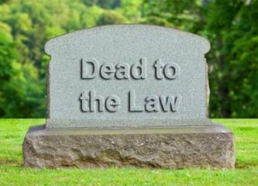
Galatians 2:19–20
¹⁹ “For through the Law I died to the Law, so that I might live to God. ²⁰ “I have been crucified with Christ; and it is no longer I who live, but Christ lives in me; and the life which I now live in the flesh I live by faith in the Son of God, who loved me and gave Himself up for me.

Slide 70
Session 10 Outline
Review
Purpose, Aim, and Objective
Session 9
Gods Talking to You but that’s Not Good - Part 2 (Numbers 22-24)
General Information
Comments & Commentary
Comparisons & Contrasts.
Conclusion

Slide 71
Take-a-ways
Law & Grace: Lesson 10 Gods Talking to You but that’s Not Good - Part 2
We are graciously empowered and enabled to live out life that God intends.
The life that God intends is only accomplished by faith in what God has revealed. It is not accomplished by waiting for the right feelings.
As God’s children, we have the power of the Holy Spirit indwelling us and all the divine riches in glory, to empower and enable and energize us, to live that life by faith.
This is all true and trustworthy because of God’s character – He cannot lie nor does He change.

Slide 72
Law & Grace: An Overview Jim McGowan, Th.D. Sugar Land Bible Church 07-15-2018
…but grace & truth were realized through Jesus Christ - John 1:17
For the Law was given through Moses…
Special thanks to Dr. Vern Peterman for access to his insights and resources.

