Slide 1

Ecclesiology
Session 26
Dr. Andy Woods
Senior Pastor – Sugar Land Bible Church
President – Chafer Theological Seminary

Slide 2


Areas of Systematic Theology
Prolegomena – Introduction
Theology – Study of God
Christology – Study of Christ
Pneumatology – Study of the Holy Spirit
Anthropology – Study of Man
Hamartiology – Study of sin
Soteriology – Study of salvation
Angelology – Study of angels
Ecclesiology – Study of the Church
Eschatology – Study of the end

Slide 3
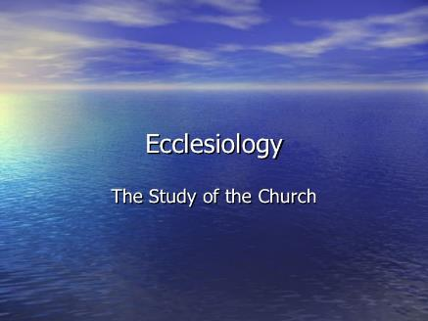
Ecclesiology Overview
Definition
Universal vs. local
Word pictures
Origin
Israel – Church differences
Intercalation
Purposes
Activities
Government
Officers
Ordinances
Purity

Slide 4

VII. Purposes of the Local Church
Glorify God (Eph 3:21)
Edify the saints (Eph 4:11-16)
Fulfill the Great Commission (Matt 28:18-20)

Slide 5
VII. Purposes of the Local Church
Glorify God (Eph 3:21)
Edify the saints (Eph 4:11-16)
Fulfill the Great Commission (Matt 28:18-20)

Slide 6

Ephesians 4:11-16
“¹¹ And He gave some as apostles, and some as prophets, and some as evangelists, and some as pastors and teachers, ¹² for the equipping of the saints for the work of service, to the building up of the body of Christ;”

Slide 7

Spiritual Gifts

Slide 8
Areas of Systematic Theology
Prolegomena – Introduction
Theology – Study of God
Christology – Study of Christ
Pneumatology – Study of the Holy Spirit
Anthropology – Study of Man
Hamartiology – Study of sin
Soteriology – Study of salvation
Angelology – Study of angels
Ecclesiology – Study of the Church
Eschatology – Study of the end

Slide 9
Four Questions
What are some general observations about spiritual gifts?
Are all the spiritual gifts for today?
What are the spiritual gifts?
How do we discover our own unique area of gifting?

Slide 10
Four Questions
What are some general observations about spiritual gifts?
Are all the spiritual gifts for today?
What are the spiritual gifts?
How do we discover our own unique area of gifting?

Slide 11
Four Questions
What are some general observations about spiritual gifts?
Are all the spiritual gifts for today?
What are the spiritual gifts?
How do we discover our own unique area of gifting?

Slide 12

The Case for Selective Cessationism
Preliminary thoughts
Four categories of gifts
  Foundational (Eph 2:20)
  Confirmatory (Heb 2:3-4)
  Revelatory (Jude 3)
  Edificatory gifts continue (Eph. 4:11-16)
Church history and selective cessationism
Proper operation of the Sign & Revelatory gifts
True source of the charismatic movement
Explanation of the Charismatic movement's popularity

Slide 13
The Case for Selective Cessationism
Preliminary thoughts
Four categories of gifts
  Foundational (Eph 2:20)
  Confirmatory (Heb 2:3-4)
  Revelatory (Jude 3)
  Edificatory gifts continue (Eph. 4:11-16)
Church history and selective cessationism
Proper operation of the Sign & Revelatory gifts
True source of the charismatic movement
Explanation of the Charismatic movement's popularity

Slide 14
12/12/4/4
Romans 12
1 Corinthians 12
1 Peter 4
Ephesians 4

Slide 15
The 7 Disputed Gifts
Apostle
Prophet
Worker of Miracles
Tongues
Interpretation of tongues
Healing
Knowledge

Slide 16
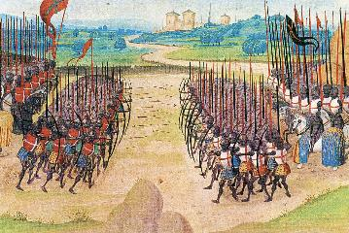
Two Camps
Charismatics – All the spiritual gifts are in operation today
Cessationists (selective)– Most of the spiritual gifts are in operation today

Slide 17
Preamble to Position Statements of SLBC Constitution
“Although agreement with the POSITION STATEMENTS is not required for membership, they are taught in this church. The POSITION STATEMENTS are not meant to prohibit honest and healthy discussions concerning what the Bible teaches about these issues; however, we believe that such discussions must be conducted under the guiding principle that believers are to strive to maintain unity.”

Slide 18
SLBC Position Statement No. 7
“TEMPORARY SPIRITUAL GIFTS – This church teaches that the miraculous sign gifts, including the gift of tongues, (always the ability to speak in a previously unlearned, known language) along with the gift of healings were temporal gifts, given by the Holy Spirit solely to authenticate both the apostles and their message before the close of the canon of Scripture (1 Cor. 13:8-10). We do not believe that these are active as gifts today. However, we affirm that God is sovereign and may heal and/or give someone the ability to speak in a tongue (foreign language) today. We believe that the majority of what is termed ‘miraculous’ within the contemporary charismatic movement is something other than the Biblical gifts of tongues or healing.”

Slide 19
The Case for Selective Cessationism
Preliminary thoughts
Four categories of gifts
  Foundational (Eph 2:20)
  Confirmatory (Heb 2:3-4)
  Revelatory (Jude 3)
  Edificatory gifts continue (Eph. 4:11-16)
Church history and selective cessationism
Proper operation of the Sign & Revelatory gifts
True source of the charismatic movement
Explanation of the Charismatic movement's popularity

Slide 20
The Case for Selective Cessationism
Preliminary thoughts
Four categories of gifts
  Foundational (Eph 2:20)
  Confirmatory (Heb 2:3-4)
  Revelatory (Jude 3)
  Edificatory gifts continue (Eph. 4:11-16)
Church history and selective cessationism
Proper operation of the Sign & Revelatory gifts
True source of the charismatic movement
Explanation of the Charismatic movement's popularity

Slide 21
The 7 Disputed Gifts
Apostle
Prophet
Worker of Miracles
Tongues
Interpretation of tongues
Healing
Knowledge

Slide 22
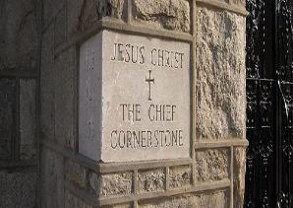
Ephesians 2:20
“having been built on the foundation of the apostles and prophets, Christ Jesus Himself being the corner stone,”

Slide 23
The Case for Selective Cessationism
Preliminary thoughts
Four categories of gifts
  Foundational (Eph 2:20)
  Confirmatory (Heb 2:3-4)
  Revelatory (Jude 3)
  Edificatory gifts continue (Eph. 4:11-16)
Church history and selective cessationism
Proper operation of the Sign & Revelatory gifts
True source of the charismatic movement
Explanation of the Charismatic movement's popularity

Slide 24
The 7 Disputed Gifts
Apostle
Prophet
Worker of Miracles
Tongues
Interpretation of tongues
Healing
Knowledge

Slide 25
Miracle Clusters In Scripture
NUM. | ERA | AUTHENTICATION
1. | Moses | Law
2. | Joshua | Conquest
3. | Elijah-Elisha | Prophet
4. | Christ | Kingdom offer
5. | Apostles | Church
6. | Tribulation & Millennium | Kingdom establishment

Slide 26
The 7 Disputed Gifts
Apostle
Prophet
Worker of Miracles
Tongues
Interpretation of tongues
Healing
Knowledge

Slide 27
Acts 2:43
“Everyone kept feeling a sense of awe; and many wonders and signs were taking place through the apostles.”

Slide 28
The 7 Disputed Gifts
Apostle
Prophet
Worker of Miracles
Tongues
Interpretation of tongues
Healing
Knowledge

Slide 29
1 Corinthians 14:21-22
“²¹ In the Law it is written, ‘By men of strange tongues and by the lips of strangers I will speak to this people, and even so they will not listen to Me,’ says the Lord. ²² So then tongues are for a sign, not to those who believe but to unbelievers; but prophecy is for a sign, not to unbelievers but to those who believe.”

Slide 30
The 7 Disputed Gifts
Apostle
Prophet
Worker of Miracles
Tongues
Interpretation of tongues
Healing
Knowledge

Slide 31
Acts 5:12, 15-16
“¹² At the hands of the apostles many signs and wonders were taking place among the people; and they were all with one accord in Solomon’s portico…¹⁵ to such an extent that they even carried the sick out into the streets and laid them on cots and pallets, so that when Peter came by at least his shadow might fall on any one of them. ¹⁶ Also the people from the cities in the vicinity of Jerusalem were coming together, bringing people who were sick or afflicted with unclean spirits, and they were all being healed.”

Slide 32

Acts 3:1-10
No prayer
No faith
Indirect
By an apostle
Instantaneous
Automatic
Undeniable
No geographical barriers
Spontaneous
Common
Universal

Slide 33
SLBC Position Statement No. 7
“TEMPORARY SPIRITUAL GIFTS – This church teaches that the miraculous sign gifts, including the gift of tongues, (always the ability to speak in a previously unlearned, known language) along with the gift of healings were temporal gifts, given by the Holy Spirit solely to authenticate both the apostles and their message before the close of the canon of Scripture (1 Cor. 13:8-10). We do not believe that these are active as gifts today. However, we affirm that God is sovereign and may heal and/or give someone the ability to speak in a tongue (foreign language) today. We believe that the majority of what is termed ‘miraculous’ within the contemporary charismatic movement is something other than the Biblical gifts of tongues or healing.”

Slide 34
James 5:14-15
“¹⁴ Is anyone among you sick? Then he must call for the elders of the church and they are to pray over him, anointing him with oil in the name of the Lord; ¹⁵ and the prayer offered in faith will restore the one who is sick, and the Lord will raise him up, and if he has committed sins, they will be forgiven him.”

Slide 35
APOSTOLIC GIFT OF HEALING | HEALING TODAY
No prayer | Prayer
Indirect | Direct
Apostles | Physicians
Instantaneous | Gradual
Common | Less common
Automatic | Non-automatic

Slide 36
Automatic Healing Today?
Scripture – Gal. 4:13; 2 Cor. 12:7-9; 1 Tim. 5:23; 2 Tim. 4:20
False guilt
False view of God
Sickness is sometimes caused by sin – John 5:14; 1 Cor. 11:30
Sickness is not always caused by sin – Job 1:1-2, 5; 2:7-8; Ps. 34:19
Theology of suffering
Healing is only guaranteed (Isa. 53:4; 1 Pet. 2:24-25) in the Eternal State – Rom. 8:22-23; Isa. 65:20; Rev. 21:4

Slide 37
Automatic Healing Today?
Scripture – Gal. 4:13; 2 Cor. 12:7-9; 1 Tim. 5:23; 2 Tim. 4:20
False guilt
False view of God
Sickness is sometimes caused by sin – John 5:14; 1 Cor. 11:30
Sickness is not always caused by sin – Job 1:1-2, 5; 2:7-8; Ps. 34:19
Theology of suffering
Healing is only guaranteed (Isa. 53:4; 1 Pet. 2:24-25) in the Eternal State – Rom. 8:22-23; Isa. 65:20; Rev. 21:4

Slide 38
Galatians 4:13-14
“¹³ but you know that it was because of a bodily illness that I preached the gospel to you the first time; ¹⁴ and that which was a trial to you in my bodily condition you did not despise or loathe, but you received me as an angel of God, as Christ Jesus Himself.”

Slide 39
1 Timothy 5:23
“No longer drink water exclusively, but use a little wine for the sake of your stomach and your frequent ailments.”

Slide 40
2 Timothy 4:20
“Erastus remained at Corinth, but Trophimus I left sick at Miletus.”

Slide 41
Automatic Healing Today?
Scripture – Gal. 4:13; 2 Cor. 12:7-9; 1 Tim. 5:23; 2 Tim. 4:20
False guilt
False view of God
Sickness is sometimes caused by sin – John 5:14; 1 Cor. 11:30
Sickness is not always caused by sin – Job 1:1-2, 5; 2:7-8; Ps. 34:19
Theology of suffering
Healing is only guaranteed (Isa. 53:4; 1 Pet. 2:24-25) in the Eternal State – Rom. 8:22-23; Isa. 65:20; Rev. 21:4

Slide 42
Galatians 4:13-14
“¹³ but you know that it was because of a bodily illness that I preached the gospel to you the first time; ¹⁴ and that which was a trial to you in my bodily condition you did not despise or loathe, but you received me as an angel of God, as Christ Jesus Himself.”

Slide 43
1 Timothy 5:23
“No longer drink water exclusively, but use a little wine for the sake of your stomach and your frequent ailments.”

Slide 44
Automatic Healing Today?
Scripture – Gal. 4:13; 2 Cor. 12:7-9; 1 Tim. 5:23; 2 Tim. 4:20
False guilt
False view of God
Sickness is sometimes caused by sin – John 5:14; 1 Cor. 11:30
Sickness is not always caused by sin – Job 1:1-2, 5; 2:7-8; Ps. 34:19
Theology of suffering
Healing is only guaranteed (Isa. 53:4; 1 Pet. 2:24-25) in the Eternal State – Rom. 8:22-23; Isa. 65:20; Rev. 21:4

Slide 45
Theology of Suffering
Sympathy – 2 Cor. 1:3-4
Christ-like character – Jas. 1:2-4
Testimony to unbelievers – John 11:4; 12:10-11
Dependence upon God – Deut. 6:10-12; 8:3; 2 Cor. 12:6-9
Prayer – Acts 12:5

Slide 46
Automatic Healing Today?
Scripture – Gal. 4:13; 2 Cor. 12:7-9; 1 Tim. 5:23; 2 Tim. 4:20
False guilt
False view of God
Sickness is sometimes caused by sin – John 5:14; 1 Cor. 11:30
Sickness is not always caused by sin – Job 1:1-2, 5; 2:7-8; Ps. 34:19
Theology of suffering
Healing is only guaranteed (Isa. 53:4; 1 Pet. 2:24-25) in the Eternal State – Rom. 8:22-23; Isa. 65:20; Rev. 21:4

Slide 47


Slide 48
Romans 8:19-23
¹⁹ “For the anxious longing of the creation waits eagerly for the revealing of the sons of God. ²⁰ For the creation was subjected to futility, not willingly, but because of Him who subjected it, in hope ²¹ that the creation itself also will be set free from its slavery to corruption into the freedom of the glory of the children of God. ²² For we know that the whole creation groans and suffers the pains of childbirth together until now. ²³ And not only this, but also we ourselves, having the first fruits of the Spirit, even we ourselves groan within ourselves, waiting eagerly for our adoption as sons, the redemption of our body.”

Slide 49
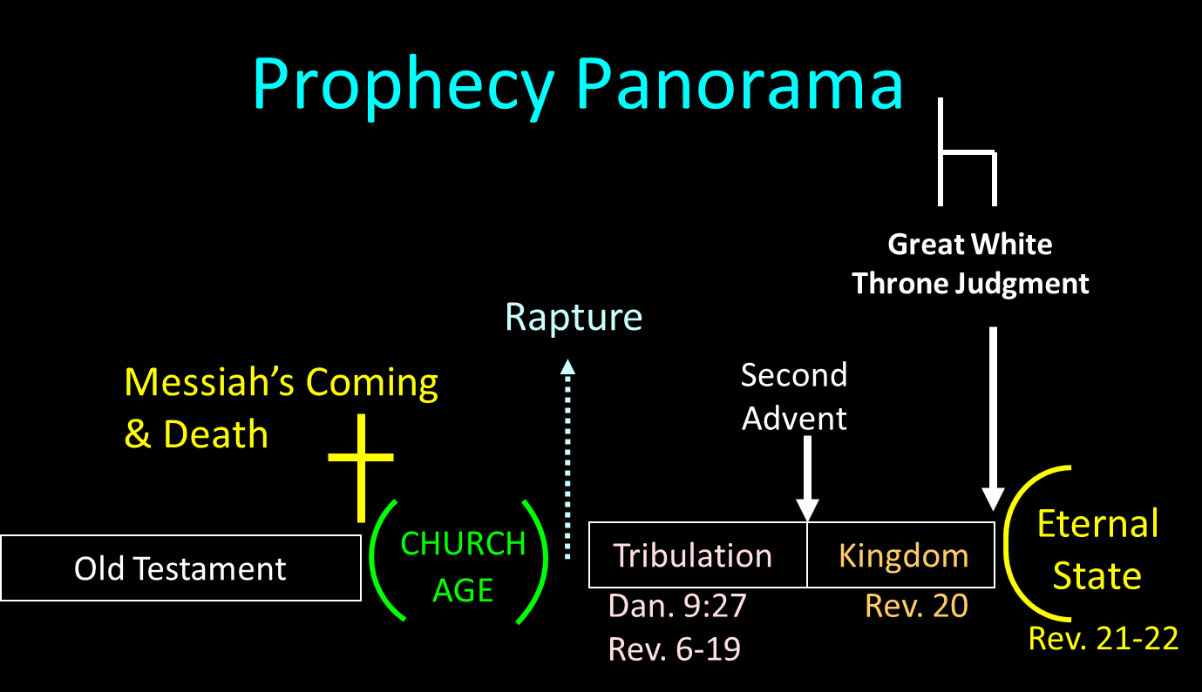

Slide 50
Millennium and Eternal State
Millennium Rev.20 | Eternal State Rev.21-22
Sin restrained | Sin removed
Curse restrained | Curse removed
Death | No death
Mortals / resurrected | Resurrected only
Destinies undecided | Destinies sealed
Renovation | Recreation
Temporary | Eternal
Transitional | Non-transitional

Slide 51
Millennium and Eternal State
 | Millennium | Eternal State
Passage | Rev 20:1-10 | Rev 21–22
Time | 20:4 | 22:5
Luminaries | Isa 30:26 | 21:23; 22:5
Temple | Ezek 40–48 | 21:22
Death | Isa 65:20 | 21:4
Satanic activity | 20:7 | 20:10
Rebellion | 20:8-9 | 21:27

Slide 52

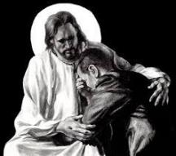
Revelation 21:4
“and He will wipe away every tear from their eyes; and there will no longer be any death; there will no longer be any mourning, or crying, or pain; the first things have passed away.”

Slide 53
The Case for Selective Cessationism
Preliminary thoughts
Four categories of gifts
  Foundational (Eph 2:20)
  Confirmatory (Heb 2:3-4)
  Revelatory (Jude 3)
  Edificatory gifts continue (Eph. 4:11-16)
Church history and selective cessationism
Proper operation of the Sign & Revelatory gifts
True source of the charismatic movement
Explanation of the Charismatic movement's popularity

Slide 54
The 7 Disputed Gifts
Apostle
Prophet
Worker of Miracles
Tongues
Interpretation of tongues
Healing
Knowledge

Slide 55
The Revelatory Gifts
Prophet (Deut. 18:18; 2 Pet. 1:20-21; Eph. 3:5; 1 Cor. 14:29-30; Acts 11:28; 21:10-11)
Knowledge (1 Cor. 13:2, 8-9; 14:6)
Tongues & Interpretation of tongues (1 Cor. 14:21-22 vs. 26-27)

Slide 56
The Revelatory Gifts
Prophet (Deut. 18:18; 2 Pet. 1:20-21; Eph. 3:5; 1 Cor. 14:29-30; Acts 11:28; 21:10-11)
Knowledge (1 Cor. 13:2, 8-9; 14:6)
Tongues & Interpretation of tongues (1 Cor. 14:21-22 vs. 26-27)

Slide 57
The Revelatory Gifts
Prophet (Deut. 18:18; 2 Pet. 1:20-21; Eph. 3:5; 1 Cor. 14:29-30; Acts 11:28; 21:10-11)
Knowledge (1 Cor. 13:2, 8-9; 14:6)
Tongues & Interpretation of tongues (1 Cor. 14:21-22 vs. 26-27)

Slide 58
1 Corinthians 13:8-10
“⁸ Love never fails; but if there are gifts of prophecy, they will be done away; if there are tongues, they will cease; if there is knowledge, it will be done away. ⁹ For we know in part and we prophesy in part; ¹⁰ but when the perfect comes, the partial will be done away.”

Slide 59
The Revelatory Gifts
Prophet (Deut. 18:18; 2 Pet. 1:20-21; Eph. 3:5; 1 Cor. 14:29-30; Acts 11:28; 21:10-11)
Knowledge (1 Cor. 13:2, 8-9; 14:6)
Tongues & Interpretation of tongues (1 Cor. 14:21-22 vs. 26-27)

Slide 60
1 Corinthians 14:21-22
“²¹ In the Law it is written, ‘By men of strange tongues and by the lips of strangers I will speak to this people, and even so they will not listen to Me,’ says the Lord. ²² So then tongues are for a sign, not to those who believe but to unbelievers; but prophecy is for a sign, not to unbelievers but to those who believe.”

Slide 61
SLBC Position Statement No. 7
“TEMPORARY SPIRITUAL GIFTS – This church teaches that the miraculous sign gifts, including the gift of tongues, (always the ability to speak in a previously unlearned, known language) along with the gift of healings were temporal gifts, given by the Holy Spirit solely to authenticate both the apostles and their message before the close of the canon of Scripture (1 Cor. 13:8-10). We do not believe that these are active as gifts today. However, we affirm that God is sovereign and may heal and/or give someone the ability to speak in a tongue (foreign language) today. We believe that the majority of what is termed ‘miraculous’ within the contemporary charismatic movement is something other than the Biblical gifts of tongues or healing.”

Slide 62
Spiritual Gifts
(1 Corinthians 12–14)
Unity (1:11; 3:22; 6; 8–10; 11:18-19; 12:25; 15:12)
Corinthians 12–14
  Many gifts for use in one Body-1 Cor. 12
  The needed emphasis of Love-1 Cor. 13
  Priority and Order-1 Cor. 14

Slide 63
Spiritual Gifts
(1 Corinthians 12–14)
Unity (1:11; 3:22; 6; 8–10; 11:18-19; 12:25; 15:12)
Corinthians 12–14
  Many gifts for use in one Body-1 Cor. 12
  The needed emphasis of Love-1 Cor. 13
  Priority and Order-1 Cor. 14

Slide 64
B. Love Emphasis (1 Cor. 13)
Necessity of love (13:1-3)
Nature of love (13:4-7)
Endurance of love (13:8-13)

Slide 65
B. Love Emphasis (1 Cor. 13)
Necessity of love (13:1-3)
Nature of love (13:4-7)
Endurance of love (13:8-13)

Slide 66
1 Corinthians 13:8-10
“⁸ Love never fails; but if there are gifts of prophecy, they will be done away; if there are tongues, they will cease; if there is knowledge, it will be done away. ⁹ For we know in part and we prophesy in part; ¹⁰ but when the perfect comes, the partial will be done away.”

Slide 67
1 Corinthians 13:11-13
“¹¹ When I was a child, I used to speak like a child, think like a child, reason like a child; when I became a man, I did away with childish things. ¹² For now we see in a mirror dimly, but then face to face; now I know in part, but then I will know fully just as I also have been fully known. ¹³ But now faith, hope, love, abide these three; but the greatest of these is love.”

Slide 68
Endurance of Love Emphasis
(1 Cor. 13:8-13)
Unlike Love, the revelatory gifts will cease (8-10)
Two illustrations (11-12)
  Immaturity to maturity (11)
  Limited to full sight (12)
Unlike love, Faith and Hope will cease (13)

Slide 69
1 Corinthians 13:8-10
“⁸ Love never fails; but if there are gifts of prophecy, they will be done away; if there are tongues, they will cease; if there is knowledge, it will be done away. ⁹ For we know in part and we prophesy in part; ¹⁰ but when the perfect [teleios] comes, the partial will be done away.”

Slide 70
Three Interpretations of “The Perfect” [teleios] in 1 Cor. 13:10
Eschaton or End
Maturity of the Church
Completion of the NT canon

Slide 71
Three Interpretations of “The Perfect” [teleios] in 1 Cor. 13:10
Eschaton or End
Maturity of the Church
Completion of the NT canon

Slide 72
SLBC Position Statement No. 7
“TEMPORARY SPIRITUAL GIFTS – This church teaches that the miraculous sign gifts, including the gift of tongues, (always the ability to speak in a previously unlearned, known language) along with the gift of healings were temporal gifts, given by the Holy Spirit solely to authenticate both the apostles and their message before the close of the canon of Scripture (1 Cor. 13:8-10). We do not believe that these are active as gifts today. However, we affirm that God is sovereign and may heal and/or give someone the ability to speak in a tongue (foreign language) today. We believe that the majority of what is termed ‘miraculous’ within the contemporary charismatic movement is something other than the Biblical gifts of tongues or healing.”

Slide 73

D. Martyn Lloyd-Jones
D. Martyn Lloyd Jones, Prove All Things, ed. Christopher Catherwood (Eastbourne, England: Kingsway, 1985), 32–33.
“It means that you and I, who have the Scriptures open before us, know much more than the apostle Paul of Gods truth...It means that we are altogether superior...even to the apostles themselves, including the apostle Paul! It means that we are now in a position which . . . ‘we know, even as we are known’ by God . . . indeed, there is only one word to describe such a view, it is nonsense.”

Slide 74
Conclusion

Slide 75
Ecclesiology Overview
Definition
Universal vs. local
Word pictures
Origin
Israel – Church differences
Intercalation
Purposes
Activities
Government
Officers
Ordinances
Purity

