Slide 1


Slide 2

The Coming Kingdom
Chapter 16
Dr. Andy Woods
Senior Pastor – Sugar Land Bible Church
President – Chafer Theological Seminary

Slide 3

Kingdom Study Outline
What does the Bible Say About the Kingdom?
The Main Problem with Kingdom Now NT interpretations
Why do some believe that we are in the kingdom now?
Why does it matter?

Slide 4
Kingdom Study Outline
What does the Bible Say About the Kingdom?
The Main Problem with Kingdom Now NT interpretations
Why do some believe that we are in the kingdom now?
Why does it matter?

Slide 5
1. Kingdom Throughout the Bible
Eden Abrahamic Covenant Mosaic Covenant Divided Kingdom Times of the Gentiles | Old Testament Prophets Post exile Offer of the King / Kingdom Rejection of the Offer Interim Age

Slide 6
1. Kingdom Throughout the Bible
Kingdom Mysteries Church Israel’s Discipline & Restoration Re-offer of the King/Kingdom | Transfer of Kingdom Authority Kingdom Establishment Eternal State Testimony of Early Church History

Slide 7
Kingdom Study Outline
What does the Bible Say About the Kingdom?
The Main Problem with Kingdom Now NT interpretations
Why do some believe that we are in the kingdom now?
Why does it matter?

Slide 8

2. The Main Problem with Kingdom Now NT interpretations
The kingdom is always earthly (Gen. 15:18-21) over a repentant Israel (Ezek. 36‒37)
The kingdom will only manifest after a time of tribulation (Jer. 30:7; Dan. 9:24-27)

Slide 9
Kingdom Study Outline
What does the Bible Say About the Kingdom?
The Main Problem with Kingdom Now NT interpretations
Why do some believe that we are in the kingdom now?
Why does it matter?

Slide 10
Response to Kingdom Now Problem Passages
Passages from Christ’s ministry
Passages from Acts
Passages from Paul
Passages from the General letters
Passages from Revelation
Miscellaneous Arguments

Slide 11
Response to Kingdom Now Problem Passages
Passages from Christ’s ministry
Passages from Acts
Passages from Paul
Passages from the General letters
Passages from Revelation
Miscellaneous Arguments

Slide 12

1. Passages from Christ’s ministry
The kingdom is at hand (Matt. 3:2)
Theirs is the kingdom (Matt. 5:3, 10)
Thy kingdom come (Matt. 6:9-13)
Seek first the kingdom (Matt. 6:33)
The kingdom suffers violence (Matt. 11:12)
Satan falls like lightning (Luke 10:18)
The kingdom has come upon you (Matt. 12:28)

Slide 13
1. Passages from Christ’s ministry
The kingdom is in your midst (Luke 17:21)
Born again to enter the kingdom (John 3:3-5)
No death until kingdom comes (Matt. 16:28)
Kingdom given to another people (Matt. 21:43)
Kingdom is not of this world (John 18:36)
All authority given to me (Matt 28:18-20)

Slide 14
1. Passages from Christ’s ministry
The kingdom is at hand (Matt. 3:2)
Theirs is the kingdom (Matt. 5:3, 10)
Thy kingdom come (Matt. 6:9-13)
Seek first the kingdom (Matt. 6:33)
The kingdom suffers violence (Matt. 11:12)
Satan falls like lightning (Luke 10:18)
The kingdom has come upon you (Matt. 12:28)

Slide 15

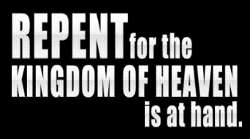
Matthew 3:1-2
“Now in those days John the Baptist came, preaching in the wilderness of Judea, saying, ‘Repent, for the kingdom of heaven is at hand (engizō).’”

Slide 16
a. The kingdom is at hand (Matt. 3:2)
Engizō (James 5:8-9)
Kingdom is undefined
Christ’s later ministry (Matt. 20:20-23; Acts 1:6-7)
Christ’s immediate presence (Deut. 17:15)

Slide 17
1. Passages from Christ’s ministry
The kingdom is at hand (Matt. 3:2)
Theirs is the kingdom (Matt. 5:3, 10)
Thy kingdom come (Matt. 6:9-13)
Seek first the kingdom (Matt. 6:33)
The kingdom suffers violence (Matt. 11:12)
Satan falls like lightning (Luke 10:18)
The kingdom has come upon you (Matt. 12:28)

Slide 18

Matthew 5:3, 10
³ “Blessed are the poor in spirit, for theirs is (eimi) the kingdom of heaven...” ¹⁰ “Blessed are those who have been persecuted for the sake of righteousness, for theirs is (eimi) the kingdom of heaven.”

Slide 19
b. Theirs is the kingdom (Matt. 5:3, 10)
Future (Matt. 5:19, 20; 6:10, 33)
Futuristic present
Kingdom undefined?
Matthew 10:5-7

Slide 20
1. Passages from Christ’s ministry
The kingdom is at hand (Matt. 3:2)
Theirs is the kingdom (Matt. 5:3, 10)
Thy kingdom come (Matt. 6:9-13)
Seek first the kingdom (Matt. 6:33)
The kingdom suffers violence (Matt. 11:12)
Satan falls like lightning (Luke 10:18)
The kingdom has come upon you (Matt. 12:28)

Slide 21
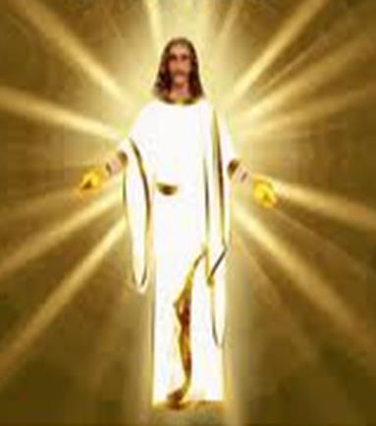
The Dispensational and Kingdom Implications of the ‘Lord’s Prayer’ In Matthew 6:9-13
Matthew 6:9-13

Slide 22
Matthew 6:9-13
“⁹ Pray, then, in this way: ‘Our Father who is in heaven, Hallowed be Your name. ¹⁰ Your kingdom come. Your will be done, On earth as it is in heaven. ¹¹ Give us this day our daily bread. ¹² And forgive us our debts, as we also have forgiven our debtors.¹³ And do not lead us into temptation, but deliver us from evil.’”

Slide 23
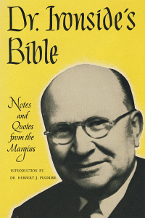
Harry Ironside
Henry Allen Ironside, Expository Notes on the Gospel of Mattthew (New York: Loizeaux, 1948), 63.
“Jesus Himself could not pray for it, for it includes a request for forgiveness of sins, and He was ever the Sinless One.”

Slide 24


Matthew’s 3-fold Purpose
To explain:
  that Jesus in whom they had believed, was the long-awaited Jewish Messiah,
  why the kingdom had been postponed despite the fact that the king had arrived, and
  the interim program of God during the kingdom’s absence.
Toussaint, Behold the King, 18-20

Slide 25

Stanley D. Toussaint
Behold the King: A Study of Matthew (Grand Rapids, Kregel, 2005), 112.
“The sample prayer, it can be concluded, is given in the context of the coming kingdom. The first three requests are petitions for the coming of the kingdom. The last three are for the needs of the disciples in the interim preceding the establishment of the kingdom.”

Slide 26

Lord’s Prayer (Matt 6:9-13)
Requests for the Kingdom to Come (9b-10)
  Hallowed be your name (9b)
  Your kingdom come (10a)
  On earth as it is in heaven (10b)
Requests for the meeting of interim needs (11-13)
  Daily bread (11)
  Forgive us as we forgive others (12)
  Deliver us from evil (13)
Toussaint, Behold the King, 107-112

Slide 27
Lord’s Prayer (Matt 6:9-13)
Requests for the Kingdom to Come (9b-10)
  Hallowed be your name (9b)
  Your kingdom come (10a)
  On earth as it is in heaven (10b)
Requests for the meeting of interim needs (11-13)
  Daily bread (11)
  Forgive us as we forgive others (12)
  Deliver us from evil (13)
Toussaint, Behold the King, 107-112

Slide 28
Lord’s Prayer (Matt 6:9-13)
Requests for the Kingdom to Come (9b-10)
  Hallowed be your name (9b)
  Your kingdom come (10a)
  On earth as it is in heaven (10b)
Requests for the meeting of interim needs (11-13)
  Daily bread (11)
  Forgive us as we forgive others (12)
  Deliver us from evil (13)
Toussaint, Behold the King, 107-112

Slide 29
Matthew 6:9-10
“⁹ Pray, then, in this way: ‘Our Father who is in heaven, Hallowed be Your name. ¹⁰ Your kingdom come. Your will be done, On earth as it is in heaven. ¹¹ Give us this day our daily bread. ¹² And forgive us our debts, as we also have forgiven our debtors.¹³ And do not lead us into temptation, but deliver us from evil.’”

Slide 30

Isaiah 29:23
“But when he sees his children, the work of My hands, in his midst, They will sanctify My name; Indeed, they will sanctify the Holy One of Jacob And will stand in awe of the God of Israel.”

Slide 31
Ezekiel 36:23
“I will vindicate the holiness of My great name which has been profaned among the nations, which you have profaned in their midst. Then the nations will know that I am the Lord,” declares the Lord God, “when I prove Myself holy among you in their sight.”

Slide 32
Lord’s Prayer (Matt 6:9-13)
Requests for the Kingdom to Come (9b-10)
  Hallowed be your name (9b)
  Your kingdom come (10a)
  On earth as it is in heaven (10b)
Requests for the meeting of interim needs (11-13)
  Daily bread (11)
  Forgive us as we forgive others (12)
  Deliver us from evil (13)
Toussaint, Behold the King, 107-112

Slide 33
Matthew 6:9-13
“⁹ Pray, then, in this way: ‘Our Father who is in heaven, Hallowed be Your name. ¹⁰ Your kingdom come. Your will be done, On earth as it is in heaven. ¹¹ Give us this day our daily bread. ¹² And forgive us our debts, as we also have forgiven our debtors.¹³ And do not lead us into temptation, but deliver us from evil.’”

Slide 34
1. Kingdom Throughout the Bible
Eden Abrahamic Covenant Mosaic Covenant Divided Kingdom Times of the Gentiles | Old Testament Prophets Post exile Offer of the King / Kingdom Rejection of the Offer Interim Age

Slide 35
1. Kingdom Throughout the Bible
Kingdom Mysteries Church Israel’s Discipline & Restoration Re-offer of the King/Kingdom | Transfer of Kingdom Authority Kingdom Establishment Eternal State Testimony of Early Church History

Slide 36

OT PROPHETS DESCRIBE THE KINGDOM
Kingdom Characteristics
Is. 2:1-4; 11:6-9; 65:17-25
  Jerusalem = center of world spiritual and political authority
  Perfect justice
  World peace
  Peace in the animal kingdom
  Universal spiritual knowledge.

Slide 37


Statue
&
Stone

Slide 38


Daniel 2:44
“In the days of those kings the God of heaven will set up a kingdom which will never be destroyed, and that kingdom will not be left for another people; it will crush and put an end to all these kingdoms, but it will itself endure forever.”

Slide 39

College of Biblical Studies
Doctrinal Statement
The imminent return of the Lord, which is the blessed hope of the Church, is to be followed in order by: the tribulation; the establishment of the reign of Christ on earth for one thousand years; the eternal state of punishment for the unsaved and the eternal state of blessing for the saved (Titus 2:13; 1 Thess. 1:10; 4:13‑18; 5:4‑10; Rev. 3:10; Matt. 24:21, 29, 30; 25:31; Rev. 20:1‑6, 11‑15; Matt. 25:46).

Slide 40

SLBC Position Statement No. 4
DISPENSATIONS - A Dispensation is a specific manner in which God governs during a particular period of time. We are a dispensational church. That is, we believe that God has chosen to administer or govern His purpose on earth through man under varying dispensations. These changes in government are a result of God’s choice, and do not indicate that His character ever changes. At least three of these dispensations are mentioned in the Bible and are the subject of extended revelation, viz.: the Dispensation of the Mosaic Law, the present Dispensation of Grace, and the future Dispensation of the Millennial Kingdom. In interpreting the Bible, we believe that these are distinct and should not be intermingled or confused.

Slide 41
Stanley D. Toussaint
Behold the King: A Study of Matthew (Grand Rapids, Kregel, 2005), 108.
Toussaint criticizes “those who with Platonic concepts subjectively spiritualize the future aspect of the kingdom of God in Christ’s teaching.”

Slide 42

Ed Glasscock
Matthew, Moody Gospel Commentary (Chicago: Moody, 1997), 147.
“It should be remembered that Jesus was teaching His disciples how to pray, and the petitioning for God to bring about His kingdom certainly indicates that the world in which we live is not yet under His rule. Jesus introduced the kingdom at His appearing (cf. Matthew 4:17) but was rejected by His own people who chose to have Caesar as their king (John 19:15). He was not declaring that the kingdom would come in the hearts of His servants but that it would exercise dominion over the whole earth (gē). Thus, even though He was the Messiah and brought the promise of the kingdom to the nation, the kingdom is still expressed in eschatological terms, ‘let it come,’ because it is not yet realized in human history since the Messiah was rejected and killed.”

Slide 43
Lord’s Prayer (Matt 6:9-13)
Requests for the Kingdom to Come (9b-10)
  Hallowed be your name (9b)
  Your kingdom come (10a)
  On earth as it is in heaven (10b)
Requests for the meeting of interim needs (11-13)
  Daily bread (11)
  Forgive us as we forgive others (12)
  Deliver us from evil (13)
Toussaint, Behold the King, 107-112

Slide 44
Matthew 6:9-13
“⁹ Pray, then, in this way: ‘Our Father who is in heaven, Hallowed be Your name. ¹⁰ Your kingdom come. Your will be done, On earth as it is in heaven. ¹¹ Give us this day our daily bread. ¹² And forgive us our debts, as we also have forgiven our debtors.¹³ And do not lead us into temptation, but deliver us from evil.’”

Slide 45
Stanley D. Toussaint
Behold the King: A Study of Matthew (Grand Rapids, Kregel, 2005), 110.
In other words, Matthew 6:10b “is an appeal for God’s sovereignty to be absolutely manifested on earth.”

Slide 46

Revelation 11:15
¹⁵ “Then the seventh angel sounded; and there were loud voices in heaven, saying, ‘The kingdom of the world has become the kingdom of our Lord and of His Christ; and He will reign forever and ever.’”

Slide 47
Lord’s Prayer (Matt 6:9-13)
Requests for the Kingdom to Come (9b-10)
  Hallowed be your name (9b)
  Your kingdom come (10a)
  On earth as it is in heaven (10b)
Requests for the meeting of interim needs (11-13)
  Daily bread (11)
  Forgive us as we forgive others (12)
  Deliver us from evil (13)
Toussaint, Behold the King, 107-112

Slide 48
Lord’s Prayer (Matt 6:9-13)
Requests for the Kingdom to Come (9b-10)
  Hallowed be your name (9b)
  Your kingdom come (10a)
  On earth as it is in heaven (10b)
Requests for the meeting of interim needs (11-13)
  Daily bread (11)
  Forgive us as we forgive others (12)
  Deliver us from evil (13)
Toussaint, Behold the King, 107-112

Slide 49

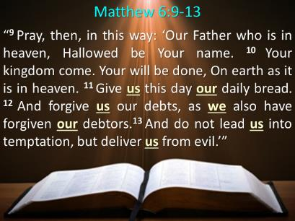
John Walvoord
Matthew: Thy Kingdom Come (Chicago: Moody, 1974), 53.
“In verse 11, the petitions are changed to the first person relating to human need.”

Slide 50
Lord’s Prayer (Matt 6:9-13)
Requests for the Kingdom to Come (9b-10)
  Hallowed be your name (9b)
  Your kingdom come (10a)
  On earth as it is in heaven (10b)
Requests for the meeting of interim needs (11-13)
  Daily bread (11)
  Forgive us as we forgive others (12)
  Deliver us from evil (13)
Toussaint, Behold the King, 107-112

Slide 51
Matthew 6:9-13
“⁹ Pray, then, in this way: ‘Our Father who is in heaven, Hallowed be Your name. ¹⁰ Your kingdom come. Your will be done, On earth as it is in heaven. ¹¹ Give us this day our daily bread. ¹² And forgive us our debts, as we also have forgiven our debtors.¹³ And do not lead us into temptation, but deliver us from evil.’”

Slide 52

Ed Glasscock
Matthew, Moody Gospel Commentary (Chicago: Moody, 1997), 148.
“According to Glasscock, ‘Bread’ was most likely used figuratively for food in general (Gen. 3:19).”

Slide 53
Amos 9:13
“Behold, days are coming,” declares the Lord,
“When the plowman will overtake the reaper
And the treader of grapes him who sows seed;
When the mountains will drip sweet wine
And all the hills will be dissolved.”

Slide 54
Isaiah 65:21-22
“²¹ They will build houses and inhabit them;
They will also plant vineyards and eat their fruit.
²² They will not build and another inhabit,
They will not plant and another eat;
For as the lifetime of a tree, so will be the days of My people, And My chosen ones will wear out the work of their hands.”

Slide 55
Zechariah 8:12
“For there will be peace for the seed: the vine will yield its fruit, the land will yield its produce and the heavens will give their dew; and I will cause the remnant of this people to inherit all these things.”

Slide 56

Matthew’s Audience
Stanley D. Toussaint, Behold the King: A Study of Matthew (Grand Rapids, Kregel, 2005), 15-18.
Jewish
  OT citations
  Five fold structure
  Jewish vocabulary
  Jewish subject matter
  Genealogy (Matt 1; Luke 3)
  Focus on Peter (Gal 2:7-8)
  Unexplained Jewish customs
  Church fathers
Believers: Eusebius, Origen

Slide 57
Divisions of Five
Toussaint, Behold the King, 15-18
Sermon on the Mount (5-7)
Missions Discourse (10)
Kingdom Parables (13)
Humility Discourse (18)
Olivet Discourse (24-25)
“…and when Jesus had finished saying these things” (7:28; 11:1; 13:53; 19:1; 26:1)

Slide 58
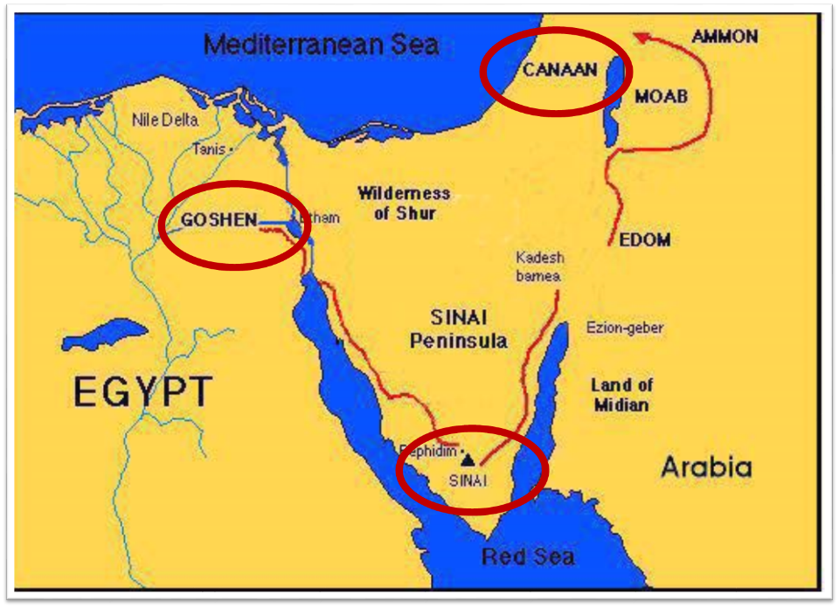

Slide 59
Lord’s Prayer (Matt 6:9-13)
Requests for the Kingdom to Come (9b-10)
  Hallowed be your name (9b)
  Your kingdom come (10a)
  On earth as it is in heaven (10b)
Requests for the meeting of interim needs (11-13)
  Daily bread (11)
  Forgive us as we forgive others (12)
  Deliver us from evil (13)
Toussaint, Behold the King, 107-112

Slide 60
Matthew 6:9-13
“⁹ Pray, then, in this way: ‘Our Father who is in heaven, Hallowed be Your name. ¹⁰ Your kingdom come. Your will be done, On earth as it is in heaven. ¹¹ Give us this day our daily bread. ¹² And forgive us our debts, as we also have forgiven our debtors.¹³ And do not lead us into temptation, but deliver us from evil.’”

Slide 61
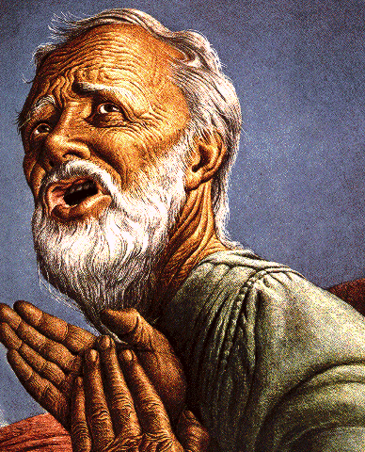
Passage Conditioning Salvation on Faith Alone (Sola Fide)
Genesis 15:6
John 3:16; 5:24; 6:28-29, 47; 16:8-9; 20:30-31
Acts 16:30-31
Romans 1:16; Ephesians 2:8-9
Hebrews 11:6

Slide 62
Belief – God’s One Condition for Justification
Gen 15:6
Then he believed in the LORD; and He reckoned it to him as righteousness.
John 3:16
For God so loved the world, that He gave His only begotten Son, that whoever believes in Him shall not perish, but have eternal life.
Acts 16:30-31
"Sirs, what must I do to be saved?" They said, "Believe in the Lord Jesus, and you will be saved..."

Slide 63

Lewis Sperry Chafer, vol. 7, Systematic Theology
(Grand Rapids, MI: Kregel Publications, 1993), 265-66.
Belief-God’s One Condition for Justification
“…because upwards of 150 passages of Scripture condition salvation upon believing only (cf. John 3:16; Acts 16:31).

Slide 64
Matthew 6:9-13
“⁹ Pray, then, in this way: ‘Our Father who is in heaven, Hallowed be Your name. ¹⁰ Your kingdom come. Your will be done, On earth as it is in heaven. ¹¹ Give us this day our daily bread. ¹² And forgive us our debts, as we also have forgiven our debtors.¹³ And do not lead us into temptation, but deliver us from evil.’”

Slide 65
Stanley D. Toussaint
Behold the King: A Study of Matthew (Grand Rapids, Kregel, 2005), 111.
Toussaint explains, “Judicial forgiveness is not in view (Acts 10:43) but fellowship (1 John 1:5–9). It is impossible for one to be in fellowship with God as long as he harbors ill will in his heart.”

Slide 66
John Walvoord
Matthew: Thy Kingdom Come (Chicago: Moody, 1974), 53.
“The Christian already forgiven judicially should not expect restoration in the family unless he, himself, is forgiving.”

Slide 67
Ed Glasscock
Matthew, Moody Gospel Commentary (Chicago: Moody, 1997), 148-49.
“It is not likely here that the issue of forgiveness is referring to initial redemptive forgiveness (for salvation) but the forgiveness for offense against the Father in the perpetual daily life situation (for fellowship). There is no salvific passage that requires the one being saved to perform any act, such as forgiving others, in order to gain forgiveness. The overwhelming testimony of Scripture is that salvation from eternal torment is a free gift not granted on the basis of any act (Eph. 2:8-9; Titus 3:5; Rom. 4:5; etc.).”

Slide 68
Three Tenses of Salvation
Phase | Justification | Sanctification | Glorification
Tense | Past | Present | Future
Saved from sin’s: | Penalty | Power | Presence
Scripture | Eph 2:8-9; Titus 3:5 | Philip 2:12 | Rom 5:10

Slide 69
Three Tenses of Salvation
Phase | Justification | Sanctification | Glorification
Tense | Past | Present | Future
Saved from sin’s: | Penalty | Power | Presence
Scripture | Eph 2:8-9; Titus 3:5 | Philip 2:12 | Rom 5:10

Slide 70
Lord’s Prayer (Matt 6:9-13)
Requests for the Kingdom to Come (9b-10)
  Hallowed be your name (9b)
  Your kingdom come (10a)
  On earth as it is in heaven (10b)
Requests for the meeting of interim needs (11-13)
  Daily bread (11)
  Forgive us as we forgive others (12)
  Deliver us from evil (13)
Toussaint, Behold the King, 107-112

Slide 71
Matthew 6:9-13
“⁹ Pray, then, in this way: ‘Our Father who is in heaven, Hallowed be Your name. ¹⁰ Your kingdom come. Your will be done, On earth as it is in heaven. ¹¹ Give us this day our daily bread. ¹² And forgive us our debts, as we also have forgiven our debtors.¹³ And do not lead us into temptation, but deliver us from evil.’”

Slide 72
Ed Glasscock
Matthew, Moody Gospel Commentary (Chicago: Moody, 1997), 150.
“...and the object from which we are to seek deliverance is evil. More literally it should be understood as 'the Evil One.'...The petition of the model prayer, then, is for God to allow us to undergo the testing but to be rescued from the snare of the Evil One, the Devil.”

Slide 73

Satan’s Progressive Defeat
Initial eviction from heaven (Isa 14:12-15; Ezek 28:12-17)
Eden (Gen 3:15)
Pre-diluvian world (1 Pet 3:19-20)
Cross (John 12:31; 16:11; Col 2:15; Heb 2:14; 1 John 3:8)
Mid point of the Tribulation (Rev 12:9)
Beginning of millennium (Rev 20:2-3)
End of millennium (Rev 20:10)

Slide 74

Names & Titles Demonstrating Satan’s Post-Fall, Earthly Authority
(Job 1:7; 2:2; Luke 4:5-8; Rom. 8:19-22)
Prince of this world (John 12:31; 14:30; 16:11)
God of this age (2 Cor. 4:4)
Prince and power of the air (Eph. 2:2)
Who the believer wrestles with (Eph. 6:12)
Roaring lion (1 Pet. 5:8)
Whole world lies in his power (1 John 5:19)

Slide 75
Lord’s Prayer (Matt 6:9-13)
Requests for the Kingdom to Come (9b-10)
  Hallowed be your name (9b)
  Your kingdom come (10a)
  On earth as it is in heaven (10b)
Requests for the meeting of interim needs (11-13)
  Daily bread (11)
  Forgive us as we forgive others (12)
  Deliver us from evil (13)
Toussaint, Behold the King, 107-112

Slide 76
CONCLUSION

Slide 77
Matthew 6:9-13
“⁹ Pray, then, in this way: ‘Our Father who is in heaven, Hallowed be Your name. ¹⁰ Your kingdom come. Your will be done, On earth as it is in heaven. ¹¹ Give us this day our daily bread. ¹² And forgive us our debts, as we also have forgiven our debtors.¹³ And do not lead us into temptation, but deliver us from evil.’”

Slide 78
Lord’s Prayer (Matt 6:9-13)
Requests for the Kingdom to Come (9b-10)
  Hallowed be your name (9b)
  Your kingdom come (10a)
  On earth as it is in heaven (10b)
Requests for the meeting of interim needs (11-13)
  Daily bread (11)
  Forgive us as we forgive others (12)
  Deliver us from evil (13)
Toussaint, Behold the King, 107-112

