Slide 1
JESUS GIVES NEW LIFE
(John 11:1-45)
April 29, 2018
Alex Garcia

Slide 2
Celcus (2nd Century) Attacks Jesus’ Works
“[Celsus] compares them [Jesus’ works] to the tricks of jugglers, who profess to do more wonderful things . . . . But, as it helped his [Celcus’] purpose, he compares the (miracles) related of Jesus to the results produced by magic.”
“Origen against Celsus,” in The Ante-Nicene Fathers, ed. A. Roberts, J. Donaldson, and A. C. Coxe, vol. 4 trans. Frederick Crombie (Buffalo, NY: Christian Literature Company, 1885), 427.

Slide 3
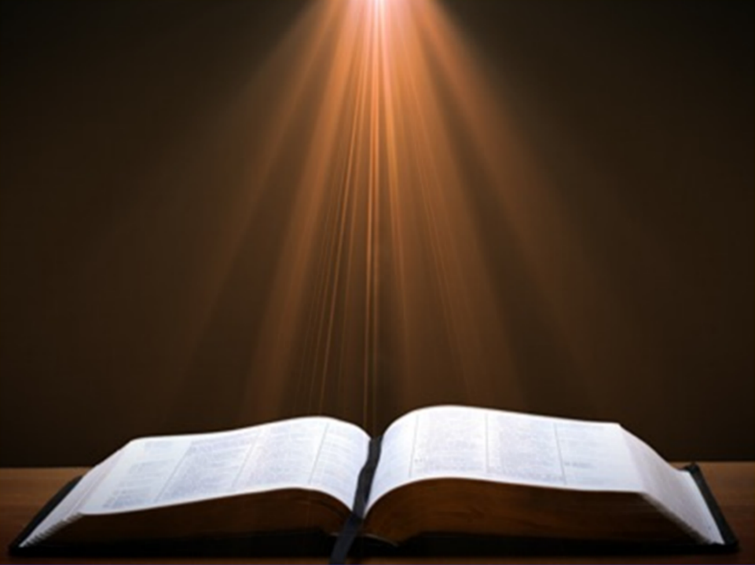
Isaiah 35:5-6
“⁵ Then the eyes of the blind will be opened and the ears of the deaf will be unstopped. ⁶ Then the lame will leap like a deer, and the tongue of the mute will shout for joy .”

Slide 4
Daniel 12:2
“Many of those who sleep in the dust of the ground will awake, these to everlasting life, but the others to disgrace and everlasting contempt.”

Slide 5
John 20:30-31
“³⁰ Therefore many other signs Jesus also performed in the presence of the disciples, which are not written in this book; ³¹ but these have been written so that you may believe that Jesus is the Christ, the Son of God; and that believing you may have life in His name.”

Slide 6
Raising of Lazarus (Outline)
Lazarus is sick and dies (v. 1-16).
Jesus claims to bring new life (v. 17-27).
Mourning over Lazarus (v. 28-37).
Jesus proves His claim of new life by raising Lazarus (v. 38-45).

Slide 7
LAZARUS PRINCIPLES
God’s purpose is to glorify Himself.
At times, God allows us to suffer for His glory.
Trust God when suffering for His glory.
Jesus, the God-Man, weeps with us in our suffering.
God blesses those who seek His glory.

Slide 8
John 11:1-3
“¹ Now a certain man was sick, Lazarus of Bethany, the village of Mary and her sister Martha. ² It was the Mary who anointed the Lord with ointment, and wiped His feet with her hair, whose brother Lazarus was sick. ³ So the sisters sent word to Him, saying, ‘Lord, behold, he whom You love is sick.’”

Slide 9
John 11:4-6
“⁴ But when Jesus heard this, He said, ‘This sickness is not to end in death, but for the glory of God, so that the Son of God may be glorified by it.’ ⁵ Now Jesus loved Martha and her sister and Lazarus. ⁶ So when He heard that he was sick, He then stayed two days longer in the place where He was.”

Slide 10
LAZARUS PRINCIPLES
God’s purpose is to glorify Himself.
(Isaiah 48:9-11, Habakkuk 2:14, John 14:13, Romans 11:36, 1 Corinthians 10:31)

Slide 11
LAZARUS PRINCIPLES
God’s purpose is to glorify Himself.
At times, God allows us to suffer for His glory.

Slide 12
LAZARUS PRINCIPLES
God’s purpose is to glorify Himself.
At times, God allows us to suffer for His glory.
Trust God when suffering for His glory.

Slide 13
LAZARUS PRINCIPLES
God’s purpose is to glorify Himself.
At times, God allows us to suffer for His glory.
Trust God when suffering for His glory.
Jesus, the God-Man, weeps with us in our suffering.

Slide 14
John 11:7-10
“⁷ Then after this He said to the disciples, ‘Let us go to Judea again.’ ⁸ The disciples said to Him, ‘Rabbi, the Jews were just now seeking to stone You, and are You going there again?’ ⁹ Jesus answered, ‘Are there not twelve hours in the day? If anyone walks in the day, he does not stumble, because he sees the light of this world. ¹⁰ But if anyone walks in the night, he stumbles, because the light is not in him.’”

Slide 15
John 11:11
“This He said, and after that He said to them, ‘Our friend Lazarus has fallen asleep; but I go, so that I may awaken him out of sleep.’”

Slide 16
Daniel 12:2
“Many of those who sleep in the dust of the ground will awake, these to everlasting life, but the others to disgrace and everlasting contempt.”

Slide 17
John 11:12-15
“¹² The disciples then said to Him, ‘Lord, if he has fallen asleep, he will recover.’ ¹³ Now Jesus had spoken of his death, but they thought that He was speaking of literal sleep. ¹⁴ So Jesus then said to them plainly, ‘Lazarus is dead, ¹⁵ and I am glad for your sakes that I was not there, so that you may believe; but let us go to him.’”

Slide 18
THREE GROUPS
The disciples (believers): grow their faith.
Martha & Mary (believers): grow their faith.
Crowd around the tomb (unbelievers): believe in Jesus and receive new life.

Slide 19
John 11:16
“Therefore Thomas, who is called Didymus, said to his fellow disciples, ‘Let us also go, so that we may die with Him.’”

Slide 20
John 11:17-19
“¹⁷ So when Jesus came, He found that he had already been in the tomb four days. ¹⁸ Now Bethany was near Jerusalem, about two miles off; ¹⁹ and many of the Jews had come to Martha and Mary, to console them concerning their brother.”

Slide 21
John 11:20-22
^{“20} Martha therefore, when she heard that Jesus was coming, went to meet Him, but Mary stayed at the house. ²¹ Martha then said to Jesus, ‘Lord, if You had been here, my brother would not have died. ²² Even now I know that whatever You ask of God, God will give You.’”

Slide 22
John 11:23-24
“²³ Jesus said to her, ‘Your brother will rise again.’ ²⁴ Martha said to Him, ‘I know that he will rise again in the resurrection on the last day.’”

Slide 23
John 11:25-26
“²⁵ Jesus said to her, ‘I am the resurrection and the life; he who believes in Me will live even if he dies, ²⁶ and everyone who lives and believes in Me will never die. Do you believe this?’”

Slide 24
1 Cor 15:55-57
“⁵⁵ O death, where is your victory? O death, where is your sting?” ⁵⁶ The sting of death is sin, and the power of sin is the law; ⁵⁷ but thanks be to God, who gives us the victory through our Lord Jesus Christ.”

Slide 25
John 11:27
“She said to Him, “Yes, Lord; I have believed that You are the Christ, the Son of God, even He who comes into the world.”

Slide 26
LAZARUS PRINCIPLES
God’s purpose is to glorify Himself.
At times, God allows us to suffer for His glory.
Trust God when suffering for His glory.
Jesus, the God-Man, weeps with us in our suffering.

Slide 27
John 11:28-30
“²⁸ When she had said this, she went away and called Mary her sister, saying secretly, ‘The Teacher is here and is calling for you.’ ²⁹ And when she heard it, she got up quickly and was coming to Him. ³⁰ Now Jesus had not yet come into the village, but was still in the place where Martha met Him.’”

Slide 28
John 11:31-32
“³¹ Then the Jews who were with her in the house, and consoling her, when they saw that Mary got up quickly and went out, they followed her, supposing that she was going to the tomb to weep there. ³² Therefore, when Mary came where Jesus was, she saw Him, and fell at His feet, saying to Him, ‘Lord, if You had been here, my brother would not have died.’”

Slide 29
John 11:33-35
“³³ When Jesus therefore saw her weeping, and the Jews who came with her also weeping, He was deeply moved in spirit and was troubled, ³⁴ and said, ‘Where have you laid him?’ They said to Him, ‘Lord, come and see.’ ³⁵ Jesus wept.”

Slide 30
LAZARUS PRINCIPLES
God’s purpose is to glorify Himself.
At times, God allows us to suffer for His glory.
Trust God when suffering for His glory.
Jesus, the God-Man, weeps with us in our suffering.

Slide 31
John 11:36-37
“³⁶ So the Jews were saying, ‘See how He loved him!’ ³⁷ But some of them said, ‘Could not this man, who opened the eyes of the blind man, have kept this man also from dying?’”

Slide 32
THREE GROUPS
The disciples (believers): grow their faith.
Martha & Mary (believers): grow their faith.
Crowd around the tomb (unbelievers): believe in Jesus and receive new life.

Slide 33
Raising of Lazarus (Outline)
Lazarus is sick and dies (v. 1-16).
Jesus claims to bring new life (v. 17-27).
Mourning over Lazarus (v. 28-37).
Jesus proves His claim of new life by raising Lazarus (v. 38-45).

Slide 34
John 11:38-40
“³⁸ So Jesus, again being deeply moved within, came to the tomb. Now it was a cave, and a stone was lying against it. ³⁹ Jesus said, ‘Remove the stone.’ Martha, the sister of the deceased, said to Him, ‘Lord, by this time there will be a stench, for he has been dead four days.’ ⁴⁰ Jesus said to her, ‘Did I not say to you that if you believe, you will see the glory of God?’”

Slide 35
LAZARUS PRINCIPLES
God’s purpose is to glorify Himself.
At times, God allows us to suffer for His glory.
Trust God when suffering for His glory.
Jesus, the God-Man, weeps with us in our suffering.
God blesses those who seek His glory.

Slide 36
John 11:41-42
“⁴¹ So they removed the stone. Then Jesus raised His eyes, and said, ‘Father, I thank You that You have heard Me. ⁴² I knew that You always hear Me; but because of the people standing around I said it, so that they may believe that You sent Me.’”

Slide 37
John 11:43-44
“⁴³ When He had said these things, He cried out with a loud voice, ‘Lazarus, come forth.’ ⁴⁴ The man who had died came forth, bound hand and foot with wrappings, and his face was wrapped around with a cloth. Jesus said to them, ‘Unbind him, and let him go.’”

Slide 38
John 11:45
“Therefore many of the Jews who came to Mary, and saw what He had done, believed in Him.”

Slide 39
LAZARUS PRINCIPLES
God’s purpose is to glorify Himself.
At times, God allows us to suffer for His glory.
Trust God when suffering for His glory.
Jesus, the God-Man, weeps with us in our suffering.
God blesses those who seek His glory.

