Slide 1
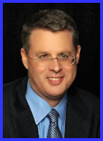
Ecclesiology Session 20
Dr. Andy Woods
Senior Pastor – Sugar Land Bible Church
President – Chafer Theological Seminary

Slide 2
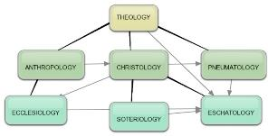
Areas of Systematic Theology
Prolegomena – Introduction
Theology – Study of God
Christology – Study of Christ
Pneumatology – Study of the Holy Spirit
Anthropology – Study of Man
Hamartiology – Study of sin
Soteriology – Study of salvation
Angelology – Study of angels
Ecclesiology – Study of the Church
Eschatology – Study of the end

Slide 3
Ecclesiology Overview
Definition
Universal vs. local
Word pictures
Origin
Israel – Church differences
Intercalation
Purposes
Activities
Government
Officers
Ordinances
Purity

Slide 4
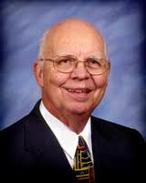
VII. Purposes of the Local Church
Glorify God (Eph 3:21)
Edify the saints (Eph 4:11-16)
Fulfill the Great Commission (Matt 28:18-20)

Slide 5
VII. Purposes of the Local Church
Glorify God (Eph 3:21)
Edify the saints (Eph 4:11-16)
Fulfill the Great Commission (Matt 28:18-20)

Slide 6
Dispensational Theology is a System of Theology
Traditional-normative dispensational theology is a system that embodies three essential, fundamental concepts called the sine qua non (lit. “without which is not”):
The consistent use of a plain, normal, literal, grammatical-historical method of interpretation;
Which reveals that the Church is distinct from Israel;
God’s overall purpose is to bring glory to Himself (Eph. 1:6, 12, 14).
Dr. Charles Ryrie, Dispensationalism, pp. 38-41

Slide 7
Dispensational Theology: Doxological Purpose
God’s ultimate purpose for the ages is to glorify Himself. Scripture is not human-centered, as though salvation were the principle point, but God-centered, because His glory is at the center.
The glory of God is the primary principle that unifies all dispensations, the program of salvation being just one of the means by which God glorifies Himself. Each successive revelation of God’s plan for the ages, as well as His dealing with the elect, non-elect, angels, and nations all manifest His glory.
Dictionary of Premillennial Theology, Charles Ryrie, p. 94

Slide 9
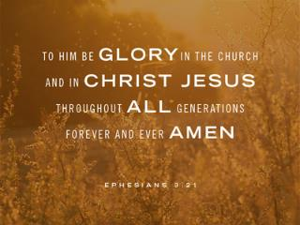
Ephesians 3:21
“to Him be the glory in the church and in Christ Jesus to all generations forever and ever. Amen.”

Slide 10
VII. Purposes of the Local Church
Glorify God (Eph 3:21)
Edify the saints (Eph 4:11-16)
Fulfill the Great Commission (Matt 28:18-20)

Slide 11
Ephesians 4:11-16
“¹¹ And He gave some as apostles, and some as prophets, and some as evangelists, and some as pastors and teachers, ¹² for the equipping of the saints for the work of service, to the building up of the body of Christ;”

Slide 12
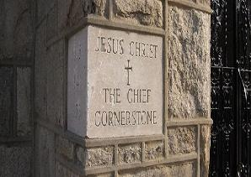
Ephesians 2:20
“having been built on the foundation of the apostles and prophets, Christ Jesus Himself being the corner stone,”

Slide 13
Ephesians 4:11-16
“¹¹ And He gave some as apostles, and some as prophets, and some as evangelists, and some as pastors and teachers, ¹² for the equipping of the saints for the work of service, to the building up of the body of Christ;”

Slide 14
2 Timothy 3:16-17
“¹⁶ All Scripture is inspired by God and profitable for teaching, for reproof, for correction, for training in righteousness; ¹⁷ so that the man of God may be adequate, equipped for every good work.”

Slide 15
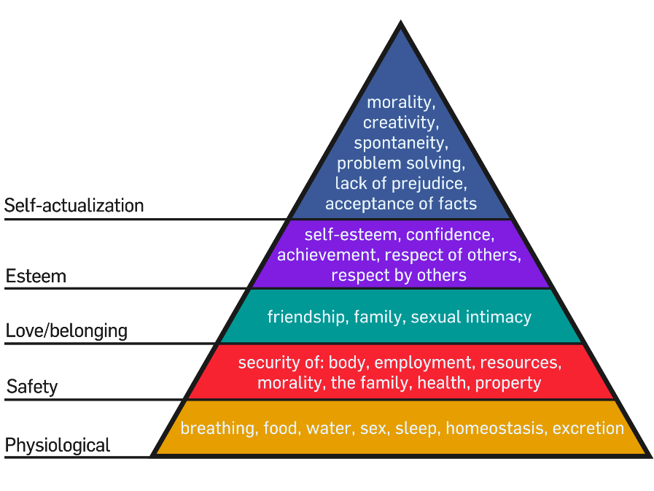

Slide 16
2 Timothy 3:16-17
“¹⁶ All Scripture is inspired by God and profitable for teaching, for reproof, for correction, for training in righteousness; ¹⁷ so that the man of God may be adequate, equipped for every good work.”

Slide 17
Ephesians 4:11-16
“¹³ until we all attain to the unity of the faith, and of the knowledge of the Son of God, to a mature man, to the measure of the stature which belongs to the fullness of Christ. ¹⁴ As a result, we are no longer to be children, tossed here and there by waves and carried about by every wind of doctrine, by the trickery of men, by craftiness in deceitful scheming;”

Slide 18
1 Corinthians 3:1-3 (NKJV)
“¹And I, brethren, could not speak to you as to spiritual people but as to carnal, as to babes in Christ. ² I fed you with milk and not with solid food; for until now you were not able to receive it, and even now you are still not able; ³ for you are still carnal. For where there are envy, strife, and divisions among you, are you not carnal and behaving like mere men?”

Slide 19
Notes:
Ray Steadman – “1st Californians”
Unbelievers vs Categories of Believers
Unbelievers – ψυχικός psuchikós; Natural, pertaining to the natural as distinguished from the spiritual
Spiritual Believers – πνευματικός pneumatikós; of persons who are spiritual, enlightened by the Holy Spirit
Infant Believers – σάρκινος sárkinos; with propensities of the flesh unto sin; νήπιος nḗpios; an infant, child, baby without any definite limitation of age. (This relates to immaturity and lack of instruction)
Carnal Believers – σαρκικός sarkikós; tendency to satisfy the flesh, implying sinfulness, sinful propensity, carnal (This relates to disobedience and open rebellion)

Slide 20
Ephesians 4:11-16
“¹⁵ but speaking the truth in love, we are to grow up in all aspects into Him who is the head, even Christ, ¹⁶ from whom the whole body, being fitted and held together by what every joint supplies, according to the proper working of each individual part, causes the growth of the body for the building up of itself in love.”

Slide 21
VII. Purposes of the Local Church
Glorify God (Eph 3:21)
Edify the saints (Eph 4:11-16)
Fulfill the Great Commission (Matt 28:18-20)

Slide 22
Matthew 28:18-20
“¹⁸ And Jesus came up and spoke to them, saying, ‘All authority has been given to Me in heaven and on earth. ¹⁹ Go therefore and make disciples of all the nations, baptizing them in the name of the Father and the Son and the Holy Spirit, ²⁰ teaching them to observe all that I commanded you; and lo, I am with you always, even to the end of the age.’”

Slide 23
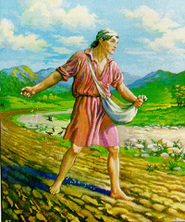
Mark 16:15
“Go into all the world and preach the gospel to all creation.”

Slide 24
Luke 24:46-48
“⁴⁶ and He said to them, “Thus it is written, that the Christ would suffer and rise again from the dead the third day, ⁴⁷ and that repentance for forgiveness of sins would be proclaimed in His name to all the nations, beginning from Jerusalem. ⁴⁸ You are witnesses of these things.”

Slide 25
Acts 1:8
“but you will receive power when the Holy Spirit has come upon you; and you shall be My witnesses both in Jerusalem, and in all Judea and Samaria, and even to the remotest part of the earth.”

Slide 26
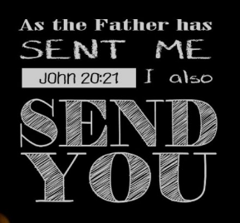
John 20:21
“So Jesus said to them again, “Peace be with you; as the Father has sent Me, I also send you.”

Slide 27
John 3:16
“For God so loved the world, that He gave His only begotten Son, that whoever believes in Him shall not perish, but have eternal life.”

Slide 28
VII. Purposes of the Local Church
Glorify God (Eph 3:21)
Edify the saints (Eph 4:11-16)
Fulfill the Great Commission (Matt 28:18-20)

Slide 29
Three Misdirected Church Purposes
Holistic Redemption
Social Gospel
Bringing in the Kingdom

Slide 30
Three Misdirected Church Purposes
Holistic Redemption
Social Gospel
Bringing in the Kingdom

Slide 31
Holistic Redemption?
“Negative-thinking theologians looked at the doctrine of sin, salvation and repentance... through distorted glasses tinted with mortification mentality. Too many prayers of confession of sin and repentance have been destructive to the emotional health of Christians...I am not fully forgiven until I allow God to write his new dream for my life on the blackboard of my mind, and I dare to believe 'I am; therefore, I can. I am a child of God...God has a great plan to redeem society...The emerging church, reformed according to the needs of self-esteem-starved-souls under the Lordship of Christ.... will help us to affirm the concept that 'While God's ideas may seem humanly impossible, he will give us these ideas which will lead to glorious, self-esteem-generating success.'"
Robert H. Schuller, Self-Esteem: The New Reformation (Waco, TX: Word Books, 1982), 104-05.

Slide 32
Holistic Redemption?
“Unfortunately, present-day dispensationalists have written very little in proposing a theology of social ministry.” He continues, “if we as a community of Christ worked on creating our community as a model of social justice and peace, then we really would have some suggestions to make for social reform in our cities and nations.”
Craig Blaising, “Dispensationalism: The Search for Definition,” in Dispensationalism, Israel and the Church, ed. Craig Blaising and Darrell Bock (Grand Rapids: Zondervan, 1992), 14, n. 3; idem, “Theological and Ministerial Issues in Progressive Dispensationalism,” in Progressive Dispensationalism, ed. Darrell Bock and Craig Blaising (Wheaton, IL: Victor, 1993), 288–89.

Slide 33
Holistic Redemption?
“Holistic redemption can easily lead to placing unbalanced, if not wrong, priorities on political action, social agendas, and improving the structures of society.”
Charles C. Ryrie, Dispensationalism (Chicago: Moody, 1995), 176.

Slide 34
Three Misdirected Church Purposes
Holistic Redemption
Social Gospel
Bringing in the Kingdom

Slide 35
Emergent Church & the Social Gospel
“The church has been preoccupied with the question, ‘What happens to your soul after you die?’ As if the reason for Jesus coming can be summed up in, ‘Jesus is trying to get more souls into heaven as opposed to hell, after they die.’ I just think a fair reading of the Gospels blows that out of the water. ”
Brian McLaren; cited in Roger Oakland, Faith Undone, 203.

Slide 36
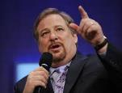
Social Gospel Confusion
“P.E.A.C.E. is an acronym for Promote reconciliation; Equip servant leaders; Assist the poor; Care for the sick; and Educate the next generation. Coalition members see these actions as Jesus’ antidote to five “global giants,”—problems that affect billions of people worldwide: spiritual emptiness, self-centered leadership, poverty, pandemic disease, and illiteracy.”
“Rick Warren and 1,700 Leaders Launch the Peace Coalition at Purpose Driven Summit,” accessed November 15, 2014, http://www.christiannewswire.com/news/249586720.html

Slide 37
Three Misdirected Church Purposes
Holistic Redemption
Social Gospel
Bringing in the Kingdom

Slide 38
Emergent Church & the Kingdom
“He selected 12 and trained them in a new way of life. He sent them to teach everyone this new way of life...Even if only a few would practice this new way, many would benefit. Oppressed people would be free. Poor people would be liberated from poverty. Minorities would be treated with respect. Sinners would be loved, not resented.”
Brian McLaren, A Generous Orthodoxy, 111.

Slide 39
Emergent Church & the Kingdom
“Industrialists would realize that God cares for sparrows and wildflowers-so their industries should respect, not rape, the environment. The homeless would be invited in for a hot meal. The kingdom of God would come – not everywhere at once, not suddenly, but gradually like a seed growing in a field, like yeast spreading in a lump of bread dough, like light spreading across the sky at dawn.”
Brian McLaren, A Generous Orthodoxy, 111.

Slide 40
Church & Kingdom Confusion
“I stand before you confidently right now and say to you that God is going to use you to change the world...I'm looking at a stadium full of people right now who are telling God they will do whatever it takes to establish God's Kingdom "on earth as it is in heaven." What will happen if the followers of Jesus say to Him, "We are yours?" What kind of spiritual awakening will occur?”
Rick Warren, cited in Oakland, Faith Undone, Kindle edition.

Slide 41
Church & Kingdom Confusion
“If we are to be a part of this coming kingdom, God expects our lives – our churches and faith communities too – to be characterized by these authentic signs of our own transformation: compassion, mercy, justice, and love – demonstrated tangibly. Only then will our light break forth like the dawn, our healing quickly appear, and our cries for help be answered with a divine Here am I.”
Stearns, Hole in the Gospel, 57.

Slide 42
Church & Kingdom Confusion
“The gospel that we have been given – the whole gospel – is God’s vision for a new way of living…Christ’s vision was of a redeemed world order populated by redeemed people – now. To accomplish this, we are to be salt and light in a dark and fallen world, the “yeast” that leavens the whole loaf of bread (the whole of society). We are the ones God has called to be His Church. It’s up to us. We are to be the change. But a changed world requires change agents, and change agents are people who have first been changed themselves.”
Stearns, Hole in the Gospel, 276, 243-44.

Slide 43
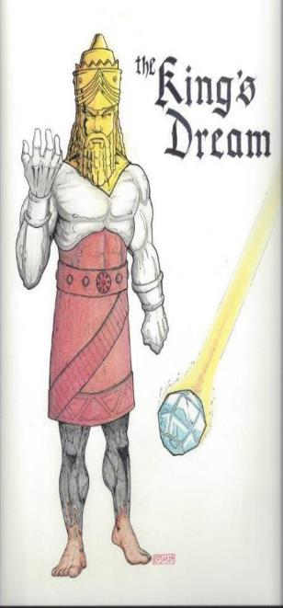
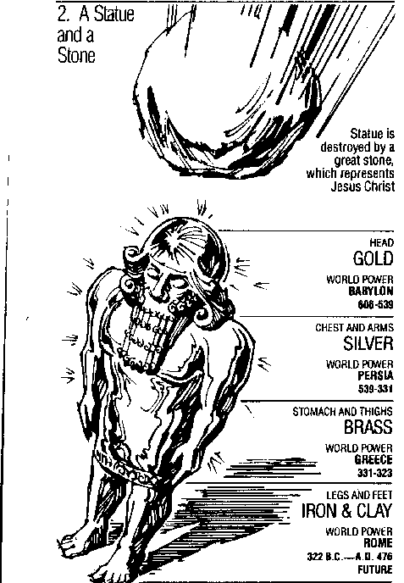
Statue
&
Stone

Slide 44
Daniel 2:44
“In the days of those kings the God of heaven will set up a kingdom which will never be destroyed, and that kingdom will not be left for another people; it will crush and put an end to all these kingdoms, but it will itself endure forever.”

Slide 45
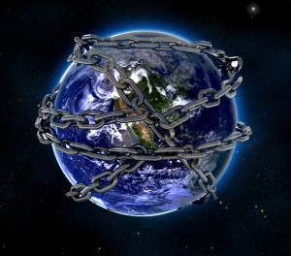

Slide 46
Ultimate Exodus (Rev 11:15)
Sores: 6th plague (Ex 9:8-12), 1st bowl (Rev 16:1-2)
Rivers to blood: 1st plague (Ex 7:19-21), 3rd bowl (Rev 16:4-7)
Darkness: 9th plague (Ex 10:21-23), 5th bowl (Rev 16:10-11)
Hail: 7th plague (Ex 9:22-26), 7th bowl (Rev 16:17-21)

Slide 47
Revelation 11:15
¹⁵ “Then the seventh angel sounded; and there were loud voices in heaven, saying, ‘The kingdom of the world has become the kingdom of our Lord and of His Christ; and He will reign forever and ever.’”

Slide 48
Hal Lindsey
The Road to Holocaust, 269
Bestselling author Hal Lindsey warned what could happen to the church in the last days if she began to see herself as the establisher of God's kingdom: “The last days of the church on the earth may be largely wasted seeking to accomplish a task that only the LORD Himself can and will do directly.”

Slide 49
Acts 15:14
“Simeon has related how God first concerned Himself about taking from among the Gentiles a people for His name.”

Slide 50
Conclusion

Slide 51
Ecclesiology Overview
Definition
Universal vs. local
Word pictures
Origin
Israel – Church differences
Intercalation
Purposes
Activities
Government
Officers
Ordinances
Purity

