Slide 1
THE BOOK OF DANIEL
Dr. Andy Woods

Slide 2
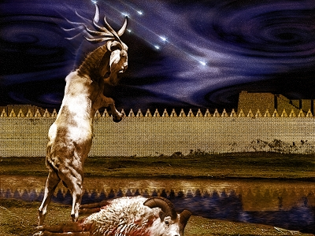
DANIEL 10-12 THE FINAL VISION

Slide 3
CHAPTER AND VERSE IN DANIEL | CHRONOLOGICAL DATE | BIBLICAL DATE
1:1 | 605 | 3rd year of Jehoiakim
2:1 | 603 | 2nd year of Nebuchadnezzar
5 | Sat. night 10/12/539 (Hoehner)
7:1 | 553 | 1st year of Belshazzar
8:1 | 551 | 3rd year of Belshazzar
9:1 | 538 | 1st year of Darius
10:1 | 536 | 3rd year of Cyrus

Slide 4
Chapter 10–12 Outline
The Setting (10:1-3)
Arrival of the Heavenly Messenger (10:4-9)
Explanation of the Heavenly Messenger (10:10–11:1)
The Prophecy of the Heavenly Messenger (11:2–12:13)

Slide 5
IV. The Prophecy of the Heavenly Messenger (11:2–12:13)
Persia (11:2)
Greece (11:3-4)
Ptolemies & Seleucids (11:5-20)
Antiochus IV (11:21-35)
Antichrist (11:36-45)
Tribulation & Millennium (12:1-13)

Slide 7
IV. The Prophecy of the Heavenly Messenger (11:2–12:13)
Persia (11:2)
Greece (11:3-4)
Ptolemies & Seleucids (11:5-20)
Antiochus IV (11:21-35)
Antichrist (11:36-45)
Tribulation & Millennium (12:1-13)

Slide 8
IV. The Prophecy of the Heavenly Messenger (11:2–12:13)
Persia (11:2)
Greece (11:3-4)
Ptolemies & Seleucids (11:5-20)
Antiochus IV (11:21-35)
Antichrist (11:36-45)
Tribulation & Millennium (12:1-13)

Slide 9
The Tribulation & Millennium Daniel 12:1-13
Description of the End Times (1-4)
The Suffering (1)
The Separation (2)
The Shining (3)
The Sealing (4)
Harold Wilmington, The Outline Bible, pp. 418-19

Slide 10
The Tribulation & Millennium Daniel 12:1-13
Duration of the End Times (5-13)
Round 1 (5-7)
Question (5-6)
Answer (7)
Round 2 (8-13)
Question (8)
Answer (9-13)
Harold Wilmington, The Outline Bible, pp. 418-19

Slide 11
The Tribulation & Millennium Daniel 12:1-13
Description of the End Times (1-4)
The Suffering (1)
The Separation (2)
The Shining (3)
The Sealing (4)
Harold Wilmington, The Outline Bible, pp. 418-19

Slide 12
The Tribulation & Millennium Daniel 12:1-13
Description of the End Times (1-4)
The Suffering (1)
The Separation (2)
The Shining (3)
The Sealing (4)
Harold Wilmington, The Outline Bible, pp. 418-19

Slide 13
The Tribulation & Millennium Daniel 12:1-13
Description of the End Times (1-4)
The Suffering (1)
The Separation (2)
The Shining (3)
The Sealing (4)
Harold Wilmington, The Outline Bible, pp. 418-19

Slide 14
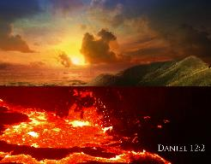
Daniel 12:2
“Many of those who sleep in the dust of the ground will awake, these to everlasting life, but the others to disgrace and everlasting contempt.”

Slide 15
The Tribulation & Millennium Daniel 12:1-13
Description of the End Times (1-4)
The Suffering (1)
The Separation (2)
The Shining (3)
The Sealing (4)
Harold Wilmington, The Outline Bible, pp. 418-19

Slide 16
Daniel 12:3
“Those who have insight will shine brightly like the brightness of the expanse of heaven, and those who lead the many to righteousness, like the stars forever and ever.”

Slide 17
Daniel 12:3
“Those who have insight will shine brightly like the brightness of the expanse of heaven, and those who lead the many to righteousness, like the stars forever and ever.”

Slide 18
Daniel 12:3
“Those who have insight will shine brightly like the brightness of the expanse of heaven, and those who lead the many to righteousness, like the stars forever and ever.”

Slide 19
The Tribulation & Millennium Daniel 12:1-13
Description of the End Times (1-4)
The Suffering (1)
The Separation (2)
The Shining (3)
The Sealing (4)
Harold Wilmington, The Outline Bible, pp. 418-19

Slide 20
Daniel 12:4, 9
“But as for you, Daniel, conceal these words and seal up the book until the end of time; many will go back and forth, and knowledge will increase...Go your way, Daniel, for these words are concealed and sealed up until the end time.”

Slide 21
Signs of the Times
Israel
International Politics
Economics
Technology
Spirituality
Society
Understanding Bible Prophecy

Slide 22
Signs of the Times
Israel
International Politics
Economics
Technology
Spirituality
Society
Understanding Bible Prophecy

Slide 23
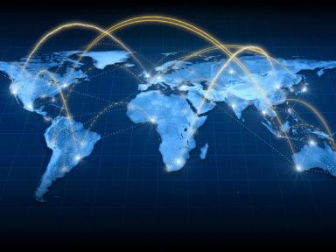
Technology
Microchip technology
Satellite TV
Weapons of Mass Destruction

Slide 24
Technology
Microchip technology
Satellite TV
Weapons of Mass Destruction

Slide 25
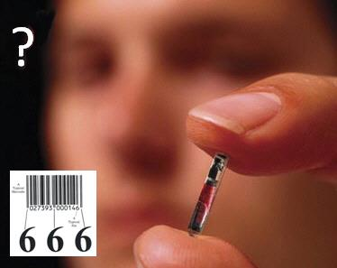
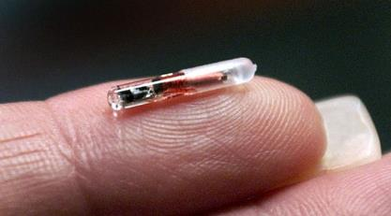
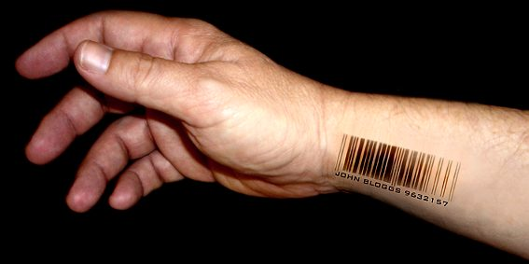

Slide 26
Wisconsin Company to Implant Microchips In Employees Josh Rosenthal of 5 Eyewitness ABC News - July 24, 2017
“A Wisconsin company is about to become the first in the U.S. to offer microchip implants to its employees. Yes, you read that right. Microchip implants. ‘It's the next thing that's inevitably going to happen, and we want to be a part of it,’ Three Square Market Chief Executive Officer Todd Westby said. The company designs software for break room markets that are commonly found in office complexes. Just as people are able to purchase items at the market using phones, Westby wants to do the same thing using a microchip implanted inside a person's hand. ‘We'll come up, scan the item,’ he explained, while showing how the process will work at an actual break room market kiosk. ‘We'll hit pay with a credit card, and it's asking to swipe my proximity payment now. I'll hold my hand up, just like my cell phone, and it'll pay for my product.’”
http://kstp.com/news/wisconsin-company-to-implant-microchips-in-employees-three-square-market/4549459/

Slide 27
Swedish Commuters Can Use Futuristic Microchip Hand Implant: The future is here – a Swedish rail company is trialing letting passengers use biometric chips as tickets, Helen Coffey of The Independent - June 16, 2017
“Gone are the days when an e-ticket was seen as cutting edge – one Swedish rail company is offering passengers the option of using a biometric chip implanted into their hand in lieu of a paper train ticket…The tiny chip has the same technology as Oyster cards and contactless bank cards…to enable conductors to scan passengers’ hands…Around 2,000 Swedes have had the surgical implant to date, most of them employed in the tech industry.”
http://www.independent.co.uk/travel/news-and-advice/sj-rail-train-tickets-hand-implant-microchip-biometric-sweden-a7793641.html

Slide 28
Technology
Microchip technology
Satellite TV
Weapons of Mass Destruction

Slide 29
Revelation 11:8-10
“⁸ And their dead bodies will lie in the street of the great city which mystically is called Sodom and Egypt, where also their Lord was crucified. ⁹ Those from the peoples and tribes and tongues and nations will look at their dead bodies for three and a half days, and will not permit their dead bodies to be laid in a tomb. ¹⁰ And those who dwell on the earth will rejoice over them and celebrate; and they will send gifts to one another, because these two prophets tormented those who dwell on the earth.”

Slide 30
Israel Installs Security Cameras as Jerusalem Tensions Build By Oren Liebermann and Ian Lee, CNN - July 24, 2017
“Jerusalem (CNN). Israel has installed security cameras near the entrance to one of the holiest sites in Jerusalem as tensions between Israelis and Palestinians edge higher after a violent week…Israel installed security cameras near the entrance to Old City of Jerusalem holy site early Sunday morning.”
http://www.cnn.com/2017/07/23/middleeast/israeli-palestinian-jerusalem-security/index.html

Slide 31
Technology
Microchip technology
Satellite TV
Weapons of Mass Destruction

Slide 32
Zechariah 14:12
“Now this will be the plague with which the Lord will strike all the peoples who have gone to war against Jerusalem; their flesh will rot while they stand on their feet, and their eyes will rot in their sockets, and their tongue will rot in their mouth.”

Slide 33
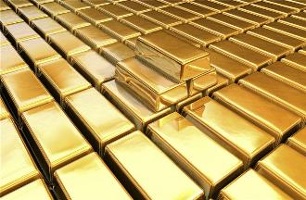
Isaiah 13:12
“I will make mortal man scarcer than pure gold and mankind than the gold of Ophir.”

Slide 35
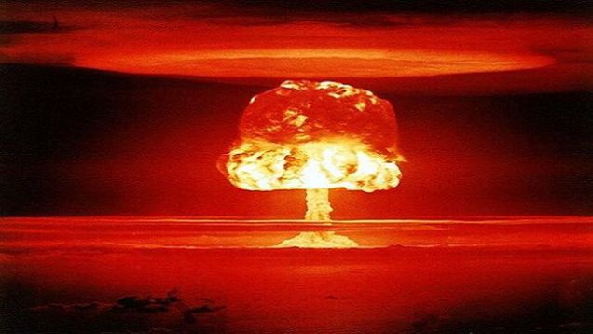

Slide 36
Amos 8:12
“People will stagger from sea to sea And from the north even to the east; They will go to and fro to seek the word of the Lord, But they will not find it.”
Notes:
‘to and fro‘ – refers to the increase in knowledge; progressive illumination

Slide 37
History of Doctrine
Canon (A.D. 180)
Christology (A.D. 500)
Atonement (A.D. 1100)
Salvation (A.D. 1500)
Eschatology (A.D. 1800)

Slide 38
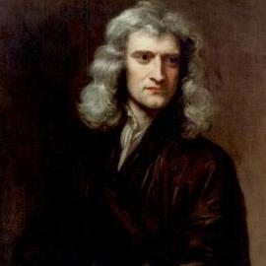
Sir Isaac Newton (1642–1727)
"About the time of the end, a body of men will be raised up who will turn their attention to the Prophecies, and insist upon their literal interpretation, in the midst of much clamor and opposition."
Isaac Newton cited in Nathaniel West, The Thousand Years in Both Testaments, 462.

Slide 39
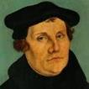
Martin Luther
Preface to the New Testament, 1522.
"I miss more than one thing in this book, and this makes me hold it to be neither apostolic nor prophetic…I think of it almost as I do of the Fourth Book of Esdras, and can in no way detect that the Holy Spirit produced it…It is just the same as if we did not have it, and there are many far better books for us to keep. Finally, let everyone think of it [Revelation] as his own spirit gives him to. My spirit cannot fit itself into this book. There is one sufficient reason for me not to think highly of it — Christ is not taught or known in it; but to teach Christ is the thing which an apostle is bound, above all else, to do, as He says in Acts 1, ‘Ye shall be my witnesses.’ Therefore I stick to the books which give me Christ, clearly and purely." In 1545, Luther printed the Book of Revelation with Hebrews, James and Jude as an appendix to the New Testament.
Notes:
Outline

Slide 40
1 Peter 1:10-11
¹⁰ As to this salvation, the prophets who prophesied of the grace that would come to you made careful searches and inquiries, ¹¹ seeking to know what person or time the Spirit of Christ within them was indicating as He predicted the sufferings of Christ and the glories to follow.

Slide 41
The Tribulation & Millennium Daniel 12:1-13
Duration of the End Times (5-13)
Round 1 (5-7)
Question (5-6)
Answer (7)
Round 2 (8-13)
Question (8)
Answer (9-13)
Harold Wilmington, The Outline Bible, pp. 418-19

Slide 42
The Tribulation & Millennium Daniel 12:1-13
Duration of the End Times (5-13)
Round 1 (5-7)
Question (5-6)
Answer (7)
Round 2 (8-13)
Question (8)
Answer (9-13)
Harold Wilmington, The Outline Bible, pp. 418-19

Slide 43
The Tribulation & Millennium Daniel 12:1-13
Duration of the End Times (5-13)
Round 1 (5-7)
Question (5-6)
Answer (7)
Round 2 (8-13)
Question (8)
Answer (9-13)
Harold Wilmington, The Outline Bible, pp. 418-19

Slide 44
Diversity of Topics in Daniel
Prophecy
Eschatology
Confidence that the Bible is God’s word
Knowledge of Intertestamental Period
Angelology
Spiritual Warfare
Living for God in a Pagan Society
God’s Sovereignty Over Empires

Slide 45
Diversity of Topics in Daniel
Prophecy
Eschatology
Confidence that the Bible is God’s word
Knowledge of Intertestamental Period
Angelology
Spiritual Warfare
Living for God in a Pagan Society
God’s Sovereignty Over Empires

Slide 46
The Tribulation & Millennium Daniel 12:1-13
Duration of the End Times (5-13)
Round 1 (5-7)
Question (5-6)
Answer (7)
Round 2 (8-13)
Question (8)
Answer (9-13)
Harold Wilmington, The Outline Bible, pp. 418-19

Slide 47
Prophetic Synonyms
Time, times, half a time (Dan. 7:25; Rev. 12:14)
42 months (Rev. 11:2; 13:5)
1260 days Division of the Tribulation into two 3½ year periods (Rev. 11:3, 12:6)

Slide 49
Ezekiel 38:12
“to capture spoil and to seize plunder, to turn your hand against the waste places which are now inhabited, and against the people who are gathered from the nations, who have acquired cattle and goods, who live at the center of the world.”

Slide 50
Mark Twain
The Innocents Abroad, Complete, 1st ed. (A Public Domain Book, 1869), 267, 285, 302. These quotes can be found in chapters 47, 49, 52.
“... A desolate country whose soil is rich enough, but is given over wholly to weeds… a silent mournful expanse…. a desolation is here that not even imagination can grace with the pomp of life and action…. we never saw a human being on the whole route…. there was hardly a tree or shrub anywhere. Even the olive tree and the cactus, those fast friends of a worthless soil, had almost deserted the country.”

Slide 51
Why?
COUNTRY | GROSS DOMESTIC PRODUCT
ISRAEL | $123 BILLION
Egypt | $81 billion
Syria | $26 billion
Lebanon | $21 billion
Jordan | $12 billion
Source: CIA World Fact Book, 2005

Slide 52
Matthew Kreiger
Jerusalem Post, cited in David Jeremiah, What in the World Is Going On? 10 Prophetic Clues You Cannot Afford to Ignore (Nashville: Nelson, 2008), 175.
“Despite a population of only slightly more than 7 million people...Israel is now home to more than 7,200 millionaires...Of the 500 wealthiest people in the world, six are now Israeli, and all told, Israel's rich had assets in 2007 of more than $35 billion dollars... Israel's GDP is almost double that of any other Middle Eastern country.”

Slide 53
The Rothschild’s Palestine, All Roads Lead to Jerusalem
http://www.matterofprinciple.net/ 011/11/rothschilds-palestine.html (accessed December 15, 2011). Although there is a wide variation of estimates, many different sources estimate the mineral wealth of the Dead Sea in the trillions of dollars.
“The value of the minerals of the Dead Sea is estimated at five trillion dollars. This estimate appears to be optimistic but it is supported in part by the report of the Crown Agents of the British Colonies entitled ‘Production of Minerals From the Waters of the Dead Sea’.... This official report estimates the minerals, except oil, in 1925 as follows: Magnesium Chloride, 22,000 tons, value 600 billion dollars; Potassium Chloride, 20,000 tons, value 75 billion dollars; other minerals valued at 1,200 billion dollars; or a total of about three trillion dollars, exclusive of oil.”

Slide 54
Todd Strandberg
“Could Israel Become a Major Oil Exporter,” online: www.bibleprophecy.com, accessed 26 May 2015.
In the summer of 2010, "...huge deposits of natural gas were found along Israel's northern coastline…Israel is actually sitting on top of a vast amount of oil. According to Harold Vinegar, the former chief scientist of Royal Dutch Shell, the Shefla Basin holds the world’s second-largest shale deposits outside the United States, from which around 250 billion barrels of oil–about the same as Saudi Arabia’s proven reserves...Estimates of global deposits range from 2.8 trillion to 3.3 trillion barrels of recoverable oil...The technology curb has now reached the point where shale is becoming an exploitable resource...the Shefla shale is in a hospitable location. It also contains oil of the light, sweet variety that is easy to refine into gasoline or other common end products. Most of all, the Jews have proven themselves to be very talented at exploiting resources. If they can't make shale oil work, I doubt any nation can.”

Slide 55
Oil Discovery in Israel?
Globes Correspondent, “Huge Oil Discovery on Golan Heights,” online: http://www.globes.co.il/en/article-huge-oil-discovery-on-golan-heights-1001071698, accessed 09 October 2015.
“After more than a year of round-the-clock drilling, large amounts of oil have been found on the Golan Heights. Estimates are that the amount of oil discovered will make Israel self sufficient for very many years to come. Afek Oil and Gas chief geologist Dr. Yuval Bartov told Channel 2 News, "We are talking about a strata which is 350 meters thick and what is important is the thickness and the porosity. On average in the world strata are 20-30 meters thick, so this is ten times as large as that, so we are talking about significant quantities. The important thing is to know the oil is in the rock and that's what we now know." Three drillings have so far taken place in the southern Golan Heights which have found large reserves of oil. Potential production is dramatic - billions of barrels, which will easily provide all Israel's oil needs...”

Slide 56
Oil Discovery in Israel?
Globes Correspondent, “Huge Oil Discovery on Golan Heights,” online: http://www.globes.co.il/en/article-huge-oil-discovery-on-golan-heights-1001071698, accessed 09 October 2015.
“Israel consumes 270,000 barrels of oil per day. Although the existence of the oil in the ground is a fact, the critical phase now is to check how easily it can be extracted and whether it involves high production costs. In a period of very low oil prices, extraction will have to be relatively cheap to make exploitation of the field profitable. Just as Israel's offshore Mediterranean gas discoveries have created an entire energy industry, so the Golan oil find could also generate a new industry around it. But while the gas has been found dozens of kilometers from Israel, the Golan find is much closer...Bartov said, "There is enormous excitement. It's a fantastic feeling. We came here thinking maybe yes or maybe no and now things are really happening.”

Slide 57
Zechariah 13:8-9
⁸“It will come about in all the land,” Declares the Lord, “That two parts in it will be cut off and perish; But the third will be left in it. ⁹“And I will bring the third part through the fire, Refine them as silver is refined, And test them as gold is tested. They will call on My name, And I will answer them; I will say, ‘They are My people,’ And they will say, ‘The Lord is my God.’ ”

Slide 58
Ephesians 3:3-6
“that by revelation there was made known to me the mystery, as I wrote before in brief. ⁴ By referring to this, when you read you can understand my insight into the mystery of Christ, ⁵ which in other generations was not made known to the sons of men, as it has now been revealed to His holy apostles and prophets in the Spirit; ⁶ to be specific, that the Gentiles are fellow heirs and fellow members of the body, and fellow partakers of the promise in Christ Jesus through the gospel”.

Slide 59
Ephesians 3:9
“and to bring to light what is the administration of the mystery which for ages has been hidden in God who created all things.”

Slide 60
“Mystery” Defined
“In the N.T, it [mystērion] denotes, not the mysterious (as with the Eng. word), but that which, being outside the range of unassisted natural apprehension, can be made known only by Divine revelation, and is made known in a manner and at a time appointed by God, and to those who are illumined by His Spirit.”
W. E. Vine, Merrill F. Unger, and William White, Vine's Complete Expository Dictionary of the Old and New Testament Words (Nashville: Nelson, 1996), 424.

Slide 61
When Will the Rapture Take Place Relative to the Tribulation Period?
Pre-tribulation rapture theory
Mid-tribulation rapture theory
Post-tribulation rapture theory
Pre-wrath rapture theory
Partial rapture theory

Slide 63
The Tribulation's Concerns Israel!
Jer 30:7; Dan 9:24
God uses Israel and the church on a mutually exclusive basis

Slide 64
Promised Exemption from Divine Wrath
The promise (1 Thess 1:10; 5:9; Rom 5:9; Rev 3:10)
Tribulation = divine wrath (Rev 6:16-17; 11:18; 15:1, 7; 16:19)

Slide 65
Daniel 9:24
Seventy weeks have been decreed for your people and your holy city, to finish the transgression, to make an end of sin, to make atonement for iniquity, to bring in everlasting righteousness, to seal up vision and prophecy and to anoint the most holy place.

Slide 66
6 Prophecies WILL BE fulfilled V.24c
“to finish transgression”
“to make an end of sin”
“to make atonement for iniquity”
“to bring in everlasting righteousness”
“to seal up vision and prophecy”
“to anoint the most holy place”
Arnold Fructenbaum, Footsteps of the Messiah, p.191-4

Slide 67
The Tribulation & Millennium Daniel 12:1-13
Duration of the End Times (5-13)
Round 1 (5-7)
Question (5-6)
Answer (7)
Round 2 (8-13)
Question (8)
Answer (9-13)
Harold Wilmington, The Outline Bible, pp. 418-19

Slide 68
The Tribulation & Millennium Daniel 12:1-13
Duration of the End Times (5-13)
Round 1 (5-7)
Question (5-6)
Answer (7)
Round 2 (8-13)
Question (8)
Answer (9-13)
Harold Wilmington, The Outline Bible, pp. 418-19

Slide 69
The Tribulation & Millennium Daniel 12:1-13
Duration of the End Times (5-13)
Round 1 (5-7)
Question (5-6)
Answer (7)
Round 2 (8-13)
Question (8)
Answer (9-13)
Harold Wilmington, The Outline Bible, pp. 418-19

Slide 70
Conclusion

Slide 71
“The Lord bless you and keep you; the Lord make his face shine on you and be gracious to you; the Lord turn his face toward you and give you peace.” (NIV)

