Slide 1


Slide 2

The Coming Kingdom
Chapter 14
Dr. Andy Woods
Senior Pastor – Sugar Land Bible Church
President – Chafer Theological Seminary

Slide 3

Kingdom Study Outline
What does the Bible Say About the Kingdom?
The Main Problem with Kingdom Now NT interpretations
Why do some believe that we are in the kingdom now?
Why does it matter?

Slide 4
1. Kingdom Throughout the Bible
Eden Abrahamic Covenant Mosaic Covenant Divided Kingdom Times of the Gentiles | Old Testament Prophets Post exile Offer of the King / Kingdom Rejection of the Offer Interim Age

Slide 5
1. Kingdom Throughout the Bible
Kingdom Mysteries Church Israel’s Discipline & Restoration Re-offer of the King/Kingdom | Transfer of Kingdom Authority Kingdom Establishment Eternal State Testimony of Early Church History

Slide 6
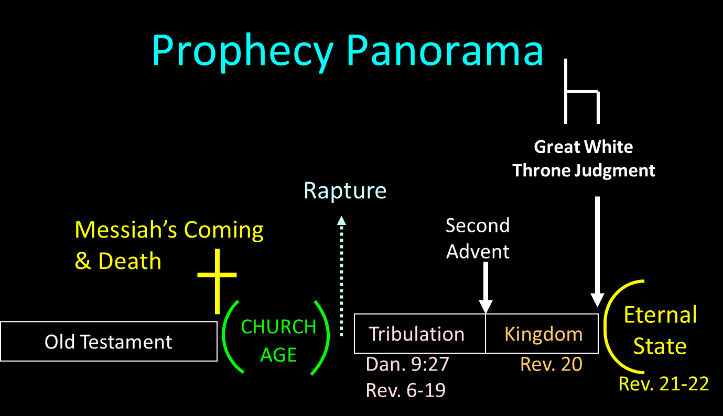

Slide 7
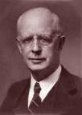
Lewis Sperry Chafer vol. 5, Systematic Theology (Grand Rapids, MI: Kregel Publications, 1993), 359.
“1. the release of Satan from the abyss, 2. the revolt on earth with judgments upon Satan and his armies, 3. the passing of the old heaven and old earth, 4. the great white throne judgment, 5. creation of a new heaven and new earth, 6. the descent of the bridal city from God out of heaven, and 7. the surrender of the mediatorial aspect of Christ's reign and adjustment to the eternal state immediately following.”

Slide 8

Satan’s Progressive Defeat
Initial eviction from heaven (Isa 14:12-15; Ezek 28:12-17)
Eden (Gen 3:15)
Pre-diluvian world (1 Pet 3:19-20)
Cross (John 12:31; 16:11; Col 2:15; Heb 2:14; 1 John 3:8)
Mid point of the Tribulation (Rev 12:9)
Beginning of millennium (Rev 20:2-3)
End of millennium (Rev 20:10)

Slide 9

The Eternal State
After Theocratic Administrator Restoration
New Creation & Not Renovation
Eternal State’s Literal Nature
Continuation of the Davidic Throne
Eternal State’s Description

Slide 10
The Eternal State
After Theocratic Administrator Restoration
New Creation & Not Renovation
Eternal State’s Literal Nature
Continuation of the Davidic Throne
Eternal State’s Description

Slide 12
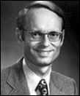
Charles Ryrie
Basic Theology, Page 511
“Why is an earthly kingdom necessary? Did He not receive His inheritance when He was raised and exalted in heaven? Is not His present rule His inheritance? Why does there need to be an earthly kingdom? Because He must be triumphant in the same arena where He was seemingly defeated. His rejection by the rulers of this world was on this earth (1Cor. 2:8). His exaltation must also be on this earth. And so it shall be when He comes again to rule this world in righteousness. He has waited long for His inheritance; soon He shall receive it.”

Slide 13

Genesis 1:26-28
²⁶ Then God said, “Let Us make man in Our image, according to Our likeness; and let them rule over the fish of the sea and over the birds of the sky and over the cattle and over all the earth, and over every creeping thing that creeps on the earth.” ²⁷ God created man in His own image, in the image of God He created him; male and female He created them. ²⁸ God blessed them; and God said to them, …

Slide 14
Genesis 1:26-28
…“Be fruitful and multiply, and fill the earth, and subdue it; and rule over the fish of the sea and over the birds of the sky and over every living thing that moves on the earth.”

Slide 15
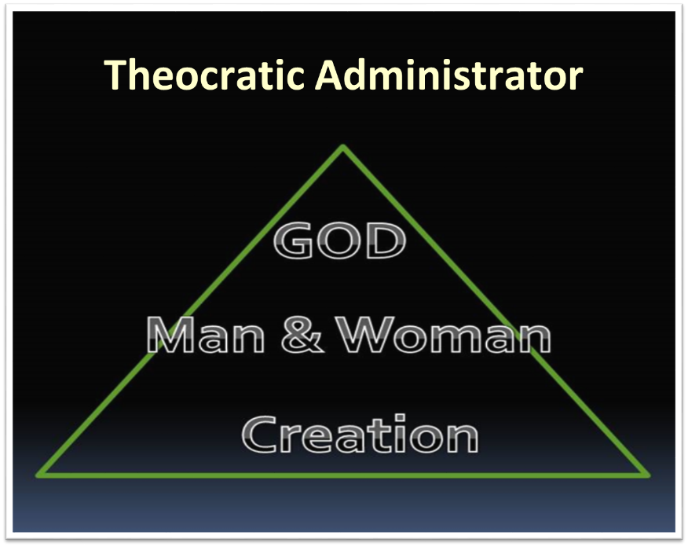

Slide 16
The Eternal State
After Theocratic Administrator Restoration
New Creation & Not Renovation
Eternal State’s Literal Nature
Continuation of the Davidic Throne
Eternal State’s Description

Slide 18
2. New Creation & Not Renovation
Sin’s contamination of the present world
Peter’s description (2 Peter 3:7, 10-11, 13)
Topographical changes
apérchomai (Rev. 21:1, 4)
Analogy with the flood?

Slide 19
2. New Creation & Not Renovation
Sin’s contamination of the present world
Peter’s description (2 Peter 3:7, 10-11, 13)
Topographical changes
aperchomai (Rev. 21:1, 4)
Analogy with the flood?

Slide 20
Genesis 3:17-19
¹⁷ Then to Adam He said, “Because you have listened to the voice of your wife, and have eaten from the tree about which I commanded you, saying, ‘You shall not eat from it’; Cursed is the ground because of you; In toil you will eat of it All the days of your life. ¹⁸ “Both thorns and thistles it shall grow for you; And you will eat the plants of the field; ¹⁹ By the sweat of your face You will eat bread...”

Slide 21
Romans 8:19-22
¹⁹ For the anxious longing of the creation waits eagerly for the revealing of the sons of God. ²⁰ For the creation was subjected to futility, not willingly, but because of Him who subjected it, in hope ²¹ that the creation itself also will be set free from its slavery to corruption into the freedom of the glory of the children of God. ²² For we know that the whole creation groans and suffers the pains of childbirth together until now.

Slide 22
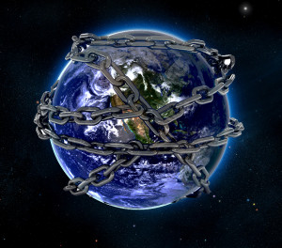

Slide 23
Revelation 20:7-10
“⁷ When the thousand years are completed, Satan will be released from his prison, ⁸ and will come out to deceive the nations which are in the four corners of the earth, Gog and Magog, to gather them together for the war; the number of them is like the sand of the seashore. ⁹ And they came up on the broad plain of the earth and surrounded the camp of the saints and the beloved city, and fire came down from heaven and devoured them. ¹⁰ And the devil…

Slide 24
Revelation 20:7-10
…who deceived them was thrown into the lake of fire and brimstone, where the beast and the false prophet are also; and they will be tormented day and night forever and ever.”

Slide 25

Revelation 21:4
“and He will wipe away every tear from their eyes; and there will no longer be any death; there will no longer be any mourning, or crying, or pain; the first things have passed away.”

Slide 26
Revelation 21:8
“But for the cowardly and unbelieving and abominable and murderers and immoral persons and sorcerers and idolaters and all liars, their part will be in the lake that burns with fire and brimstone, which is the second death.”

Slide 27
2. New Creation & Not Renovation
Sin’s contamination of the present world
Peter’s description (2 Peter 3:7, 10-11, 13)
Topographical changes
aperchomai (Rev. 21:1, 4)
Analogy with the flood?

Slide 28
2 Peter 3:10-12
¹⁰ But the day of the Lord will come like a thief. The heavens will disappear with a roar; the elements will be destroyed by fire, and the earth and everything in it will be laid bare. ¹¹ Since everything will be destroyed in this way, what kind of people ought you to be? You ought to live holy and godly lives ¹² as you look forward to the day of God.
Notes:
READ… The fact that this earth is going up in smoke should help us shape our lives. Don’t live life just for what’s down here, Peter tells us.
One man was in Navigators, a Christian discipleship ministry. He built bridges for a living. It took most of his time and energy. As he reflected on this verse, and the ultimate end of those bridges, he dedicated his life to full-time service for the Lord. We don’t have to serve God as an occupation. But every moment of our lives should be lived with the knowledge that this world will some day be burned up. Only what is done for Christ will have any lasting value. How about us? What are we using our time to build? Something temporal? Or something eternal?

Slide 29
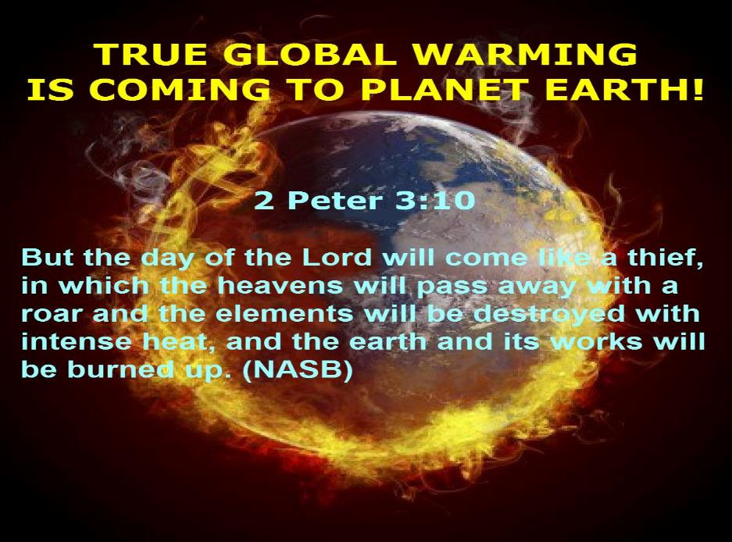

Slide 30
2. New Creation & Not Renovation
Sin’s contamination of the present world
Peter’s description (2 Peter 3:7, 10-11, 13)
Topographical changes
aperchomai (Rev. 21:1, 4)
Analogy with the flood?

Slide 31
Eden = Probationary Environment
Eden (Genesis 1-2) | Eternal State (Rev 21-22)
Division: light/darkness 1:4 | No night 21:25
Division: land/sea 1:10 | No sea 21:1
Sun & moon 1:16 | No sun & moon 21:23
Garden 2:8-9 | City (21:2)
River flowing out of Eden 2:10 | River flowing from throne 22:1
Gold in the land 2:12 | Gold in the city 21:21
Tree of life in the middle of garden 2:9 | Tree of life throughout city 22:2
Bdellium and onyx stone 2:12 | All manner of stones 21:19
God walking in the garden 3:8 | God dwelling with His people 21:3
Henry Morris, Genesis Record, p.33

Slide 32
2. New Creation & Not Renovation
Sin’s contamination of the present world
Peter’s description (2 Peter 3:7, 10-11, 13)
Topographical changes
aperchomai (Rev. 21:1, 4)
Analogy with the flood?

Slide 33
Revelation 21:1, 4
¹ Then I saw a new heaven and a new earth; for the first heaven and the first earth passed away [aperchomai], and there is no longer any sea…⁴ and He will wipe away every tear from their eyes; and there will no longer be any death; there will no longer be any mourning, or crying, or pain; the first things have passed away [aperchomai].

Slide 34
2. New Creation & Not Renovation
Sin’s contamination of the present world
Peter’s description (2 Peter 3:7, 10-11, 13)
Topographical changes
aperchomai (Rev. 21:1, 4)
Analogy with the flood?

Slide 35
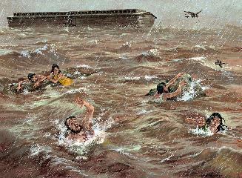
2 Peter 3:6
through which the world [kosmos] at that time was destroyed, being flooded with water.

Slide 36
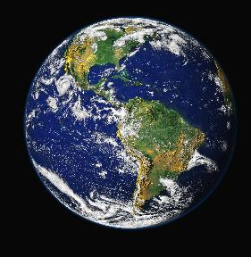
John 3:16
For God so loved the world [kosmos], that He gave His only begotten Son, that whoever believes in Him shall not perish, but have eternal life.

Slide 37
2. New Creation & Not Renovation
Sin’s contamination of the present world
Peter’s description (2 Peter 3:7, 10-11, 13)
Topographical changes
aperchomai (Rev. 21:1, 4)
Analogy with the flood?

Slide 39
Millennium Rev.20 | Eternal State Rev.21-22
Sin restrained | Sin removed
Curse restrained | Curse removed
Death | No death
Mortals / resurrected | Resurrected only
Destinies undecided | Destinies sealed
Renovation | Recreation
Temporary | Eternal
Transitional | Non-transitional

Slide 40
The Eternal State
After Theocratic Administrator Restoration
New Creation & Not Renovation
Eternal State’s Literal Nature
Continuation of the Davidic Throne
Eternal State’s Description

Slide 41
3. The Eternal State’s Literal Nature
“city,” “Jerusalem” | (21:2) | “pearls” | (21:21)
“gold,” “jasper,” “glass,” “wall” | (21:18) | “tribes” | (21:12)
“square,” “miles” | (21:16) | “foundations,” “apostles” | (21:14)
“high” | (21:12) | “street” | (21:21)
“seventy-two yards” | (21:17) | “river” | (22:1)
“gates” | (21:12) | “tree of life” | (22:2)
 |  | “fruit,” “month,” “nations,” “leaves” | (22:2)

Slide 42
The Eternal State
After Theocratic Administrator Restoration
New Creation & Not Renovation
Eternal State’s Literal Nature
Continuation of the Davidic Throne
Eternal State’s Description

Slide 43


Slide 44
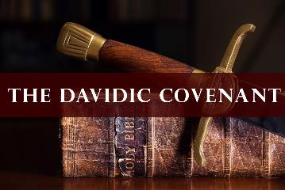
2 Samuel 7:16
Your house and your kingdom shall endure before Me forever; your throne shall be established forever.”

Slide 45
4. David’s Eternal Throne
Psalms 89:3–4, 34–37; 45:6; 72:5, 17
Isaiah 9:6–7
Jeremiah 33:14–17, 20–21
Ezekiel 37:24–28
Daniel 2:44; 7:13–14
Luke 1:30–33
1 Timothy 1:17;
Revelation 11:15

Slide 46
Revelation 11:15
“Then the seventh angel sounded; and there were loud voices in heaven, saying, ‘The kingdom of the world has become the kingdom of our Lord and of His Christ; and He will reign forever and ever.’”

Slide 47
Lewis Sperry Chafer vol. 5, Systematic Theology (Grand Rapids, MI: Kregel Publications, 1993), 360, 373-74.
“The delivery to God of a now unmarred kingdom does not imply the release of authority on the part of the Son. . . . The distinction to be noted lies between the presentation to the Father of a restored authority and the supposed abrogation of a throne on the part of the Son. The latter is neither required in the text nor even intimated. The picture presented in Revelation 22:3 is of the New Jerusalem in the eternal state, and it is declared that ‘the throne of God and of the Lamb shall be in it.’”

Slide 48

Alva J. McClain
Alva J. McClain, The Greatness of the Kingdom: An Inductive Study of the Kingdom of God as Set Forth in the Scriptures (Grand Rapids: Zondervan, 1959), 513.
“As we passed from chapter 20 into chapter 21 of the Apocalypse, therefore, we stand at the junction point between two worlds and between two kingdoms. It is the end of the “first” or “natural” order of things, and the beginning of the final order of things. Here also the mediatorial kingdom of our Lord ends, not by abolition, but by its mergence into the Universal Kingdom of God. Thus, it is perpetuated forever, no longer as a separate entity, but in indissoluble union with the original Kingdom of God from which it sprang.”

Slide 49
Alva J. McClain
Alva J. McClain, The Greatness of the Kingdom: An Inductive Study of the Kingdom of God as Set Forth in the Scriptures (Grand Rapids: Zondervan, 1959), 513.
“What will happen is succinctly described in St. Paul’s classic passage on the subject: ‘Then cometh the end, when he shall have delivered up the kingdom to God, even the Father; when he shall have put down all rule and all authority and power. . . . And when all things shall be subdued unto him, then shall the Son also himself be subject unto him that put all things under him, that God may be all in all’ (1 Cor. 15:24, 28). This does not mean the end of our Lord’s regal activity, but rather that from here onward in the unity of the Godhead He reigns with the Father as eternal Son. There are no longer two thrones, one His Messianic Throne and the other the Father’s Throne, as our Lord indicated in Revelation 3:21. In the final Kingdom there is but one throne, and it is ‘the throne of God and of the Lamb’” (22:3).”

Slide 50

Michael J. Vlach
Michael J. Vlach, Premillennialism: Why There Must Be a Future Earthly Kingdom of Jesus (Los Angeles, CA: Theological Studies, 2015), 101–2.
“The Father commissions Jesus to conquer and restore this fallen world on His behalf, and when Jesus accomplishes this task He then will subject Himself to the Father. Jesus’ mission is accomplished and the Father is pleased with His reign. Every square inch of this universe has been restored. At this point the reign of Jesus is followed by the universal reign of God the Father. This does not mean that Jesus ceases to reign. Revelation 11:15 says Jesus ‘will reign forever and ever.’…Messiah’s kingdom is then blended into the Father’s universal kingdom. Jesus’ prayer, ‘Thy kingdom come, Thy will be done on earth as it is in heaven’ (Matt. 6:10) is fully accomplished. Jesus’ kingdom does not end like earthly kingdoms do by defeat, but by fulfillment.”

Slide 51
Conclusion

Slide 52
The Eternal State
After Theocratic Administrator Restoration
New Creation & Not Renovation
Eternal State’s Literal Nature
Continuation of the Davidic Throne
Eternal State’s Description

