Slide 1
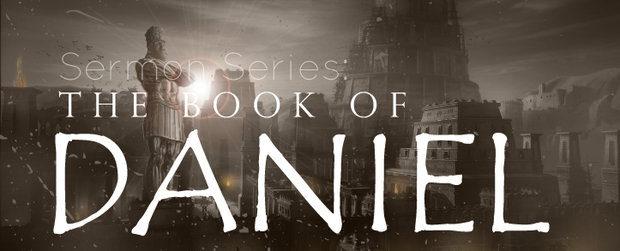
THE BOOK OF DANIEL
Dr. Andy Woods

Slide 2
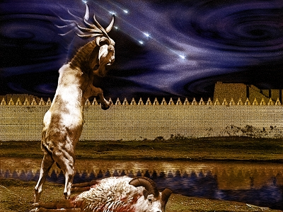
DANIEL 10-12 THE FINAL VISION

Slide 3
CHAPTER AND VERSE IN DANIEL | CHRONOLOGICAL DATE | BIBLICAL DATE
1:1 | 605 | 3rd year of Jehoiakim
2:1 | 603 | 2nd year of Nebuchadnezzar
5 | Sat. night 10/12/539 (Hoehner)
7:1 | 553 | 1st year of Belshazzar
8:1 | 551 | 3rd year of Belshazzar
9:1 | 538 | 1st year of Darius
10:1 | 536 | 3rd year of Cyrus

Slide 4
Chapter 10–12 Outline
The Setting (10:1-3)
Arrival of the Heavenly Messenger (10:4-9)
Explanation of the Heavenly Messenger (10:10–11:1)
The Prophecy of the Heavenly Messenger (11:2–12:13)

Slide 5
IV. The Prophecy of the Heavenly Messenger (11:2–12:13)
Persia (11:2)
Greece (11:3-4)
Ptolemies & Seleucids (11:5-20)
Antiochus IV (11:21-35)
Antichrist (11:36-45)
Tribulation & Millennium (12:1-13)

Slide 6
IV. The Prophecy of the Heavenly Messenger (11:2–12:13)
Persia (11:2)
Greece (11:3-4)
Ptolemies & Seleucids (11:5-20)
Antiochus IV (11:21-35)
Antichrist (11:36-45)
Tribulation & Millennium (12:1-13)

Slide 7
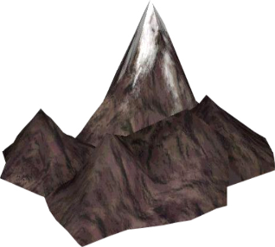
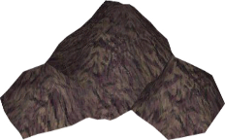
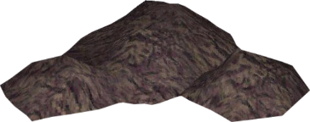
Understanding Daniel’s
Prophetic Perspective
Antichrist
Antiochus IV
(Daniel 11:36-45)
(Daniel 11:21-35)
Far
Fulfillment
Near
Fulfillment
Daniel

Slide 8
The Career of the Antichrist Daniel 11:36-45
His self-magnification (36-37)
His military power (38-39)
His military successes (40-43)
His military defeat (44-45)

Slide 9
The Career of the Antichrist Daniel 11:36-45
His self-magnification (36-37)
His military power (38-39)
His military successes (40-43)
His military defeat (44-45)

Slide 10
The Career of the Antichrist Daniel 11:36-45
His self-magnification (36-37)
His military power (38-39)
His military successes (40-43)
His military defeat (44-45)

Slide 11
The Career of the Antichrist Daniel 11:36-45
His self-magnification (36-37)
His military power (38-39)
His military successes (40-43)
His military defeat (44-45)

Slide 13
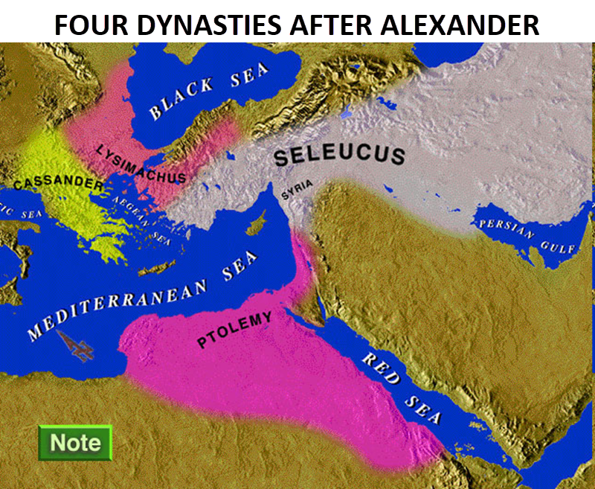

Slide 15
Daniel 9:27
And he will make a firm covenant with the many for one week, but in the middle of the week he will put a stop to sacrifice and grain offering; and on the wing of abominations will come one who makes desolate, even until a complete destruction, one that is decreed, is poured out on the one who makes desolate.

Slide 16
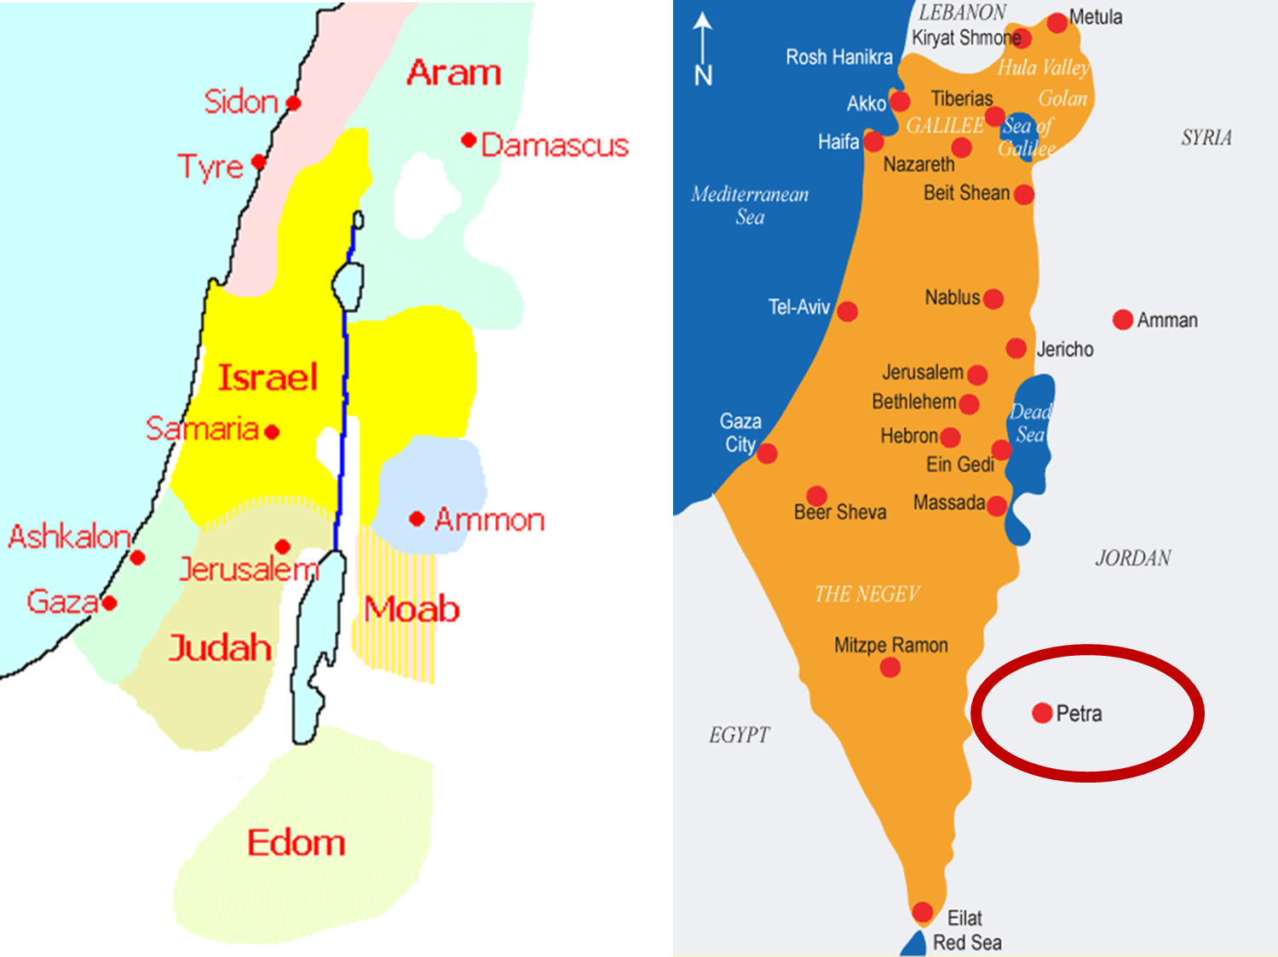

Slide 17
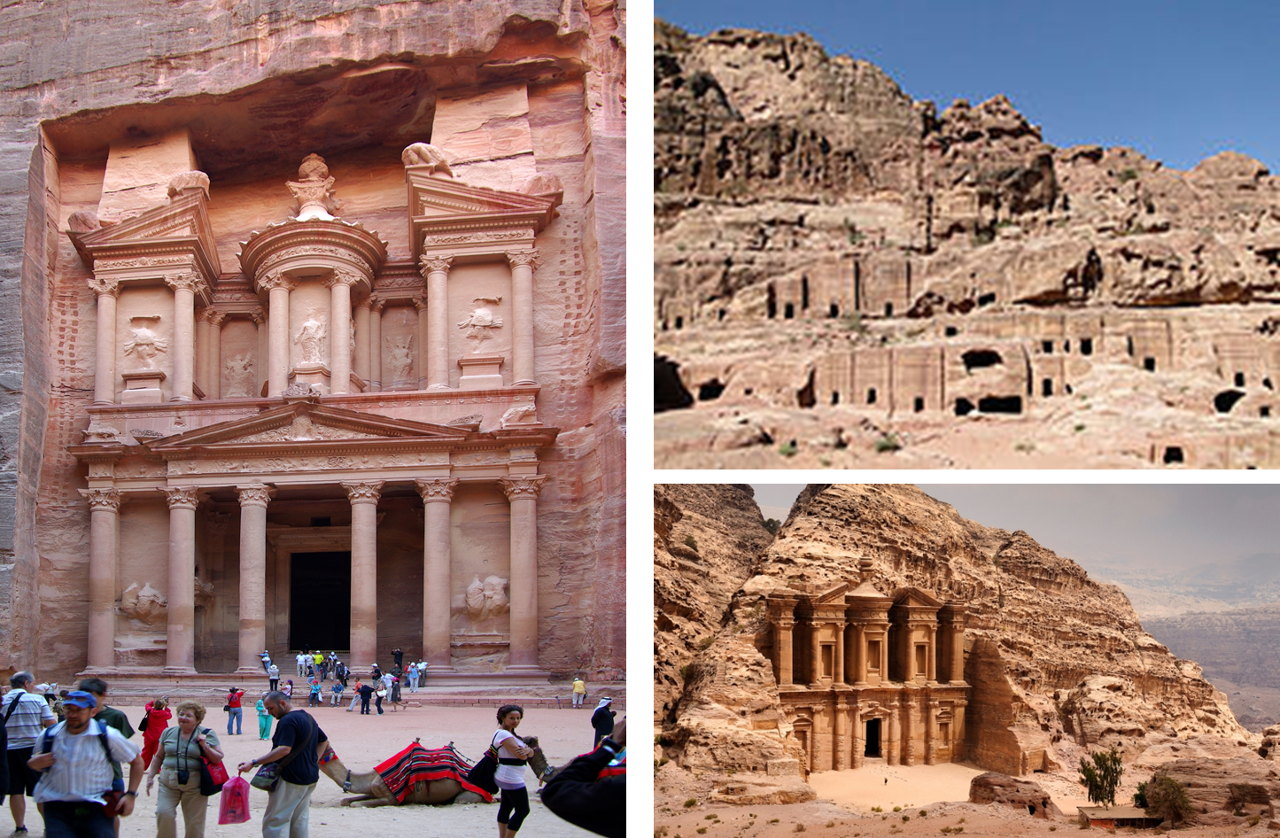

Slide 18
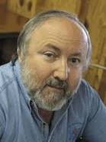
Arnold Fruchtenbaum (2003). The Footsteps of the Messiah : a study of the sequence of prophetic events (Rev. ed., p. 297). Tustin, CA: Ariel Ministries.
“The passage states that while the Antichrist will conquer the whole world, three nations will escape his domination: Edom, Moab, and Ammon. All three of these ancient nations currently comprise the single modern kingdom of Jordan. The city of Bozrah in Mount Seir is located in ancient Edom or southern Jordan. Since this area will escape the domination of the Antichrist, it is logical for the Jews to flee to this place. Thus, God will provide a city of refuge outside the Antichrist’s domain for the fleeing Remnant. It will be a very defensible city located in Mount Seir…Furthermore, as they flee and while they are living there, food and water will be miraculously provided.”

Slide 20
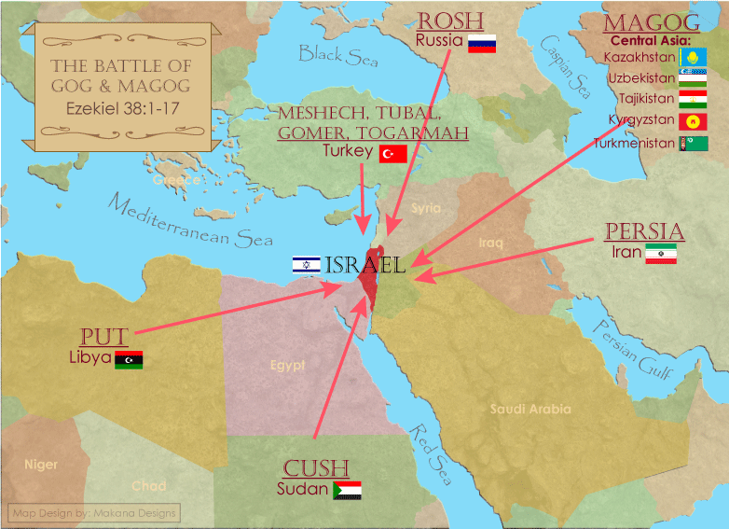

Slide 24
The Career of the Antichrist Daniel 11:36-45
His self-magnification (36-37)
His military power (38-39)
His military successes (40-43)
His military defeat (44-45)

Slide 25
Isaiah 9:6-7
⁶ For a child will be born to us, a son will be given to us; And the government will rest on His shoulders; And His name will be called Wonderful Counselor, Mighty God, Eternal Father, Prince of Peace.⁷ There will be no end to the increase of His government or of peace, On the throne of David and over his kingdom, To establish it and to uphold it with justice and righteousness From then on and forevermore. The zeal of the Lord of hosts will accomplish this.

Slide 26
2 Thessalonians 2:3, 7
³ “Let no one in any way deceive you, for it will not come unless the apostasy comes first, and the man of lawlessness is revealed, the son of destruction…⁷ For the mystery of lawlessness is already at work; only he who now restrains will do so until he is taken out of the way.”

Slide 27
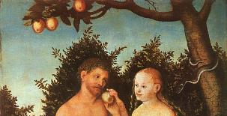
1 John 4:3
“and every spirit that does not confess Jesus is not from God; this is the spirit of the antichrist, of which you have heard that it is coming, and now it is already in the world.”

Slide 28
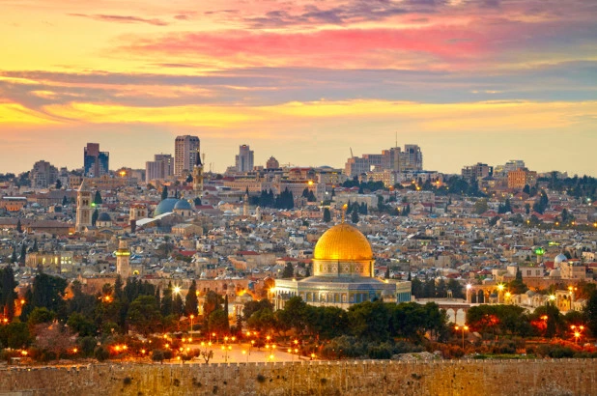
Ezekiel 5:5
“Thus says the Lord God, ‘This is Jerusalem; I have set her at the center of the nations, with lands around her.’”

Slide 29
Ezekiel 38:12
“to capture spoil and to seize plunder, to turn your hand against the waste places which are now inhabited, and against the people who are gathered from the nations, who have acquired cattle and goods, who live at the center of the world.”

Slide 31
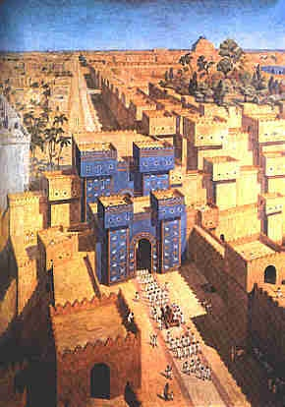
East = Babylon
Genesis 2:8
Genesis 11:2
Matthew 2:2

Slide 32
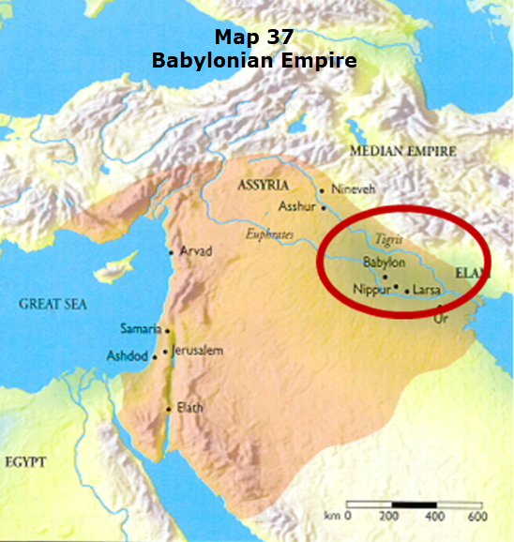

Slide 33
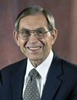
Renald Showers (2002). The Most High God (p. 166). Bellmawr, NJ. Friends Of Israel.
“Inasmuch as Christ did not tell Daniel that the king of the South and the king of the North of verse 40 are different from those of verses two through 35, it would appear that Christ intended them to be understood as being the same. This would mean, then, that in verse 40 the king of the South is still Egypt, and the king of the North is still Syria.”

Slide 36
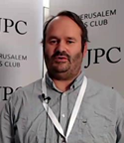
Seth J. Frantzman
The Jerusalem Post, online: http://www.jpost.com/Middle-East/Iran-News/Analysis-Russia-Iran-Turkey-meeting-is-message-to-US-514581. November 19, 2017 , accessed 12 December 2017.
“Analysis: Russia-Iran-Turkey meeting is message to US. Moscow, Turkey and Iran are all sending symbolic messages to Washington that the Americans are out in the cold and the post-ISIS era may well be dictated by regional powers.”

Slide 37
Schams Elwazer
Milena Veselinovic and Hilary McGann. CNN, online: http://www.cnn.com/2017/11/22/world/syria-russia-turkey-iran-talks/index.html. November 22, 2017 , accessed 12 December 2017.
“Russia, Iran, Turkey agree to hold Syrian 'congress' to talk peace. Russian President Vladimir Putin, center, addresses reporters with Iranian President Hassan Rouhani, left, and Turkish President Recep Tayyip Erdogan after a meeting on Syria in Sochi, Russia, on Wednesday.”

Slide 38
Daily Sabah
online: https://www.dailysabah.com/diplomacy/2017/08/07/turkey-iran-russia-to-hold-syria-talks-in-tehran-aug-8-9. August 07, 2017, accessed 12 December 2017.
“Turkey, Iran, Russia to hold Syria talks in Tehran Aug. 8-9. Iranian Foreign Minister Javad Zarif (L), Russian Foreign Minister Sergey Lavrov (C), and Turkish Foreign Minister Mevlüt Çavuşoğlu attend a joint press conference after talks in Moscow, Russia, December 20, 2016. Turkish, Iranian and Russian officials will hold talks concerning war-torn Syria in Tehran on August 8-9, Russian Foreign Minister Sergey Lavrov said Sunday.”

Slide 39
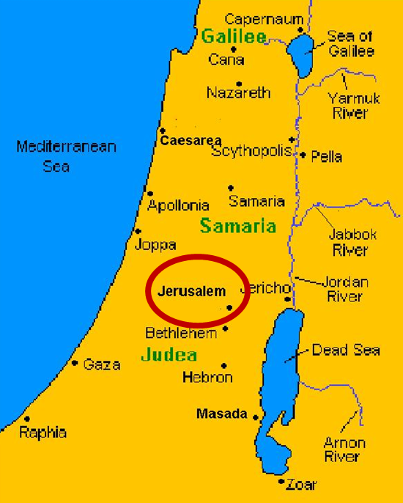

Slide 40
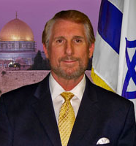
Randall Price (1998). Jerusalem in Prophecy ( p. 139). Eugene, OR: harvest House.
“The two ‘seas’ referenced here are most likely the Mediterranean Sea to the west and the Dead Sea to the east, since between them is the ‘beautiful Holy Mountain.’ No other place qualifies as the ‘Holy Mountain’ but the Temple Mount in Jerusalem. The ‘royal pavilion’ in Daniel 11:45 refers to the military command center of the Antichrist in Jerusalem. Why in Jerusalem? Because apparently he will already be there. It is for this reason that the attack by the other kings will be aimed at Jerusalem (Daniel 11:44) and why the Antichrist will be killed there...”
Notes:
Fruchtenbaum, A. G. (2003). The footsteps of the Messiah : a study of the sequence of prophetic

Slide 41
Arnold Fruchtenbaum (2003). The Footsteps of the Messiah : a study of the sequence of prophetic events (Rev. ed., p. 245). Tustin, CA: Ariel Ministries.
“The word for tent refers to a military tent of a general, and the word for palace to a royal tent. It is a royal tent of a military general (the Antichrist) that is set up. It is set up between the seas, meaning between the Mediterranean Sea and the Dead Sea. Furthermore, it is at the glorious holy mountain, meaning the Temple Mount, or Mount Moriah or Mount Zion.”

Slide 42
Daniel 9:27
And he will make a firm covenant with the many for one week, but in the middle of the week he will put a stop to sacrifice and grain offering; and on the wing of abominations will come one who makes desolate, even until a complete destruction, one that is decreed, is poured out on the one who makes desolate.

Slide 44
NO. | CATEGORY | JESUS CHRIST | ANTICHRIST
1. | World prepared in advance | Gal. 4:4 | 2 Thess. 2:7
2. | Revealed at the proper time | Gal. 4:4 | 2 Thess. 2:6
3. | Claim of deity | John 14:9 | 2 Thess. 2:4
4. | Heralded by a forerunner | John 1:23 | Rev. 13:12
5. | Forerunner comes in the Spirit and power of Elijah | Luke 1:17 | 1 Kgs. 8:37-38; Rev. 13:13
6. | Empowered by a higher source | 1 Cor. 6:14 | Rev. 13:14
7. | Member of a Trinity | Phil. 1:2; Acts 5:3-4; John 14:9 | Rev. 16:13; 20:10
8. | Head of a Church | Eph. 5:23 | Rev. 2:9; 3:9
9. | Miracle worker | Acts 2:22 | 2 Thess. 2:9
10. | Resurrection from the dead | 1 Cor. 15:3-6 | Rev. 13:3, 12, 14

Slide 45
NO. | CATEGORY | JESUS CHRIST | ANTICHRIST
11. | Ruling a political kingdom | Isa. 9:6-7 | Rev. 13:5
12. | Ushering in world peace | Isa. 9:6-7 | Rev. 6:1-4
13. | Activity in the Temple | Luke 2:41-50 | 2 Thess. 2:4
14. | Putting an end to animal sacrifices | Heb. 9:26-29 | Dan. 9:27
15. | Length of ministry | Over 3 years | Rev. 13:5
16. | Sealing ministry | Eph. 4:30 | Rev. 13:16-17
17. | Presentation to Israel as her Messiah | John 1:11 | John 5:43
18. | Covenant with Israel | Gen. 15:18 | Dan. 9:27
19. | Reception of worship | Zech. 14:16 | 2 Thess. 2:4
20. | Establishing Jerusalem as the center of worldwide worship | Zech. 14:17 | 2 Thess. 2:4

Slide 46
Conclusion

Slide 47
Chapter 10–12 Outline
The Setting (10:1-3)
Arrival of the Heavenly Messenger (10:4-9)
Explanation of the Heavenly Messenger (10:10–11:1)
The Prophecy of the Heavenly Messenger (11:2–12:13)

Slide 48
IV. The Prophecy of the Heavenly Messenger (11:2–12:13)
Persia (11:2)
Greece (11:3-4)
Ptolemies & Seleucids (11:5-20)
Antiochus IV (11:21-35)
Antichrist (11:36-45)
Tribulation & Millennium (12:1-13)

Slide 49
Purpose
To encourage Judah by emphasizing the sovereignty of God during the Babylonian captivity and to teach Judah how to live while outside the land

Slide 50
“The Lord bless you and keep you; the Lord make his face shine on you and be gracious to you; the Lord turn his face toward you and give you peace.” (NIV)

