Slide 1
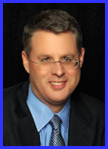
Ecclesiology Session 5
Dr. Andy Woods
Senior Pastor – Sugar Land Bible Church
President – Chafer Theological Seminary

Slide 2
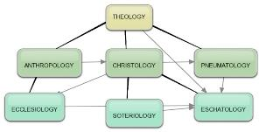
Areas of Systematic Theology
Prolegomena – Introduction
Theology – Study of God
Christology – Study of Christ
Pneumatology – Study of the Holy Spirit
Anthropology – Study of Man
Hamartiology – Study of sin
Soteriology – Study of salvation
Angelology – Study of angels
Ecclesiology – Study of the Church
Eschatology – Study of the end

Slide 3
Ecclesiology Overview
Definition
Universal vs. local
Word pictures
Origin
Israel – Church differences
Intercalation
Purposes
Activities
Government
Officers
Ordinances
Purity

Slide 4
Ecclesiology Overview
Definition
Universal vs. local
Word pictures
Origin
Israel – Church differences
Intercalation
Purposes
Activities
Government
Officers
Ordinances
Purity

Slide 5
Definition of Ecclesiology
Ekklēsía (ἐκκλησία)
ĕk (ἐκ) / kaleo (καλέω)
Acts 15:14
Logos
1 Cor 10:32

Slide 6
1 Corinthians 10:32
“Give no offense either to Jews or to Greeks or to the church of God.”

Slide 7
The Definition of the Church
All (both Jew & Gentile) who have trusted in the very Messiah rejected by first-century national Israel (Gal. 3:28; Rom. 10:19; Eph. 2:14)
Intercalation
Does not fulfill Israel’s purposes

Slide 8
Ecclesiology Overview
Definition
Universal vs. local
Word pictures
Origin
Israel – Church differences
Intercalation
Purposes
Activities
Government
Officers
Ordinances
Purity

Slide 9
The Universal vs. Local Church
 | Universal | Local
Number | One | Many
Members | All believers from Pentecost to the Rapture | Local gathering
Spiritual status | Believers only | Believers and unbelievers
Living or dead | Living and dead | Living only
Assembly | Cannot assemble at one place and time | Can assemble at one place and time
Visibility | Invisible | Visible
NT Material | Minority | Majority
Joining | Faith alone | Unique requirements
Denomination | All believers | Specific denomination

Slide 10
Ecclesiology Overview
Definition
Universal vs. local
Word pictures
Origin
Israel – Church differences
Intercalation
Purposes
Activities
Government
Officers
Ordinances
Purity

Slide 11
Universal Church Word Pictures
Shepherd/sheep – John 10:16; Acts 20:28; Heb 13:20; 1 Pet 5:2-4
Head/body – Rom 12:5; 1 Cor 12:12-13; Eph 1:22-23
Bride/groom – Eph 5:22-33; 2 Cor 11:2-3
Temple – 1 Cor 3:16-17; Eph 2:19-22; Gal 6:10
High priest/priesthood – Heb 4:14-15; 1 Pet 2:5-9; Rev 1:6
Pillar of truth – 1 Tim 3:15
Vine and branches – John 15:1-8

Slide 12
Universal Church Word Pictures
Shepherd/sheep – John 10:16; Acts 20:28; Heb 13:20; 1 Pet 5:2-4
Head/body – Rom 12:5; 1 Cor 12:12-13; Eph 1:22-23
Bride/groom – Eph 5:22-33; 2 Cor 11:2-3
Temple – 1 Cor 3:16-17; Eph 2:19-22; Gal 6:10
High priest/priesthood – Heb 4:14-15; 1 Pet 2:5-9; Rev 1:6
Pillar of truth – 1 Tim 3:15
Vine and branches – John 15:1-8

Slide 13
Universal Church Word Pictures
Shepherd/sheep – John 10:16; Acts 20:28; Heb 13:20; 1 Pet 5:2-4
Head/body – Rom 12:5; 1 Cor 12:12-13; Eph 1:22-23
Bride/groom – Eph 5:22-33; 2 Cor 11:2-3
Temple – 1 Cor 3:16-17; Eph 2:19-22; Gal 6:10
High priest/priesthood – Heb 4:14-15; 1 Pet 2:5-9; Rev 1:6
Pillar of truth – 1 Tim 3:15
Vine and branches – John 15:1-8

Slide 14
Universal Church Word Pictures
Shepherd/sheep – John 10:16; Acts 20:28; Heb 13:20; 1 Pet 5:2-4
Head/body – Rom 12:5; 1 Cor 12:12-13; Eph 1:22-23
Bride/groom – Eph 5:22-33; 2 Cor 11:2-3
Temple – 1 Cor 3:16-17; Eph 2:19-22; Gal 6:10
High priest/priesthood – Heb 4:14-15; 1 Pet 2:5-9; Rev 1:6
Pillar of truth – 1 Tim 3:15
Vine and branches – John 15:1-8

Slide 15
Jewish Marriage Analogy
Marriage covenant | Groom initiated; Covenant established upon payment for bride; drank same cup | Christ initiated; Christ’s sacrificial death (1 Cor. 6:19-20; 11:25)
Bride set apart | Bride set apart exclusively for groom | Church’s positionally sanctified (1 Cor. 1:2; 6:9-11)
Bridal chamber prepared | Groom separates from bride and returns to his father’s house to prepare bridal chamber | Christ’s 2000 year separation from church; Ascension; return to heaven to prepare dwellings (John 14:2; Acts 1:9-11)
Betrothal period | Loyalty test | Reward determined by orthodoxy and orthopraxy (Jas. 4:4)
Bride retrieved | Groom returns at unknown time preceded by a shout with escorts to retrieve bride | Rapture at unknown time (John 14:3; 1 Thess. 4:16-17)
Showers, Maranatha Our Lord, Come!, 164-69.

Slide 16
Jewish Marriage Analogy
Bride and groom hidden in Father’s house for seven days | Hidden in the Father’s house for seven days: three events transpire | Church hidden from world during Daniel’s 70th Week
Bride cleansed | Bride undergoes ritual cleansing prior to wedding ceremony | Bema Seat Judgment 1 Cor 3:10-15; 2 Cor 5:10)
Wedding ceremony | Meeting with the Father’s assembled wedding guests; Private wedding ceremony | Meeting with OT saints; Rev 19:7
Consummation | Bride and groom consummate the marriage | Eph 5:27
Marriage feast | Public presentation; Bride unveiled; marriage feast | Col 3:3-4; Rev 19:9
Showers, Maranatha Our Lord, Come!, 164-69.

Slide 17
Universal Church Word Pictures
Shepherd/sheep – John 10:16; Acts 20:28; Heb 13:20; 1 Pet 5:2-4
Head/body – Rom 12:5; 1 Cor 12:12-13; Eph 1:22-23
Bride/groom – Eph 5:22-33; 2 Cor 11:2-3
Temple – 1 Cor 3:16-17; Eph 2:19-22; Gal 6:10
High priest/priesthood – Heb 4:14-15; 1 Pet 2:5-9; Rev 1:6
Pillar of truth – 1 Tim 3:15
Vine and branches – John 15:1-8

Slide 18
ISRAEL’S FOUR TEMPLES
Solomon’s pre exilic temple (966 bc, Kings and Chronicles)
Zerubbabel’s post exilic temple (Ezra 1-6; John 2:20)
Antichrist's temple (Dan 9:27; Matt 24:15; 2 Thess 2:4; Rev 11:1-2)
Millennial temple (Ezek 40-48)
Notes:
Herod proposed to renovate Zerubbabel’s Temple in 20-19 BC. Finishing touches continued until AD 63.

Slide 19
Universal Church Word Pictures
Shepherd/sheep – John 10:16; Acts 20:28; Heb 13:20; 1 Pet 5:2-4
Head/body – Rom 12:5; 1 Cor 12:12-13; Eph 1:22-23
Bride/groom – Eph 5:22-33; 2 Cor 11:2-3
Temple – 1 Cor 3:16-17; Eph 2:19-22; Gal 6:10
High priest/priesthood – Heb 4:14-15; 1 Pet 2:5-9; Rev 1:6
Pillar of truth – 1 Tim 3:15
Vine and branches – John 15:1-8

Slide 20
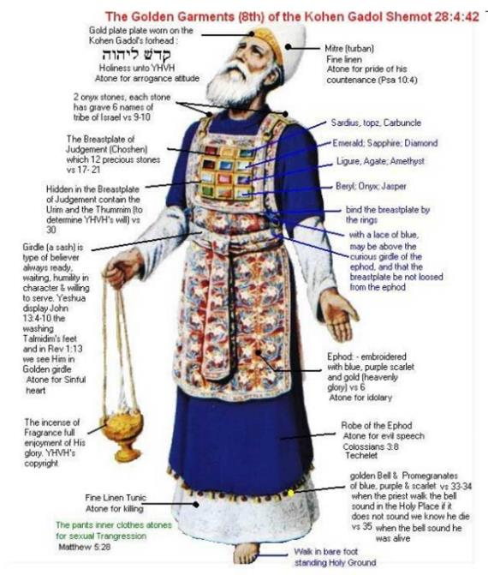

Slide 21
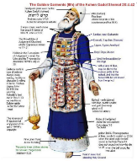
Revelation 1:6
“and He [God] has made us [Church] to be a kingdom, priests to His God and Father—to Him be the glory and the dominion forever and ever. Amen.”

Slide 22
Spiritual Sacrifices
Body – Rom 12:1
Praise – Heb 13:15
Good works – Philip 2:17
Financial giving – Heb 13:16

Slide 23
Universal Church Word Pictures
Shepherd/sheep – John 10:16; Acts 20:28; Heb 13:20; 1 Pet 5:2-4
Head/body – Rom 12:5; 1 Cor 12:12-13; Eph 1:22-23
Bride/groom – Eph 5:22-33; 2 Cor 11:2-3
Temple – 1 Cor 3:16-17; Eph 2:19-22; Gal 6:10
High priest/priesthood – Heb 4:14-15; 1 Pet 2:5-9; Rev 1:6
Pillar of truth – 1 Tim 3:15
Vine and branches – John 15:1-8

Slide 24
1 Timothy 3:15
“but in case I am delayed, I write so that you will know how one ought to conduct himself in the household of God, which is the church of the living God, the pillar and support of the truth.”

Slide 25
D. Martyn Lloyd-Jones
Knowing the Times (Carlisle, PA: The Banner of Truth Trust, 1989; reprint, 2001), 161-62.
“To regard a church, or a council of churches, as a forum in which fundamental matters can be debated and discussed, or as an opportunity for witness-bearing, is sheer confusion and muddled thinking. There is to be no discussion about ‘the foundation’, as we have seen. If men do not accept that, they are not brethren and we can have no dialogue with them. We are to preach to such and to evangelize them. Discussion takes place among the brethren who share the same life and subscribe to the same essential truths. It is right and good that brethren should discuss together matters which are not essential to salvation and about which there is, and always has been, and always will be, legitimate differences of opinion. We can do no better at that point than quote the old adage, ‘In things essential, unity, in things indifferent liberty, in all things charity.’”

Slide 26
D. Martyn Lloyd-Jones
Knowing the Times (Carlisle, PA: The Banner of Truth Trust, 1989; reprint, 2001), 161-62.
“Before there can be any real discussion and dialogue and exchange there must be agreement concerning primary and fundamental matters. Without the acceptance of certain axioms and propositions in geometry, for example, it is idle to attempt to solve any problem. If certain people refuse to accept the axioms, and are constantly querying and disputing them, clearly there is no point of contact between them and those who do accept them. It is precisely the same in the realm of the church. Those who question and query, let alone deny, the great cardinal truths that have been accepted throughout the centuries do not belong to the church, and to regard them as brethren is to betray the truth. As we have already reminded ourselves, the apostle Paul tells us clearly what our attitude to them should be: ‘A man that is a heretic after the first and second admonition reject’ (Tit. 3:10).”

Slide 27
D. Martyn Lloyd-Jones
Knowing the Times (Carlisle, PA: The Banner of Truth Trust, 1989; reprint, 2001), 161-62.
“They are to be regarded as unbelievers and need to be called to repentance and acceptance of the truth as it is in Christ Jesus. To give the impression that they are Christians with whom other Christians disagree about certain matters is to confuse the genuine seeker and enquirer who is outside. But such is the position prevailing today. It is based upon a failure to understand the nature of the New Testament church which is ‘the pillar and ground of the truth’ (1 Tim. 3:15). In the same way it is a sheer waste of time to discuss or debate the implications of Christianity with people who are not agreed as to what Christianity is. Failure to realize this constitutes the very essence of the modern confusion.”

Slide 28
2 John 9-11
“⁷ For many deceivers have gone out into the world, those who do not acknowledge Jesus Christ as coming in the flesh. This is the deceiver and the antichrist. ⁸ Watch yourselves, that you do not lose what we have accomplished, but that you may receive a full reward. ⁹ Anyone who goes too far and does not abide in the teaching of Christ, does not have God; the one who abides in the teaching, he has both the Father and the Son. ¹⁰ If anyone comes to you and does not bring this teaching, do not receive him into your house, and do not give him a greeting; ¹¹ for the one who gives him a greeting participates in his evil deeds.”

Slide 29
Universal Church Word Pictures
Shepherd/sheep – John 10:16; Acts 20:28; Heb 13:20; 1 Pet 5:2-4
Head/body – Rom 12:5; 1 Cor 12:12-13; Eph 1:22-23
Bride/groom – Eph 5:22-33; 2 Cor 11:2-3
Temple – 1 Cor 3:16-17; Eph 2:19-22; Gal 6:10
High priest/priesthood – Heb 4:14-15; 1 Pet 2:5-9; Rev 1:6
Pillar of truth – 1 Tim 3:15
Vine and branches – John 15:1-8

Slide 30
CONCLUSION

Slide 31
Universal Church Word Pictures
Shepherd/sheep – John 10:16; Acts 20:28; Heb 13:20; 1 Pet 5:2-4
Head/body – Rom 12:5; 1 Cor 12:12-13; Eph 1:22-23
Bride/groom – Eph 5:22-33; 2 Cor 11:2-3
Temple – 1 Cor 3:16-17; Eph 2:19-22; Gal 6:10
High priest/priesthood – Heb 4:14-15; 1 Pet 2:5-9; Rev 1:6
Pillar of truth – 1 Tim 3:15
Vine and branches – John 15:1-8

Slide 32
Ecclesiology Overview
Definition
Universal vs. local
Word pictures
Origin
Israel – Church differences
Intercalation
Purposes
Activities
Government
Officers
Ordinances
Purity

