Slide 1

THE BOOK OF DANIEL
Dr. Andy Woods

Slide 2

Message
Times of the Gentiles are revealed prophetically (2, 7, 8-12) and ethically (1, 3-6)

Slide 3

Synthetic Outline
Historical (1-7):
  Daniel interprets, 3rd person, gentile nations
  Intro “Hebrew” (1)
  Aramaic chiasm (2-7)

Slide 4
Synthetic Outline
Historical (1-7):
  Daniel interprets, 3rd person, gentile nations
  Intro “Hebrew” (1)
  Aramaic chiasm (2-7)

Slide 5
Synthetic Outline
Historical (1-7):
  Daniel interprets, 3rd person, gentile nations
  Intro “Hebrew” (1)
  Aramaic chiasm (2-7)

Slide 6

Synthetic Outline
  Chiasm “Aramaic” ( 2-7)
1. Gentile History (2)
  2. Protection (3)
    3. Revelation to a gentile king (4)
    3. Revelation to a gentile king (5)
  2. Protection (6)
1. Gentile history (7)

Slide 7
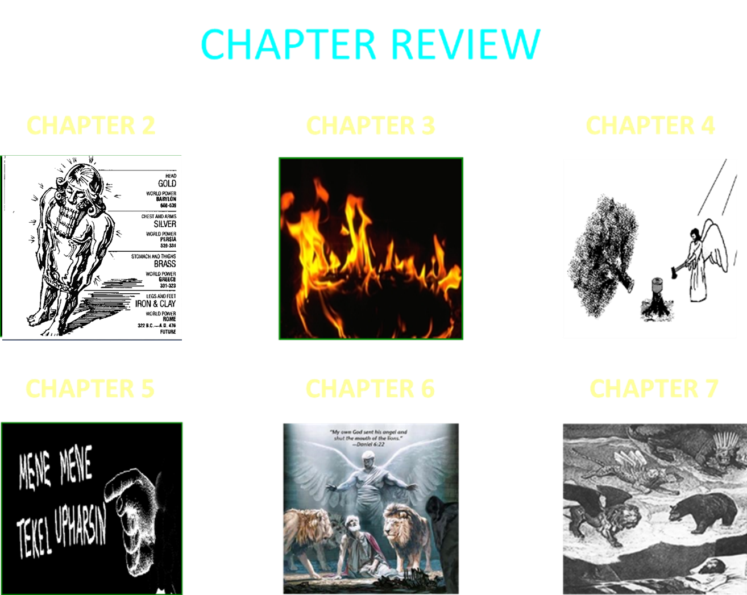

Slide 8
Synthetic Outline
Prophetic (8-12):
  Angel interprets, 1st person, Jewish nation, Hebrew
  Ram & Goat (8)
  70 weeks (9)
  Final vision (10-12)

Slide 9
Synthetic Outline
Prophetic (8-12):
  Angel interprets, 1st person, Jewish nation, Hebrew
  Ram & Goat (8)
  70 weeks (9)
  Final vision (10-12)

Slide 10
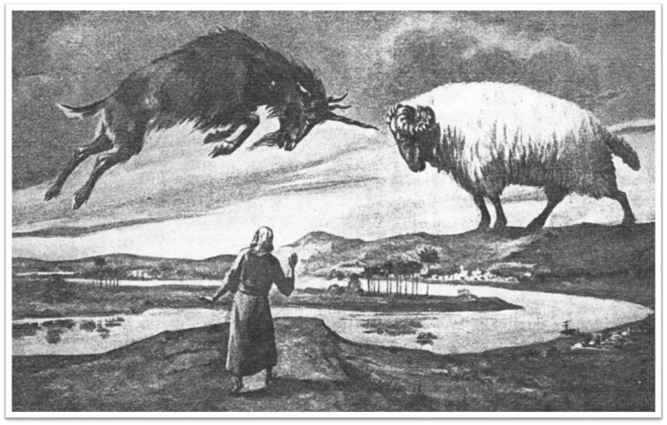

Slide 11
Synthetic Outline
Prophetic (8-12):
  Angel interprets, 1st person, Jewish nation, Hebrew
  Ram & Goat (8)
  70 weeks (9)
  Final vision (10-12)

Slide 12

Chapter 9 Outline
The Setting (1-2)
Daniel’s prayer (3-19)
Gabriel’s arrival (20-23)
The Seventy Weeks Prophecy (24-27)

Slide 13
Chapter 9 Outline
The Setting (1-2)
Daniel’s prayer (3-19)
Gabriel’s arrival (20-23)
The Seventy Weeks Prophecy (24-27)

Slide 14
I. The Setting (1-2)
Historical setting (v.1)
Prophetic setting (v.2)

Slide 15
I. The Setting (1-2)
Historical setting (v.1)
Prophetic setting (v.2)

Slide 16
Succession of Gentile Rulers
1-4: Nebuchadnezzar of Babylon
5: Belshazzar of Babylon
6: Darius of Media – Persia
7-8: Belshazzar of Babylon
9: Darius of Media – Persia
10-12: Cyrus of Media – Persia

Slide 17
CHAPTER AND VERSE IN DANIEL | CHRONOLOGICAL DATE | BIBLICAL DATE
1:1 | 605 | 3rd year of Jehoiakim
2:1 | 603 | 2nd year of Nebuchadnezzar
5 | Sat. night 10/12/539 (Hoehner)
7:1 | 553 | 1st year of Belshazzar
8:1 | 551 | 3rd year of Belshazzar
9:1 | 538 | 1st year of Darius
10:1 | 536 | 3rd year of Cyrus

Slide 18
Daniel’s Age
CHAPTER | EVENTS | AGE
1 | Taken to Babylonian captivity | 15
2 | Interpreting Nebuchadnezzar’s 1st dream (huge image) | 17
3 | Daniel’s 3 friends cast into the fiery furnace | 19 or 20
4 | Interpreting Nebuchadnezzar’s 2nd dream (huge tree) | 45-50
5 | Interpreting handwriting of the wall at Belshazzar’s feast | Early 80’s
6 | Delivered from the den of lions | c.83
7-8 | Daniel’s visions and dreams | Mid-60’s
9 | Daniel’s seventy “sevens” prophecy | Early-80’s
10-12 | Final dreams and visions | Mid-80’s

Slide 19
I. The Setting (1-2)
Historical setting (v.1)
Prophetic setting (v.2)

Slide 20
SETTING : PROPHETIC
V.2
70 YEAR CAPTIVITY ABOUT TO END
  Jeremiah 25:11; 29:10
  Prophecy provides important information
  Prophecy gives insight into current events
  Why 70 years?
    Lev. 25:1-5; 26:33-35; 2 Chron. 36:21

Slide 21
Chapter 9 Outline
The Setting (1-2)
Daniel’s prayer (3-19)
Gabriel’s arrival (20-23)
The Seventy Weeks Prophecy (24-27)

Slide 22


Slide 23
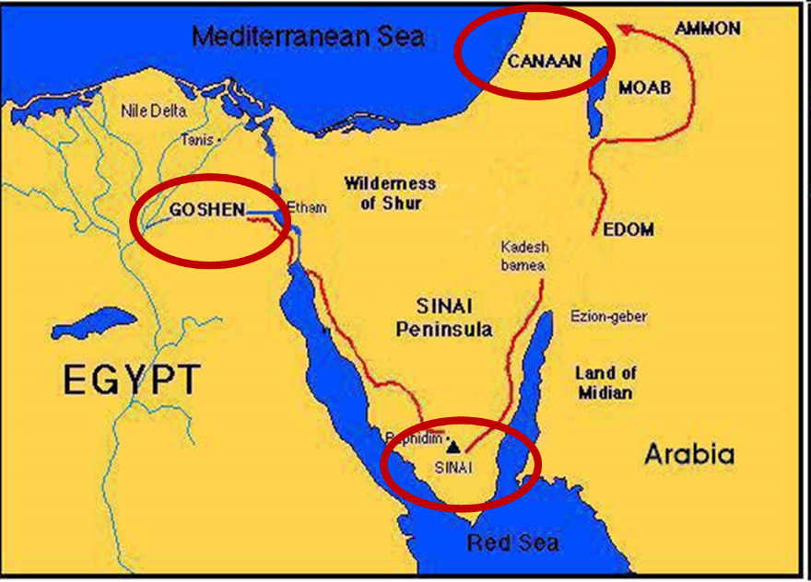

Slide 24


Exodus 19:5-6
“Now then, if you will indeed obey My voice and keep My covenant, then you shall be My own possession among all the peoples, for all the earth is Mine; and you shall be to Me a kingdom of priests and a holy nation.’ These are the words that you shall speak to the sons of Israel.”

Slide 25
Six Parts of a Suzerain-Vassal Treaty in Deuteronomy
Preamble (1:1-5)
Prologue (1:6–4:40)
Covenant obligations (5–26)
Storage and reading instructions (27:2-3; 31:9, 24, 26)
Witnesses (32:1)
Blessings and curses (28)

Slide 26
II. Daniel’s Prayer (3-19)
Confession of sin (v.3-10)
Acknowledgment of judgment (v.11-14)
Request for mercy (v.15-19)

Slide 27
II. Daniel’s Prayer (3-19)
Confession of sin (v.3-10)
Acknowledgment of judgment (v.11-14)
Request for mercy (v.15-19)

Slide 28
CONFESSION OF SIN
V.3-10
V.3 Repentance (2 Chron. 7:14)
V.4 Appeal to the Covenant
V.5 We (32 times); Acknowledgment of rebellion against covenant (Lev. 26, Dt. 28)
V.6 Function of a prophet, ignored
V.7 Deut. 28:49, 64
V.8-10 We

Slide 29
II. Daniel’s Prayer (3-19)
Confession of sin (v.3-10)
Acknowledgment of judgment (v.11-14)
Request for mercy (v.15-19)

Slide 30
ACKNOWLEDGMENT OF JUDGMENT V.11-14
V.11 CURSE-Dt. 28:15-68
V.12-14 MOSAIC COVENANT

Slide 31
II. Daniel’s Prayer (3-19)
Confession of sin (v.3-10)
Acknowledgment of judgment (v.11-14)
Request for mercy (v.15-19)

Slide 32
REQUEST FOR DIVINE MERCY
V.15-19
V.15 God’s past covenant faithfulness; ex. 2:23-24
V.16 Jerusalem
V.17 Sanctuary
V.18 Daniel approached god on the basis of his grace and not human merit
V.19 The jewish people

Slide 33
Chapter 9 Outline
The Setting (1-2)
Daniel’s prayer (3-19)
Gabriel’s arrival (20-23)
The Seventy Weeks Prophecy (24-27)

Slide 34
THE ARRIVAL OF GABRIEL
V.20-23
V.20-21
  Gabriel is the mediary
  Gabriel’s previous involvement (8:16)
V.22
  Gabriel came to give Daniel insight
  Daniel’s misconception of the kingdom’s coming after 70 years
V.23
  Daniel is highly esteemed

Slide 35


Statue
&
Stone

Slide 36
Chapter 9 Outline
The Setting (1-2)
Daniel’s prayer (3-19)
Gabriel’s arrival (20-23)
The Seventy Weeks Prophecy (24-27)

Slide 37
Conclusion

Slide 38
Chapter 9 Outline
The Setting (1-2)
Daniel’s prayer (3-19)
Gabriel’s arrival (20-23)
The Seventy Weeks Prophecy (24-27)

