Slide 1
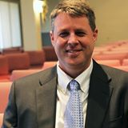
The Protestant Reformation: The Good, The Bad, and The Ugly Session 6
Andy Woods, Th.M.., JD., PhD.
Sr. Pastor, Sugar Land Bible Church
President Chafer Theological Seminary

Slide 2
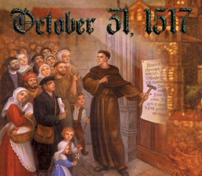
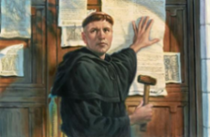
Introduction
Oct 31, 1517
500 years
Far reaching impact
Partial restoration
Restoration of a hermeneutic
Selectively applied
Subsequent generations applied consistently
Preview

Slide 3
Overview
The early church
The Alexandrian eclipse
The Dark Ages
The contribution of the Protestant Reformers
The Reformers’ incomplete revolution
Reformed Theology today
Dispensationalism & the completed revolution
Looking back 500 years later
Notes:
Outline

Slide 4
Overview
THE EARLY CHURCH
The Alexandrian eclipse
The Dark Ages
The contribution of the Protestant Reformers
The Reformers’ incomplete revolution
Reformed Theology today
Dispensationalism & the completed revolution
Looking back 500 years later
Notes:
Outline

Slide 5
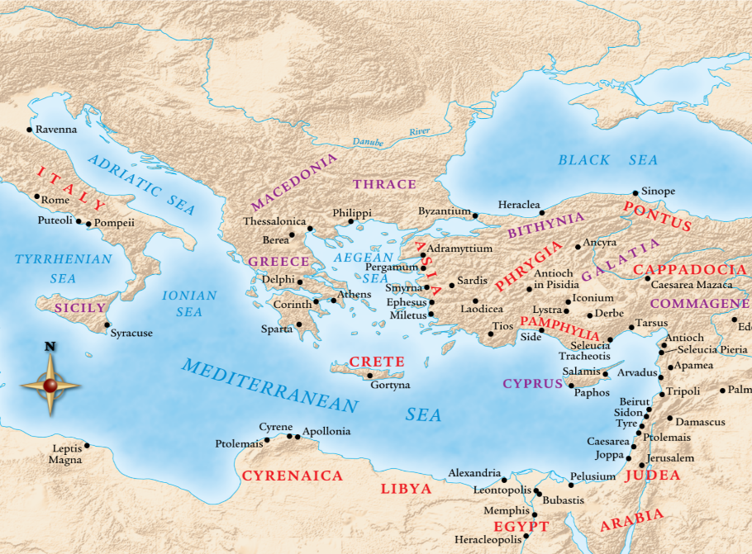

Slide 6
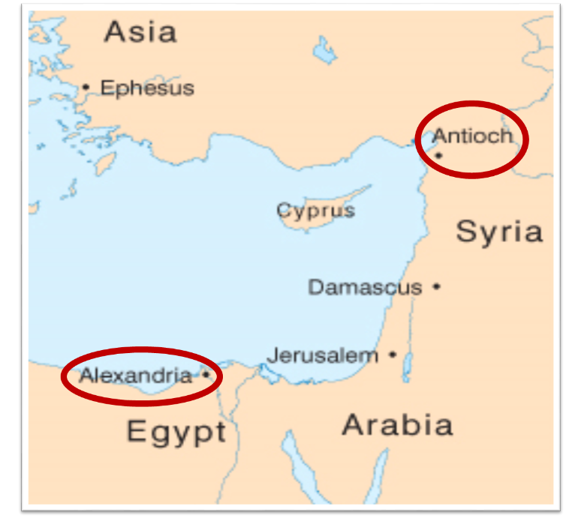

Slide 7
Overview
The early church
THE ALEXANDRIAN ECLIPSE
The Dark Ages
The contribution of the Protestant Reformers
The Reformers’ incomplete revolution
Reformed Theology today
Dispensationalism & the completed revolution
Looking back 500 years later
Notes:
Outline

Slide 10
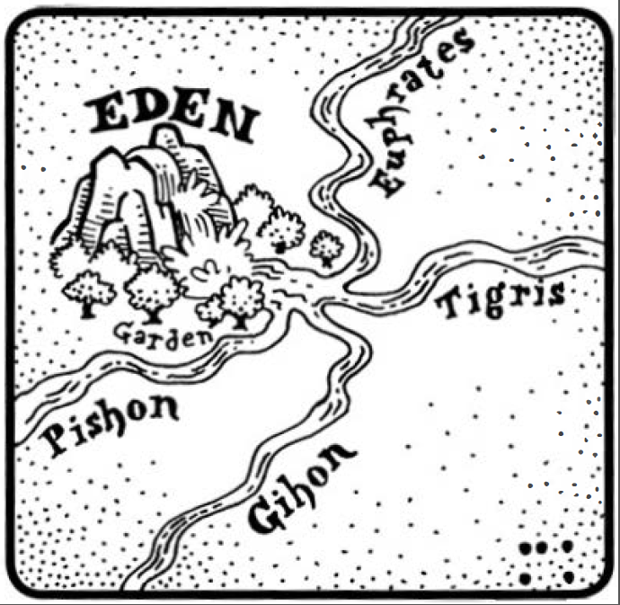
Dangers of Allegorization – Philo

Slide 11
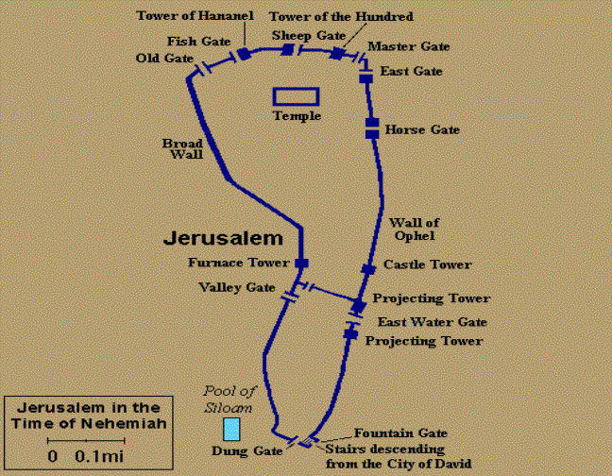
Dangers of Allegorization
Gates of Nehemiah

Slide 12
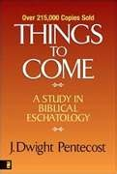
Dangers of Allegorization
Text is not being interpreted
Authority is transferred from text to interpreter
There is no way to test the interpreter
No mechanism for controlling the interpreter’s imagination
Pentecost, Things to Come, pps. 4-5

Slide 13
What Caused the Shift Into Allegorism?
Need for immediate relevance
Incorporation of human philosophy into interpretation
Gnostic dualism (Gen. 1:31; 1 John 2:22; 4:2-3; Acts 17:32; 1 Cor. 15:12)
Decline of the church's Jewish population
Constantine’s Edict of Milan (A.D. 313)
AD 70 and Hadrian’s (A.D. 117–138)“Palestine”
Notes:
Outline

Slide 14
Overview
The early church
The Alexandrian eclipse
THE DARK AGES
The contribution of the Protestant Reformers
The Reformers’ incomplete revolution
Reformed Theology today
Dispensationalism & the completed revolution
Looking back 500 years later
Notes:
Outline

Slide 15
III. The Dark Ages (or the Middle Ages)
Lasted from the 4th to the 16th centuries
Obsolescence of prophetic studies
Domination of Augustinian Amillennialism
Only one church: Roman Catholicism
The Bible is removed from the people
Allegorization
Illiteracy
Mass read in Latin
Sale of indulgences
Anti-Semitism
Church in need of rescue
Notes:
Outline

Slide 16
Overview
The early church
The Alexandrian eclipse
The Dark Ages
THE CONTRIBUTION OF THE PROTESTANT REFORMERS
The Reformers’ incomplete revolution
Reformed Theology today
Dispensationalism & the completed revolution
Looking back 500 years later
Notes:
Outline

Slide 17
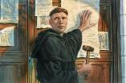
IV. Contribution of the Protestant Reformers
Preparation of the Reformers
Emphasis on literal interpretation
Denunciation of allegorization
Rejection of church tradition as a guide
Priesthood of all believers
Bible translations
Literacy
Basis for the American system of governance
Five solas
Rejection of celibacy of the priesthood
The ultimate sacrifice
Rejoice
Notes:
Outline

Slide 18
IV. Contribution of the Protestant Reformers
Preparation of the Reformers
Emphasis on literal interpretation
Denunciation of allegorization
Rejection of church tradition as a guide
Priesthood of all believers
Bible translations
Literacy
Basis for the American system of governance
Five solas
Rejection of celibacy of the priesthood
The ultimate sacrifice
Rejoice
Notes:
Outline

Slide 19
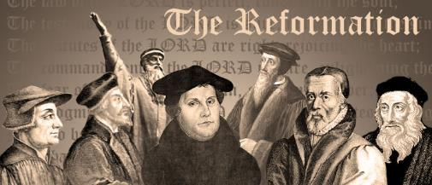
A. Preparation of the Reformers
Morning stars of the Reformation
God prepares His instruments
Legal background
Luther
Consecration
Monasticism
Conversion
Reformation
Notes:
Outline

Slide 20
IV. Contribution of the Protestant Reformers
Preparation of the Reformers
Emphasis on literal interpretation
Denunciation of allegorization
Rejection of church tradition as a guide
Priesthood of all believers
Bible translations
Literacy
Basis for the American system of governance
Five solas
Rejection of celibacy of the priesthood
The ultimate sacrifice
Rejoice
Notes:
Outline

Slide 21
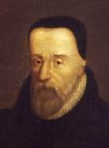
William Tyndale
(A.D. 1494‒1536)
“The Scripture hath but one sense, which is the literal sense.”
William Tyndale, "Obedience of a Christian Man," in Doctrinal Treatises and Introductions to Different Portions of the Holy Scriptures, ed. Henry Walter (Cambridge: Cambridge University Press, 1848), 304.
Notes:
Outline

Slide 22
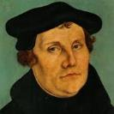
Martin Luther
Quoted by Roy B. Zuck, Basic Bible Interpretation: A Practical Guide to Discovering Biblical Truth (Colorado Springs, CO: Victor, 1991), 45.
[The Scriptures] “are to be retained in their simplest meaning ever possible, and to be understood in their grammatical and literal sense unless the context plainly forbids”.
Notes:
Outline

Slide 23
"I have observed this, that all heresies and errors have originated, not from the simple words of Scripture, as is so universally asserted, but from neglecting the simple words of Scripture, and from the affection of purely subjective…tropes and inferences." "In the schools of theologians it is a well-known rule that Scripture is to be understood in four ways, literal, allegoric, moral, anagogic. But if we wish to handle Scripture aright, our one effort will be to obtain unum, simplecum, germanum, et certum sensum literalem." "Each passage has one clear, definite, and true sense of its own. All others are but doubtful and uncertain opinions."
Martin Luther
Quoted in Frederic W. Farrar, History of Interpretation (Grand Rapids: Baker, 1961; reprint, 1886), 327.

Slide 24
“Thus Luther (Table Talk, ‘On God’s Word,’ 11) remarks: ‘I have grounded my preaching upon the literal word; he that pleases may follow me, he that will not may stay.’”
Martin Luther
Quoted in George N. H. Peters, The Theocratic Kingdom, 3 vols. (New York: Funk & Wagnalls, 1884; reprint, Grand Rapids: Kregel, 1952), 1:47.

Slide 25
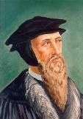
John Calvin
Quoted by Roy B. Zuck, Basic Bible Interpretation: A Practical Guide to Discovering Biblical Truth (Colorado Springs, CO: Victor, 1991), 47.
Calvin wrote in the preface of his commentary on Romans “it is the first business of an interpreter to let the author say what he does say, instead of attributing to him what we think he ought to say.”
Notes:
Outline

Slide 26
Calvin wrote in his commentary on Galatians “Let us know then that the true meaning of Scripture is the natural and obvious meaning; and let us embrace and abide by it resolutely.”
John Calvin
John Calvin, Commentary on the Epistle of Paul to the Galatians, p. 136; Quoted by Gerrit H. Hospers, The Principle of Spiritualization in Hermeneutics (E. Williamson, NY: Author, 1935), p. 11.

Slide 27
Schaff
Quoted by Gerrit H. Hospers, The Principle of Spiritualization in Hermeneutics (E. Williamson, NY: Author, 1935), p. 12.
“Calvin is the founder of grammatico–historical exegesis. He affirmed and carried out the sound hermeneutical principle the biblical writers, like all sensible writers, wished to convey to their reader's – one definite thought in words which they could understand. A passage may have a literal or figurative sense; but cannot have two senses at once. The Word of God is inexhaustible and applicable to all times, but there is a difference between explanation and application, and application must be consistent with explanation.”

Slide 28
IV. Contribution of the Protestant Reformers
Preparation of the Reformers
Emphasis on literal interpretation
Denunciation of allegorization
Rejection of church tradition as a guide
Priesthood of all believers
Bible translations
Literacy
Basis for the American system of governance
Five solas
Rejection of celibacy of the priesthood
The ultimate sacrifice
Rejoice
Notes:
Outline

Slide 31
Martin Luther
Quoted in Frederic W. Farrar, History of Interpretation (Grand Rapids: Baker, 1961; reprint, 1886), 328.
Luther denounced the allegorical approach to Scripture in strong words. He said: “An interpreter…must as much as possible avoid allegory, that he may not wander in idle dreams.” “Allegories are empty speculations and as it were the scum of Holy Scripture.” “Origen’s allegories are not worth so much dirt.” “To allegorize is to juggle with Scripture.” “Allegory is sort of a beautiful harlot, who proves herself specially seductive to idle men.” “Allegorizing may degenerate into a mere monkey game.” “Allegories are awkward, absurd, inventive, obsolete, loose rags…mere spangles and pretty ornaments but nothing more."
Notes:
Outline

Slide 32
John Calvin
Quoted by Roy B. Zuck, Basic Bible Interpretation: A Practical Guide to Discovering Biblical Truth (Colorado Springs, CO: Victor, 1991), 47.
Calvin similarly rejected allegorical interpretations. He called them “frivolous games” and accused Origen and other allegorists of “torturing scripture, in every possible sense, from the true sense.”
Notes:
Outline

Slide 33
IV. Contribution of the Protestant Reformers
Preparation of the Reformers
Emphasis on literal interpretation
Denunciation of allegorization
Rejection of church tradition as a guide
Priesthood of all believers
Bible translations
Literacy
Basis for the American system of governance
Five solas
Rejection of celibacy of the priesthood
The ultimate sacrifice
Rejoice
Notes:
Outline

Slide 34
Mark 7:13 (NASB)
“thus invalidating the word of God by your tradition which you have handed down; and you do many things such as that.”

Slide 35
“Unless I am convinced by Scripture and plain reason - I do not accept the authority of the popes and councils, for they have contradicted each other - my conscience is captive to the Word of God. I cannot and I will not recant anything for to go against conscience is neither right nor safe. God help me. Amen.”
Martin Luther
Luther at the Imperial Diet of Worms (1521)

Slide 36
“I ask for the Scripture, and Eck offers me the Fathers. I ask for the sun, and he shows me his lanterns. I ask, ‘where is your Scripture proof?’ and he adduces Ambrose and Cyril…With all due respect to the Fathers, I prefer the authority of Scripture.”
Martin Luther
Quoted by F.W. Farrar, History of interpretation (NY: E.P. Dutton and Company, 1886), 327.

Slide 37
Matthew 16:18 (NASB)
“I also say to you that you are Peter (petros, masculine, little stone), and upon this rock (petra, feminine, large stone) I will build My church; and the gates of Hades will not overpower it.”

Slide 38
IV. Contribution of the Protestant Reformers
Preparation of the Reformers
Emphasis on literal interpretation
Denunciation of allegorization
Rejection of church tradition as a guide
Priesthood of all believers
Bible translations
Literacy
Basis for the American system of governance
Five solas
Rejection of celibacy of the priesthood
The ultimate sacrifice
Rejoice
Notes:
Outline

Slide 39
Revelation 1:6 (NASB)
“and He has made us to be a kingdom, priests to His God and Father—to Him be the glory and the dominion forever and ever. Amen.”

Slide 40
IV. Contribution of the Protestant Reformers
Preparation of the Reformers
Emphasis on literal interpretation
Denunciation of allegorization
Rejection of church tradition as a guide
Priesthood of all believers
Bible translations
Literacy
Basis for the American system of governance
Five solas
Rejection of celibacy of the priesthood
The ultimate sacrifice
Rejoice
Notes:
Outline

Slide 41
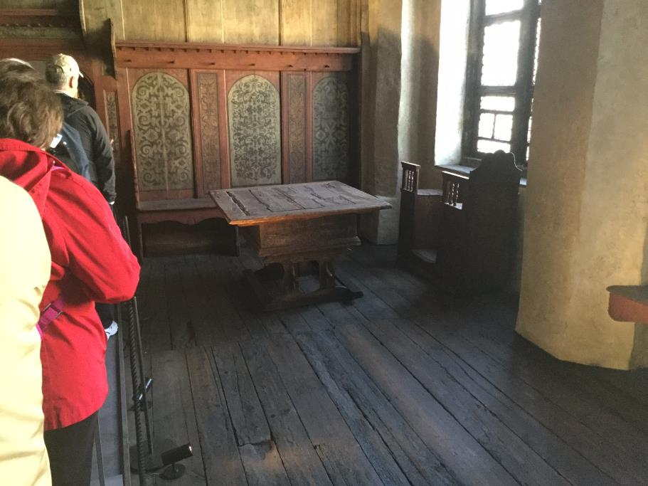

Slide 42
IV. Contribution of the Protestant Reformers
Preparation of the Reformers
Emphasis on literal interpretation
Denunciation of allegorization
Rejection of church tradition as a guide
Priesthood of all believers
Bible translations
Literacy
Basis for the American system of governance
Five solas
Rejection of celibacy of the priesthood
The ultimate sacrifice
Rejoice
Notes:
Outline

Slide 43
Martin Luther
Luther's Works: The Christian in Society, ed. James Atkinson, vol. 44 (Philadelphia, PA: Fortress, 1966), 207.
“I am afraid that the schools will prove the very gates of hell, unless they diligently labor in explaining the Holy Scriptures and engraving them in the heart of the youth...I advise no one to place his child where the Scriptures do not reign paramount. Every institution in which men are not unceasingly occupied with the Word of God must become corrupt."
Notes:
Outline

Slide 44
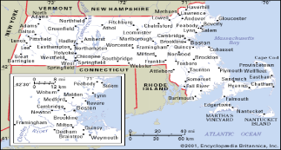
Old Satan Deluder Law: 1642 Massachusetts Church of the Holy Trinity v. U.S., 143 U.S. 457, 467 (1892)
“It being one chief project of that old deluder, Satan, to keep men from the knowledge of the Scriptures, as in former time…It is therefore ordered…that after the Lord hath increased the settlement…they shall…appoint one within their town, to teach all such children to read…they shall set up a grammar school to instruct youths…”

Slide 45
IV. Contribution of the Protestant Reformers
Preparation of the Reformers
Emphasis on literal interpretation
Denunciation of allegorization
Rejection of church tradition as a guide
Priesthood of all believers
Bible translations
Literacy
Basis for the American system of governance
Five solas
Rejection of celibacy of the priesthood
The ultimate sacrifice
Rejoice
Notes:
Outline

Slide 46
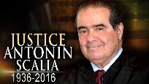
“Every tin horn dictator in the world today, every president for life, has a Bill of Rights,”...“That’s not what makes us free; if it did, you would rather live in Zimbabwe. But you wouldn’t want to live in most countries in the world that have a Bill of Rights. What has made us free is our Constitution. Think of the word ‘constitution;’ it means structure.” “That’s why America’s framers debated not the Bill of Rights during the Constitutional Convention of 1787 in Philadelphia,” he said, “but rather the structure of the federal government.” “The genius of the American constitutional system is the dispersal of power,” he said. “Once power is centralized in one person, or one part [of government], a Bill of Rights is just words on paper.”...“A constitution is about setting structure; it is not about writing the preferences of special interest groups,” he said.”
Kevin Mooney, “Supreme Court Justice Scalia: Constitution, Not Bill of Rights, Makes Us Free,” online: http://dailysignal.com/2015/05/11/supreme-court-justice-scalia-constitution-not-bill-of-rights-makes-us-free/, May 11 2015, accessed 20 January 2016.

Slide 48
Martin Luther
The Bondage of the Will

Slide 49
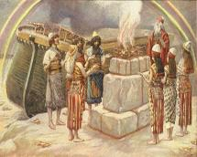
Genesis 8:21
The Lord smelled the soothing aroma; and the Lord said to Himself, “I will never again curse the ground on account of man, for the intent of man’s heart is evil from his youth; and I will never again destroy every living thing, as I have done.[emphasis mine].

Slide 50
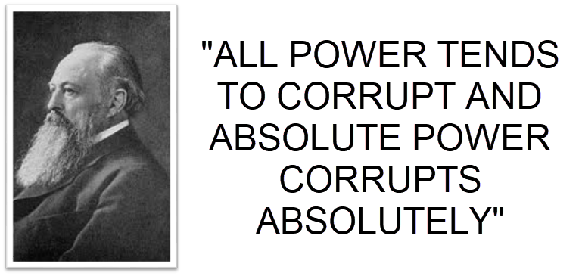
Lord Acton

Slide 51
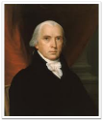
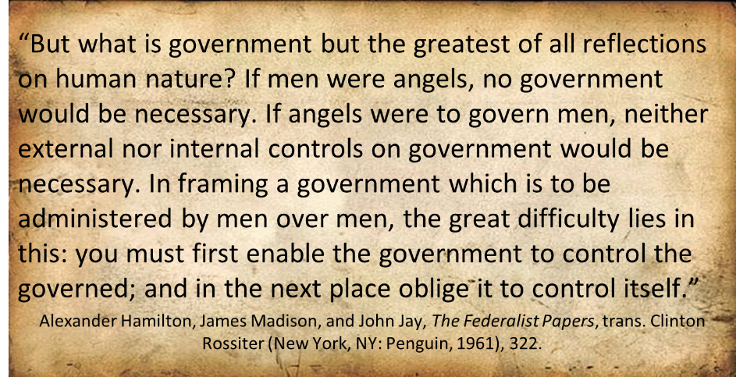
Federalist # 51

Slide 52
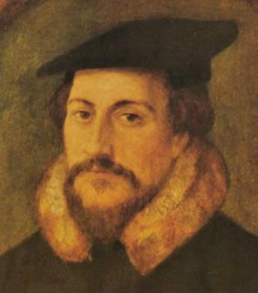
John Calvin

Slide 53
IV. Contribution of the Protestant Reformers
Preparation of the Reformers
Emphasis on literal interpretation
Denunciation of allegorization
Rejection of church tradition as a guide
Priesthood of all believers
Bible translations
Literacy
Basis for the American system of governance
Five solas
Rejection of celibacy of the priesthood
The ultimate sacrifice
Rejoice
Notes:
Outline

Slide 54
Number | Latin | Meaning
1. | Sola Scriptura | Scripture Alone
2. | Solus Christus | Christ Alone
3. | Sola Fide | Faith Alone
4. | Sola Graetia | Grace Alone
5. | Soli Deo Gloria | To the Glory of God Alone

Slide 55
Number | Latin | Meaning
1. | Sola Scriptura | Scripture Alone
2. | Solus Christus | Christ Alone
3. | Sola Fide | Faith Alone
4. | Sola Graetia | Grace Alone
5. | Soli Deo Gloria | To the Glory of God Alone

Slide 56
Emergent Church & Biblical Authority
“Anglicans have demonstrated this both/and beautifully in relation to Scripture. Scripture is always a factor in Anglican thinking. In Anglicans’ best moments, it is their primary factor, but it is never…the only factor. Rather Scripture is always in dialogue with tradition, reason, and experience. None of them sola can be the ultimate source of authority…” (Italics added).
Brian McLaren, A Generous Orthodoxy, 210.

Slide 57
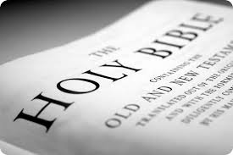
Biblical Authority
Tradition? (Mark 7:13; Col 2:8)
Reason? (Prov 3:5; 14:12; Isa 55:8-9)
Experience? (2 Thess 2:9)

Slide 58
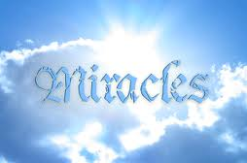
Satanic/Demonic Miracles
Exod 7–8
Deut 13:1-3
Matt 7:21-23; 24:24
Acts 8:9; 16:16
Gal 1:6-9
2 Thess 2:9
Rev 13:3, 13; 16:13-14

Slide 59
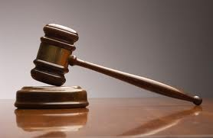
Biblical Authority
Where in Scripture are we told to dialogue with all four?
Magisterial vs. ministerial

Slide 60
Number | Latin | Meaning
1. | Sola Scriptura | Scripture Alone
2. | Solus Christus | Christ Alone
3. | Sola Fide | Faith Alone
4. | Sola Graetia | Grace Alone
5. | Soli Deo Gloria | To the Glory of God Alone

Slide 61
John 14:6 (NASB)
“Jesus said to him, “I am the way, and the truth, and the life; no one comes to the Father but through Me.”

Slide 62
Acts 4:12 (NASB)
“And there is salvation in no one else; for there is no other name under heaven that has been given among men by which we must be saved.”

Slide 63
1 Timothy 2:5 (NASB)
“For there is one God, and one mediator also between God and men, the man Christ Jesus.”

Slide 64
Matthew 13:55 (NASB)
“Is not this the carpenter’s son? Is not His mother called Mary, and His brothers, James and Joseph and Simon and Judas?”

Slide 65
Luke 1:46-47 (NASB)
“And Mary said: ‘My soul exalts the Lord, And my spirit has rejoiced in God my Savior.’”

Slide 66
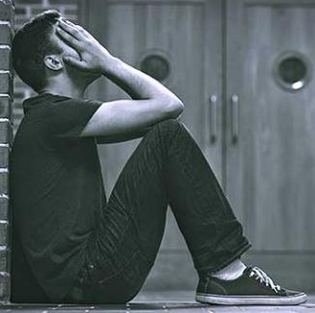
Romans 3:23 (NASB)
“ for all have sinned and fall short of the glory of God.”

Slide 67
Number | Latin | Meaning
1. | Sola Scriptura | Scripture Alone
2. | Solus Christus | Christ Alone
3. | Sola Fide | Faith Alone
4. | Sola Graetia | Grace Alone
5. | Soli Deo Gloria | To the Glory of God Alone

Slide 68
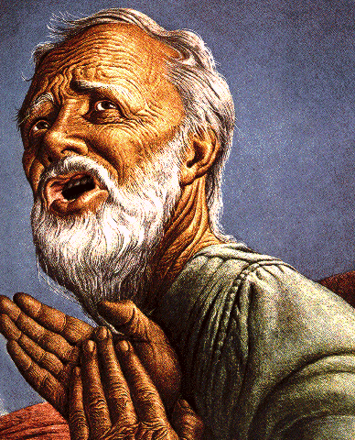
Belief – God’s One Condition for Justification
Gen 15:6
Then he believed in the LORD; and He reckoned it to him as righteousness.
John 3:16
For God so loved the world, that He gave His only begotten Son, that whoever believes in Him shall not perish, but have eternal life.
Acts 16:30-31
"Sirs, what must I do to be saved?" They said, "Believe in the Lord Jesus, and you will be saved..."

Slide 69
Ephesians 2:8-9 (NASB)
“For by grace you have been saved through faith; and that not of yourselves, it is the gift of God; ⁹ not as a result of works, so that no one may boast.”

Slide 70
Hebrews 11:6 (NASB)
“And without faith it is impossible to please Him, for he who comes to God must believe that He is and that He is a rewarder of those who seek Him.”

Slide 71
Number | Latin | Meaning
1. | Sola Scriptura | Scripture Alone
2. | Solus Christus | Christ Alone
3. | Sola Fide | Faith Alone
4. | Sola Graetia | Grace Alone
5. | Soli Deo Gloria | To the Glory of God Alone

Slide 72
Ephesians 2:8-9 (NASB)
“For by grace you have been saved through faith; and hat not of yourselves, it is the gift of God; ⁹ not as a result of works, so that no one may boast.”

Slide 73
Number | Latin | Meaning
1. | Sola Scriptura | Scripture Alone
2. | Solus Christus | Christ Alone
3. | Sola Fide | Faith Alone
4. | Sola Graetia | Grace Alone
5. | Soli Deo Gloria | To the Glory of God Alone

Slide 74
Ephesians 2:8-9 (NASB)
“For by grace you have been saved through faith; and that not of yourselves, it is the gift of God; ⁹ not as a result of works, so that no one may boast.”

Slide 75
Romans 3:27-28 (NASB)
“Where then is boasting? It is excluded. By what kind of law? Of works? No, but by a law of faith. ²⁸ For we maintain that a man is justified by faith apart from works of the Law.”

Slide 76
IV. Contribution of the Protestant Reformers
Preparation of the Reformers
Emphasis on literal interpretation
Denunciation of allegorization
Rejection of church tradition as a guide
Priesthood of all believers
Bible translations
Literacy
Basis for the American system of governance
Five solas
Rejection of celibacy of the priesthood
The ultimate sacrifice
Rejoice
Notes:
Outline

Slide 77
Matthew 16:18 (NASB)
“I also say to you that you are Peter, and upon this rock I will build My church; and the gates of Hades will not overpower it.”

Slide 78
Matthew 8:14 (NASB)
“When Jesus came into Peter’s home, He saw his mother-in-law lying sick in bed with a fever.”

Slide 79
1 Corinthians 9:5 (NASB)
“Do we not have a right to take along a believing wife, even as the rest of the apostles and the brothers of the Lord and Cephas?”

Slide 80
IV. Contribution of the Protestant Reformers
Preparation of the Reformers
Emphasis on literal interpretation
Denunciation of allegorization
Rejection of church tradition as a guide
Priesthood of all believers
Bible translations
Literacy
Basis for the American system of governance
Five solas
Rejection of celibacy of the priesthood
The ultimate sacrifice
Rejoice
Notes:
Outline

Slide 81
IV. Contribution of the Protestant Reformers
Preparation of the Reformers
Emphasis on literal interpretation
Denunciation of allegorization
Rejection of church tradition as a guide
Priesthood of all believers
Bible translations
Literacy
Basis for the American system of governance
Five solas
Rejection of celibacy of the priesthood
The ultimate sacrifice
Rejoice
Notes:
Outline

Slide 82
CONCLUSION

Slide 83
IV. Contribution of the Protestant Reformers
Preparation of the Reformers
Emphasis on literal interpretation
Denunciation of allegorization
Rejection of church tradition as a guide
Priesthood of all believers
Bible translations
Literacy
Basis for the American system of governance
Five solas
Rejection of celibacy of the priesthood
The ultimate sacrifice
Rejoice
Notes:
Outline

Slide 84
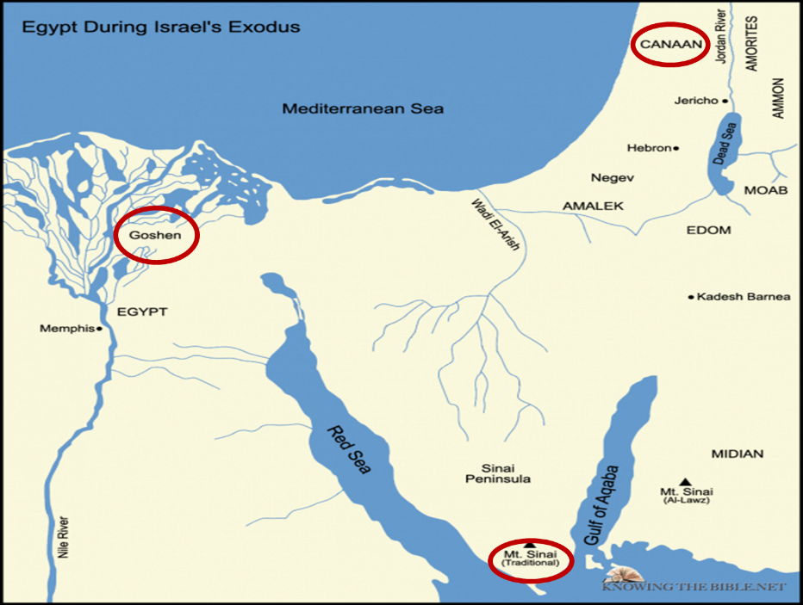

Slide 85
Numbers 21:9 (NASB)
“And Moses made a bronze serpent and set it on the standard; and it came about, that if a serpent bit any man, when he looked to the bronze serpent, he lived.”

Slide 86
John 3:14-15 (NASB)
“As Moses lifted up the serpent in the wilderness, even so must the Son of Man be lifted up; ¹⁵ so that whoever believes will in Him have eternal life.”

Slide 87
2 Kings 18:4 (NASB)
“He removed the high places and broke down the sacred pillars and cut down the Asherah. He also broke in pieces the bronze serpent that Moses had made, for until those days the sons of Israel burned incense to it; and it was called Nehushtan.”

Slide 88
Joshua 1:2 (NASB)
“Moses My servant is dead; now therefore arise, cross this Jordan, you and all this people, to the land which I am giving to them, to the sons of Israel.”

Slide 89
Matthew 16:13-23 (NASB)
¹⁶ Now when Jesus came into the district of Caesarea Philippi, He was asking His disciples, “Who do people say that the Son of Man is?”…¹⁶ Simon Peter answered, “You are the Christ, the Son of the living God.” ¹⁷ And Jesus said to him, “Blessed are you, Simon Barjona, because flesh and blood did not reveal this to you, but My Father who is in heaven. ¹⁸ I also say to you that you are Peter, and upon this rock I will build My church; and the gates of Hades will not overpower it. ¹⁹ I will give you the keys of the kingdom of heaven; and whatever you bind on earth shall have been bound in heaven, and whatever you loose on earth shall have been loosed in heaven.”

Slide 90
Matthew 16:13-23 (NASB)
²⁰ Then He warned the disciples that they should tell no one that He was the Christ.²¹ From that time Jesus began to show His disciples that He must go to Jerusalem, and suffer many things from the elders and chief priests and scribes, and be killed, and be raised up on the third day. ²² Peter took Him aside and began to rebuke Him, saying, “God forbid it, Lord! This shall never happen to You.” ²³ But He turned and said to Peter, “Get behind Me, Satan! You are a stumbling block to Me; for you are not setting your mind on God’s interests, but man’s.

Slide 91
NEXT WEEK
The early church
The Alexandrian eclipse
The Dark Ages
The Contribution of the Protestant Reformers
THE REFORMERS INCOMPLETE REVOLUTION
Reformed Theology today
Dispensationalism & the completed revolution
Looking back 500 years later
Notes:
Outline

