Slide 1

THE BOOK OF DANIEL
Dr. Andy Woods

Slide 2

Message
Times of the Gentiles are revealed prophetically (2, 7, 8-12) and ethically (1, 3-6)

Slide 3

Synthetic Outline
Historical (1-7):
  Daniel interprets, 3rd person, gentile nations
  Intro “Hebrew” (1)
  Aramaic chiasm (2-7)

Slide 4
Synthetic Outline
Prophetic (8-12):
  Angel interprets, 1st person, Jewish nation, Hebrew
  Ram & Goat (8)
  70 weeks (9)
  Final vision (10-12)

Slide 5
Synthetic Outline
Historical (1-7):
  Daniel interprets, 3rd person, gentile nations
  Intro “Hebrew” (1)
  Aramaic chiasm (2-7)

Slide 6
Synthetic Outline
Historical (1-7):
  Daniel interprets, 3rd person, gentile nations
  Intro “Hebrew” (1)
  Aramaic chiasm (2-7)

Slide 7

Synthetic Outline
  Chiasm “Aramaic” ( 2-7)
1. Gentile History (2)
  2. Protection (3)
    3. Revelation to a gentile king (4)
    3. Revelation to a gentile king (5)
  2. Protection (6)
1. Gentile history (7)

Slide 8
Synthetic Outline
  Chiasm “Aramaic” ( 2-7)
1. Gentile History (2)
  2. Protection (3)
    3. Revelation to a gentile king (4)
    3. Revelation to a gentile king (5)
  2. Protection (6)
1. Gentile history (7)

Slide 9
Synthetic Outline
  Chiasm “Aramaic” ( 2-7)
1. Gentile History (2)
  2. Protection (3)
    3. Revelation to a gentile king (4)
    3. Revelation to a gentile king (5)
  2. Protection (6)
1. Gentile history (7)

Slide 10
Synthetic Outline
  Chiasm “Aramaic” ( 2-7)
1. Gentile History (2)
  2. Protection (3)
    3. Revelation to a gentile king (4)
    3. Revelation to a gentile king (5)
  2. Protection (6)
1. Gentile history (7)

Slide 11
Synthetic Outline
  Chiasm “Aramaic” ( 2-7)
1. Gentile History (2)
  2. Protection (3)
    3. Revelation to a gentile king (4)
    3. Revelation to a gentile king (5)
  2. Protection (6)
1. Gentile history (7)

Slide 12
Synthetic Outline
  Chiasm “Aramaic” ( 2-7)
1. Gentile History (2)
  2. Protection (3)
    3. Revelation to a gentile king (4)
    3. Revelation to a gentile king (5)
  2. Protection (6)
1. Gentile history (7)

Slide 13
Synthetic Outline
  Chiasm “Aramaic” ( 2-7)
1. Gentile History (2)
  2. Protection (3)
    3. Revelation to a gentile king (4)
    3. Revelation to a gentile king (5)
  2. Protection (6)
1. Gentile history (7)

Slide 14
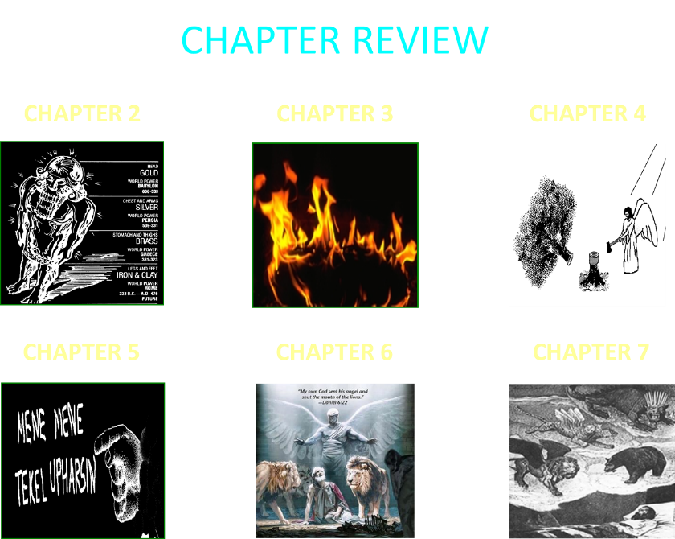

Slide 15

Chapter 7 Outline
The Historical Setting (1)
The Vision (2-14)
The Vision’s Interpretation (15-27)
The Personal Impact on Daniel (28)

Slide 16
Chapter 7 Outline
The Historical Setting (1)
The Vision (2-14)
The Vision’s Interpretation (15-27)
The Personal Impact on Daniel (28)

Slide 17
The Historical Setting V.1
First Year Belshazzar?
Daniel Rather than Nebuchadnezzar (2:1) has the Dream

Slide 18
The Historical Setting V.1
First Year Belshazzar?
Daniel Rather than Nebuchadnezzar (2:1) has the Dream

Slide 19
CHAPTER AND VERSE IN DANIEL | CHRONOLOGICAL DATE | BIBLICAL DATE
1:1 | 605 | 3rd year of Jehoiakim
2:1 | 603 | 2nd year of Nebuchadnezzar
5 | Sat. night 10/12/539 (Hoehner)
7:1 | 553 | 1st year of Belshazzar
8:1 | 551 | 3rd year of Belshazzar
9:1 | 538 | 1st year of Darius
10:1 | 536 | 3rd year of Cyrus

Slide 20
CHAPTER AND VERSE IN DANIEL | CHRONOLOGICAL DATE | BIBLICAL DATE
1:1 | 605 | 3rd year of Jehoiakim
2:1 | 603 | 2nd year of Nebuchadnezzar
5 | Sat. night 10/12/539 (Hoehner)
7:1 | 553 | 1st year of Belshazzar
8:1 | 551 | 3rd year of Belshazzar
9:1 | 538 | 1st year of Darius
10:1 | 536 | 3rd year of Cyrus

Slide 21
Daniel’s Age
CHAPTER | EVENTS | AGE
1 | Taken to Babylonian captivity | 15
2 | Interpreting Nebuchadnezzar’s 1st dream (huge image) | 17
3 | Daniel’s 3 friends cast into the fiery furnace | 19 or 20
4 | Interpreting Nebuchadnezzar’s 2nd dream (huge tree) | 45-50
5 | Interpreting handwriting of the wall at Belshazzar’s feast | Early 80’s
6 | Delivered from the den of lions | c.83
7-8 | Daniel’s visions and dreams | Mid-60’s
9 | Daniel’s seventy “sevens” prophecy | Early-80’s
10-12 | Final dreams and visions | Mid-80’s

Slide 22
Daniel’s Age
CHAPTER | EVENTS | AGE
1 | Taken to Babylonian captivity | 15
2 | Interpreting Nebuchadnezzar’s 1st dream (huge image) | 17
3 | Daniel’s 3 friends cast into the fiery furnace | 19 or 20
4 | Interpreting Nebuchadnezzar’s 2nd dream (huge tree) | 45-50
5 | Interpreting handwriting of the wall at Belshazzar’s feast | Early 80’s
6 | Delivered from the den of lions | c.83
7-8 | Daniel’s visions and dreams | Mid-60’s
9 | Daniel’s seventy “sevens” prophecy | Early-80’s
10-12 | Final dreams and visions | Mid-80’s

Slide 23
Synthetic Outline
  Chiasm “Aramaic” ( 2-7)
1. Gentile History (2)
  2. Protection (3)
    3. Revelation to a gentile king (4)
    3. Revelation to a gentile king (5)
  2. Protection (6)
1. Gentile history (7)

Slide 24
Succession of Gentile Rulers
1-4: Nebuchadnezzar of Babylon
5: Belshazzar of Babylon
6: Darius of Media – Persia
7-8: Belshazzar of Babylon
9: Darius of Media – Persia
10-12: Cyrus of Media – Persia

Slide 25
Succession of Gentile Rulers
1-4: Nebuchadnezzar of Babylon
5: Belshazzar of Babylon
6: Darius of Media – Persia
7-8: Belshazzar of Babylon
9: Darius of Media – Persia
10-12: Cyrus of Media – Persia

Slide 26
The Historical Setting V.1
First Year Belshazzar?
Daniel Rather than Nebuchadnezzar (2:1) has the Dream

Slide 27
Synthetic Outline
  Chiasm “Aramaic” ( 2-7)
1. Gentile History (2)
  2. Protection (3)
    3. Revelation to a gentile king (4)
    3. Revelation to a gentile king (5)
  2. Protection (6)
1. Gentile history (7)

Slide 28

Matthew 24:15
“Therefore when you see the abomination of desolation which was spoken of through Daniel the prophet, standing in the holy place (let the reader understand).”

Slide 29
Chapter 7 Outline
The Historical Setting (1)
The Vision (2-14)
The Vision’s Interpretation (15-27)
The Personal Impact on Daniel (28)

Slide 30
DANIEL 7:2-14
Outline
4 Beasts Coming out of the Sea V.2-3
A Description of the 4 Beasts V.4-8
The Ancient of Days V. 9-12
The Son of Man V.13-14

Slide 31
DANIEL 7:2-14
Outline
4 Beasts Coming out of the Sea V.2-3
A Description of the 4 Beasts V.4-8
The Ancient of Days V. 9-12
The Son of Man V.13-14

Slide 32
Four Beasts Coming out of the Sea (V. 2-3)
Times of the Gentiles
The Sea (Isaiah 57:20-21)
God’s View vs. Man’s View

Slide 33


Statue
&
Stone

Slide 34

CHART1

Slide 35
Comparing Daniel 2 & 7: A Matter of Perspective
 | Daniel 2 | Daniel 7
Receiver | Nebuchadnezzar | Daniel
Position | Oppressor | Oppressee
Nationality | Babylonian | Hebrew
Perspective | Jewish | Gentile
Viewpoint | Antropocentric | Theocentric
Description | Statue | Beasts
Appearance | Beautiful | Grotesque

Slide 36
DANIEL 7:2-14
Outline
4 Beasts Coming out of the Sea V.2-3
A Description of the 4 Beasts V.4-8
The Ancient of Days V. 9-12
The Son of Man V.13-14

Slide 37

Description of 4 Beasts
1st Beast (V.4)
  Lion
  Babylon
  Head of Gold
  2:38
  605-539 BC
  Eagle’s Wings
  Nebuchadnezzar’s Experience

Slide 38
Statue
&
Stone

Slide 39
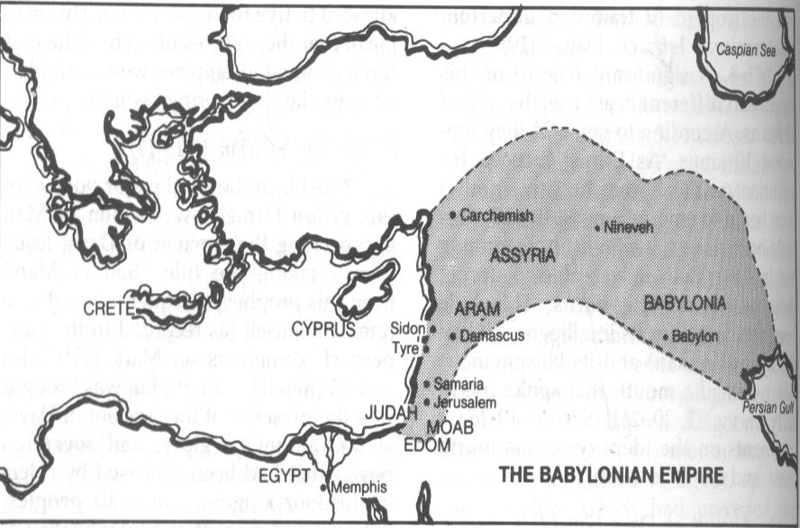
MAP 2A

Slide 40

Description of 4 Beasts
2nd Beast (V.5)
  Bear
  Media-Persia
  Chest & Arms of Silver
  5:28; 8:20
  539-331 BC
  Raised on One Side
  Three Ribs
  Arise and Devour

Slide 41
Statue
&
Stone

Slide 42
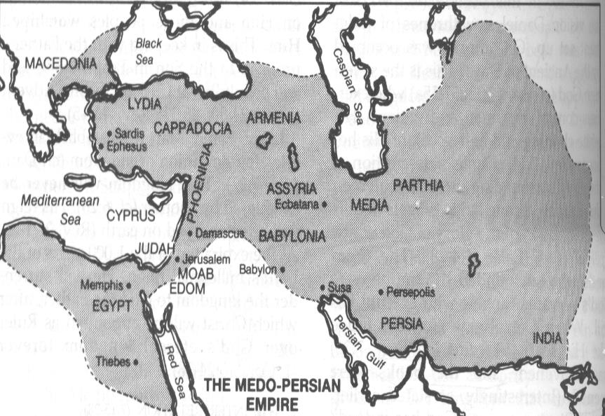
MAP 2B

Slide 43
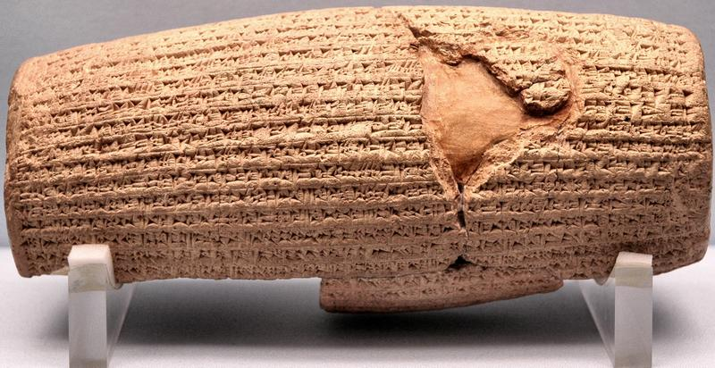
Cyrus Cylinder

Slide 44
Three Returns
 | Date | Duration | Persian king | Jewish leader | Scripture | Purpose | Number of returnees
1st return | 538–515 B.C. | 23 years | Cyrus (Isa 44:28‒45:1) | Zerubbabel | Ezra 1–6; Isaiah 44:28 | Rebuilding the temple | 50,000
2nd return | 458–457 B.C. | 2 years | Artaxerxes | Ezra | Ezra 7–10 | Adorning of the temple and reforming the people | 2,000
3rd return | 444–432 B.C. | 8 years | Artaxerxes | Nehemiah | Nehemiah | Rebuilding the wall

Slide 45

Description of 4 Beasts
3rd Beast (V. 6)
  Leopard
  Greece
  Belly & Thighs of Bronze
  8:21
  331-63 BC
  Rapid Conquest (Wings & Leopard)
  Four Generals (Wings & Heads)

Slide 46
Statue
&
Stone

Slide 47
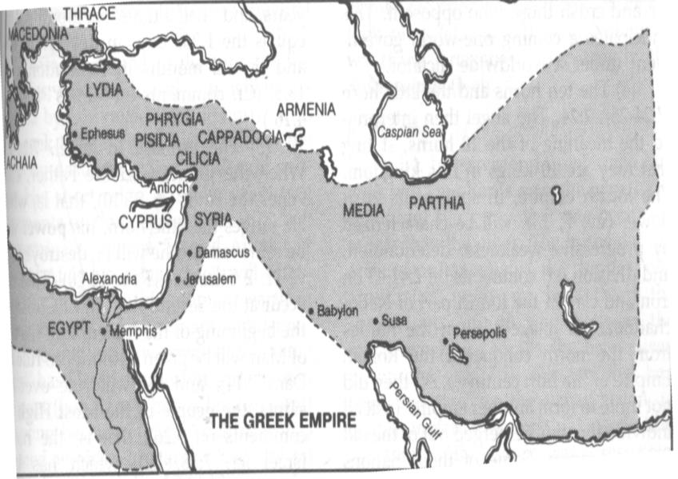
MAP 2C

Slide 48
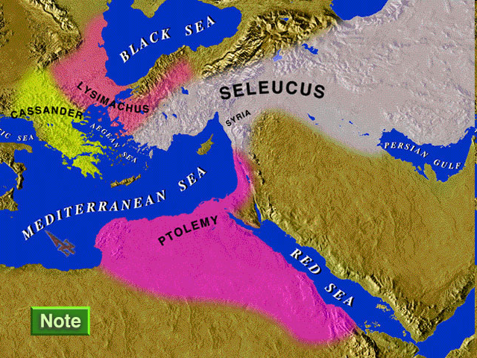
MAP OF FOUR KINGDOMS

Slide 49
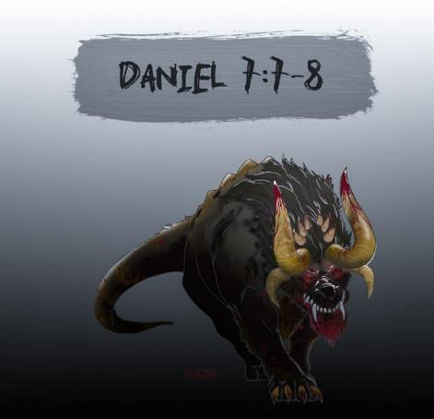
Description of 4 Beasts
4th Beast (V.7-8)
  Description
  Rome
  Legs of Iron
  Secular History
  63 Bc-70 AD
  10 Horns & Little Horn
  Revelation 13:2

Slide 50
Description of 4 Beasts
4th Beast (V.7-8)
  Description
  Rome
  Legs of Iron
  Secular History
  63 Bc-70 AD
  10 Horns & Little Horn
  Revelation 13:2

Slide 51
Statue
&
Stone

Slide 52
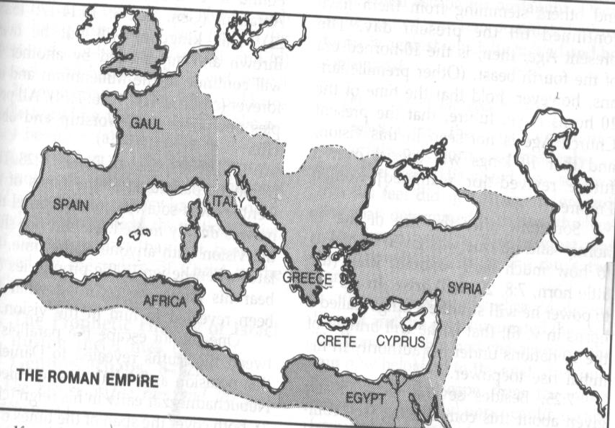
MAP 2D

Slide 53

Isaiah 9:6-7 (NASB)
⁶ For a child will be born to us, a son will be given to us; And the government will rest on His shoulders; And His name will be called Wonderful Counselor, Mighty God, Eternal Father, Prince of Peace.⁷ There will be no end to the increase of His government or of peace, On the throne of David and over his kingdom, To establish it and to uphold it with justice and righteousness From then on and forevermore. The zeal of the Lord of hosts will accomplish this.

Slide 54
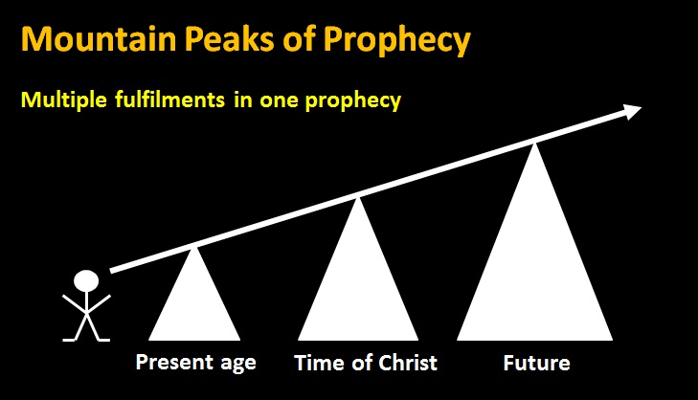
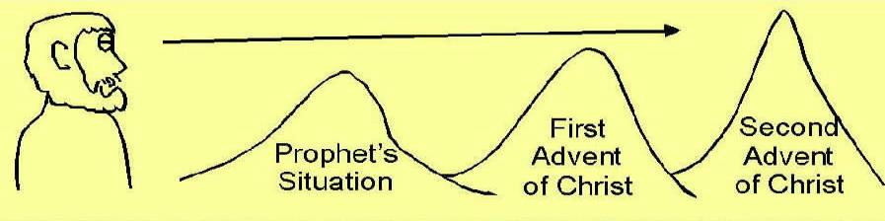

Slide 55
Description of 4 Beasts
4th Beast (V.7-8)
  Description
  Rome
  Legs of Iron
  Secular History
  63 Bc-70 AD
  10 Horns & Little Horn
  Revelation 13:2

Slide 56
Statue
&
Stone

Slide 57
Revelation 13:2
“And the beast which I saw was like a leopard, and his feet were like those of a bear, and his mouth like the mouth of a lion. And the dragon gave him his power and his throne and great authority.”

Slide 58
DANIEL 7:2-14
Outline
4 Beasts Coming out of the Sea V.2-3
A Description of the 4 Beasts V.4-8
The Ancient of Days V. 9-12
The Son of Man V.13-14

Slide 59
ANCIENT OF DAYS
V. 9-12
His Description (V. 9-10)
His Destruction of 4th Beast (V. 11)
His Judgment of Other 3 Beasts (V. 12)

Slide 60
ANCIENT OF DAYS
V. 9-12
His Description (V. 9-10)
His Destruction of 4th Beast (V. 11)
His Judgment of Other 3 Beasts (V. 12)

Slide 61
ANCIENT OF DAYS
V. 9-12
His Description (V. 9-10)
His Destruction of 4th Beast (V. 11)
His Judgment of Other 3 Beasts (V. 12)

Slide 62
Statue
&
Stone

Slide 63
ANCIENT OF DAYS
V. 9-12
His Description (V. 9-10)
His Destruction of 4th Beast (V. 11)
His Judgment of Other 3 Beasts (V. 12)

Slide 64

Herodotus, Histories, 1:191 (450 B.C.)
“…he conducted the river by a channel into the lake…and so he made the former course of the river passable by the sinking of the stream. When this had been done, the Persians who had been posted for this very purpose entered by the bed of the river Euphrates into Babylon, the stream having sunk so far that it reached about to the middle of a man’s thigh…those Babylonians who dwelt in the middle did not know that they had been captured…”

Slide 65
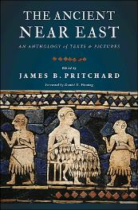
James Pritchard
The Ancient Near East Texts Relating to the Old Testament, 315-16.
Without any battle. . . sparing Babylon . . . any calamity.... I am Cyrus...king of Babylon....When I entered Babylon...under jubilation and rejoicing...troops walked around Babylon...in peace, I did not allow anybody to terrorize (any place) of the [country of Sumer] and Akkad. I strove for peace in Babylon...and in all his (other) sacred cities....I returned to (these) sacred cities on the other side of the Tigris, the sanctuaries of which have been in ruins for a long time, the images which (used) to live therein and established for them permanent sanctuaries.

Slide 66
James Pritchard
The Ancient Near East Texts Relating to the Old Testament, 315-16.
I (also) gathered all their (former) inhabitants and returned (to them) their habitations. Furthermore, I resettled... unharmed, in their (former) chapels, the places which make them happy. May all the gods whom I have resettled in their sacred cities ask daily Bel and Nebo for a long life for me...all of them I resettled in a peaceful place... ducks and doves,...I endeavoured to fortify/repair their dwelling places . . .

Slide 67
Revelation 13:2
“And the beast which I saw was like a leopard, and his feet were like those of a bear, and his mouth like the mouth of a lion. And the dragon gave him his power and his throne and great authority.”

Slide 68
DANIEL 7:2-14
Outline
4 Beasts Coming out of the Sea V.2-3
A Description of the 4 Beasts V.4-8
The Ancient of Days V. 9-12
The Son of Man V.13-14

Slide 69
SON OF MAN
V. 13-14
His Presentation to the Ancient of Days (V. 13)
His Reception of the Kingdom (V. 14)
  Son of Man
  Mark 14:60-64

Slide 70
SON OF MAN
V. 13-14
His Presentation to the Ancient of Days (V. 13)
His Reception of the Kingdom (V. 14)
  Son of Man
  Mark 14:60-64

Slide 71
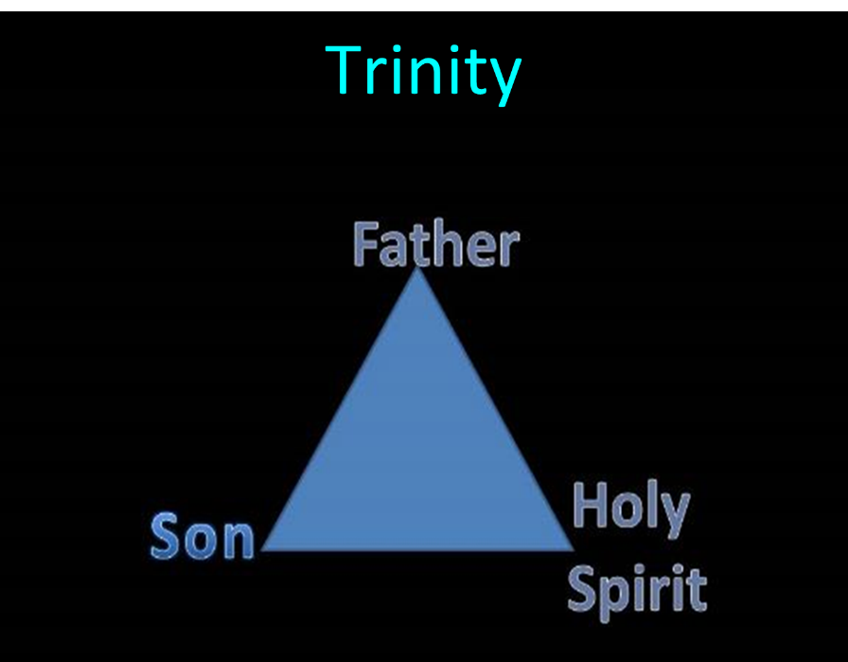

Slide 72
SON OF MAN
V. 13-14
His Presentation to the Ancient of Days (V. 13)
His Reception of the Kingdom (V. 14)
  Son of Man
  Mark 14:60-64

Slide 73
Statue
&
Stone

Slide 74
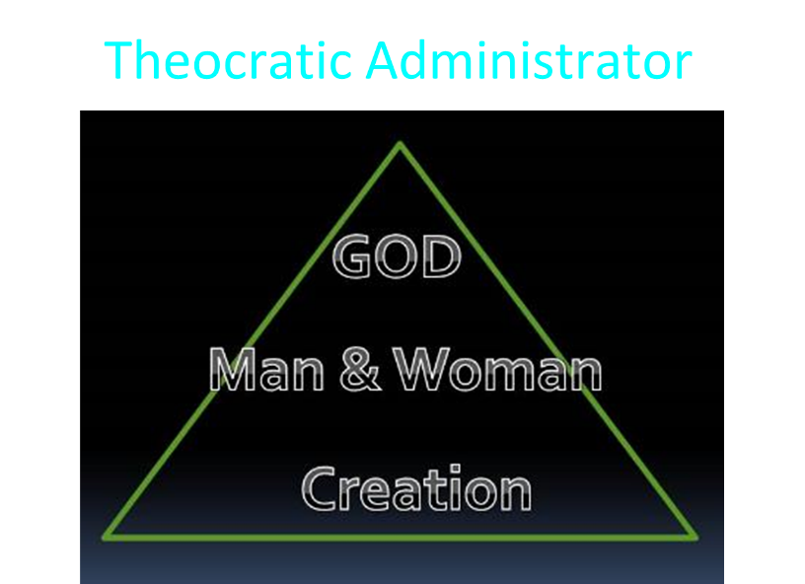

Slide 75
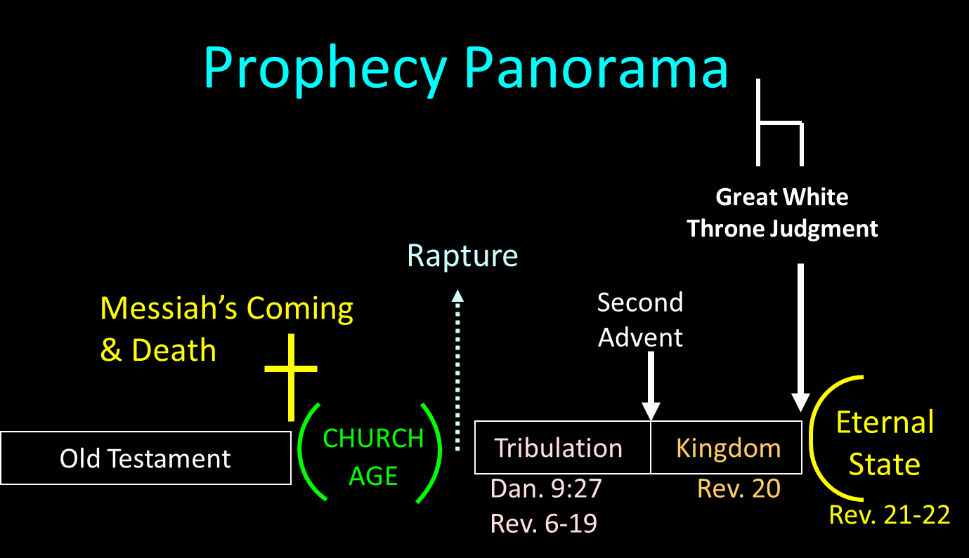

Slide 76
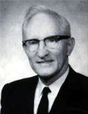
Merill F. Unger
Unger's Commentary on the Old Testament (Chicago: Moody, 1981; reprint, Chatanooga, TN: AMG, 2002), 1643.
“Hence, the iron kingdom with its feet of iron and clay (cf. 3:33-35, 40, 44) and the nondescript beast of 7:7-8 envision…the form in which it will exist after the church period, when God will resume His dealing with the nation Israel. How futile for conservative scholars to ignore that fact and to seek to find literal fulfillment of those prophecies in history or in the church, when those predictions refer to events yet future and have no application whatever to the church.”

Slide 77
Chapter 7 Outline
The Historical Setting (1)
The Vision (2-14)
The Vision’s Interpretation (15-27)
The Personal Impact on Daniel (28)

Slide 78
DANIEL 7:15-27
OUTLINE
The Vision Troubles Daniel V.15
Daniel Requests An Intepretation V.16
An Interpretation Is Given V. 17-18
Daniel Requests Further Explanation V. 19-22
Angelic Interpretation V. 23-27

Slide 79
DANIEL 7:15-27
OUTLINE
The Vision Troubles Daniel V.15
Daniel Requests An Intepretation V.16
An Interpretation Is Given V. 17-18
Daniel Requests Further Explanation V. 19-22
Angelic Interpretation V. 23-27

Slide 80
DANIEL 7:15-27
OUTLINE
The Vision Troubles Daniel V.15
Daniel Requests An Intepretation V.16
An Interpretation Is Given V. 17-18
Daniel Requests Further Explanation V. 19-22
Angelic Interpretation V. 23-27

Slide 81
Daniel Seeks An Interpretation
V.16
Daniel asks an Angel for an interpretation V. 16
  No Guesswork Needed
  Gabriel ?

Slide 82
DANIEL 7:15-27
OUTLINE
The Vision Troubles Daniel V.15
Daniel Requests An Intepretation V.16
An Interpretation Is Given V. 17-18
Daniel Requests Further Explanation V. 19-22
Angelic Interpretation V. 23-27

Slide 83
DANIEL 7:15-27
OUTLINE
The Vision Troubles Daniel V.15
Daniel Requests An Intepretation V.16
An Interpretation Is Given V. 17-18
Daniel Requests Further Explanation V. 19-22
Angelic Interpretation V. 23-27

Slide 84

Ephesians 3:3-6 (NASB)
“that by revelation there was made known to me the mystery, as I wrote before in brief. ⁴ By referring to this, when you read you can understand my insight into the mystery of Christ, ⁵ which in other generations was not made known to the sons of men, as it has now been revealed to His holy apostles and prophets in the Spirit; ⁶ to be specific, that the Gentiles are fellow heirs and fellow members of the body, and fellow partakers of the promise in Christ Jesus through the gospel”.

Slide 85
Ephesians 3:9 (NASB)
“and to bring to light what is the administration of the mystery which for ages has been hidden in God who created all things.”

Slide 86
“Mystery” Defined
“In the N.T, it [mystērion] denotes, not the mysterious (as with the Eng. word), but that which, being outside the range of unassisted natural apprehension, can be made known only by Divine revelation, and is made known in a manner and at a time appointed by God, and to those who are illumined by His Spirit.”
W. E. Vine, Merrill F. Unger, and William White, Vine's Complete Expository Dictionary of the Old and New Testament Words (Nashville: Nelson, 1996), 424.

Slide 87
Distinctions Between 144,000 & Multitude
REVELATION 7:1-8 | REVELATION 7:9-17
Numbered | Innumerable
Jews | All nations
Sealed | Slain
Sealed before the Tribulation | Converted out of the Tribulation
Hitchcock and Ice, The Truth Behind Left Behind, 77

Slide 88
DANIEL 7:15-27
OUTLINE
The Vision Troubles Daniel V.15
Daniel Requests An Intepretation V.16
An Interpretation Is Given V. 17-18
Daniel Requests Further Explanation V. 19-22
Angelic Interpretation V. 23-27

Slide 89
Angelic Interpretation
V. 23
  A Revived Roman Empire
  Daniel 2:40, 41-43
  EEC or ECM / European Common Market?

Slide 90
Angelic Interpretation
  V. 24
  A Ten King Confederacy
  The Antichrist Will Subdue 3 Kings

Slide 91
Angelic Interpretation
  V. 25
  His Boasting Mouth (Dan. 7:8,11,20; Rev 13:5-6)
  Persecution Of The Saints (Rev. 6:9-11; 13:7, 17:6; Matt. 24:9)
  The Creation Of A New System
  Three And A Half Years (Dan. 12:7; Rev. 12:14,13:5; 12:6; Dan. 9:27)

Slide 92
Angelic Interpretation
  V. 26
  The Ancient of Days Destroys the Little Horn
  The Ancient of Days is God the Father
  Dan. 9:27; 2 Thess. 2:8; Rev. 19:20
  Antichrist’s Rise and Fall

Slide 93
Angelic Interpretation
  V. 27
  Rev. 11:15
  The Millinnieum
  Dan. 2:44-45
  Six Kingdoms?
  Our Focus Vs. Judah’s Focus
  Our Hope

Slide 94
6 Empires
Babylon (2:36-38) 605-539 BC
Media-Persia (2:39a) 539-331 BC
Greece (2:39b) 331-63 BC
Rome I (2:40) 63 BC – 70 AD
Rome II (2:41-43) Tribulation
Kingdom (2:44-45) After 2nd Coming

Slide 95
Chapter 7 Outline
The Historical Setting (1)
The Vision (2-14)
The Vision’s Interpretation (15-27)
The Personal Impact on Daniel (28)

Slide 96
THE EFFECT ON DANIEL
V. 28
Daniel is Traumatized
7:19
Daniel’s Heart for His People
8:27

Slide 97
Conclusion

Slide 98
Chapter 7 Outline
The Historical Setting (1)
The Vision (2-14)
The Vision’s Interpretation (15-27)
The Personal Impact on Daniel (28)

