Slide 1
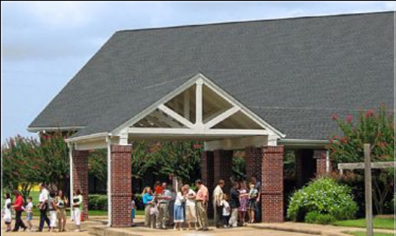
Beholding the Lord through His Word Part 2
Jim McGowan, Th.D. Sugar Land Bible Church 05-28-2017.

Slide 2
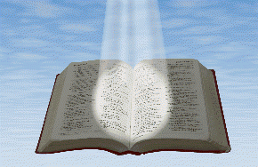
Beholding the Lord through His Word
Seeing
the Living Word of God
in the written word of God

Slide 3
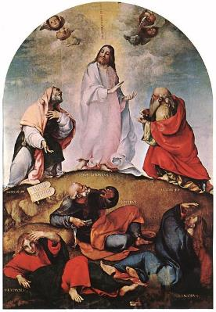
Beholding the Lord through His word
2 Corinthians 3:18
“But we all… beholding… the glory of the Lord”
John 1:14
“we saw His glory…full of grace and truth” (see 1:1-18)
Seeing the Living Word of God
in the written word of God

Slide 4
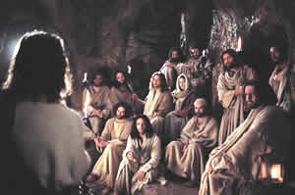
Beholding the Lord through His word
1 John 1:3
“we have seen with our eyes…the Word of Life” (see 1:1-4)
Hebrews 12:2
“fixing our eyes on Jesus” (see 12:1-2)
Seeing the Living Word of God
in the written word of God

Slide 5
John 1:1–18 (NASB95)
¹ In the beginning was the Word, and the Word was with God, and the Word was God. ² He was in the beginning with God. ³ All things came into being through Him, and apart from Him nothing came into being that has come into being. ⁴ In Him was life, and the life was the Light of men. ⁵ The Light shines in the darkness, and the darkness did not comprehend it. ⁶ There came a man sent from God, whose name was John. ⁷ He came as a witness, to testify about the Light, so that all might believe through him. ⁸ He was not the Light, but he came to testify about the Light. ⁹ There was the true Light which, coming into the world, …

Slide 6
John 1:1–18 (NASB95)
…enlightens every man. ¹⁰ He was in the world, and the world was made through Him, and the world did not know Him. ¹¹ He came to His own, and those who were His own did not receive Him. ¹² But as many as received Him, to them He gave the right to become children of God, even to those who believe in His name, ¹³ who were born, not of blood nor of the will of the flesh nor of the will of man, but of God. ¹⁴ And the Word became flesh, and dwelt among us, and we saw His glory, glory as of the only begotten from the Father, full of grace and truth. ¹⁵ John testified about Him and cried out, saying, “This was He of whom…

Slide 7
John 1:1–18 (NASB95)
…I said, ‘He who comes after me has a higher rank than I, for He existed before me.’ ” ¹⁶ For of His fullness we have all received, and grace upon grace. ¹⁷ For the Law was given through Moses; grace and truth were realized through Jesus Christ. ¹⁸ No one has seen God at any time; the only begotten God who is in the bosom of the Father, He has explained Him.

Slide 8
5 Preliminary Observations
John’s Use of Chiasm (Chiasmus).
John’s Use of Old Testament References.
John’s Unique Use of the phrase, “the Word” as a title for Christ.
John Shared Words and Names in His Writings.

Slide 9
5 Preliminary Observations
John’s Use of Chiasm (Chiasmus).
John’s Use of Old Testament References.
John’s Unique Use of the phrase, “the Word” as a title for Christ.
John Shared Words and Names in His Writings.
John’s Stated Purpose for His Gospel.

Slide 10
Chiasm (Chiasmus)
A chiasm is an emphatic literary device in which an author presents a sequence of ideas and then repeats them in reverse order, resulting in a “mirror” effect. Each idea is related to its “reflection” by a repeated, related, word. The author’s main idea is found in the middle of the chiasm.

Slide 12
5 Preliminary Observations
John’s Use of Chiasm (Chiasmus).
John’s Use of Old Testament References.
John’s Unique Use of the phrase, “the Word” as a title for Christ.
John Shared Words and Names in His Writings.
John’s Stated Purpose for His Gospel.

Slide 13
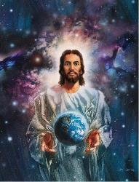
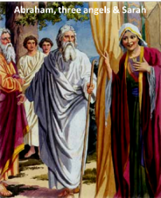
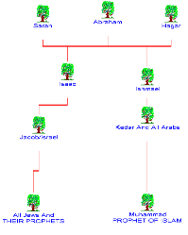
John 1:1-18 Draws from the Oldest, Old Testament References
John 1:1-10 draws from Gen. 1:
“In the beginning”, “light”, “darkness”, “life”, “the world was made through Him”.
John 1:11-13 draws from Gen. 16:
Abraham, offspring and his descendants.

Slide 14
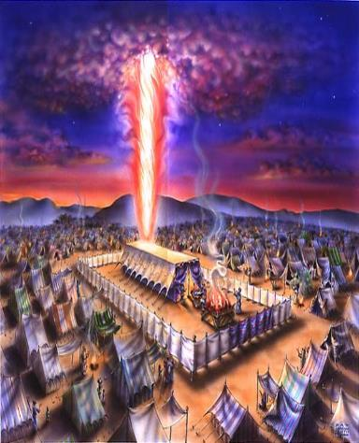
John 1:1-18 Draws from the Oldest, Old Testament References
John 1:14-18 draws from Exodus 33:
v.7 – presence, tent
vv. 8, 10 – gaze, saw
v. 13 – know God
v. 17 – Moses’ name
vv. 18, 22 – show glory
vv. 20, 23 – cannot see God directly

Slide 15
5 Preliminary Observations
John’s Use of Chiasm (Chiasmus).
John’s Use of Old Testament References.
John’s Unique Use of the phrase, “the Word” as a title for Christ.
John Shared Words and Names in His Writings.
John’s Stated Purpose for His Gospel.

Slide 16
Christ “the Word”, unique to the Apostle John
John 1:1 – the Word was God
John 1:14 – the Word became flesh
1 John 1:1 – the Word of Life
Revelation 19:13b – The Word of God

Slide 17
John 1:1
In the beginning was the Word, and the Word was with God, and the Word was God.
John 1:14
And the Word became flesh, and dwelt among us, and we saw His glory, glory as of the only begotten from the Father, full of grace and truth.

Slide 18
1 John 1:1
What was from the beginning, what we have heard, what we have seen with our eyes, what we have looked at and touched with our hands, concerning the Word of Life—
Revelation 19:13b
…and His name is called, The Word of God.

Slide 19
5 Preliminary Observations
John’s Use of Chiasm (Chiasmus).
John’s Use of Old Testament References.
John’s Unique Use of the phrase, “the Word” as a title for Christ.
John Shared Words and Names in His Writings.
John’s Stated Purpose for His Gospel.

Slide 20
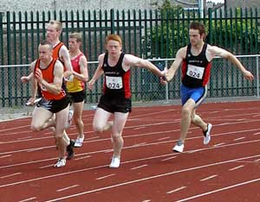
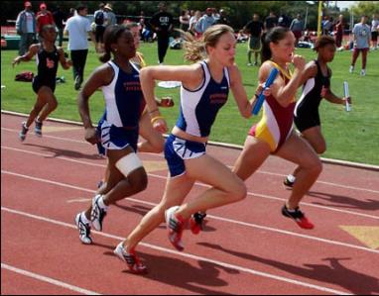
John shared words and names like a baton, in his writings
Passing words from book to book
Passing names from verse to verse

Slide 21
5 Preliminary Observations
John’s Use of Chiasm (Chiasmus).
John’s Use of Old Testament References.
John’s Unique Use of the phrase, “the Word” as a title for Christ.
John Shared Words and Names in His Writings.
John’s Stated Purpose for His Gospel.

Slide 23
John 20:30-31
³⁰ Therefore many other signs Jesus also performed in the presence of the disciples, which are not written in this book; ³¹ but these have been written so that you may believe that Jesus is the Christ, the Son of God; and that believing you may have life in His name.
2
Notes:
Why John wrote this book:
The apostle John wrote with astounding consistency. This verse is the last place in the gospel of John where he wrote about believing, having used the word (or some variation of it) about 100 times! ‘Believe’ is also the center of the John 1:1-18 chiasm.

Slide 24
The High Points of John 1:1-18
John 1:1-5 – The deity of Jesus Christ
John 1:6-13 – John the Baptist as a witness
John 1:14-18 – The Word made flesh
Notes:
John 1:14, “And the Word became flesh, and dwelt among us, and we saw His glory, glory as of the only begotten from the Father, full of grace and truth.”

Slide 25
The High Points of John 1:1-18
John 1:1-5 – The deity of Jesus Christ
John 1:6-13 – John the Baptist as a witness
John 1:14-18 – The Word made flesh

Slide 26
John 1:1-5 (NASB95)
¹ In the beginning was the Word, and the Word was with God, and the Word was God. ² He was in the beginning with God. ³ All things came into being through Him, and apart from Him nothing came into being that has come into being. ⁴ In Him was life, and the life was the Light of men. ⁵ The Light shines in the darkness, and the darkness did not comprehend it.
Notes:
John wrote about the relationship of Christ to God at the time of the beginning of this present created universe (Genesis 1:1)

Slide 27
Genesis 1:1
In the beginning God created the heavens and the earth.
John 1:1-3
¹ In the beginning was the Word, and the Word was with God, and the Word was God. ² He was in the beginning with God. ³ All things came into being through Him [the Word], and apart from Him [the Word] nothing came into being that has come into being. (cf. Col. 1:16-17)
Notes:
Two Bible books starting with “In the beginning”

Slide 28
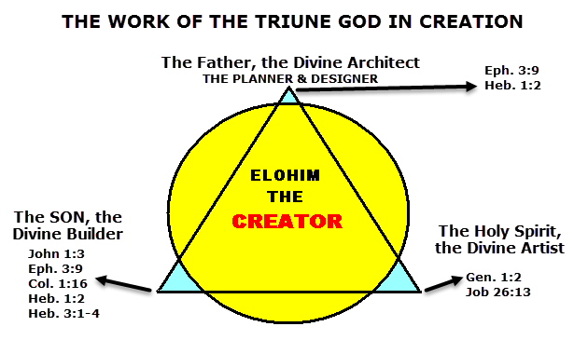
The Deity of Jesus Christ
Notes:
John wrote about the relationship of Christ to God at the time of the beginning of this present created universe (Genesis 1:1)

Slide 29
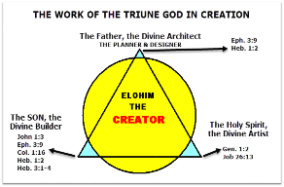
Colossians 1:16-17 (NASB95)
¹⁶ For by Him all things were created, both in the heavens and on earth, visible and invisible, whether thrones or dominions or rulers or authorities—all things have been created through Him and for Him. ¹⁷ He is before all things, and in Him all things hold together.

Slide 30
Genesis 1:1
In the beginning God created the heavens and the earth.
John 1:1-3
¹ In the beginning was the Word, and the Word was with God, and the Word was God. ² He was in the beginning with God. ³ All things came into being through Him [the Word], and apart from Him [the Word] nothing came into being that has come into being. (cf. Col. 1:16-17)
Notes:
Two Bible books starting with “In the beginning”

Slide 31
John 1:1-5 (NASB95)
¹ In the beginning was the Word, and the Word was with God, and the Word was God. ² He was in the beginning with God. ³ All things came into being through Him, and apart from Him nothing came into being that has come into being. ⁴ In Him was life, and the life was the Light of men. ⁵ The Light shines in the darkness, and the darkness did not comprehend it.
Notes:
Though it may appear that John is being quite repetitive, John has a very specific message in each thing that he wrote in John 1:1 & 2.

Slide 32
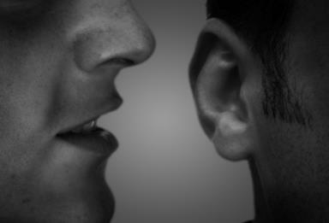
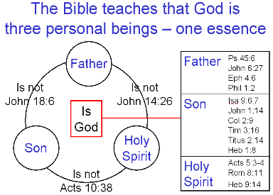
What John 1:1-2 is saying…
“In the beginning was the Word, and…
Jesus Christ, God’s personal expression, existed from the very beginning:
the Word was with God, and…
Jesus Christ, God’s personal expression, had fellowship with the Father and the Holy Spirit:

Slide 33
What John 1:1-2 is saying…
…the Word was God.
Jesus Christ, God’s personal expression was indeed deity Himself:
…He was in the beginning with God.
His fellowship with the Father and the Holy Spirit was already there in the beginning:

Slide 34
John 1:1-5 (NASB95)
¹ In the beginning was the Word, and the Word was with God, and the Word was God. ² He was in the beginning with God. ³ All things came into being through Him, and apart from Him nothing came into being that has come into being. ⁴ In Him was life, and the life was the Light of men. ⁵ The Light shines in the darkness, and the darkness did not comprehend it.

Slide 35
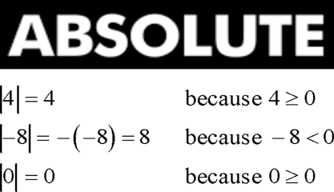
The Hebrew Poetry Pattern in John 1:3
First, the positive statement:
All things came into being through Him, and
Then, the negative statement:
apart from Him nothing came into being that has come into being.
Notes:
John’s statements about Christ as the Creator are absolute: All things… nothing... John’s choice of words about creation are also absolute: Everything either came into being through Christ or it never existed at all!

Slide 36
The ‘baton handoff’ of words in John 1:1-5
Passing words from book to book
Passing names from verse to verse

Slide 37
John 1:1-5
¹ In the beginning was the Word, and the Word was with God, and the Word was God. ² He was in the beginning with God. ³ All things came into being through Him, and apart from Him nothing came into being that has come into being. ⁴ In Him was life, and the life was the Light of men. ⁵ The Light shines in the darkness, and the darkness did not comprehend it. (cf. the Light: John 3,8,9,12)
Notes:
John’s ‘baton handoff’ in John 1:1-5: the Word > He or Him > the life > the Light. John passes identity & character verse to verse

Slide 38
The High Points of John 1:1-18
John 1:1-5 – The deity of Jesus Christ
John 1:6-13 – John the Baptist as a witness
vv. 6-10
vv. 11-13
John 1:14-18 – The Word made flesh

Slide 39
John 1:6–10 (NASB95)
⁶ There came a man sent from God, whose name was John. ⁷ He came as a witness, to testify about the Light, so that all might believe through him. ⁸ He was not the Light, but he came to testify about the Light. ⁹ There was the true Light which, coming into the world, enlightens every man. ¹⁰ He was in the world, and the world was made through Him, and the world did not know Him.
Notes:
Verses 6-8 introduce, & are substantially about, John the Baptist, whom John the apostle will expand upon later in this book

Slide 40
John 1:6–10 (NASB95)
⁶ There came a man sent from God, whose name was John. ⁷ He came as a witness, to testify about the Light, so that all might believe through him. ⁸ He was not the Light, but he came to testify about the Light. ⁹ There was the true Light which, coming into the world, enlightens every man. ¹⁰ He was in the world, and the world was made through Him, and the world did not know Him.
Notes:
In verse 7, “so that all might believe through him” is John’s 1st use of ‘believe’ in this book, telling why John the Baptist came to testify.

Slide 42
John 20:30-31
³⁰ Therefore many other signs Jesus also performed in the presence of the disciples, which are not written in this book; ³¹ but these have been written so that you may believe that Jesus is the Christ, the Son of God; and that believing you may have life in His name.
2
Notes:
Why John wrote this book:
The apostle John wrote with astounding consistency. This verse is the last place in the gospel of John where he wrote about believing, having used the word (or some variation of it) about 100 times! ‘Believe’ is also the center of the John 1:1-18 chiasm.

Slide 43
John 1:6–10 (NASB95)
⁶ There came a man sent from God, whose name was John. ⁷ He came as a witness, to testify about the Light, so that all might believe through him. ⁸ He was not the Light, but he came to testify about the Light. ⁹ There was the true Light which, coming into the world, enlightens every man. ¹⁰ He was in the world, and the world was made through Him, and the world did not know Him. (cf. John 8:12; 9:5; 1 John 2:8)
Notes:
In these verses, John continues to call Christ ‘the Light’ & then switches back to ‘He or Him’. ‘The Light’ turns to ‘the true Light’ (1 John 2:8)

Slide 44
John 1:6–10 (NASB95)
⁶ There came a man sent from God, whose name was John. ⁷ He came as a witness, to testify about the Light, so that all might believe through him. ⁸ He was not the Light, but he came to testify about the Light. ⁹ There was the true Light which, coming into the world, enlightens every man. ¹⁰ He was in the world, and the world was made through Him, and the world did not know Him.
Notes:
Christ’s relationship to the world (kosmos) is given in verse 10: ‘in the world’, ‘made through Him’, & ‘did not know Him’

Slide 45
John 1:6–10 (NASB95)
⁶ There came a man sent from God, whose name was John. ⁷ He came as a witness, to testify about the Light, so that all might believe through him. ⁸ He was not the Light, but he came to testify about the Light. ⁹ There was the true Light which, coming into the world, enlightens every man. ¹⁰ He was in the world, and the world was made through Him, and the world did not know Him.
Notes:
Christ’s relationship to the world (kosmos) is given in verse 10: ‘in the world’, ‘made through Him’, & ‘did not know Him’

Slide 46
The High Points of John 1:1-18
John 1:1-5 – The deity of Jesus Christ
John 1:6-13 – John the Baptist as a witness
vv. 6-10
vv. 11-13
John 1:14-18 – The Word made flesh

Slide 47
John 1:11-13 (NASB95)
¹¹ He came to His own, and those who were His own did not receive Him. ¹² But as many as received Him, to them He gave the right to become children of God, even to those who believe in His name, ¹³ who were born, not of blood nor of the will of the flesh nor of the will of man, but of God.
Notes:
Now John on the one hand gets specific within the world: ‘His own’ (the Jews), on the other hand presenting a general summary of the response of His own (the Jews) to His coming to them: “…did not receive Him”.

Slide 48
John 1:11-13 (NASB95)
¹¹ He came to His own, and those who were His own did not receive Him. ¹² But as many as received Him, to them He gave the right to become children of God, even to those who believe in His name, ¹³ who were born, not of blood nor of the will of the flesh nor of the will of man, but of God.
Receiving = Believing and Believing = Receiving
Notes:
There were those exceptions (‘But as many as’) who did receive Him, & that receiving was expressed in their believing in His name (not just a set of sounds, but the Person), who then became children of God (relationship).

Slide 49
John 1:11-13 (NASB95)
¹¹ He came to His own, and those who were His own did not receive Him. ¹² But as many as received Him, to them He gave the right to become children of God, even to those who believe in His name, ¹³ who were born, not of blood nor of the will of the flesh nor of the will of man, but of God.
Notes:
So here’s how the ‘children of God’ (verse 12) who became so by means of believing, were & were not spiritually born (verse 13): ‘not of blood, nor of the will of the flesh nor of the will of man, but of God.’

Slide 50
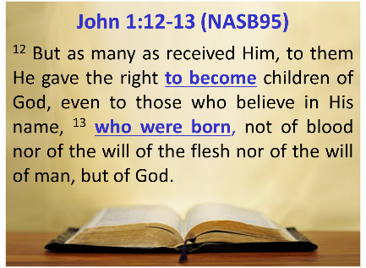
What does John mean by ‘born’?

Slide 51
What does John mean by ‘born’?
We have the clue of context in verse 12 that says that those who receive Christ by believing in Him become (ginomai) children of God.
were ‘born’ is gennaō, derived from the word ginomai
Notes:
We have the clue of context in verse 12 that says that those who receive Christ by believing in Him become (ginomai) children of God.
γίνομαι gínomai - This verb is mid. deponent intrans. primarily meaning to begin to be, that is, to come into existence or into any state… Zodhiates, S. (2000). The complete word study dictionary: New Testament (electronic ed.). Chattanooga, TN: AMG Publishers.

Slide 52
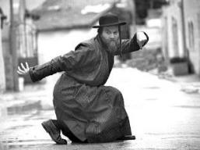
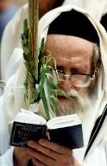
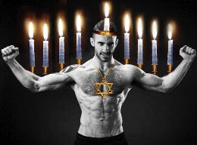
John 1:12-13, let’s untie the ‘nots’
Being born a child of God is not of bloods (οὐκ ἐξ αἱμάτων Gk: plural) – not just from a Jewish bloodline
Being born a child of God is not of the will of the flesh (οὐδὲ ἐκ θελήματος σαρκὸς) - not of human desire to have offspring
Notes:
13 οἳ οὐκ ἐξ αἱμάτων οὐδὲ ἐκ θελήματος σαρκὸς οὐδὲ ἐκ θελήματος ἀνδρὸς ἀλλ̓ ἐκ θεοῦ ἐγεννήθησαν.
Black, M., Martini, C. M., Metzger, B. M., & Wikgren, A. (1997). The Greek New Testament (Jn 1:13). Federal Republic of Germany: United Bible Societies.

Slide 53
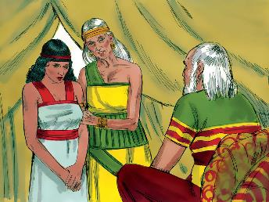
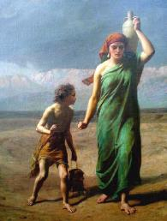
John 1:12-13, let’s untie the ‘nots’
Being born a child of God is ‘not of the will of man’, (οὐδὲ ἐκ θελήματος ἀνδρὸς) – ‘man’ is andros, meaning specifically male, pointing to fathering a child as a strategy, as even Abraham once did (Gen. 16-17).

Slide 54
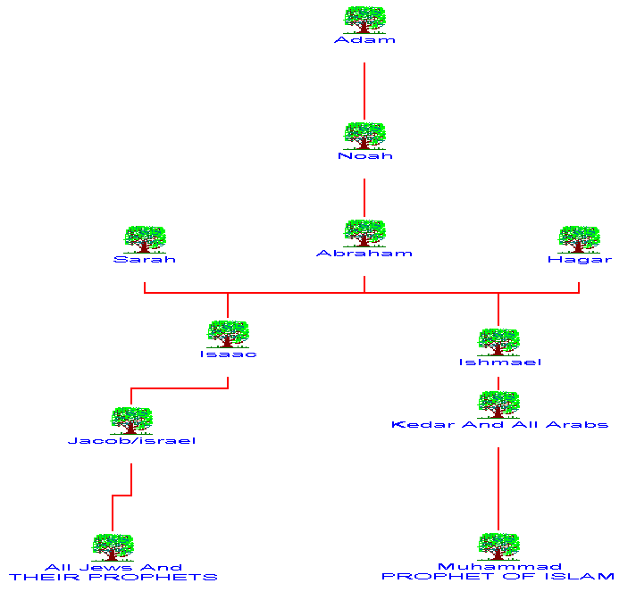
‘nor of the will of man’

Slide 55
So in v. 13, who are the “children or God”?
John 1:13 (NASB95)
¹³ who were born, not of blood nor of the will of the flesh nor of the will of man, but of God.
¹³ οἳ οὐκ ἐξ αἱμάτων οὐδὲ ἐκ θελήματος σαρκὸς οὐδὲ ἐκ θελήματος ἀνδρὸς ἀλλʼ ἐκ θεοῦ ἐγεννήθησαν.
Notes:
13 οἳ οὐκ ἐξ αἱμάτων οὐδὲ ἐκ θελήματος σαρκὸς οὐδὲ ἐκ θελήματος ἀνδρὸς ἀλλʼ ἐκ θεοῦ ἐγεννήθησαν. (API3P)
Nestle, E., Nestle, E., Aland, B., Aland, K., Karavidopoulos, J., Martini, C. M., & Metzger, B. M. (1993). The Greek New Testament with McReynolds English Interlinear (27th ed., Jn 1:13). Stuttgart: Deutsche Bibelgesellschaft.
This verse negates human strategies & human means for being born spiritually – but says that spiritual birth is ‘of’ or ‘out of’ God. So in Verse 13, who are the “children or God”? They are those “…who were born…of God.’

Slide 56
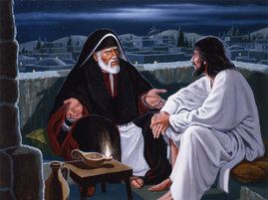
What does John mean by ‘born’?
John introduced the concept of new spiritual birth first here, but he will narrate a private conversation between Christ and Nicodemus in chapter 3, where he which will shed greater light on what was meant by being ‘born’, or as Jesus put it, being ‘born again’.
Notes:
John will narrate a private conversation between Christ & Nicodemus in John chapter 3, which will shed more light on what was meant by being ‘born’, or as Jesus put it, being ‘born again’.

Slide 57
The High Points of John 1:1-18
John 1:1-5 – The deity of Jesus Christ
John 1:6-13 – John the Baptist as a witness
John 1:14-18 – The Word made flesh

Slide 58
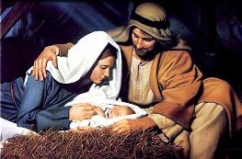
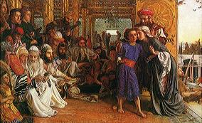
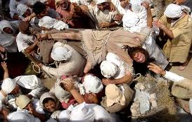
John 1:14 (NASB95)
¹⁴ And the Word became flesh, and dwelt among us, and we saw His glory, glory as of the only begotten from the Father, full of grace and truth.
Notes:
God’s expression of Himself toward mankind became flesh – born of Mary in Bethlehem; He did not cease from being or having the character of deity, but added humanity.
ἐγένετο – Verb Aorist Middle Indicative 3S – γίνομαι
Flesh in Scripture has a literal meaning, namely material human flesh, and a metaphorical meaning, human nature. Here John used it in the metaphorical sense. God the Son assumed a human, though not sinful, nature.
Constable, T. (2003)..
The Word, God’s very Self-expression, who was both with God and who was God, became flesh: he donned our humanity, save only our sin. - Carson, D. A. (1991). The Gospel According to John (p. 127). Leicester, England; Grand Rapids, MI: Inter-Varsity Press; W.B. Eerdmans.

Slide 59
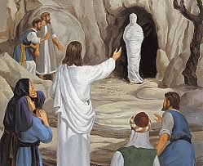
John 1:14 (NASB95)
¹⁴ And the Word became flesh, and dwelt among us, and we saw His glory, glory as of the only begotten from the Father, full of grace and truth. (cf. Rev 7:15; 12:12; 13:6; 21:3)
Notes:
The particular word John chose for ‘dwelt’ meant ‘to live in a tent’. In the New Testament, it is used only 5 times., and only by John. Once here and four times in Rev. In each case it is used for God dwelling with men.
dwelt ἐσκήνωσεν σκηνόω VAAI3S - Or tabernacled; i.e. lived temporarily
New American Standard Bible: 1995 Update
Rev 7:15 - “For this reason, they are before the throne of God; and they serve Him day and night in His temple; and He who sits on the throne will spread His tabernacle over them.
Rev 12:12 - “For this reason, rejoice, O heavens and you who dwell in them. Woe to the earth and the sea, because the devil has come down to you, having great wrath, knowing that he has only a short time.”
Rev 13:6 - And he opened his mouth in blasphemies against God, to blaspheme His name and His tabernacle, that is, those who dwell in heaven.
Rev 21:3 - And I heard a loud voice from the throne, saying, “Behold, the tabernacle of God is among men, and He will dwell among them, and they shall be His people, and God Himself will be among them,

Slide 60
John 1:14 (NASB95)
¹⁴ And the Word became flesh, and dwelt among us, and we saw His glory, glory as of the only begotten from the Father, full of grace and truth.
Notes:
In this case ‘among us’ refers to Jesus having dwelt among the disciples & others in their company, because it was those who saw (KJV: beheld; Greek: theaomai) His glory. The Greek word for ‘saw’ or ‘beheld’ means to ‘look closely’. So John meant that he & those in company with Christ looked closely at His radiant essence, which was glorious because of His deity.

Slide 61
John 1:14 (NASB95)
¹⁴ And the Word became flesh, and dwelt among us, and we saw His glory, glory as of the only begotten from the Father, full of grace and truth.
Notes:
In order for us to understand the magnitude & character of the glory John & the others in company beheld, he wrote that it was a glory ‘as of the only begotten’ from the Father.
John used this word (Greek: monogenes) more than any other New Testament author, & by it he meant that Christ was ‘unique’. The Greek has no definite article (equivalent to English ‘the’), so John was focusing on the character of Christ’s uniqueness.
In keeping with the character of Christ having been uniquely from God the Father, John will later provide profound and unique insights into the relationship of Christ with the Father, as well as the ministry of the Holy Spirit, sent from both the Father & His unique Son, Jesus Christ.

Slide 62
John 1:14 (NASB95)
¹⁴ And the Word became flesh, and dwelt among us, and we saw His glory, glory as of the only begotten from the Father, full of grace and truth.
Notes:
John wrote that when Christ dwelt among them, they looked closely upon Christ’s awesome unique glory, and that Christ was full of grace & truth. Glory is the radiant essence of who God is, and God is by His eternal character also infinite grace and truth. Christ’s capacity for and expression of grace and truth was not partial or limited, but instead was ‘full’.

Slide 63
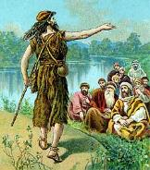
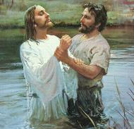
John 1:15 (NASB95)
¹⁵ John testified about Him and cried out, saying, “This was He of whom I said, ‘He who comes after me has a higher rank than I, for He existed before me.’ ”
Notes:
John the Baptist was six months older than Christ, by birth time & sequence, & apparently began his public ministry before Christ did as well. Yet John the Baptist himself proclaimed that Christ was greater than himself because Christ existed before him.
John the Baptist’s ‘existed before’ statement was not just a confusion of the facts, but a recognition that Christ existed in eternity past.
John 8:58 - Jesus said to them, “Truly, truly, I say to you, before Abraham was born, I am.”

Slide 64
John 1:16 (NASB95)
For of His fullness we have all received, and grace upon grace.
Notes:
John the apostle & those who were in company with Christ all received of the fullness of Christ’s character (glory, grace, & truth).
Regarding the grace John said they all received, he expressed it as ‘grace upon grace’. But what does that mean?
John is picturing two things: both the abundance & continuity of the grace that came from Christ, & both of those abundantly & infinitely flowing from His changeless character.

Slide 65
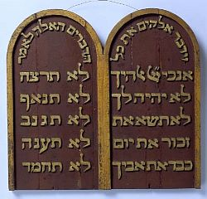
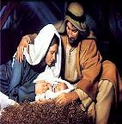
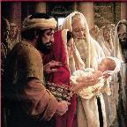
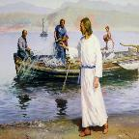
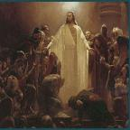
John 1:17 (NASB95)
For the Law was given through Moses; the grace and the truth were realized through Jesus Christ.
Notes:
John makes it pretty clear, doesn’t he?
Moses carried out his charge by passing along the Law to Israel - all 613 individual ordinances!
Moses gave the Law, as moral & spiritual information.
But the grace & the truth were not just given through Jesus Christ, but the grace & the truth came in walking, talking, living, breathing human form – flesh & bones – through Jesus Christ.

Slide 66
John 1:14-17(NASB95)
¹⁴ And the Word became flesh, and dwelt among us, and we saw His glory, glory as of the only begotten from the Father, full of grace and truth. ¹⁵ John testified about Him and cried out, saying, "This was He of whom I said, 'He who comes after me has a higher rank than I, for He existed before me.'" ¹⁶ For of His fullness we have all received, and grace upon grace. ¹⁷ For the Law was given through Moses; the grace and the truth were realized through Jesus Christ.
Notes:
v. 14 - full of grace and truth , character
v. 17 - the grace and the truth, These are singularly & specifically expressed through Christ: He is the grace and the truth!

Slide 67
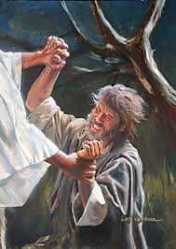
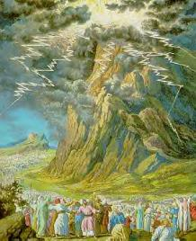
John 1:18 (NASB95)
¹⁸ No one has seen God at any time; the only begotten God who is in the bosom of the Father, He has explained Him.
Notes:
If no one has seen God at any time, why do we read of people seeing ‘God’ in various forms in the Bible?
What is John saying here?
The answer is that while God has taken on a visible form at times - even Christ was God in human form - no one can see God’s essence. God is an uncreated spiritual being (John 4:24), & all of what humans see with their eyes is matter that was created by God.

Slide 68
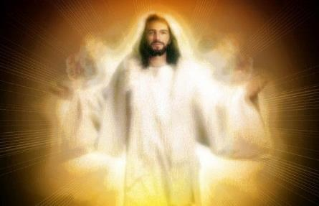
John 1:18 (NASB95)
¹⁸ No one has seen God at any time; the only begotten God who is in the bosom of the Father, He has explained Him.
Notes:
The one who is ‘only begotten’ in verse 14, who is Jesus Christ, is here called ‘only begotten God’. Jesus Christ is deity. He & the Father are one in essence. John 8:59 & 10:31 record two instances where the Jews picked up stones to kill Jesus because He so clearly claimed to be God that they thought it to be blasphemy.

Slide 69
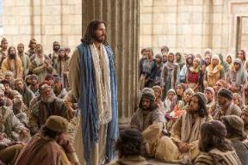
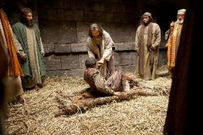
John 1:18 (NASB95)
¹⁸ No one has seen God at any time; the only begotten God who is in the bosom of the Father, He has explained Him.
Notes:
When John wrote that he saw Christ (see John 1:14 & also 1 John 4:1-4), he was not saying that he saw the essence of God, but that he saw Jesus Christ the person, who, being deity, expressed that deity in human form, revealing & explaining in the context of real life the matchless & changeless & eternal character of God Himself.
Let’s return to John 1:14

Slide 70
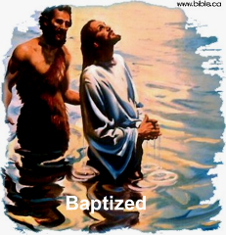
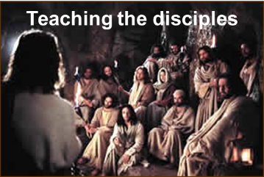
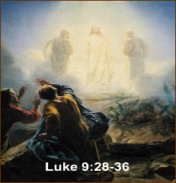
John 1:14
And the Word became flesh, and dwelt among us, and we saw His glory, glory as of the only begotten from the Father, full of grace and truth.
Notes:
Remember the message of 2 Corinthians 3:18?

Slide 71
Beholding the Lord through His Word
Seeing
the Living Word of God
in the written word of God
CONCLUSION

Slide 73
Beholding the Lord through His Word
So our reading about how John beheld the glory of Christ in His first coming, is our beholding Christ through the Word. As we are reading about John’s “beholding” we too are “beholding” and we “are being transformed from glory to glory” and that is a work of the Holy Spirit.

Slide 74
John 1:14
Expanded & Explained in light of 2 Corinthians 3:18
And Jesus Christ, the Son of God, and God‘s communication of His own personal, essential, being, came so as to be born in human form, and though total deity, ¹⁴ He was dwelling in that human form even while among us, and we beheld, and oh, this is awesome, we beheld His glory, that radiant essence of God Himself, since Christ is the unique Son of, and expression from, the Father, full of the grace and the truth, which are God’s eternal and infinite character. As we behold John’s description of how he and the disciples beheld Christ, we too are beholding Him as well, and as a work of the Holy Spirit, our being made to grow in and into, the glorious character of Christ.

Slide 75
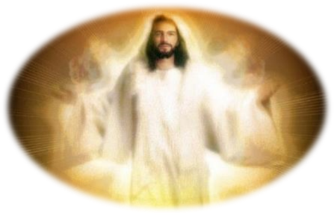
Seeing
the Living Word of God in
the Written Word of God

