Slide 1


Slide 2

The Coming Kingdom
Chapter 3
Dr. Andy Woods
Senior Pastor – Sugar Land Bible Church
Adjunct Professor of Bible & Theology – College of Biblical Studies

Slide 3

Kingdom Study Outline
What does the Bible Say About the Kingdom?
The Main Problem with Kingdom Now NT interpretations
Why do some believe that we are in the kingdom now?
Why does it matter?

Slide 4
Kingdom Study Outline
What does the Bible Say About the Kingdom?
The Main Problem with Kingdom Now NT interpretations
Why do some believe that we are in the kingdom now?
Why does it matter?

Slide 5
1. Kingdom Throughout the Bible
Eden Abrahamic Covenant Mosaic Covenant Divided Kingdom Times of the Gentiles | Old Testament Prophets Post exile Offer of the King / Kingdom Rejection of the Offer Interim Age

Slide 6
1. Kingdom Throughout the Bible
Eden Abrahamic Covenant Mosaic Covenant Divided Kingdom Times of the Gentiles | Old Testament Prophets Post exile Offer of the King / Kingdom Rejection of the Offer Interim Age

Slide 7
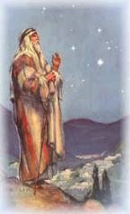
Abrahamic Covenant of Genesis 15
Necessity (Gen. 11:1-9)
Promises (Gen. 12:1-3, 7)
Literal (Gen. 11:31; 13:14-17)
To Abram’s physical descendants (Gen. 15:4-5)
Covenantal (Gen. 15:18)
Land, Seed, Blessing (Gen. 15: 1, 4-5, 18-21)
Reliable (Num. 23:19; Titus 1:2; Heb. 6:18)
Basis of the sub-covenants
Unconditional
Unfulfilled
Conclusion

Slide 8
Abrahamic Covenant of Genesis 15
Necessity (Gen. 11:1-9)
Promises (Gen. 12:1-3, 7)
Literal (Gen. 11:31; 13:14-17)
To Abram’s physical descendants (Gen. 15:4-5)
Covenantal (Gen. 15:18)
Land, Seed, Blessing (Gen. 15: 1, 4-5, 18-21)
Reliable (Num. 23:19; Titus 1:2; Heb. 6:18)
Basis of the sub-covenants
Unconditional
Unfulfilled
Conclusion

Slide 9

Genesis 3:15 (NASB)
“And I will put enmity Between you and the woman, And between your seed and her seed; He shall bruise you on the head, And you shall bruise him on the heel.”

Slide 10
God’s Messianic Purposes Beginning in Genesis
Proto evangelium (3:15, 21)
Seth (4:25)
Noah (Gen 5:29)
Shem (9:26)
Abraham (12:3)
Isaac (21:12)
Jacob (25:23)
Judah (49:10)

Slide 11
Genesis 11:1-4
¹ Now the whole earth used the same language and the same words. ² It came about as they journeyed east, that they found a plain in the land of Shinar and settled there. ³ They said to one another, “Come, let us make bricks and burn them thoroughly.” And they used brick for stone, and they used tar for mortar. ⁴ They said, “Come, let us build for ourselves a city, and a tower whose top will reach into heaven, and let us make for ourselves a name, otherwise we will be scattered abroad over the face of the whole earth.”

Slide 12
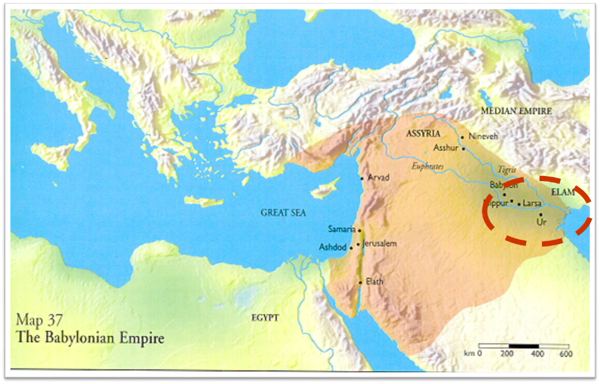

Slide 13
Genesis 11:1-4
¹ Now the whole earth used the same language and the same words. ² It came about as they journeyed east, that they found a plain in the land of Shinar and settled there. ³ They said to one another, “Come, let us make bricks and burn them thoroughly.” And they used brick for stone, and they used tar for mortar. ⁴ They said, “Come, let us build for ourselves a city, and a tower whose top will reach into heaven, and let us make for ourselves a name, otherwise we will be scattered abroad over the face of the whole earth.”

Slide 14
Genesis 11:5-7
⁵ The Lord came down to see the city and the tower which the sons of men had built. ⁶ The Lord said, “Behold, they are one people, and they all have the same language. And this is what they began to do, and now nothing which they purpose to do will be impossible for them. ⁷ “Come, let Us go down and there confuse their language, so that they will not understand one another’s speech.”

Slide 15
Genesis 11:8-9
⁸ So the Lord scattered them abroad from there over the face of the whole earth; and they stopped building the city. ⁹ Therefore its name was called Babel, because there the Lord confused the language of the whole earth; and from there the Lord scattered them abroad over the face of the whole earth.

Slide 16
Spread of the Mother-Child Cult
 | Mother | Child
Assyria | Ishtar | Tammuz
Phoenicia | Astarte | Baal
Egypt | Isis | Osirus/Horus
Greece | Aphrodite | Eros
Rome | Venus | Cupid
Asia | Cybele | Desius
India | Isi | Aswara
Roman Catholicism | Mary | Jesus
Israel | Queen of Heaven (Jer. 7:18; 44:17) | Tammuz (Ezek. 8:14-15)
Alexander Hislop, Two Babylons

Slide 17
Abrahamic Covenant of Genesis 15
Necessity (Gen. 11:1-9)
Promises (Gen. 12:1-3, 7)
Literal (Gen. 11:31; 13:14-17)
To Abram’s physical descendants (Gen. 15:4-5)
Covenantal (Gen. 15:18)
Land, Seed, Blessing (Gen. 15: 1, 4-5, 18-21)
Reliable (Num. 23:19; Titus 1:2; Heb. 6:18)
Basis of the sub-covenants
Unconditional
Unfulfilled
Conclusion

Slide 18

Joshua 24:2-3

Slide 19
Genesis 12:1-3, 7
Now the Lord said to Abram, “Go forth from your country, And from your relatives And from your father’s house, To the land which I will show you;² And I will make you a great nation, And I will bless you, And make your name great; And so you shall be a blessing;³ And I will bless those who bless you, And the one who curses you I will curse. And in you all the families of the earth will be blessed.”…The Lord appeared to Abram and said, “To your descendants I will give this land.”

Slide 20
Genesis 12:1-3, 7
Now the Lord said to Abram, “Go forth from your country, And from your relatives And from your father’s house, To the land which I will show you;² And I will make you a great nation, And I will bless you, And make your name great; And so you shall be a blessing;³ And I will bless those who bless you, And the one who curses you I will curse. And in you all the families of the earth will be blessed.”…The Lord appeared to Abram and said, “To your descendants I will give this land.”

Slide 21
Abrahamic Covenant of Genesis 15
Necessity (Gen. 11:1-9)
Promises (Gen. 12:1-3, 7)
Literal (Gen. 11:31; 13:14-17)
To Abram’s physical descendants (Gen. 15:4-5)
Covenantal (Gen. 15:18)
Land, Seed, Blessing (Gen. 15: 1, 4-5, 18-21)
Reliable (Num. 23:19; Titus 1:2; Heb. 6:18)
Basis of the sub-covenants
Unconditional
Unfulfilled
Conclusion

Slide 22
Joshua 24:2-3

Slide 23
Genesis 15:18-21
¹⁸ On that day the Lord made a covenant with Abram, saying, “To your descendants I have given this land, From the river of Egypt as far as the great river, the river Euphrates: ¹⁹ the Kenite and the Kenizzite and the Kadmonite ²⁰ and the Hittite and the Perizzite and the Rephaim ²¹ and the Amorite and the Canaanite and the Girgashite and the Jebusite.”

Slide 24
Genesis 15:18-21
¹⁸ On that day the Lord made a covenant with Abram, saying, “To your descendants I have given this land, From the river of Egypt as far as the great river, the river Euphrates: ¹⁹ the Kenite and the Kenizzite and the Kadmonite ²⁰ and the Hittite and the Perizzite and the Rephaim ²¹ and the Amorite and the Canaanite and the Girgashite and the Jebusite.”

Slide 25
Genesis 15:18-21
¹⁸ On that day the Lord made a covenant with Abram, saying, “To your descendants I have given this land, From the river of Egypt as far as the great river, the river Euphrates: ¹⁹ the Kenite and the Kenizzite and the Kadmonite ²⁰ and the Hittite and the Perizzite and the Rephaim ²¹ and the Amorite and the Canaanite and the Girgashite and the Jebusite.”

Slide 26
Genesis 15:18-21
¹⁸ On that day the Lord made a covenant with Abram, saying, “To your descendants I have given this land, From the river of Egypt as far as the great river, the river Euphrates: ¹⁹ the Kenite and the Kenizzite and the Kadmonite ²⁰ and the Hittite and the Perizzite and the Rephaim ²¹ and the Amorite and the Canaanite and the Girgashite and the Jebusite.”

Slide 27
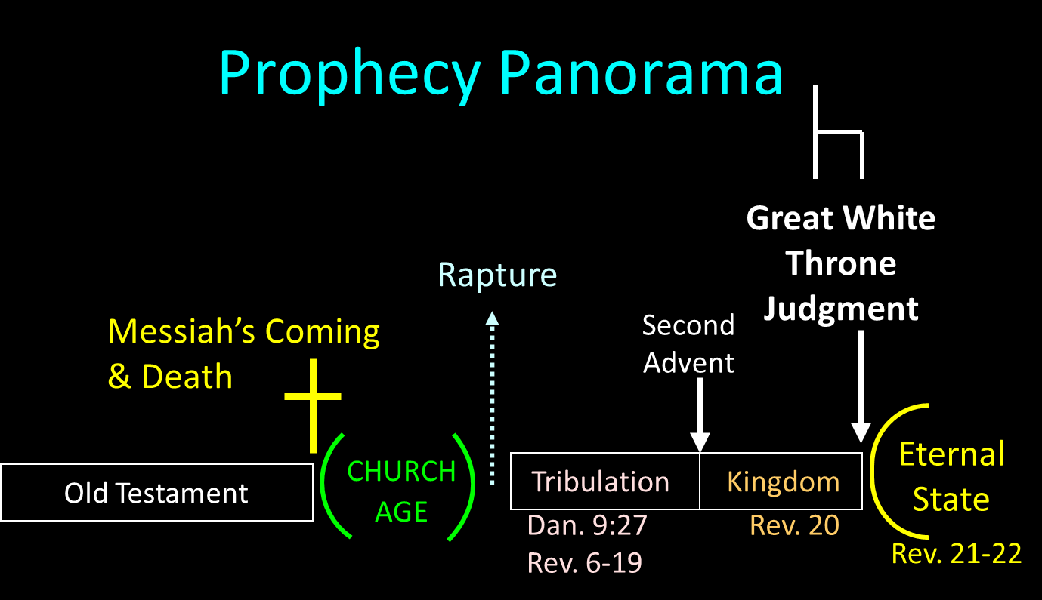

Slide 28
DIFFERENCES BETWEEN THE MILLENNIUM & ETERNAL STATE
Millennium (Rev. 20:1-10) | Eternal State (Rev. 21‒22)
Present earth (Gen. 13:17) | New Earth (Rev. 21:1)
Waters (Gen. 15:18-21) | No sea (Rev. 21:1)
Rebellion (Zech. 14:16-18) | No rebellion (Rev. 21:4)
Tribal land (Ezek. 47:13-23) | Tribal city gates (Rev. 21:12)
Sin exists (Ezek 45:22) | No sin (Rev. 21:4)
Temple (Ezek. 40‒46) | No temple (Rev. 21:22)
Rod of iron (Ps. 2:6-8) | No rod needed (Rev. 21:8)
Death (Isa. 65:20) | No death (Rev. 21:4)
Sun exists (Isa. 30:26) | No sun (Rev. 21:23; 22:5)

Slide 29
DIFFERENCES BETWEEN THE MILLENNIUM & ETERNAL STATE
Millennium (Rev. 20:1-10) | Eternal State (Rev. 21‒22)
Present earth (Gen. 13:17) | New Earth (Rev. 21:1)
Waters (Gen. 15:18-21) | No sea (Rev. 21:1)
Rebellion (Zech. 14:16-18) | No rebellion (Rev. 21:4)
Tribal land (Ezek. 47:13-23) | Tribal city gates (Rev. 21:12)
Sin exists (Ezek 45:22) | No sin (Rev. 21:4)
Temple (Ezek. 40‒46) | No temple (Rev. 21:22)
Rod of iron (Ps. 2:6-8) | No rod needed (Rev. 21:8)
Death (Isa. 65:20) | No death (Rev. 21:4)
Sun exists (Isa. 30:26) | No sun (Rev. 21:23; 22:5)

Slide 30
Abrahamic Covenant of Genesis 15
Necessity (Gen. 11:1-9)
Promises (Gen. 12:1-3, 7)
Literal (Gen. 11:31; 13:14-17)
To Abram’s physical descendants (Gen. 15:4-5)
Covenantal (Gen. 15:18)
Land, Seed, Blessing (Gen. 15: 1, 4-5, 18-21)
Reliable (Num. 23:19; Titus 1:2; Heb. 6:18)
Basis of the sub-covenants
Unconditional
Unfulfilled
Conclusion

Slide 31
Genesis 15:4-5
Then behold, the word of the Lord came to him, saying, “This man will not be your heir; but one who will come forth from your own body, he shall be your heir.” ⁵ And He took him outside and said, “Now look toward the heavens, and count the stars, if you are able to count them.” And He said to him, “So shall your descendants be.”

Slide 32
Genesis 12:1-3, 7
Now the Lord said to Abram, “Go forth from your country, And from your relatives And from your father’s house, To the land which I will show you;² And I will make you a great nation, And I will bless you, And make your name great; And so you shall be a blessing;³ And I will bless those who bless you, And the one who curses you I will curse. And in you all the families of the earth will be blessed.”…The Lord appeared to Abram and said, “To your descendants I will give this land.”

Slide 33
Abrahamic Covenant of Genesis 15
Necessity (Gen. 11:1-9)
Promises (Gen. 12:1-3, 7)
Literal (Gen. 11:31; 13:14-17)
To Abram’s physical descendants (Gen. 15:4-5)
Covenantal (Gen. 15:18)
Land, Seed, Blessing (Gen. 15: 1, 4-5, 18-21)
Reliable (Num. 23:19; Titus 1:2; Heb. 6:18)
Basis of the sub-covenants
Unconditional
Unfulfilled
Conclusion

Slide 34
Genesis 15:18-21
¹⁸ On that day the Lord made a covenant with Abram, saying, “To your descendants I have given this land, From the river of Egypt as far as the great river, the river Euphrates: ¹⁹ the Kenite and the Kenizzite and the Kadmonite ²⁰ and the Hittite and the Perizzite and the Rephaim ²¹ and the Amorite and the Canaanite and the Girgashite and the Jebusite.”

Slide 35
Abrahamic Covenant of Genesis 15
Necessity (Gen. 11:1-9)
Promises (Gen. 12:1-3, 7)
Literal (Gen. 11:31; 13:14-17)
To Abram’s physical descendants (Gen. 15:4-5)
Covenantal (Gen. 15:18)
Land, Seed, Blessing (Gen. 15: 1, 4-5, 18-21)
Reliable (Num. 23:19; Titus 1:2; Heb. 6:18)
Basis of the sub-covenants
Unconditional
Unfulfilled
Conclusion

Slide 36
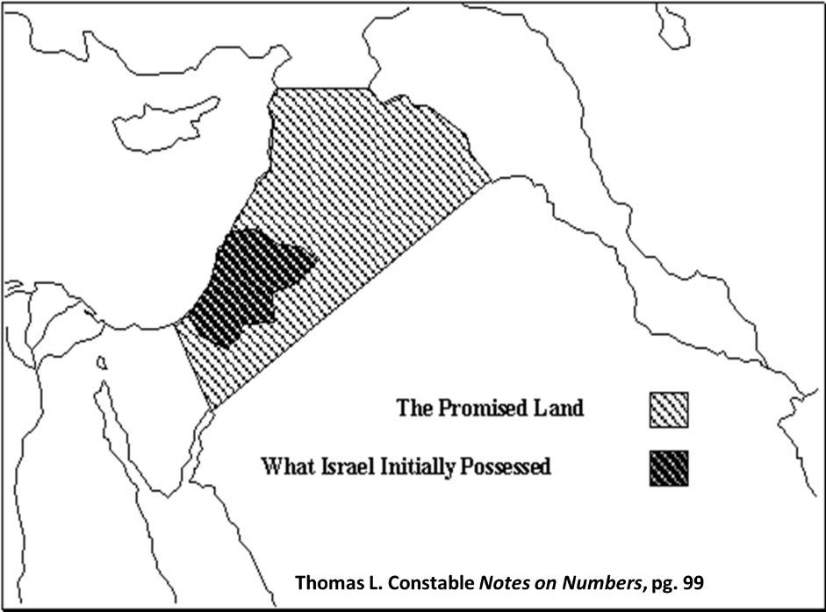

Slide 37
Genesis 15:18-21
¹⁸ On that day the Lord made a covenant with Abram, saying, “To your descendants I have given this land, From the river of Egypt as far as the great river, the river Euphrates: ¹⁹ the Kenite and the Kenizzite and the Kadmonite ²⁰ and the Hittite and the Perizzite and the Rephaim ²¹ and the Amorite and the Canaanite and the Girgashite and the Jebusite.”

Slide 39
DIFFERENCES BETWEEN THE MILLENNIUM & ETERNAL STATE
Millennium (Rev. 20:1-10) | Eternal State (Rev. 21‒22)
Present earth (Gen. 13:17) | New Earth (Rev. 21:1)
Waters (Gen. 15:18-21) | No sea (Rev. 21:1)
Rebellion (Zech. 14:16-18) | No rebellion (Rev. 21:4)
Tribal land (Ezek. 47:13-23) | Tribal city gates (Rev. 21:12)
Sin exists (Ezek 45:22) | No sin (Rev. 21:4)
Temple (Ezek. 40‒46) | No temple (Rev. 21:22)
Rod of iron (Ps. 2:6-8) | No rod needed (Rev. 21:8)
Death (Isa. 65:20) | No death (Rev. 21:4)
Sun exists (Isa. 30:26) | No sun (Rev. 21:23; 22:5)

Slide 40
Genesis 15:4-5
Then behold, the word of the Lord came to him, saying, “This man will not be your heir; but one who will come forth from your own body, he shall be your heir.” ⁵ And He took him outside and said, “Now look toward the heavens, and count the stars, if you are able to count them.” And He said to him, “So shall your descendants be.”

Slide 41
Abrahamic Covenant of Genesis 15
Necessity (Gen. 11:1-9)
Promises (Gen. 12:1-3, 7)
Literal (Gen. 11:31; 13:14-17)
To Abram’s physical descendants (Gen. 15:4-5)
Covenantal (Gen. 15:18)
Land, Seed, Blessing (Gen. 15: 1, 4-5, 18-21)
Reliable (Num. 23:19; Titus 1:2; Heb. 6:18)
Basis of the sub-covenants
Unconditional
Unfulfilled
Conclusion

Slide 42
Abrahamic Covenant of Genesis 15
Necessity (Gen. 11:1-9)
Promises (Gen. 12:1-3, 7)
Literal (Gen. 11:31; 13:14-17)
To Abram’s physical descendants (Gen. 15:4-5)
Covenantal (Gen. 15:18)
Land, Seed, Blessing (Gen. 15: 1, 4-5, 18-21)
Reliable (Num. 23:19; Titus 1:2; Heb. 6:18)
Basis of the sub-covenants
Unconditional
Unfulfilled
Conclusion

Slide 43


Slide 44

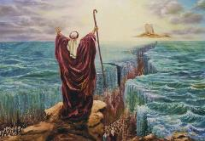
Deuteronomy 29:1
“These are the words of the covenant which the Lord commanded Moses to make with the sons of Israel in the land of Moab, besides the covenant which He had made with them at Horeb.”

Slide 45
Deuteronomy 30:3
“ Then the Lord your God will restore you from captivity, and have compassion on you, and will gather you again from all the peoples where the Lord your God has scattered you.”

Slide 47

2 Samuel 7:12-16
“When your days are complete and you lie down with your fathers, I will raise up your descendant after you, who will come forth from you, and I will establish his kingdom. ¹³ He shall build a house for My name, and I will establish the throne of his kingdom forever. ¹⁴ I will be a father to him and he will be a son to Me; when he commits iniquity, I will correct him with the rod of men and the strokes of the sons of men, ¹⁵ but My lovingkindness shall not depart from him, as I took it away from Saul, whom I removed from before you. ¹⁶ Your house and your kingdom shall endure before Me forever; your throne shall be established forever.” ¹⁷ In accordance with all these words and all this vision, so Nathan spoke to David.”

Slide 48
2 Samuel 7:12-16
“When your days are complete and you lie down with your fathers, I will raise up your descendant after you, who will come forth from you, and I will establish his kingdom. ¹³ He shall build a house for My name, and I will establish the throne of his kingdom forever. ¹⁴ I will be a father to him and he will be a son to Me; when he commits iniquity, I will correct him with the rod of men and the strokes of the sons of men, ¹⁵ but My lovingkindness shall not depart from him, as I took it away from Saul, whom I removed from before you. ¹⁶ Your house and your kingdom shall endure before Me forever; your throne shall be established forever.” ¹⁷ In accordance with all these words and all this vision, so Nathan spoke to David.”

Slide 49
Genesis 3:15 (NASB)
“And I will put enmity Between you and the woman, And between your seed and her seed; He shall bruise you on the head, And you shall bruise him on the heel.”

Slide 50
Genesis 3:15 (NASB)
“And I will put enmity Between you and the woman, And between your seed and her seed; He shall bruise you on the head, And you shall bruise him on the heel.”

Slide 51
Galatians 3:16 (NASB)
“Now the promises were spoken to Abraham and to his seed. He does not say, “And to seeds,” as referring to many, but rather to one, “And to your seed,” that is, Christ.”

Slide 52
Galatians 3:16 (NASB)
“Now the promises were spoken to Abraham and to his seed. He does not say, “And to seeds,” as referring to many, but rather to one, “And to your seed,” that is, Christ.”

Slide 53

John F. Walvoord
Israel in Prophecy (Grand Rapids: Zondervan, 1962), 84-85, 87.
“The covenant with David is not only given twice in its major content— namely, II Samuel 7 and I Chronicles 17—but it is also confirmed in Psalm 89. In this and other Old Testament references there is no allusion anywhere to the idea that these promises are to be understood in a spiritualized sense as referring to the church or to a reign of God in heaven. Rather, it is linked to the earth and to the seed of Israel, and to the land...There is no indication that this kingdom extended to a spiritual entity such as the church nor that the throne in view is the throne of God in heaven rather than the throne of David on earth...Such a situation does not prevail in this present age and is not related here or elsewhere to the reign of Christ from the throne of His Father in heaven.”

Slide 55
Jeremiah 31:31-34
“Behold, days are coming,” declares the Lord, “when I will make a new covenant with the house of Israel and with the house of Judah, ³² not like the covenant which I made with their fathers in the day I took them by the hand to bring them out of the land of Egypt, My covenant which they broke, although I was a husband to them,” declares the Lord. ³³ “But this is the covenant which I will make with the house of Israel after those days,” declares the Lord, “I will put My law within them and on their heart I will write it; and I will be their God, and they shall be My people. ³⁴ They will not teach again, each man his neighbor and each man his brother, saying, ‘Know the Lord,’ for they will all know Me, from the least of them to the greatest of them,” declares the Lord, “for I will forgive their iniquity, and their sin I will remember no more.”

Slide 56
Jeremiah 31:31-34
“Behold, days are coming,” declares the Lord, “when I will make a new covenant with the house of Israel and with the house of Judah, ³² not like the covenant which I made with their fathers in the day I took them by the hand to bring them out of the land of Egypt, My covenant which they broke, although I was a husband to them,” declares the Lord. ³³ “But this is the covenant which I will make with the house of Israel after those days,” declares the Lord, “I will put My law within them and on their heart I will write it; and I will be their God, and they shall be My people. ³⁴ They will not teach again, each man his neighbor and each man his brother, saying, ‘Know the Lord,’ for they will all know Me, from the least of them to the greatest of them,” declares the Lord, “for I will forgive their iniquity, and their sin I will remember no more.”

Slide 57
Abrahamic Covenant of Genesis 15
Necessity (Gen. 11:1-9)
Promises (Gen. 12:1-3, 7)
Literal (Gen. 11:31; 13:14-17)
To Abram’s physical descendants (Gen. 15:4-5)
Covenantal (Gen. 15:18)
Land, Seed, Blessing (Gen. 15: 1, 4-5, 18-21)
Reliable (Num. 23:19; Titus 1:2; Heb. 6:18)
Basis of the sub-covenants
Unconditional
Unfulfilled
Conclusion

Slide 58
Proverbs 3:5-6 (NASB)
“Trust in the Lord with all your heart And do not lean on your own understanding. In all your ways acknowledge Him, And He will make your paths straight.”

Slide 59
Evidence of Abrahamic Covenant’s Unconditional Nature
ANE covenant ratification ceremony (Gen 15)
Lack of stated conditions for Israel’s obedience (Gen 15)
Covenant's eternality (Gen 17:7, 13, 19; Ps. 90:2)
Covenant's immutability (Heb 6:13-18; Mal. 3:6)
Trans-generational reaffirmation despite perpetual national disobedience (Jer 31:35-37)
Walvoord, The Millennial Kingdom, 149-52

Slide 60
Evidence of Abrahamic Covenant’s Unconditional Nature
ANE covenant ratification ceremony (Gen 15)
Lack of stated conditions for Israel’s obedience (Gen 15)
Covenant's eternality (Gen 17:7, 13, 19; Ps. 90:2)
Covenant's immutability (Heb 6:13-18; Mal. 3:6)
Trans-generational reaffirmation despite perpetual national disobedience (Jer 31:35-37)
Walvoord, The Millennial Kingdom, 149-52

Slide 61
ANE covenant ratification ceremony (Gen 15)
ANE covenant ratification ceremony (Jer. 34:8-10, 18-19)
Abram never passed through the animal pieces
  Asleep (Gen. 15:12)
  Tardeimah (Gen. 2:21)
God alone passed through the animal pieces (Gen. 15:17; Exod. 13:21)
Oven and torch do not represent God and man
Walvoord, The Millennial Kingdom, 149-52

Slide 62
Evidence of Abrahamic Covenant’s Unconditional Nature
ANE covenant ratification ceremony (Gen 15)
Lack of stated conditions for Israel’s obedience (Gen 15)
Covenant's eternality (Gen 17:7, 13, 19; Ps. 90:2)
Covenant's immutability (Heb 6:13-18; Mal. 3:6)
Trans-generational reaffirmation despite perpetual national disobedience (Jer 31:35-37)
Walvoord, The Millennial Kingdom, 149-52

Slide 63
Evidence of Abrahamic Covenant’s Unconditional Nature
ANE covenant ratification ceremony (Gen 15)
Lack of stated conditions for Israel’s obedience (Gen 15)
Covenant's eternality (Gen 17:7, 13, 19; Ps. 90:2)
Covenant's immutability (Heb 6:13-18; Mal. 3:6)
Trans-generational reaffirmation despite perpetual national disobedience (Jer 31:35-37)
Walvoord, The Millennial Kingdom, 149-52

Slide 64
Trans-generational reaffirmation despite perpetual national disobedience
Covenant continuously reaffirmed to Abraham (Gen. 13:14-17; 22:17-18) despite his perpetual disobedience (Gen. 12:10-20; 20; 12:1, 4-5, 10; Acts 7:3-4)
Covenant continuously reaffirmed to Jacob (Gen. 28:14-15) despite his perpetual disobedience (Gen. 27; meaning of “Jacob”)
Covenant continuously reaffirmed to the nation of Israel (Jer. 31:35-37) despite her perpetual disobedience (Jer. 7:18; 44:17-18)
Walvoord, The Millennial Kingdom, 149-52

Slide 65
Trans-generational reaffirmation despite perpetual national disobedience
Covenant continuously reaffirmed to Abraham (Gen. 13:14-17; 22:17-18) despite his perpetual disobedience (Gen. 12:10-20; 20; 12:1, 4-5, 10; Acts 7:3-4)
Covenant continuously reaffirmed to Jacob (Gen. 28:14-15) despite his perpetual disobedience (Gen. 27; meaning of “Jacob”)
Covenant continuously reaffirmed to the nation of Israel (Jer. 31:35-37) despite her perpetual disobedience (Jer. 7:18; 44:17-18)
Walvoord, The Millennial Kingdom, 149-52

Slide 66
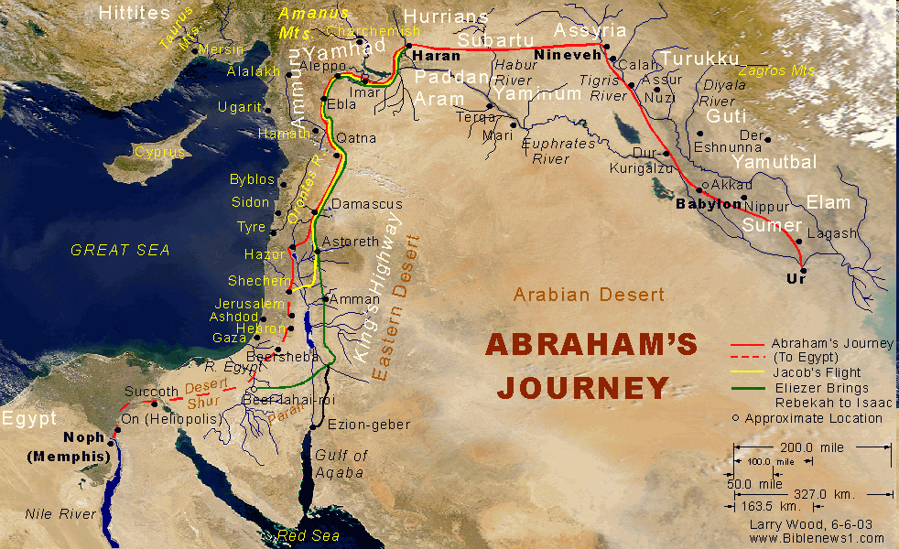

Slide 67
Genesis 12:1-3, 7
Now the Lord said to Abram, “Go forth from your country, And from your relatives And from your father’s house, To the land which I will show you;² And I will make you a great nation, And I will bless you, And make your name great; And so you shall be a blessing;³ And I will bless those who bless you, And the one who curses you I will curse. And in you all the families of the earth will be blessed.”…The Lord appeared to Abram and said, “To your descendants I will give this land.”

Slide 68
Acts 7:3-4
And he said, “Hear me, brethren and fathers! The God of glory appeared to our father Abraham when he was in Mesopotamia, before he lived in Haran, ³ and said to him, ‘Leave your country and your relatives, and come into the land that I will show you.’ ⁴ Then he left the land of the Chaldeans and settled in Haran. From there, after his father died, God had him move to this country in which you are now living..”

Slide 69
Trans-generational reaffirmation despite perpetual national disobedience
Covenant continuously reaffirmed to Abraham (Gen. 13:14-17; 22:17-18) despite his perpetual disobedience (Gen. 12:10-20; 20; 12:1, 4-5, 10; Acts 7:3-4)
Covenant continuously reaffirmed to Jacob (Gen. 28:14-15) despite his perpetual disobedience (Gen. 27; meaning of “Jacob”)
Covenant continuously reaffirmed to the nation of Israel (Jer. 31:35-37) despite her perpetual disobedience (Jer. 7:18; 44:17-18)
Walvoord, The Millennial Kingdom, 149-52

Slide 70
Trans-generational reaffirmation despite perpetual national disobedience
Covenant continuously reaffirmed to Abraham (Gen. 13:14-17; 22:17-18) despite his perpetual disobedience (Gen. 12:10-20; 20; 12:1, 4-5, 10; Acts 7:3-4)
Covenant continuously reaffirmed to Jacob (Gen. 28:14-15) despite his perpetual disobedience (Gen. 27; meaning of “Jacob”)
Covenant continuously reaffirmed to the nation of Israel (Jer. 31:35-37) despite her perpetual disobedience (Jer. 7:18; 44:17-18)
Walvoord, The Millennial Kingdom, 149-52

Slide 71
Jeremiah 31:35-37
“Thus says the Lord, Who gives the sun for light by day And the fixed order of the moon and the stars for light by night, Who stirs up the sea so that its waves roar; The Lord of hosts is His name:³⁶ “If this fixed order departs From before Me,” declares the Lord, “Then the offspring of Israel also will cease From being a nation before Me forever.”³⁷ Thus says the Lord, “If the heavens above can be measured And the foundations of the earth searched out below, Then I will also cast off all the offspring of Israel For all that they have done,” declares the Lord.”

Slide 72
Abrahamic Covenant of Genesis 15
Necessity (Gen. 11:1-9)
Promises (Gen. 12:1-3, 7)
Literal (Gen. 11:31; 13:14-17)
To Abram’s physical descendants (Gen. 15:4-5)
Covenantal (Gen. 15:18)
Land, Seed, Blessing (Gen. 15: 1, 4-5, 18-21)
Reliable (Num. 23:19; Titus 1:2; Heb. 6:18)
Basis of the sub-covenants
Unconditional
Unfulfilled
Conclusion

Slide 73

Land Promises Fulfilled in the Time of Joshua (Josh. 11:23; 21:43-45) or Solomon (1 Kgs. 4:21)?
Extended context (Josh 13:1-7; Judges 1:19, 21, 27, 29, 30-36)
Land gained in conquest was only a fraction of what was promised (1 Kgs. 4:25)
Jerusalem not conquered in Joshua’s day (Josh 15:63; 2 Sam 5)
Solomon’s reign extended to the border of Egypt (1 Kgs. 4:21) and not the River of Egypt (Gen. 15:18)
Solomon’s reign was tributary only (1 Kgs. 4:21)
Forever? (Gen 17:7-8, 13, 19)
Reaffirmation of land promises long after Joshua and Solomon’s time (Amos 9:11-15)
Fruchtenbaum, Israelology, 521-22, 631-32

Slide 74
Land Promises Fulfilled in the Time of Joshua (Josh. 11:23; 21:43-45) or Solomon (1 Kgs. 4:21)?
Extended context (Josh 13:1-7; Judges 1:19, 21, 27, 29, 30-36)
Land gained in conquest was only a fraction of what was promised (1 Kgs. 4:25)
Jerusalem not conquered in Joshua’s day (Josh 15:63; 2 Sam 5)
Solomon’s reign extended to the border of Egypt (1 Kgs. 4:21) and not the River of Egypt (Gen. 15:18)
Solomon’s reign was tributary only (1 Kgs. 4:21)
Forever? (Gen 17:7-8, 13, 19)
Reaffirmation of land promises long after Joshua and Solomon’s time (Amos 9:11-15)
Fruchtenbaum, Israelology, 521-22, 631-32

Slide 75
Land Promises Fulfilled in the Time of Joshua (Josh. 11:23; 21:43-45) or Solomon (1 Kgs. 4:21)?
Extended context (Josh 13:1-7; Judges 1:19, 21, 27, 29, 30-36)
Land gained in conquest was only a fraction of what was promised (1 Kgs. 4:25)
Jerusalem not conquered in Joshua’s day (Josh 15:63; 2 Sam 5)
Solomon’s reign extended to the border of Egypt (1 Kgs. 4:21) and not the River of Egypt (Gen. 15:18)
Solomon’s reign was tributary only (1 Kgs. 4:21)
Forever? (Gen 17:7-8, 13, 19)
Reaffirmation of land promises long after Joshua and Solomon’s time (Amos 9:11-15)
Fruchtenbaum, Israelology, 521-22, 631-32

Slide 76
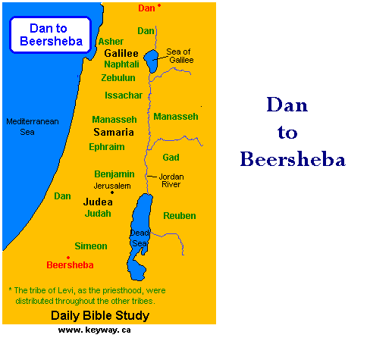

Slide 78
Land Promises Fulfilled in the Time of Joshua (Josh. 11:23; 21:43-45) or Solomon (1 Kgs. 4:21)?
Extended context (Josh 13:1-7; Judges 1:19, 21, 27, 29, 30-36)
Land gained in conquest was only a fraction of what was promised (1 Kgs. 4:25)
Jerusalem not conquered in Joshua’s day (Josh 15:63; 2 Sam 5)
Solomon’s reign extended to the border of Egypt (1 Kgs. 4:21) and not the River of Egypt (Gen. 15:18)
Solomon’s reign was tributary only (1 Kgs. 4:21)
Forever? (Gen 17:7-8, 13, 19)
Reaffirmation of land promises long after Joshua and Solomon’s time (Amos 9:11-15)
Fruchtenbaum, Israelology, 521-22, 631-32

Slide 79
Land Promises Fulfilled in the Time of Joshua (Josh. 11:23; 21:43-45) or Solomon (1 Kgs. 4:21)?
Extended context (Josh 13:1-7; Judges 1:19, 21, 27, 29, 30-36)
Land gained in conquest was only a fraction of what was promised (1 Kgs. 4:25)
Jerusalem not conquered in Joshua’s day (Josh 15:63; 2 Sam 5)
Solomon’s reign extended to the border of Egypt (1 Kgs. 4:21) and not the River of Egypt (Gen. 15:18)
Solomon’s reign was tributary only (1 Kgs. 4:21)
Forever? (Gen 17:7-8, 13, 19)
Reaffirmation of land promises long after Joshua and Solomon’s time (Amos 9:11-15)
Fruchtenbaum, Israelology, 521-22, 631-32

Slide 80
Israel's Historical Judgments
Division of the kingdom in 931 B.C. (1 Kgs. 12)
Assyrian judgment in 722 B.C. (2 Kgs. 17)
Babylonian captivity in 586 B.C. (2 Kgs. 25)
Roman Judgment in A.D. 70 (Luke 19:41-44)

Slide 81
Israel's Historical Judgments
Division of the kingdom in 931 B.C. (1 Kgs. 12)
Assyrian judgment in 722 B.C. (2 Kgs. 17)
Babylonian captivity in 586 B.C. (2 Kgs. 25)
Roman Judgment in A.D. 70 (Luke 19:41-44)

Slide 82
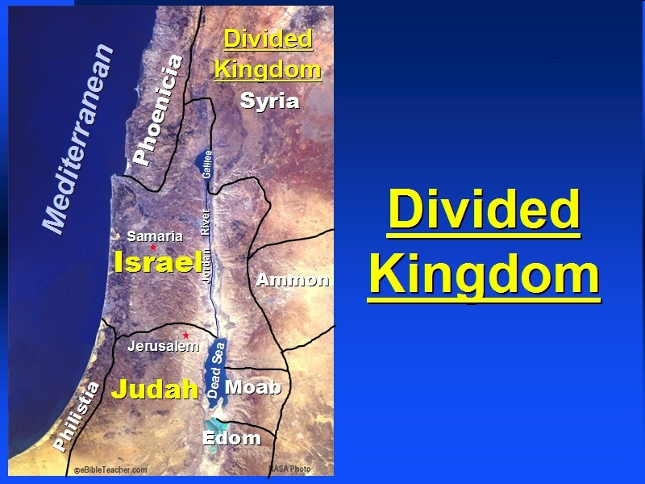

Slide 83
Israel's Historical Judgments
Division of the kingdom in 931 B.C. (1 Kgs. 12)
Assyrian judgment in 722 B.C. (2 Kgs. 17)
Babylonian captivity in 586 B.C. (2 Kgs. 25)
Roman Judgment in A.D. 70 (Luke 19:41-44)

Slide 84
Land Promises Fulfilled in the Time of Joshua (Josh. 11:23; 21:43-45) or Solomon (1 Kgs. 4:21)?
Extended context (Josh 13:1-7; Judges 1:19, 21, 27, 29, 30-36)
Land gained in conquest was only a fraction of what was promised (1 Kgs. 4:25)
Jerusalem not conquered in Joshua’s day (Josh 15:63; 2 Sam 5)
Solomon’s reign extended to the border of Egypt (1 Kgs. 4:21) and not the River of Egypt (Gen. 15:18)
Solomon’s reign was tributary only (1 Kgs. 4:21)
Forever? (Gen 17:7-8, 13, 19)
Reaffirmation of land promises long after Joshua and Solomon’s time (Amos 9:11-15)
Fruchtenbaum, Israelology, 521-22, 631-32

Slide 86
Jeremiah 31:31-34
“Behold, days are coming,” declares the Lord, “when I will make a new covenant with the house of Israel and with the house of Judah, ³² not like the covenant which I made with their fathers in the day I took them by the hand to bring them out of the land of Egypt, My covenant which they broke, although I was a husband to them,” declares the Lord. ³³ “But this is the covenant which I will make with the house of Israel after those days,” declares the Lord, “I will put My law within them and on their heart I will write it; and I will be their God, and they shall be My people. ³⁴ They will not teach again, each man his neighbor and each man his brother, saying, ‘Know the Lord,’ for they will all know Me, from the least of them to the greatest of them,” declares the Lord, “for I will forgive their iniquity, and their sin I will remember no more.”

Slide 87
Abrahamic Covenant of Genesis 15
Necessity (Gen. 11:1-9)
Promises (Gen. 12:1-3, 7)
Literal (Gen. 11:31; 13:14-17)
To Abram’s physical descendants (Gen. 15:4-5)
Covenantal (Gen. 15:18)
Land, Seed, Blessing (Gen. 15: 1, 4-5, 18-21)
Reliable (Num. 23:19; Titus 1:2; Heb. 6:18)
Basis of the sub-covenants
Unconditional
Unfulfilled
Conclusion

Slide 88
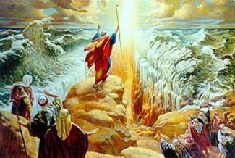
Importance
God’s promises & covenant to Israel remain literal, reliable, unconditional, and unfulfilled (Gen. 23)
Basis of God’s intervention in history (Gen. 15:14-16; Exod. 2:24)
God must once again move His hand in history to fulfill His Word (Ezek. 36:22)
Forms the expectation of a future earthly kingdom

Slide 89
1. Kingdom Throughout the Bible
Eden Abrahamic Covenant Mosaic Covenant Divided Kingdom Times of the Gentiles | Old Testament Prophets Post exile Offer of the King / Kingdom Rejection of the Offer Interim Age

