Slide 1
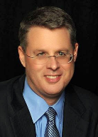
Soteriology
Session 41
Dr. Andy Woods
Senior Pastor – Sugar Land Bible Church
Professor of Bible & Theology – College of Biblical Studies

Slide 2
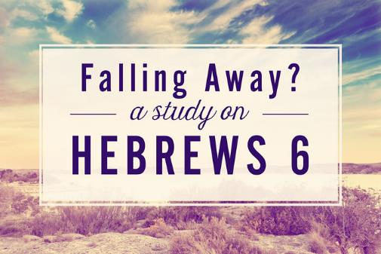
The Kadesh Barnea Paradigm as a Solution to the Problem of Hebrews 6:4-6
Dr. Andy Woods

Slide 3

Hebrews 6:4-6 (NASB)
⁴ For in the case of those who have once been enlightened and have tasted of the heavenly gift and have been made partakers of the Holy Spirit, ⁵ and have tasted the good word of God and the powers of the age to come, ⁶ and then have fallen away, it is impossible to renew them again to repentance, since they again crucify to themselves the Son of God and put Him to open shame.

Slide 4
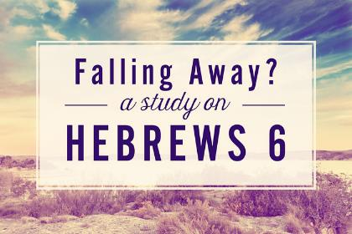
4 Views on Warning Passages
Calvinism/Reformed
Arminianism
Hypothetical
Loss of blessings

Slide 5
4 Views on Warning Passages
Calvinism/Reformed
Arminianism
Hypothetical
Loss of blessings

Slide 6
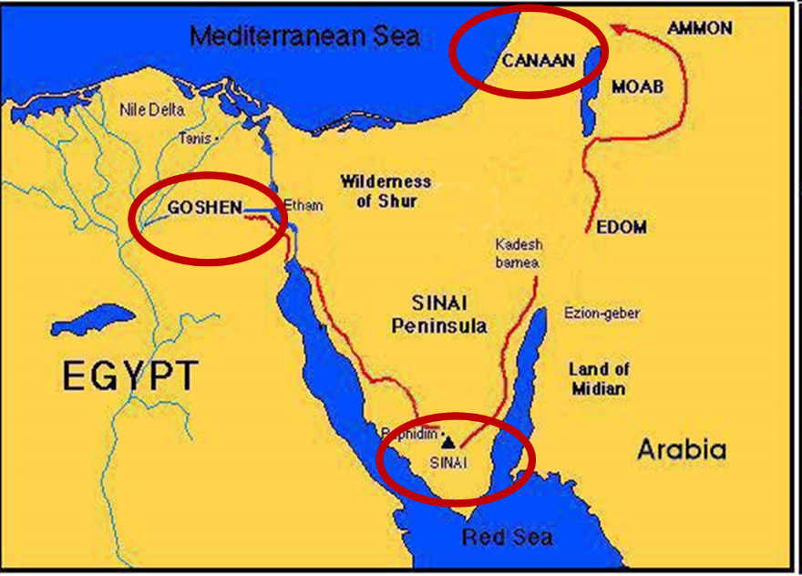

Slide 7
Kadesh Barnea Paradigm
 | Kadesh Barnea | Hebrews
Source of fear: | Giants | Unbelieving Jews
Disobedience: | Occupy Canaan | Do not lapse back into Judaism
Consequence: | Loss of Canaan | Loss of maturity; divine discipline

Slide 8
The Kadesh Barnea Paradigm as a Solution to the Problem of Hebrews 6:4-6
The Exodus Generation
  Believing status
  Loss of Canaan
The Hebrews
  Believing status
  Loss of blessings
Inadequate alternatives
  Calvinism/Reformed
  Arminianism
  Hypothetical

Slide 9
The Kadesh Barnea Paradigm as a Solution to the Problem of Hebrews 6:4-6
The Exodus Generation
  Believing status
  Loss of Canaan
The Hebrews
  Believing status
  Loss of blessings
Inadequate alternatives
  Calvinism/Reformed
  Arminianism
  Hypothetical

Slide 10
The Kadesh Barnea Paradigm as a Solution to the Problem of Hebrews 6:4-6
The Exodus Generation
  Believing status
  Loss of Canaan
The Hebrews
  Believing status
  Loss of blessings
Inadequate alternatives
  Calvinism/Reformed
  Arminianism
  Hypothetical

Slide 11
  A. Believing status
Old Testament
New Testament

Slide 12
  A. Believing status
Old Testament
New Testament

Slide 14
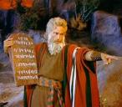
Exodus 14:30-31 (NASB)
³⁰ Thus the Lord saved Israel that day from the hand of the Egyptians, and Israel saw the Egyptians dead on the seashore. ³¹ When Israel saw the great power which the Lord had used against the Egyptians, the people feared the Lord, and they believed in the Lord and in His servant Moses.”

Slide 15
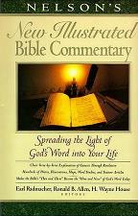
Exodus 14:31
“When we read so the people feared the Lord and the words that follow, we are meant to understand that the community had come to saving faith and so were a reborn people. They believed the Lord (the same wording used of Abraham’s saving faith in Gen. 15:6; read Paul’s comments in Rom. 4)…The people were transformed spiritually even as they were delivered physically.”
Nelson's New Illustrated Bible Commentary, 113.

Slide 16
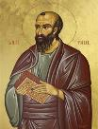
1 Corinthians 1:2 (NASB)
“To the church of God that is in Corinth, to those sanctified in Christ Jesus, called to be saints together with all those who in every place call upon the name of our Lord Jesus Christ, both their Lord and ours.”

Slide 17
2 Corinthians 1:1 (NASB)
"To the church of God that is at Corinth, with all the saints who are in the whole of Achaia."

Slide 18
The Corinthians' Assumed Believing Status
1 Corinthians 1:2; 3:1, 5, 6:11, 19-20
2 Corinthians 1:1, 21-22, 24; 3:2-3; 6:14-16; 8:9; 10:15

Slide 19
  A. Believing status
Old Testament
New Testament

Slide 20
The Kadesh Barnea Paradigm as a Solution to the Problem of Hebrews 6:4-6
The Exodus Generation
  Believing status
  Loss of Canaan
The Hebrews
  Believing status
  Loss of blessings
Inadequate alternatives
  Calvinism/Reformed
  Arminianism
  Hypothetical

Slide 21
The Kadesh Barnea Paradigm as a Solution to the Problem of Hebrews 6:4-6
The Exodus Generation
  Believing status
  Loss of Canaan
The Hebrews
  Believing status
  Loss of blessings
Inadequate alternatives
  Calvinism/Reformed
  Arminianism
  Hypothetical

Slide 22
The Kadesh Barnea Paradigm as a Solution to the Problem of Hebrews 6:4-6
The Exodus Generation
  Believing status
  Loss of Canaan
The Hebrews
  Believing status
  Loss of blessings
Inadequate alternatives
  Calvinism/Reformed
  Arminianism
  Hypothetical

Slide 23
  A. Believing status
Extended context
Preceding context
Immediate context
Subsequent context

Slide 24
  A. Believing status
Extended context
Preceding context
Immediate context
Subsequent context

Slide 25
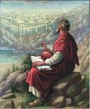
John 20:30-31 (NASB)
³⁰ “Therefore many other signs Jesus also performed in the presence of the disciples, which are not written in this book; ³¹ but these have been written so that you may believe that Jesus is the Christ, the Son of God; and that believing you may have life in His name.”

Slide 26
  A. Believing status
Extended context
Preceding context
Immediate context
Subsequent context

Slide 27
  2. Preceding Context
Hebrews 5:11-14
Hebrews 6:1-3

Slide 28
  2. Preceding Context
Hebrews 5:11-14
Hebrews 6:1-3

Slide 29

Heb. 5:11-14 (NASB)
¹¹ Concerning him we have much to say, and it is hard to explain, since you have become dull of hearing. ¹² For though by this time you ought to be teachers, you have need again for someone to teach you the elementary principles of the oracles of God, and you have come to need milk and not solid food. ¹³ For everyone who partakes only of milk is not accustomed to the word of righteousness, for he is an infant. ¹⁴ But solid food is for the mature, who because of practice have their senses trained to discern good and evil.

Slide 30
Heb. 5:11-14 (NASB)
¹¹ Concerning him we have much to say, and it is hard to explain, since you have become dull of hearing. ¹² For though by this time you ought to be teachers, you have need again for someone to teach you the elementary principles of the oracles of God, and you have come to need milk and not solid food. ¹³ For everyone who partakes only of milk is not accustomed to the word of righteousness, for he is an infant. ¹⁴ But solid food is for the mature, who because of practice have their senses trained to discern good and evil.

Slide 31
Heb. 5:11-14 (NASB)
¹¹ Concerning him we have much to say, and it is hard to explain, since you have become dull of hearing. ¹² For though by this time you ought to be teachers, you have need again for someone to teach you the elementary principles of the oracles of God, and you have come to need milk and not solid food. ¹³ For everyone who partakes only of milk is not accustomed to the word of righteousness, for he is an infant. ¹⁴ But solid food is for the mature, who because of practice have their senses trained to discern good and evil.

Slide 32
Heb. 5:11-14 (NASB)
¹¹ Concerning him we have much to say, and it is hard to explain, since you have become dull of hearing. ¹² For though by this time you ought to be teachers, you have need again for someone to teach you the elementary principles of the oracles of God, and you have come to need milk and not solid food. ¹³ For everyone who partakes only of milk is not accustomed to the word of righteousness, for he is an infant. ¹⁴ But solid food is for the mature, who because of practice have their senses trained to discern good and evil.

Slide 33
Heb. 5:11-14 (NASB)
¹¹ Concerning him we have much to say, and it is hard to explain, since you have become dull of hearing. ¹² For though by this time you ought to be teachers, you have need again for someone to teach you the elementary principles of the oracles of God, and you have come to need milk and not solid food. ¹³ For everyone who partakes only of milk is not accustomed to the word of righteousness, for he is an infant. ¹⁴ But solid food is for the mature, who because of practice have their senses trained to discern good and evil.

Slide 34
Heb. 5:11-14 (NASB)
¹¹ Concerning him we have much to say, and it is hard to explain, since you have become dull of hearing. ¹² For though by this time you ought to be teachers, you have need again for someone to teach you the elementary principles of the oracles of God, and you have come to need milk and not solid food. ¹³ For everyone who partakes only of milk is not accustomed to the word of righteousness, for he is an infant. ¹⁴ But solid food is for the mature, who because of practice have their senses trained to discern good and evil.

Slide 35
Heb. 5:11-14 (NASB)
¹¹ Concerning him we have much to say, and it is hard to explain, since you have become dull of hearing. ¹² For though by this time you ought to be teachers, you have need again for someone to teach you the elementary principles of the oracles of God, and you have come to need milk and not solid food. ¹³ For everyone who partakes only of milk is not accustomed to the word of righteousness, for he is an infant. ¹⁴ But solid food is for the mature, who because of practice have their senses trained to discern good and evil.

Slide 36
  2. Preceding Context
Hebrews 5:11-14
Hebrews 6:1-3

Slide 37
Heb. 6:1-3 (NASB)
¹ Therefore leaving the elementary teaching about the Christ, let us press on to maturity, not laying again a foundation of repentance from dead works and of faith toward God, ² of instruction about washings and laying on of hands, and the resurrection of the dead and eternal judgment. ³ And this we will do, if God permits.

Slide 38
Heb. 6:1-3 (NASB)
¹ Therefore leaving the elementary teaching about the Christ, let us press on to maturity, not laying again a foundation of repentance from dead works and of faith toward God, ² of instruction about washings and laying on of hands, and the resurrection of the dead and eternal judgment. ³ And this we will do, if God permits.

Slide 39
Heb. 6:1-3 (NASB)
¹ Therefore leaving the elementary teaching about the Christ, let us press on to maturity, not laying again a foundation of repentance from dead works and of faith toward God, ² of instruction about washings and laying on of hands, and the resurrection of the dead and eternal judgment. ³ And this we will do, if God permits.

Slide 40
Heb. 6:1-3 (NASB)
¹ Therefore leaving the elementary teaching about the Christ, let us press on to maturity, not laying again a foundation of repentance from dead works and of faith toward God, ² of instruction about washings and laying on of hands, and the resurrection of the dead and eternal judgment. ³ And this we will do, if God permits.

Slide 41
Heb. 6:1-3 (NASB)
¹ Therefore leaving the elementary teaching about the Christ, let us press on to maturity, not laying again a foundation of repentance from dead works and of faith toward God, ² of instruction about washings and laying on of hands, and the resurrection of the dead and eternal judgment. ³ And this we will do, if God permits.

Slide 42
Heb. 6:1-3 (NASB)
¹ Therefore leaving the elementary teaching about the Christ, let us press on to maturity, not laying again a foundation of repentance from dead works and of faith toward God, ² of instruction about washings and laying on of hands, and the resurrection of the dead and eternal judgment. ³ And this we will do, if God permits.

Slide 43
  A. Believing status
Extended context
Preceding context
Immediate context
Subsequent context

Slide 44
Heb. 6:4-6 (NASB)
⁴ For in the case of those who have once been enlightened and have tasted of the heavenly gift and have been made partakers of the Holy Spirit, ⁵ and have tasted the good word of God and the powers of the age to come, ⁶ and then have fallen away, it is impossible to renew them again to repentance, since they again crucify to themselves the Son of God and put Him to open shame.

Slide 45
Heb. 6:4-6 (NASB)
⁴ For in the case of those who have once been enlightened and have tasted of the heavenly gift and have been made partakers of the Holy Spirit, ⁵ and have tasted the good word of God and the powers of the age to come, ⁶ and then have fallen away, it is impossible to renew them again to repentance, since they again crucify to themselves the Son of God and put Him to open shame.

Slide 46
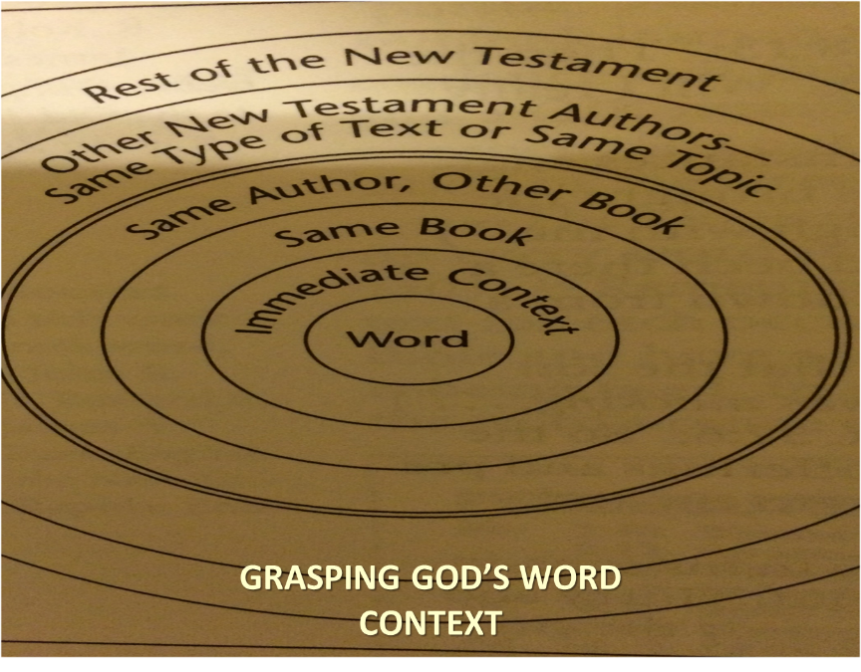

Slide 47
Heb. 6:4-6 (NASB)
⁴ For in the case of those who have once been enlightened and have tasted of the heavenly gift and have been made partakers of the Holy Spirit, ⁵ and have tasted the good word of God and the powers of the age to come, ⁶ and then have fallen away, it is impossible to renew them again to repentance, since they again crucify to themselves the Son of God and put Him to open shame.

Slide 48
Heb. 6:4-6 (NASB)
⁴ For in the case of those who have once been enlightened and have tasted of the heavenly gift and have been made partakers of the Holy Spirit, ⁵ and have tasted the good word of God and the powers of the age to come, ⁶ and then have fallen away, it is impossible to renew them again to repentance, since they again crucify to themselves the Son of God and put Him to open shame.

Slide 49
Heb. 6:4-6 (NASB)
⁴ For in the case of those who have once been enlightened and have tasted of the heavenly gift and have been made partakers of the Holy Spirit, ⁵ and have tasted the good word of God and the powers of the age to come, ⁶ and then have fallen away, it is impossible to renew them again to repentance, since they again crucify to themselves the Son of God and put Him to open shame.

Slide 50
Heb. 6:4-6 (NASB)
⁴ For in the case of those who have once been enlightened and have tasted of the heavenly gift and have been made partakers of the Holy Spirit, ⁵ and have tasted the good word of God and the powers of the age to come, ⁶ and then have fallen away, it is impossible to renew them again to repentance, since they again crucify to themselves the Son of God and put Him to open shame.

Slide 51
Heb. 6:4-6 (NASB)
⁴ For in the case of those who have once been enlightened and have tasted of the heavenly gift and have been made partakers of the Holy Spirit, ⁵ and have tasted the good word of God and the powers of the age to come, ⁶ and then have fallen away, it is impossible to renew them again to repentance, since they again crucify to themselves the Son of God and put Him to open shame.

Slide 52
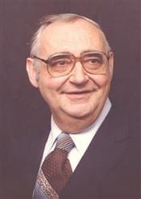
Dr. Roger R. Nicole
Professor Emeritus - Gordon-Conwell Theological Seminary
“The most immediate impulse would be to interpret this cluster of statements as describing regenerate persons."
R. Nicole, “Some Comments on Hebrews 6:4-6 and the Doctrine of the Perseverance of God with the Saints,” in Current Issues in Biblical and Patristic Interpretation, ed. G.G. Hawthorne (Grand Rapids: Eerdmans, 1975), 356.

Slide 53
Heb. 6:4-6 (NASB)
⁴ For in the case of those who have once been enlightened and have tasted of the heavenly gift and have been made partakers of the Holy Spirit, ⁵ and have tasted the good word of God and the powers of the age to come, ⁶ and then have fallen away, it is impossible to renew them again to repentance, since they again crucify to themselves the Son of God and put Him to open shame.

Slide 54
Heb. 6:4-6 (NASB)
⁴ For in the case of those who have once been enlightened and have tasted of the heavenly gift and have been made partakers of the Holy Spirit, ⁵ and have tasted the good word of God and the powers of the age to come, ⁶ and then have fallen away, it is impossible to renew them again to repentance, since they again crucify to themselves the Son of God and put Him to open shame.

Slide 55
Heb. 6:4-6 (NASB)
⁴ For in the case of those who have once been enlightened and have tasted of the heavenly gift and have been made partakers of the Holy Spirit, ⁵ and have tasted the good word of God and the powers of the age to come, ⁶ and then have fallen away, it is impossible to renew them again to repentance, since they again crucify to themselves the Son of God and put Him to open shame.

Slide 56
  A. Believing status
Extended context
Preceding context
Immediate context
Subsequent context

Slide 57

Hebrews 6:7–12 (NASB95)
⁷ For ground that drinks the rain which often falls on it and brings forth vegetation useful to those for whose sake it is also tilled, receives a blessing from God; ⁸ but if it yields thorns and thistles, it is worthless and close to being cursed, and it ends up being burned. ⁹ But, beloved, we are convinced of better things concerning you, and things that accompany salvation, though we are speaking in this way. ¹⁰ For God is not unjust so as to forget your work and the love which you have shown toward His name, in having ministered and in still ministering to the saints. ¹¹ And we desire that each one of you show the same diligence so as to realize the full assurance of hope until the end, ¹² so that you will not be sluggish, but imitators of those who through faith and patience inherit the promises.

Slide 58
Hebrews 6:7–12 (NASB95)
⁷ For ground that drinks the rain which often falls on it and brings forth vegetation useful to those for whose sake it is also tilled, receives a blessing from God; ⁸ but if it yields thorns and thistles, it is worthless and close to being cursed, and it ends up being burned. ⁹ But, beloved, we are convinced of better things concerning you, and things that accompany salvation, though we are speaking in this way. ¹⁰ For God is not unjust so as to forget your work and the love which you have shown toward His name, in having ministered and in still ministering to the saints. ¹¹ And we desire that each one of you show the same diligence so as to realize the full assurance of hope until the end, ¹² so that you will not be sluggish, but imitators of those who through faith and patience inherit the promises.

Slide 59
Hebrews 6:7–12 (NASB95)
⁷ For ground that drinks the rain which often falls on it and brings forth vegetation useful to those for whose sake it is also tilled, receives a blessing from God; ⁸ but if it yields thorns and thistles, it is worthless and close to being cursed, and it ends up being burned. ⁹ But, beloved, we are convinced of better things concerning you, and things that accompany salvation, though we are speaking in this way. ¹⁰ For God is not unjust so as to forget your work and the love which you have shown toward His name, in having ministered and in still ministering to the saints. ¹¹ And we desire that each one of you show the same diligence so as to realize the full assurance of hope until the end, ¹² so that you will not be sluggish, but imitators of those who through faith and patience inherit the promises.

Slide 60
Hebrews 6:7–12 (NASB95)
⁷ For ground that drinks the rain which often falls on it and brings forth vegetation useful to those for whose sake it is also tilled, receives a blessing from God; ⁸ but if it yields thorns and thistles, it is worthless and close to being cursed, and it ends up being burned. ⁹ But, beloved, we are convinced of better things concerning you, and things that accompany salvation, though we are speaking in this way. ¹⁰ For God is not unjust so as to forget your work and the love which you have shown toward His name, in having ministered and in still ministering to the saints. ¹¹ And we desire that each one of you show the same diligence so as to realize the full assurance of hope until the end, ¹² so that you will not be sluggish, but imitators of those who through faith and patience inherit the promises.

Slide 61
Six Parts of a Suzerain-Vassal Treaty in Deuteronomy
Preamble (1:1-5)
Prologue (1:6–4:40)
Covenant obligations (5–26)
Storage and reading instructions (27:2-3; 31:9, 24, 26)
Witnesses (32:1)
Blessings and curses (28)

Slide 63
Hebrews 6:7–12 (NASB95)
⁷ For ground that drinks the rain which often falls on it and brings forth vegetation useful to those for whose sake it is also tilled, receives a blessing from God; ⁸ but if it yields thorns and thistles, it is worthless and close to being cursed, and it ends up being burned. ⁹ But, beloved, we are convinced of better things concerning you, and things that accompany salvation, though we are speaking in this way. ¹⁰ For God is not unjust so as to forget your work and the love which you have shown toward His name, in having ministered and in still ministering to the saints. ¹¹ And we desire that each one of you show the same diligence so as to realize the full assurance of hope until the end, ¹² so that you will not be sluggish, but imitators of those who through faith and patience inherit the promises.

Slide 64
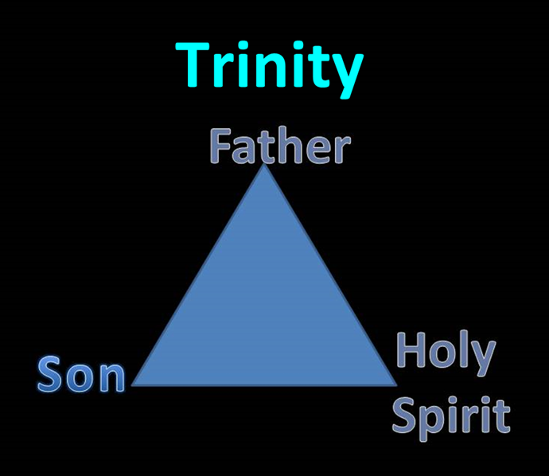

Slide 65
Hebrews 6:7–12 (NASB95)
⁷ For ground that drinks the rain which often falls on it and brings forth vegetation useful to those for whose sake it is also tilled, receives a blessing from God; ⁸ but if it yields thorns and thistles, it is worthless and close to being cursed, and it ends up being burned. ⁹ But, beloved, we are convinced of better things concerning you, and things that accompany salvation, though we are speaking in this way. ¹⁰ For God is not unjust so as to forget your work and the love which you have shown toward His name, in having ministered and in still ministering to the saints. ¹¹ And we desire that each one of you show the same diligence so as to realize the full assurance of hope until the end, ¹² so that you will not be sluggish, but imitators of those who through faith and patience inherit the promises.

Slide 66
Hebrews 6:7–12 (NASB95)
⁷ For ground that drinks the rain which often falls on it and brings forth vegetation useful to those for whose sake it is also tilled, receives a blessing from God; ⁸ but if it yields thorns and thistles, it is worthless and close to being cursed, and it ends up being burned. ⁹ But, beloved, we are convinced of better things concerning you, and things that accompany salvation, though we are speaking in this way. ¹⁰ For God is not unjust so as to forget your work and the love which you have shown toward His name, in having ministered and in still ministering to the saints. ¹¹ And we desire that each one of you show the same diligence so as to realize the full assurance of hope until the end, ¹² so that you will not be sluggish, but imitators of those who through faith and patience inherit the promises.

Slide 67
Hebrews 6:7–12 (NASB95)
⁷ For ground that drinks the rain which often falls on it and brings forth vegetation useful to those for whose sake it is also tilled, receives a blessing from God; ⁸ but if it yields thorns and thistles, it is worthless and close to being cursed, and it ends up being burned. ⁹ But, beloved, we are convinced of better things concerning you, and things that accompany salvation, though we are speaking in this way. ¹⁰ For God is not unjust so as to forget your work and the love which you have shown toward His name, in having ministered and in still ministering to the saints. ¹¹ And we desire that each one of you show the same diligence so as to realize the full assurance of hope until the end, ¹² so that you will not be sluggish, but imitators of those who through faith and patience inherit the promises.

Slide 68
1 Corinthians 9:27
“but I discipline my body and make it my slave, so that, after I have preached to others, I myself will not be disqualified.”

Slide 69
Hebrews 6:7–12 (NASB95)
⁷ For ground that drinks the rain which often falls on it and brings forth vegetation useful to those for whose sake it is also tilled, receives a blessing from God; ⁸ but if it yields thorns and thistles, it is worthless and close to being cursed, and it ends up being burned. ⁹ But, beloved, we are convinced of better things concerning you, and things that accompany salvation, though we are speaking in this way. ¹⁰ For God is not unjust so as to forget your work and the love which you have shown toward His name, in having ministered and in still ministering to the saints. ¹¹ And we desire that each one of you show the same diligence so as to realize the full assurance of hope until the end, ¹² so that you will not be sluggish, but imitators of those who through faith and patience inherit the promises.

Slide 70
Six Parts of a Suzerain-Vassal Treaty in Deuteronomy
Preamble (1:1-5)
Prologue (1:6–4:40)
Covenant obligations (5–26)
Storage and reading instructions (27:2-3; 31:9, 24, 26)
Witnesses (32:1)
Blessings and curses (28)

Slide 71
Hebrews 6:7–12 (NASB95)
⁷ For ground that drinks the rain which often falls on it and brings forth vegetation useful to those for whose sake it is also tilled, receives a blessing from God; ⁸ but if it yields thorns and thistles, it is worthless and close to being cursed, and it ends up being burned. ⁹ But, beloved, we are convinced of better things concerning you, and things that accompany salvation, though we are speaking in this way. ¹⁰ For God is not unjust so as to forget your work and the love which you have shown toward His name, in having ministered and in still ministering to the saints. ¹¹ And we desire that each one of you show the same diligence so as to realize the full assurance of hope until the end, ¹² so that you will not be sluggish, but imitators of those who through faith and patience inherit the promises.

Slide 72
The Kadesh Barnea Paradigm as a Solution to the Problem of Hebrews 6:4-6
The Exodus Generation
  Believing status
  Loss of Canaan
The Hebrews
  Believing status
  Loss of blessings
Inadequate alternatives
  Calvinism/Reformed
  Arminianism
  Hypothetical

Slide 73
Heb. 6:4-6 (NASB)
⁴ For in the case of those who have once been enlightened and have tasted of the heavenly gift and have been made partakers of the Holy Spirit, ⁵ and have tasted the good word of God and the powers of the age to come, ⁶ and then have fallen away, it is impossible to renew them again to repentance, since they again crucify to themselves the Son of God and put Him to open shame.

Slide 74
Hebrews 6:7–12 (NASB95)
⁷ For ground that drinks the rain which often falls on it and brings forth vegetation useful to those for whose sake it is also tilled, receives a blessing from God; ⁸ but if it yields thorns and thistles, it is worthless and close to being cursed, and it ends up being burned. ⁹ But, beloved, we are convinced of better things concerning you, and things that accompany salvation, though we are speaking in this way. ¹⁰ For God is not unjust so as to forget your work and the love which you have shown toward His name, in having ministered and in still ministering to the saints. ¹¹ And we desire that each one of you show the same diligence so as to realize the full assurance of hope until the end, ¹² so that you will not be sluggish, but imitators of those who through faith and patience inherit the promises.

Slide 75
The Kadesh Barnea Paradigm as a Solution to the Problem of Hebrews 6:4-6
The Exodus Generation
  Believing status
  Loss of Canaan
The Hebrews
  Believing status
  Loss of blessings
Inadequate alternatives
  Calvinism/Reformed
  Arminianism
  Hypothetical

Slide 76
The Kadesh Barnea Paradigm as a Solution to the Problem of Hebrews 6:4-6
The Exodus Generation
  Believing status
  Loss of Canaan
The Hebrews
  Believing status
  Loss of blessings
Inadequate alternatives
  Calvinism/Reformed
  Arminianism
  Hypothetical

Slide 77
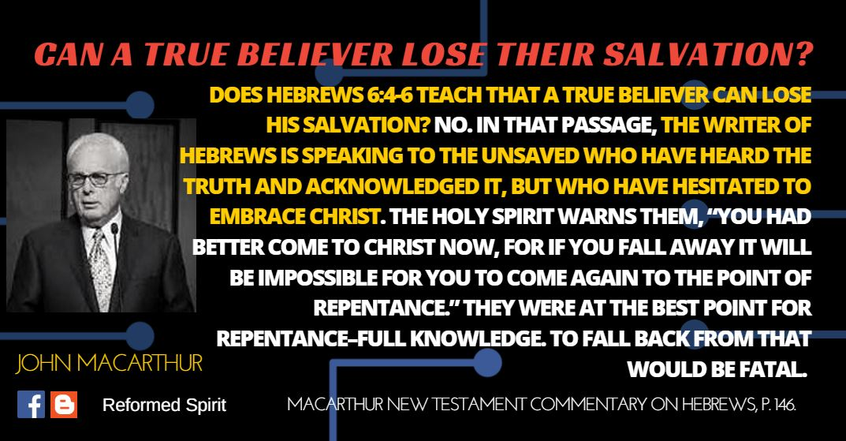

Slide 78
Heb. 6:4-6 (NASB)
⁴ For in the case of those who have once been enlightened and have tasted of the heavenly gift and have been made partakers of the Holy Spirit, ⁵ and have tasted the good word of God and the powers of the age to come, ⁶ and then have fallen away, it is impossible to renew them again to repentance, since they again crucify to themselves the Son of God and put Him to open shame.

Slide 79
Heb. 6:4-6 (NASB)
⁴ For in the case of those who have once been enlightened and have tasted of the heavenly gift and have been made partakers of the Holy Spirit, ⁵ and have tasted the good word of God and the powers of the age to come, ⁶ and then have fallen away, it is impossible to renew them again to repentance, since they again crucify to themselves the Son of God and put Him to open shame.

Slide 80
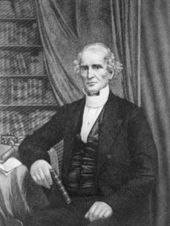
Albert Barnes
“…and it seems plain to me, that no other interpretation would ever have been thought of, if this view had not seemed to conflict with the doctrine of the ‘perseverance of the saints.’"
Albert Barnes, Notes, Explanatory and Practical, on the Epistle to the Hebrews (New York: Harper and Brothers Publishers, 1854), 134.

Slide 81
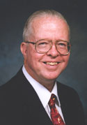
Zane Hodges
“The assertion that such a failure is not possible for a regenerate person is a theological proposition which is not supported by the New Testament...’"
Zane Hodges, “Hebrews,” in The Bible Knowledge Commentary, ed. John F. Walvoord and Roy B. Zuck (Wheaton: Victor, 1983), 795.

Slide 82
The Kadesh Barnea Paradigm as a Solution to the Problem of Hebrews 6:4-6
The Exodus Generation
  Believing status
  Loss of Canaan
The Hebrews
  Believing status
  Loss of blessings
Inadequate alternatives
  Calvinism/Reformed
  Arminianism
  Hypothetical

Slide 84
The Kadesh Barnea Paradigm as a Solution to the Problem of Hebrews 6:4-6
The Exodus Generation
  Believing status
  Loss of Canaan
The Hebrews
  Believing status
  Loss of blessings
Inadequate alternatives
  Calvinism/Reformed
  Arminianism
  Hypothetical

Slide 85
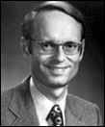
Charles Ryrie, Ryrie Study Bible,
Page 1521
“Others understand the passage to be a warning to genuine believers to urge them on in Christian growth and maturity. To ‘fall away’ is impossible (since, according to this view, true believers are eternally secure), but the phrase is placed in the sentence to strengthen the warning. It is similar to saying something like this to a class of students: ‘It is impossible for a student, once enrolled in this course, if he turns the clock back [which cannot be done], to start the course over. Therefore, let all students go on to deeper knowledge.’ In this view the phrases in verses 4-5 are understood to refer to the conversion experience.”

Slide 86
Conclusion

Slide 87
The Kadesh Barnea Paradigm as a Solution to the Problem of Hebrews 6:4-6
The Exodus Generation
  Believing status
  Loss of Canaan
The Hebrews
  Believing status
  Loss of blessings
Inadequate alternatives
  Calvinism/Reformed
  Arminianism
  Hypothetical

