Slide 1
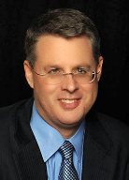
Soteriology Session 38
Dr. Andy Woods
Senior Pastor – Sugar Land Bible Church
Professor of Bible & Theology – College of Biblical Studies

Slide 2
Soteriology Overview
Definition
Election
Atonement
Salvation words
God’s one condition of salvation
Results of salvation
Eternal security
Faulty views of salvation

Slide 3
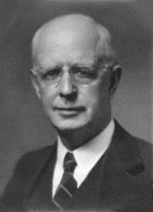
Soteriology Overview
This Session
VII. Eternal Security

Slide 4
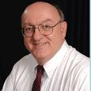
Definition of Eternal Security
“Eternal Security means that those who have been genuinely saved by God’s grace through faith alone in Christ alone shall never be in danger of God’s condemnation or loss of salvation but God’s grace and power keep them forever saved and secure.”
Dennis Rokser, Shall Never Perish Forever, p. 11

Slide 5
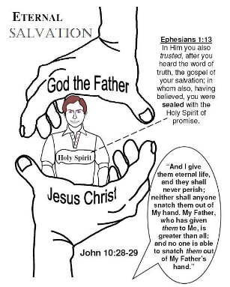
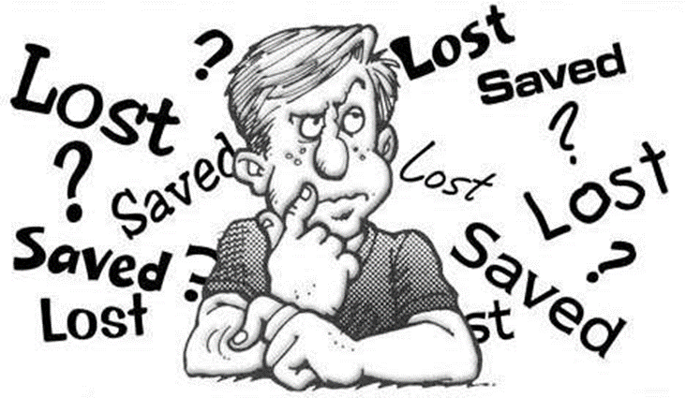
Eternal Security Outline
Eternal security arguments
Response to problem passages

Slide 6
Eternal Security Outline
Eternal security arguments
Response to problem passages

Slide 7
Eternal Security Outline
Eternal security arguments
Response to problem passages

Slide 8
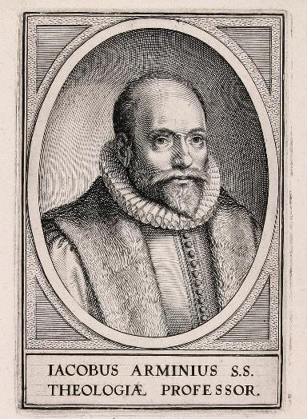
Response to Problem Passages
OT Passages
Passages from Matthew
Passages from John
Passages from Acts
Passages from Paul

Slide 9
Response to Problem Passages
Passages from James
Passages from Hebrews
Passages from 2 Peter
Passages from 1 John
Passages from Revelation
Miscellaneous argument

Slide 10
Response to Problem Passages
OT Passages
Passages from Matthew
Passages from John
Passages from Acts
Passages from Paul

Slide 11
Response to Problem Passages
OT Passages
Passages from Matthew
Passages from John
Passages from Acts
Passages from Paul

Slide 12
Response to Problem Passages
OT Passages
Passages from Matthew
Passages from John
Passages from Acts
Passages from Paul

Slide 13
Response to Problem Passages
OT Passages
Passages from Matthew
Passages from John
Passages from Acts
Passages from Paul

Slide 14
Response to Problem Passages
OT Passages
Passages from Matthew
Passages from John
Passages from Acts
Passages from Paul

Slide 15
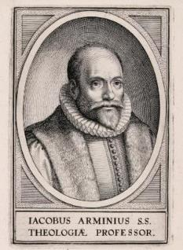
5. Passages From Paul
Gal. 5:4
Gal. 5:19-21
Rom. 8:13
1 Cor. 8:11
1 Cor. 9:24-27
1 Cor. 11:28-30, 32
1 Cor. 15:2
2 Cor. 13:5
Philip. 2:12
Col. 1:23
1 Tim. 5:15
2 Tim. 2:12
2 Tim. 4:10

Slide 16
5. Passages From Paul
Gal. 5:4
Gal. 5:19-21
Rom. 8:13
1 Cor. 8:11
1 Cor. 9:24-27
1 Cor. 11:28-30, 32
1 Cor. 15:2
2 Cor. 13:5
Philip. 2:12
Col. 1:23
1 Tim. 5:15
2 Tim. 2:12
2 Tim. 4:10

Slide 17
5. Passages From Paul
Gal. 5:4
Gal. 5:19-21
Rom. 8:13
1 Cor. 8:11
1 Cor. 9:24-27
1 Cor. 11:28-30, 32
1 Cor. 15:2
2 Cor. 13:5
Philip. 2:12
Col. 1:23
1 Tim. 5:15
2 Tim. 2:12
2 Tim. 4:10

Slide 18
5. Passages From Paul
Gal. 5:4
Gal. 5:19-21
Rom. 8:13
1 Cor. 8:11
1 Cor. 9:24-27
1 Cor. 11:28-30, 32
1 Cor. 15:2
2 Cor. 13:5
Philip. 2:12
Col. 1:23
1 Tim. 5:15
2 Tim. 2:12
2 Tim. 4:10

Slide 19
5. Passages From Paul
Gal. 5:4
Gal. 5:19-21
Rom. 8:13
1 Cor. 8:11
1 Cor. 9:24-27
1 Cor. 11:28-30, 32
1 Cor. 15:2
2 Cor. 13:5
Philip. 2:12
Col. 1:23
1 Tim. 5:15
2 Tim. 2:12
2 Tim. 4:10

Slide 20
5. Passages From Paul
Gal. 5:4
Gal. 5:19-21
Rom. 8:13
1 Cor. 8:11
1 Cor. 9:24-27
1 Cor. 11:28-30, 32
1 Cor. 15:2
2 Cor. 13:5
Philip. 2:12
Col. 1:23
1 Tim. 5:15
2 Tim. 2:12
2 Tim. 4:10

Slide 21
5. Passages From Paul
Gal. 5:4
Gal. 5:19-21
Rom. 8:13
1 Cor. 8:11
1 Cor. 9:24-27
1 Cor. 11:28-30, 32
1 Cor. 15:2
2 Cor. 13:5
Philip. 2:12
Col. 1:23
1 Tim. 5:15
2 Tim. 2:12
2 Tim. 4:10

Slide 22
5. Passages From Paul
Gal. 5:4
Gal. 5:19-21
Rom. 8:13
1 Cor. 8:11
1 Cor. 9:24-27
1 Cor. 11:28-30, 32
1 Cor. 15:2
2 Cor. 13:5
Philip. 2:12
Col. 1:23
1 Tim. 5:15
2 Tim. 2:12
2 Tim. 4:10

Slide 23
5. Passages From Paul
Gal. 5:4
Gal. 5:19-21
Rom. 8:13
1 Cor. 8:11
1 Cor. 9:24-27
1 Cor. 11:28-30, 32
1 Cor. 15:2
2 Cor. 13:5
Philip. 2:12
Col. 1:23
1 Tim. 5:15
2 Tim. 2:12
2 Tim. 4:10

Slide 24
5. Passages From Paul
Gal. 5:4
Gal. 5:19-21
Rom. 8:13
1 Cor. 8:11
1 Cor. 9:24-27
1 Cor. 11:28-30, 32
1 Cor. 15:2
2 Cor. 13:5
Philip. 2:12
Col. 1:23
1 Tim. 5:15
2 Tim. 2:12
2 Tim. 4:10

Slide 25
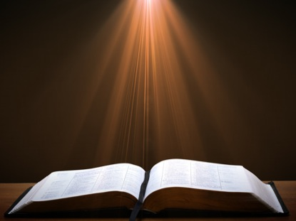
Philippians 2:12 (NASB)
“So then, my beloved, just as you have always obeyed, not as in my presence only, but now much more in my absence, work out your salvation with fear and trembling.”

Slide 26
Three Tenses of Salvation
Phase | Justification | Sanctification | Glorification
Tense | Past | Present | Future
Saved from sin’s: | Penalty | Power | Presence
Scripture | Eph 2:8-9; Titus 3:5 | Philip 2:12 | Rom 5:10

Slide 27
Three Tenses of Salvation
Phase | Justification | Sanctification | Glorification
Tense | Past | Present | Future
Saved from sin’s: | Penalty | Power | Presence
Scripture | Eph 2:8-9; Titus 3:5 | Philip 2:12 | Rom 5:10

Slide 28
Three Tenses of Salvation
Phase | Justification | Sanctification | Glorification
Tense | Past | Present | Future
Saved from sin’s: | Penalty | Power | Presence
Scripture | Eph 2:8-9; Titus 3:5 | Philip 2:12 | Rom 5:10

Slide 29
Philippians 2:12
Middle tense of salvation
Immediate context – Philippians 2:14-16
Overall context – Philippians 4:2-3

Slide 30
5. Passages From Paul
Gal. 5:4
Gal. 5:19-21
Rom. 8:13
1 Cor. 8:11
1 Cor. 9:24-27
1 Cor. 11:28-30, 32
1 Cor. 15:2
2 Cor. 13:5
Philip. 2:12
Col. 1:23
1 Tim. 5:15
2 Tim. 2:12
2 Tim. 4:10

Slide 31
Colossians 1:23 (NASB)
“if indeed you continue in the faith firmly established and steadfast, and not moved away from the hope of the gospel that you have heard, which was proclaimed in all creation under heaven, and of which I, Paul, was made a minister.”

Slide 32
Colossians 1:23
Believing audience – Col. 1:2, 4, 5, 6, 14, 15
Paul desires their continued maturity so that they will have a favorable ruling at the future judgment seat of rewards – Col. 122, 28
For this to occur they must continue on in the faith despite the inroads of false doctrine – Col. 2:8, 16-23
First class condition “if” (23) assumes that they will persevere
Their ultimate salvation is not in doubt
Ongoing growth would require perseverance in the faith

Slide 33
5. Passages From Paul
Gal. 5:4
Gal. 5:19-21
Rom. 8:13
1 Cor. 8:11
1 Cor. 9:24-27
1 Cor. 11:28-30, 32
1 Cor. 15:2
2 Cor. 13:5
Philip. 2:12
Col. 1:23
1 Tim. 5:15
2 Tim. 2:12
2 Tim. 4:10

Slide 34
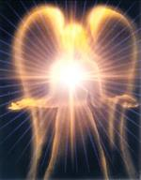
1 Timothy 5:15 (NASB)
“for some have already turned aside to follow Satan.”

Slide 35
1 Timothy 5:15
Believing, younger church widows (1 Tim. 5:11-15)
Connection between Satan & his world system (John 12:31; Eph. 2:2)
World referred to as Satan (1 Cor. 5:5; 1 Tim. 1:20; 5:15)
Warning against worldliness rather than loss of salvation (Heb. 11:25; 1 John 2:15-17; Jas. 4:4)

Slide 36
5. Passages From Paul
Gal. 5:4
Gal. 5:19-21
Rom. 8:13
1 Cor. 8:11
1 Cor. 9:24-27
1 Cor. 11:28-30, 32
1 Cor. 15:2
2 Cor. 13:5
Philip. 2:12
Col. 1:23
1 Tim. 5:15
2 Tim. 2:12
2 Tim. 4:10

Slide 37
2 Timothy 2:11-13 (NASB)
“It is a trustworthy statement: For if we died with Him, we will also live with Him; ¹² If we endure, we will also reign with Him; If we deny Him, He also will deny us;¹³ If we are faithless, He remains faithful, for He cannot deny Himself.”

Slide 38
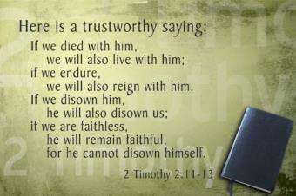
Trustworthy Statement (2:11-13)
If we died with Christ, we will live with Christ (11b)
If we endure for Christ, we will reign with Christ (12a)
If we deny Christ, He will deny us (12b)
If we are unfaithful, Christ remains faithful (13)

Slide 39
Trustworthy Statement (2:11-13)
If we died with Christ, we will live with Christ (11b)
If we endure for Christ, we will reign with Christ (12a)
If we deny Christ, He will deny us (12b)
If we are unfaithful, Christ remains faithful (13)

Slide 40
Trustworthy Statement (2:11-13)
If we died with Christ, we will live with Christ (11b)
If we endure for Christ, we will reign with Christ (12a)
If we deny Christ, He will deny us (12b)
If we are unfaithful, Christ remains faithful (13)

Slide 41
Trustworthy Statement (2:11-13)
If we died with Christ, we will live with Christ (11b)
If we endure for Christ, we will reign with Christ (12a)
If we deny Christ, He will deny us (12b)
If we are unfaithful, Christ remains faithful (13)

Slide 42
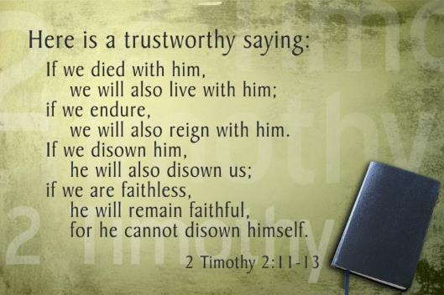
Trustworthy Statement (2:12)
Four views (2:12)
Hypothetical
Arminian
Calvinistic
Rewards

Slide 43
Trustworthy Statement (2:12)
Four views (2:12)
Hypothetical
Arminian
Calvinistic
Rewards

Slide 44
Trustworthy Statement (2:12)
Four views (2:12)
Hypothetical
Arminian
Calvinistic
Rewards

Slide 45
Trustworthy Statement (2:12)
Four views (2:12)
Hypothetical
Arminian
Calvinistic
Rewards

Slide 46
2 Timothy 2:11-13 (NASB)
“It is a trustworthy statement: For if we died with Him, we will also live with Him; ¹² If we endure, we will also reign with Him; If we deny Him, He also will deny us; ¹³ If we are faithless, He remains faithful, for He cannot deny Himself.”

Slide 47
2 Timothy 2:11-13
2 Tim. 1:2
2 Timothy 1:5
1 Timothy 1:5

Slide 48
Trustworthy Statement (2:12)
Four views (2:12)
Hypothetical
Arminian
Calvinistic
Rewards

Slide 49
Scripture’s Four Judgments
Name | Sheep and Goat | Judgment of the Jews | Bema Seat | Great White Throne
Scripture | Matt 25:31-46 | Ezek 20:33-44 | 1 Cor 3:10-15 | Rev 20:11-15
Place | Earth, Jerusalem | Earth, wilderness | Heaven | Earth
Audience | Gentile Tribulation survivors | Jewish Tribulation survivors | Church Age believers | All unsaved
When | After Tribulation | After Tribulation | After rapture | After Millennium
Purpose | Saved Gentiles enter kingdom | Saved Jews enter kingdom | Reward believers | Degree of punishment in hell
Evaluation | Treatment of Christ’s brethren | Passing under shepherd’s rod | Works taken through fire | Not in the book; judged by books

Slide 50
Scripture’s Five Crowns (Rev 4:10: 3:11; 2 John 8)
Scripture | Crown | Purpose
1 Cor. 9:24-27 | Incorruptible | Gaining mastery over the flesh
1 Thess. 2:19-20 | Rejoicing | Soul winning
Jas. 1:12; Rev. 2:10 | Life | Enduring trials
1 Pet. 5:2-4 | Glory | Shepherding God’s people
2 Tim. 4:8 | Righteousness | Longing for His appearing

Slide 51
Rewards (2 Timothy 2:12)
Loss of reward – 1 Cor. 3:15; 1 John 2:28; 2 John 8; Rev. 3:11)
Loss of authority – Luke 19:17, 19
Context of Second Timothy – 2 Tim. 1:7-8
areneomai = “deny”
Not “disown” (NIV)
Used of Peter’s denial of Christ (Matt. 26:70, 72; Mark 14:68, 70; Luke 22:57; John 13:38; 18:25, 27)
Not salvation but needed restoration
Rewards mentioned in elsewhere in 2 Tim. (1:18; 2:4-6; 4:1, 7-8, 14)
Perseverance (UNLIKE Eternal Security) is not guaranteed – DR, SNPF, ch. 13

Slide 52
2 Timothy 2:11-13 (NASB)
“It is a trustworthy statement: For if we died with Him, we will also live with Him; ¹² If we endure, we will also reign with Him; If we deny Him, He also will deny us; ¹³ If we are faithless, He remains faithful, for He cannot deny Himself.”

Slide 53
2 Timothy 2:11-13 (NIV)
“Here is a trustworthy saying: If we died with him, we will also live with him;¹² if we endure, we will also reign with him. If we disown him, he will also disown us;¹³ if we are faithless, he remains faithful, for he cannot disown himself.”

Slide 54
Rewards (2 Timothy 2:12)
Loss of reward – 1 Cor. 3:15; 1 John 2:28; 2 John 8; Rev. 3:11)
Loss of authority – Luke 19:17, 19
Context of Second Timothy – 2 Tim. 1:7-8
areneomai = “deny”
Not “disown” (NIV)
Used of Peter’s denial of Christ (Matt. 26:70, 72; Mark 14:68, 70; Luke 22:57; John 13:38; 18:25, 27)
Not salvation but needed restoration
Rewards mentioned in elsewhere in 2 Tim. (1:18; 2:4-6; 4:1, 7-8, 14)
Perseverance (UNLIKE Eternal Security) is not guaranteed – DR, SNPF, ch. 13

Slide 55
Trustworthy Statement (2:11-13)
If we died with Christ, we will live with Christ (11b)
If we endure for Christ, we will reign with Christ (12a)
If we deny Christ, He will deny us (12b)
If we are unfaithful, Christ remains faithful (13)

Slide 56
2 Timothy 2:11-13 (NASB)
“It is a trustworthy statement: For if we died with Him, we will also live with Him; ¹² If we endure, we will also reign with Him; If we deny Him, He also will deny us; ¹³ If we are faithless, He remains faithful, for He cannot deny Himself.”

Slide 57
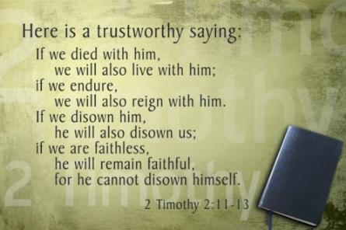
2 Timothy 2:13
Christ will never renege on his initial promise of granting the believer the gift of eternal life
apisteō
Unfaithful
Faithless (Jas. 1:5-8)

Slide 58
John 5:24 (NASB)
“Truly, truly, I say to you, he who hears My word, and believes Him who sent Me, has eternal life, and does not come into judgment, but has passed out of death into life.”

Slide 59
5. Passages From Paul
Gal. 5:4
Gal. 5:19-21
Rom. 8:13
1 Cor. 8:11
1 Cor. 9:24-27
1 Cor. 11:28-30, 32
1 Cor. 15:2
2 Cor. 13:5
Philip. 2:12
Col. 1:23
1 Tim. 5:15
2 Tim. 2:12
2 Tim. 4:10

Slide 60
2 Timothy 4:10 (NASB)
“for Demas, having loved this present world, has deserted me and gone to Thessalonica; Crescens has gone to Galatia, Titus to Dalmatia.”

Slide 61
2 Timothy 4:10
Demas was a believer – Col. 4:14; Philemon 24
Passage does not say that Demas lost his salvation
Demas became worldly – Luke 4:5-8; 1 John 2:15-17; Rom. 12:2; Jas. 4:4
Contrast to Paul – 2 Tim. 4:6-8

Slide 62
CONCLUSION

Slide 63
5. Passages From Paul
Gal. 5:4
Gal. 5:19-21
Rom. 8:13
1 Cor. 8:11
1 Cor. 9:24-27
1 Cor. 11:28-30, 32
1 Cor. 15:2
2 Cor. 13:5
Philip. 2:12
Col. 1:23
1 Tim. 5:15
2 Tim. 2:12
2 Tim. 4:10

