Slide 1

DANIEL INTRODUCTION
Dr. Andy Woods

Slide 2

The Building Blocks
Diversity of Topics
Date
Authorship
Literary Genre
The Covenants
Message
Purpose
Synthetic Outline
Succession of Gentile Rulers
Imbedded chronology
Daniel’s Age

Slide 3
Message
Times of the Gentiles are revealed prophetically (2, 7, 8-12) and ethically (1, 3-6)

Slide 4

Purpose
To encourage Judah by emphasizing the sovereignty of God during the Babylonian captivity and to teach Judah how to live while outside the land
Bifurcating Daniel

Slide 5
Synthetic Outline
Historical (1-7):
  Daniel interprets, 3rd person, gentile nations
  Intro “Hebrew” (1)
  Aramaic chiasm (2-7)

Slide 6
Synthetic Outline
Prophetic (8-12):
  Angel interprets, 1st person, Jewish nation, Hebrew
  Ram & Goat (8)
  70 weeks (9)
  Final vision (10-12)

Slide 7
Synthetic Outline
Historical (1-7):
  Daniel interprets, 3rd person, gentile nations
  Intro “Hebrew” (1)
  Aramaic chiasm (2-7)

Slide 8
Focus of chapter 1
Introductory information
Stage setting for displaying God’s sovereignty
How God will preserve a remnant (Jer. 31:35-37)

Slide 9
Chapter 1 Outline
Daniel’s circumstances (1:1-2)
Daniel’s selection (1:3-7)
Daniel’s dedication (1:8-16)
Daniel’s blessing (1:17-21)

Slide 10
Chapter 1 Outline
Daniel’s circumstances (1:1-2)
Daniel’s selection (1:3-7)
Daniel’s dedication (1:8-16)
Daniel’s blessing (1:17-21)

Slide 11
Captivity of the Jews (1:1-2)
Nebuchadnezzar’s siege (1:1)
  Deut. 28:49
  3 sieges
    605 (Dan 1:1, Daniel and a few princes, Jehoiakim)
    596 (2 Kings 24:10-16, majority, Ezekiel, Jehoiachin)
    586 (2 Kings 25:1-21, remnant captured, Jerusalem and temple destroyed, Zedekiah)
Nebuchadnezzar’s booty (1:2)

Slide 12
Captivity of the Jews (1:1-2)
Nebuchadnezzar’s siege (1:1)
  Deut. 28:49
  3 sieges
    605 (Dan 1:1, Daniel and a few princes, Jehoiakim)
    596 (2 Kings 24:10-16, majority, Ezekiel, Jehoiachin)
    586 (2 Kings 25:1-21, remnant captured, Jerusalem and temple destroyed, Zedekiah)
Nebuchadnezzar’s booty (1:2)

Slide 13
Succession of Gentile Rulers
1-4: Nebuchadnezzar of Babylon
5: Belshazzar of Babylon
6: Darius of Media – Persia
7-8: Belshazzar of Babylon
9: Darius of Media – Persia
10-12: Cyrus of Media – Persia

Slide 14
Succession of Gentile Rulers
1-4: Nebuchadnezzar of Babylon
5: Belshazzar of Babylon
6: Darius of Media-Persia
7-8: Belshazzar of Babylon
9: Darius of Media-Persia
10-12: Cyrus of Media-Persia

Slide 15
Captivity of the Jews (1:1-2)
Nebuchadnezzar’s siege (1:1)
  Deut. 28:49
  3 sieges
    605 (Dan 1:1, Daniel and a few princes, Jehoiakim)
    596 (2 Kings 24:10-16, majority, Ezekiel, Jehoiachin)
    586 (2 Kings 25:1-21, remnant captured, Jerusalem and temple destroyed, Zedekiah)
Nebuchadnezzar’s booty (1:2)

Slide 16
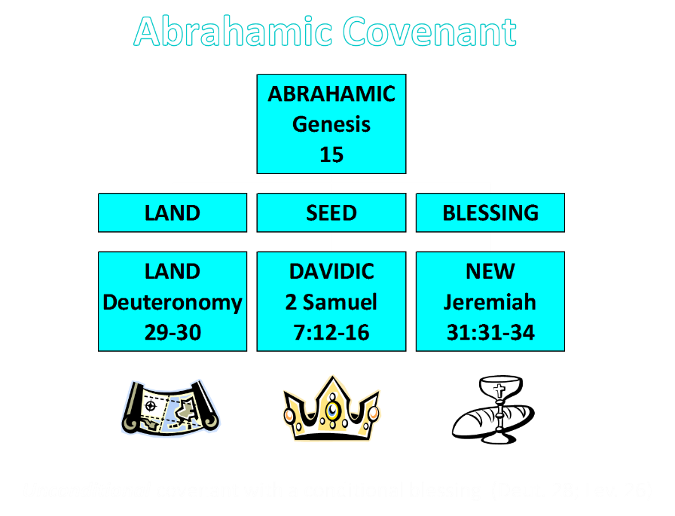

Slide 17
Mosaic Covenant
Exodus 19-24
Deut. 28:1-14, 15-68
  Deut. 28:49-50
  Explains Babylonian Captivity of 605 BC

Slide 18
Six Parts of a Suzerain-Vassal Treaty in Deuteronomy
Preamble (1:1-5)
Prologue (1:6–4:40)
Covenant obligations (5–26)
Storage and reading instructions (27:2-3; 31:9, 24, 26)
Witnesses (32:1)
Blessings and curses (28)

Slide 19
Six Parts of a Suzerain-Vassal Treaty in Deuteronomy
Preamble (1:1-5)
Prologue (1:6–4:40)
Covenant obligations (5–26)
Storage and reading instructions (27:2-3; 31:9, 24, 26)
Witnesses (32:1)
Blessings and curses (28)

Slide 20
Captivity of the Jews (1:1-2)
Nebuchadnezzar’s siege (1:1)
  Deut. 28:49
  3 sieges
    605 (Dan 1:1, Daniel and a few princes, Jehoiakim)
    596 (2 Kings 24:10-16, majority, Ezekiel, Jehoiachin)
    586 (2 Kings 25:1-21, remnant captured, Jerusalem and temple destroyed, Zedekiah)
Nebuchadnezzar’s booty (1:2)

Slide 21
NEBUCHADNEZZAR’S 3 SIEGES OF JUDAH
 | 1 | 2 | 3
Year | 605 | 597 | 586
Scripture | 2 Kings 24:1; Dan.1:1 | 2 Kings 24:10-16; Ezek. 1:1-2 | 2 Kings 25:1-2, Ezek 33:21
Judah’s king | Jehoiakim | Jehoiachin | Zedekiah
Those taken | Daniel & some princes | Ezekiel & majority 10k | Remnant captured, Jerusalem & Temple destroyed

Slide 22
CHAPTER AND VERSE IN DANIEL | CHRONOLOGICAL DATE | BIBLICAL DATE
1:1 | 605 | 3rd year of Jehoiakim
2:1 | 603 | 2nd year of Nebuchadnezzar
5 | Sat. night 10/12/539 (Hoehner)
7:1 | 553 | 1st year of Belshazzar
8:1 | 551 | 3rd year of Belshazzar
9:1 | 538 | 1st year of Darius
10:1 | 536 | 3rd year of Cyrus

Slide 23
CHAPTER AND VERSE IN DANIEL | CHRONOLOGICAL DATE | BIBLICAL DATE
1:1 | 605 | 3rd year of Jehoiakim
2:1 | 603 | 2nd year of Nebuchadnezzar
5 | Sat. night 10/12/539 (Hoehner)
7:1 | 553 | 1st year of Belshazzar
8:1 | 551 | 3rd year of Belshazzar
9:1 | 538 | 1st year of Darius
10:1 | 536 | 3rd year of Cyrus

Slide 24
Daniel’s Age
CHAPTER | EVENTS | AGE
1 | Taken to Babylonian captivity | 15
2 | Interpreting Nebuchadnezzar’s 1st dream (huge image) | 17
3 | Daniel’s 3 friends cast into the fiery furnace | 19 or 20
4 | Interpreting Nebuchadnezzar’s 2nd dream (huge tree) | 45-50
5 | Interpreting handwriting of the wall at Belshazzar’s feast | Early 80’s
6 | Delivered from the den of lions | c.83
7-8 | Daniel’s visions and dreams | Mid-60’s
9 | Daniel’s seventy “sevens” prophecy | Early-80’s
10-12 | Final dreams and visions | Mid-80’s

Slide 25
Daniel’s Age
CHAPTER | EVENTS | AGE
1 | TAKEN TO BABYLONIAN CAPTIVITY | 15
2 | Interpreting Nebuchadnezzar’s 1st dream (huge image) | 17
3 | Daniel’s 3 friends cast into the fiery furnace | 19 or 20
4 | Interpreting Nebuchadnezzar’s 2nd dream (huge tree) | 45-50
5 | Interpreting handwriting of the wall at Belshazzar’s feast | Early 80’s
6 | Delivered from the den of lions | c.83
7-8 | Daniel’s visions and dreams | Mid-60’s
9 | Daniel’s seventy “sevens” prophecy | Early-80’s
10-12 | Final dreams and visions | Mid-80’s

Slide 26
Captivity of the Jews (1:1-2)
Nebuchadnezzar’s siege (1:1)
  Deut. 28:49
  3 sieges
    605 (Dan 1:1, Daniel and a few princes, Jehoiakim)
    596 (2 Kings 24:10-16, majority, Ezekiel, Jehoiachin)
    586 (2 Kings 25:1-21, remnant captured, Jerusalem and temple destroyed, Zedekiah)
Nebuchadnezzar’s booty (1:2)

Slide 27
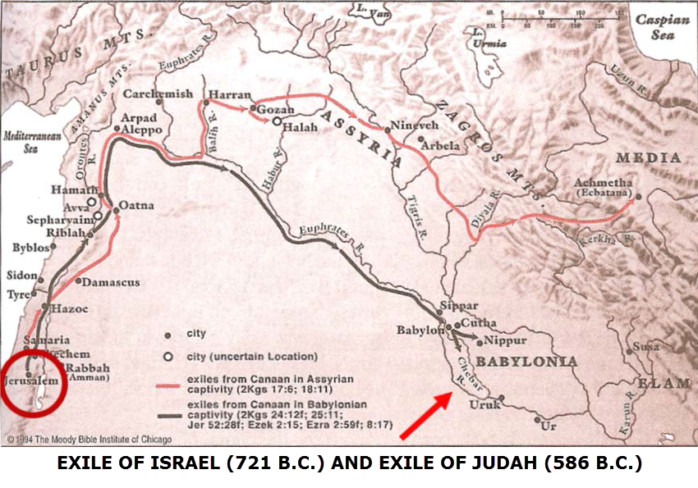

Slide 28
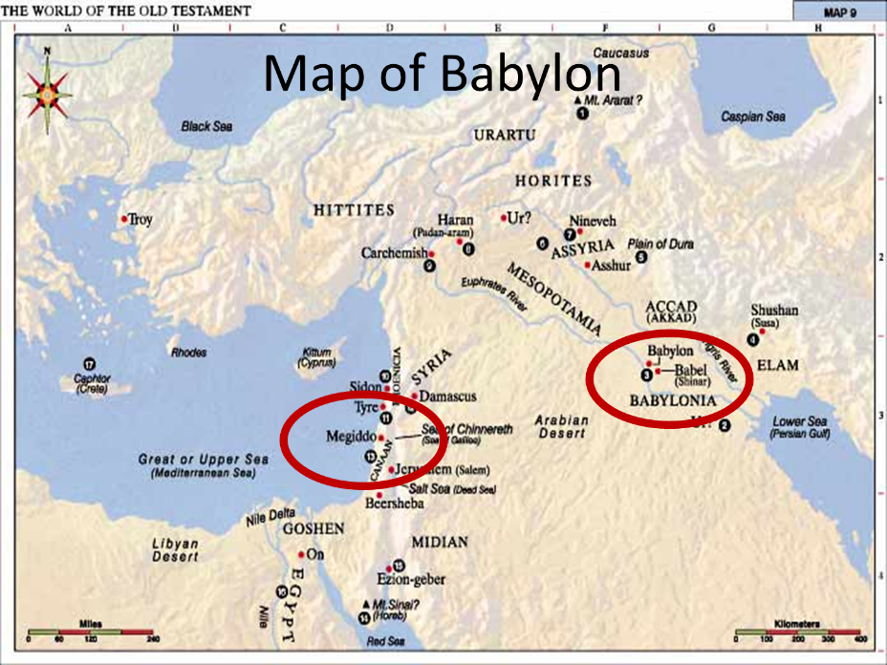

Slide 29
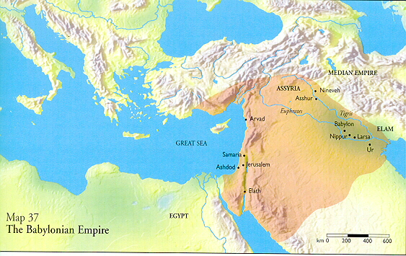

Slide 30
Babylon = Shinar
Past: Gen 11:2
Present: Dan 1:2
Future: Zech 5:11 and Rev 17-18

Slide 31
Babylon = Shinar
Past: Gen 11:2
Present: Dan 1:2
Future: Zech 5:11 and Rev 17-18

Slide 32

Genesis 11:1-4
¹ Now the whole earth used the same language and the same words. ² It came about as they journeyed east, that they found a plain in the land of Shinar and settled there. ³ They said to one another, “Come, let us make bricks and burn them thoroughly.” And they used brick for stone, and they used tar for mortar. ⁴ They said, “Come, let us build for ourselves a city, and a tower whose top will reach into heaven, and let us make for ourselves a name, otherwise we will be scattered abroad over the face of the whole earth.”

Slide 33
Babylon = Shinar
Past: Gen 11:2
Present: Dan 1:2
Future: Zech 5:11 and Rev 17-18

Slide 34
Babylon’s History After 539 B.C.
Herodotus gives Babylon’s measurements (450 B.C.)
Alexander the Great visits and dies in Babylon (323 B.C.)
Seleucus seizes Babylon (312 B.C.)
Strabo pronounces Babylon’s hanging gardens as one of “seven wonders of the world” (25 B.C)
Home of the Magi (Matt. 2:2)
Babylonians present on Pentecost (Acts 2:9)
Talmud promulgated from Babylon (A.D. 500)
Haukal mentions Babylonian village (A.D. 917)
Babylon known as “Two Mosques” and “Hilah” (A.D. 1100)
Hitchcock and Ice, The Truth Behind Left Behind, 109

Slide 35
Babylon = Shinar
Past: Gen 11:2
Present: Dan 1:2
Future: Zech 5:11 and Rev 17-18

Slide 36
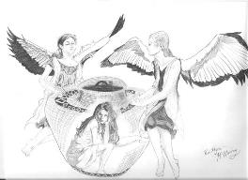
Zechariah 5:5-11
Woman (wickedness)
Ephah (commerce)
House (Temple-2 Sam 7; religion)
Shinar (Gen 10:10; 11:2; Dan 1:2)

Slide 37
Hitchcock, The Second Coming of Babylon, 109.
Zechariah 5:5-11 | Revelation 17–18
Woman sitting in a basket | Woman sitting on beast, seven mountains, many waters (17: 3, 9, 15)
Emphasis on commerce (a basket for measuring grain) | Emphasis on commerce (merchant of grain, 18:13)
Woman’s name is wickedness | Woman’s name is Babylon the Great, Mother of Harlots and Abominations of the Earth
Focus on False worship (a temple is built for the woman) | Focus on False worship (17:5)
Woman is taken to Babylon | Woman is called Babylon

Slide 38
Chapter 1 Outline
Daniel’s circumstances (1:1-2)
Daniel’s selection (1:3-7)
Daniel’s dedication (1:8-16)
Daniel’s blessing (1:17-21)

Slide 39
Daniel’s Selection (1:3-7)
The selection (1:3)
The program (1:4-5)
  Entrance requirements (1:4a)
  Course of study (4b)
  Physical provision (5a)
  Length of study (5b)
The candidates (6-7)
  Hebrew names (6)
  Babylonian names (7)

Slide 40
Daniel’s Selection (1:3-7)
The selection (1:3)
The program (1:4-5)
  Entrance requirements (1:4a)
  Course of study (4b)
  Physical provision (5a)
  Length of study (5b)
The candidates (6-7)
  Hebrew names (6)
  Babylonian names (7)

Slide 41
Daniel’s Selection (1:3-7)
The selection (1:3)
The program (1:4-5)
  Entrance requirements (1:4a)
  Course of study (4b)
  Physical provision (5a)
  Length of study (5b)
The candidates (6-7)
  Hebrew names (6)
  Babylonian names (7)

Slide 42
Daniel’s Selection (1:3-7)
The selection (1:3)
The program (1:4-5)
  Entrance requirements (1:4a)
  Course of study (4b)
  Physical provision (5a)
  Length of study (5b)
The candidates (6-7)
  Hebrew names (6)
  Babylonian names (7)

Slide 43
Daniel’s Selection (1:3-7)
The selection (1:3)
The program (1:4-5)
  Entrance requirements (1:4a)
  Course of study (4b)
  Physical provision (5a)
  Length of study (5b)
The candidates (6-7)
  Hebrew names (6)
  Babylonian names (7)

Slide 44
Changing of the names
Jewish names (Deut. 6:6-7; Prov. 22:6)
  Daniel-God is my judge
  Hananiah-Yahweh is gracious
  Mishael-Who is what God is?
  Azariah-Yahweh has helped

Slide 45
Daniel’s Selection (1:3-7)
The selection (1:3)
The program (1:4-5)
  Entrance requirements (1:4a)
  Course of study (4b)
  Physical provision (5a)
  Length of study (5b)
The candidates (6-7)
  Hebrew names (6)
  Babylonian names (7)

Slide 46
Changing of the names
Babylonian names (Gen 2:19; Rom 12:2)
  Beltshazzar-Lady protect the king
  Shadrach-I am fearful of God
  Meshach-I am of little account
  Abed-nego-Servant of Nebo

Slide 47
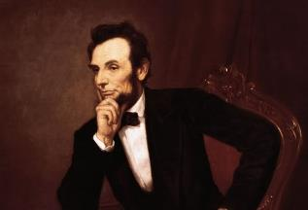
Cited in Mark A. Beliles and Stephen K. McDowell, America's Providential History (Charlottesville, VA: Providence, 1989), 95.
“The philosophy of the school room in one generation will be the philosophy of government in the next.”

Slide 48
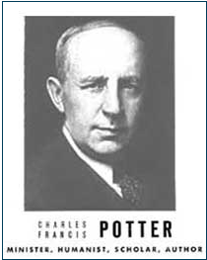
Humanist Proselytizing
“Education is thus a most powerful ally of Humanism, and every public school is a school of Humanism. What can the theistic Sunday-schools, meeting for an hour once a week, and teaching only a fraction of the children, do to stem the tide of a five-day program of humanistic teaching?”
Charles Francis Potter, Humanism: A New Religion (New York: Simon and Schuster, 1930), 128

Slide 49
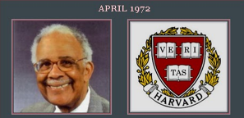
Humanist Proselytizing
“Every child in America entering school at the age of five is mentally ill because he comes to school with certain allegiances to our founding fathers, toward our elected officials, toward his parents, toward a belief in a supernatural being, and toward the sovereignty of this nation as a separate entity. It's up to you as teachers to make all these sick children well by creating the international child of the future.”
Chester M. Pierce, Harvard psychiatrist, speaking as an expert in public education at the 1973 International Education Seminar.

Slide 50


Humanist Proselytizing
“I am convinced that the battle for humankind’s future must be waged and won in the public school classrooms by teachers who correctly perceive their role as proselytizers of a new faith: a religion of humanity that recognizes and respects the spark of what theologians call the Divinity in every human being. These teachers must embody the same selfless dedication as the most rabid fundamentalist preachers.”
John Dunphy, “A Religion for the New Age,” The Humanist (January/February 1983): 26

Slide 51
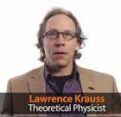
Teaching Creation: Child Abuse and Terrorism?
“Sure, it is mild child abuse…We need to encourage our children to question freely and try to think for themselves. Anything we do that counters that is unfair to them…If you’re introducing it as reality, if you’re telling your kids the world is 6,000 years old, and they shouldn’t believe scientists because there is no way humans are related to other animals, and don’t believe any of that stuff you learned in school, or take your kids of out of school because they are learning something, then it is like the Taliban at some level, which is an extreme form of child abuse...The Taliban doesn’t want girls to be educated or people to be educated because if they do they’ll understand the myths that they are learning are crap.”
Lawrence Krauss, ASU Physics Professor, www.youtube.com/watch?v=K_ZDH5JzgPY

Slide 52
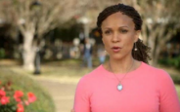
Do Children Belong to Their Parents?
“We have never invested as much in public education as we should have because we've always had kind of a private notion of children. Your kid is yours and totally your responsibility. We haven't had a very collective notion of these are our children. So part of it is we have to break through our kind of private idea that kids belong to their parents, or kids belong to their families, and recognize that kids belong to whole communities.”
Melissa Harris Perry, MSNBC host www.youtube.com/watch?v=N3qtpdSQox0

Slide 53

Kimberly A. Yuracko
There must be legal and constitutional limits on the ability of homeschooling parents “to teach their children idiosyncratic and illiberal beliefs and values”... [Government control must be exercised against] “parents [who] want to teach against the enlightenment. ...Parental control over children’s basic education flows from the state (rather than visa versa). States delegate power over children’s basic education to parents. . . .”
Kimberly A. Yuracko, “Education Off the Grid…”, California Law Review 96 (February 2008) (She is a professor at the Northwestern University School of Law)

Slide 54
“This essay explores the choice many traditionalist Christian parents (both fundamentalist and evangelical) make to leave public schools in order to teach their children at home, thus in most instances escaping meaningful oversight....society need not and should not tolerate the inculcation of absolutist views that undermine toleration of difference....If a parent subscribes to an absolutist belief system premised on the notion that it was handed down by a creator, that it (like the Ten Commandments) is etched in stone and that all other systems are wrong, the essential lessons of a civic education...often seem deeply challenging and suspect....Such ‘private truths’ have no place in the public arena, including the public schools.”
Catherine Ross, “Fundamentalist Challenges to Core Democratic Values: Exit and Homeschooling”, William and Mary Bill of Rights Journal 18 (May 2010) (She is professor at George Washington Law School)

Slide 55

“The risk that parents or private schools unfairly impose hierarchical or oppressive beliefs on their children is magnified by the absence of state oversight or the application of any particular educational standards....Public education should be mandatory and universal.”
Martha Fineman and Karen Worthington, What is Right for Children? The Competing Paradigms of Religion and Human Rights (Burlington, VT: Ashgate Publishing Co., 2009).

Slide 56

Chapter 1 Outline
Daniel’s circumstances (1:1-2)
Daniel’s selection (1:3-7)
Daniel’s dedication (1:8-16)
Daniel’s blessing (1:17-21)

Slide 57

Daniel’s Dedication (1:8-16)
First round (1:8-10)
  Daniel’s resolve (1:8a)
  Daniel’s request (1:8b)
  Commander’s response (1:9-10)
Second round (1:11-16)
  Daniel’s request (1:11-13)
  Commander’s response (1:14)
  Results (1:15-16)

Slide 58
Daniel’s Dedication (1:8-16)
First round (1:8-10)
  Daniel’s resolve (1:8a)
  Daniel’s request (1:8b)
  Commander’s response (1:9-10)
Second round (1:11-16)
  Daniel’s request (1:11-13)
  Commander’s response (1:14)
  Results (1:15-16)

Slide 59
Daniel’s Dedication (1:8-16)
First round (1:8-10)
  Daniel’s resolve (1:8a)
  Daniel’s request (1:8b)
  Commander’s response (1:9-10)
Second round (1:11-16)
  Daniel’s request (1:11-13)
  Commander’s response (1:14)
  Results (1:15-16)

Slide 60
Chapter 1 Outline
Daniel’s circumstances (1:1-2)
Daniel’s selection (1:3-7)
Daniel’s dedication (1:8-16)
Daniel’s blessing (1:17-21)

Slide 61
The 4 Jewish Youths Rise to Favor (1:17-21)
Their God – given knowledge (1:17) – 1Cor 2:14, James 1:5
Their exam before the king (1:18-20)
The length of their service (1:21)

Slide 62
The 4 Jewish Youths Rise to Favor (1:17-21)
Their God – given knowledge (1:17) – 1Cor 2:14, James 1:5
Their exam before the king (1:18-20)
The length of their service (1:21)

Slide 63
The 4 Jewish Youths Rise to Favor (1:17-21)
Their God – given knowledge (1:17) – 1Cor 2:14, James 1:5
Their exam before the king (1:18-20)
The length of their service (1:21)

Slide 64
The 4 Jewish Youths Rise to Favor (1:17-21)
Their God – given knowledge (1:17) – 1Cor 2:14, James 1:5
Their exam before the king (1:18-20)
The length of their service (1:21)

Slide 65
The 4 Jewish Youths Rise to Favor (1:17-21)
The length of their service (1:21)
  Nebuchadnezzar’s initial siege (605)
  Decree of Cyrus (536)
  Daniel served for 69 years
  Daniel served through 2 gentile empires and 4 successive gentile administrations

Slide 66
Basic Chronology
Babylon (605‒539)
  Nebuchadnezzar
  Belshazzar
Media-Persia (538‒536)
  Darius
  Cyrus

Slide 67
Conclusion

Slide 68
Chapter 1 Outline
Daniel’s circumstances (1:1-2)
Daniel’s selection (1:3-7)
Daniel’s dedication (1:8-16)
Daniel’s blessing (1:17-21)

