Slide 1
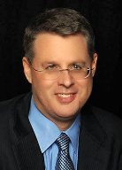
Soteriology Session 39
Dr. Andy Woods
Senior Pastor – Sugar Land Bible Church
Professor of Bible & Theology – College of Biblical Studies

Slide 2
Soteriology Overview
Definition
Election
Atonement
Salvation words
God’s one condition of salvation
Results of salvation
Eternal security
Faulty views of salvation

Slide 3
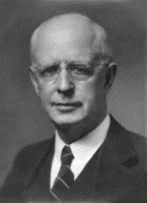
Soteriology Overview
This Session
VII. Eternal Security

Slide 4
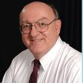
Definition of Eternal Security
“Eternal Security means that those who have been genuinely saved by God’s grace through faith alone in Christ alone shall never be in danger of God’s condemnation or loss of salvation but God’s grace and power keep them forever saved and secure.”
Dennis Rokser, Shall Never Perish Forever, p. 11

Slide 5
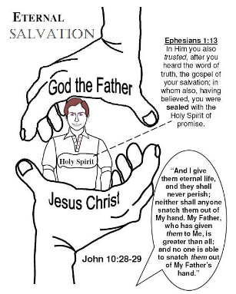
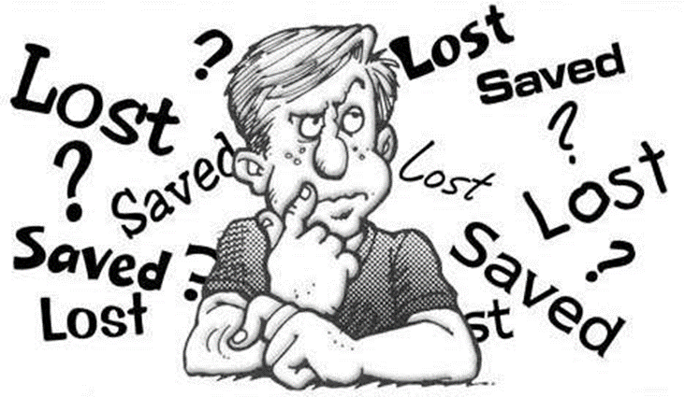
Eternal Security Outline
Eternal security arguments
Response to problem passages

Slide 6
Eternal Security Outline
Eternal security arguments
Response to problem passages

Slide 7
Eternal Security Outline
Eternal security arguments
Response to problem passages

Slide 8
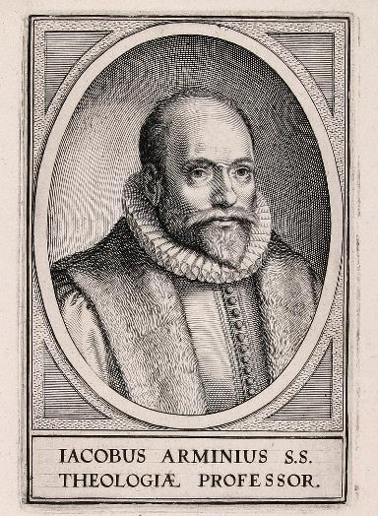
Response to Problem Passages
OT Passages
Passages from Matthew
Passages from John
Passages from Acts
Passages from Paul

Slide 9
Response to Problem Passages
Passages from James
Passages from Hebrews
Passages from 2 Peter
Passages from 1 John
Passages from Revelation
Miscellaneous argument

Slide 10
Response to Problem Passages
OT Passages
Passages from Matthew
Passages from John
Passages from Acts
Passages from Paul

Slide 11
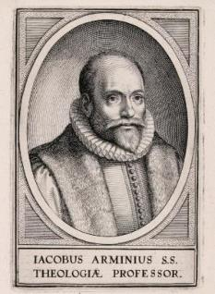
5. Passages From Paul
Gal. 5:4
Gal. 5:19-21
Rom. 8:13
1 Cor. 8:11
1 Cor. 9:24-27
1 Cor. 11:28-30, 32
1 Cor. 15:2
2 Cor. 13:5
Philip. 2:12
Col. 1:23
1 Tim. 5:15
2 Tim. 2:12
2 Tim. 4:10

Slide 12
5. Passages From Paul
Gal. 5:4
Gal. 5:19-21
Rom. 8:13
1 Cor. 8:11
1 Cor. 9:24-27
1 Cor. 11:28-30, 32
1 Cor. 15:2
2 Cor. 13:5
Philip. 2:12
Col. 1:23
1 Tim. 5:15
2 Tim. 2:12
2 Tim. 4:10

Slide 13
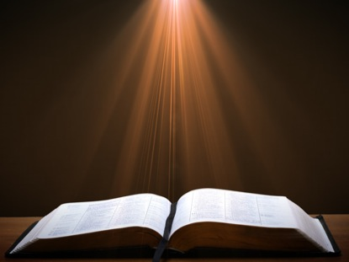
2 Timothy 2:11-13 (NASB)
“It is a trustworthy statement: For if we died with Him, we will also live with Him; ¹² If we endure, we will also reign with Him; If we deny Him, He also will deny us;¹³ If we are faithless, He remains faithful, for He cannot deny Himself.”

Slide 14
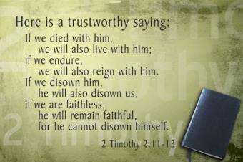
Trustworthy Statement (2:11-13)
If we died with Christ, we will live with Christ (11b)
If we endure for Christ, we will reign with Christ (12a)
If we deny Christ, He will deny us (12b)
If we are unfaithful, Christ remains faithful (13)

Slide 15
Trustworthy Statement (2:11-13)
If we died with Christ, we will live with Christ (11b)
If we endure for Christ, we will reign with Christ (12a)
If we deny Christ, He will deny us (12b)
If we are unfaithful, Christ remains faithful (13)

Slide 16
Trustworthy Statement (2:11-13)
If we died with Christ, we will live with Christ (11b)
If we endure for Christ, we will reign with Christ (12a)
If we deny Christ, He will deny us (12b)
If we are unfaithful, Christ remains faithful (13)

Slide 17
Trustworthy Statement (2:11-13)
If we died with Christ, we will live with Christ (11b)
If we endure for Christ, we will reign with Christ (12a)
If we deny Christ, He will deny us (12b)
If we are unfaithful, Christ remains faithful (13)

Slide 18
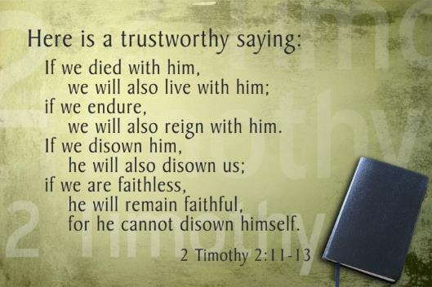
Trustworthy Statement (2:12)
Four views (2:12)
Hypothetical
Arminian
Calvinistic
Rewards

Slide 19
Trustworthy Statement (2:12)
Four views (2:12)
Hypothetical
Arminian
Calvinistic
Rewards

Slide 20
Trustworthy Statement (2:12)
Four views (2:12)
Hypothetical
Arminian
Calvinistic
Rewards

Slide 21
Trustworthy Statement (2:12)
Four views (2:12)
Hypothetical
Arminian
Calvinistic
Rewards

Slide 22
2 Timothy 2:11-13 (NASB)
“It is a trustworthy statement: For if we died with Him, we will also live with Him; ¹² If we endure, we will also reign with Him; If we deny Him, He also will deny us; ¹³ If we are faithless, He remains faithful, for He cannot deny Himself.”

Slide 23
2 Timothy 2:11-13
2 Tim. 1:2
2 Timothy 1:5
1 Timothy 1:5

Slide 24
Trustworthy Statement (2:12)
Four views (2:12)
Hypothetical
Arminian
Calvinistic
Rewards

Slide 25
Scripture’s Four Judgments
Name | Sheep and Goat | Judgment of the Jews | Bema Seat | Great White Throne
Scripture | Matt 25:31-46 | Ezek 20:33-44 | 1 Cor 3:10-15 | Rev 20:11-15
Place | Earth, Jerusalem | Earth, wilderness | Heaven | Earth
Audience | Gentile Tribulation survivors | Jewish Tribulation survivors | Church Age believers | All unsaved
When | After Tribulation | After Tribulation | After rapture | After Millennium
Purpose | Saved Gentiles enter kingdom | Saved Jews enter kingdom | Reward believers | Degree of punishment in hell
Evaluation | Treatment of Christ’s brethren | Passing under shepherd’s rod | Works taken through fire | Not in the book; judged by books

Slide 26
Scripture’s Five Crowns (Rev 4:10: 3:11; 2 John 8)
Scripture | Crown | Purpose
1 Cor. 9:24-27 | Incorruptible | Gaining mastery over the flesh
1 Thess. 2:19-20 | Rejoicing | Soul winning
Jas. 1:12; Rev. 2:10 | Life | Enduring trials
1 Pet. 5:2-4 | Glory | Shepherding God’s people
2 Tim. 4:8 | Righteousness | Longing for His appearing

Slide 27
Rewards (2 Timothy 2:12)
Loss of reward – 1 Cor. 3:15; 1 John 2:28; 2 John 8; Rev. 3:11)
Loss of authority – Luke 19:17, 19
Context of Second Timothy – 2 Tim. 1:7-8
areneomai = “deny”
Not “disown” (NIV)
Used of Peter’s denial of Christ (Matt. 26:70, 72; Mark 14:68, 70; Luke 22:57; John 13:38; 18:25, 27)
Not salvation but needed restoration
Rewards mentioned in elsewhere in 2 Tim. (1:18; 2:4-6; 4:1, 7-8, 14)
Perseverance (UNLIKE Eternal Security) is not guaranteed – DR, SNPF, ch. 13

Slide 28
2 Timothy 2:11-13 (NASB)
“It is a trustworthy statement: For if we died with Him, we will also live with Him; ¹² If we endure, we will also reign with Him; If we deny Him, He also will deny us; ¹³ If we are faithless, He remains faithful, for He cannot deny Himself.”

Slide 29
2 Timothy 2:11-13 (NIV)
“Here is a trustworthy saying: If we died with him, we will also live with him;¹² if we endure, we will also reign with him. If we disown him, he will also disown us;¹³ if we are faithless, he remains faithful, for he cannot disown himself.”

Slide 30
Rewards (2 Timothy 2:12)
Loss of reward – 1 Cor. 3:15; 1 John 2:28; 2 John 8; Rev. 3:11)
Loss of authority – Luke 19:17, 19
Context of Second Timothy – 2 Tim. 1:7-8
areneomai = “deny”
Not “disown” (NIV)
Used of Peter’s denial of Christ (Matt. 26:70, 72; Mark 14:68, 70; Luke 22:57; John 13:38; 18:25, 27)
Not salvation but needed restoration
Rewards mentioned in elsewhere in 2 Tim. (1:18; 2:4-6; 4:1, 7-8, 14)
Perseverance (UNLIKE Eternal Security) is not guaranteed – DR, SNPF, ch. 13

Slide 31
Trustworthy Statement (2:11-13)
If we died with Christ, we will live with Christ (11b)
If we endure for Christ, we will reign with Christ (12a)
If we deny Christ, He will deny us (12b)
If we are unfaithful, Christ remains faithful (13)

Slide 32
2 Timothy 2:11-13 (NASB)
“It is a trustworthy statement: For if we died with Him, we will also live with Him; ¹² If we endure, we will also reign with Him; If we deny Him, He also will deny us; ¹³ If we are faithless, He remains faithful, for He cannot deny Himself.”

Slide 33
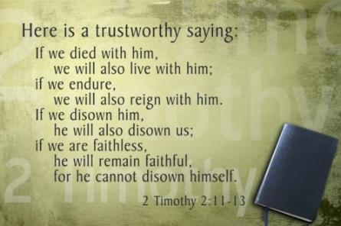
2 Timothy 2:13
Christ will never renege on his initial promise of granting the believer the gift of eternal life
apisteō
Unfaithful
Faithless (Jas. 1:5-8)

Slide 34
John 5:24 (NASB)
“Truly, truly, I say to you, he who hears My word, and believes Him who sent Me, has eternal life, and does not come into judgment, but has passed out of death into life.”

Slide 35
Passages from the General Letters & Revelation
Jas. 5:19-20
Heb. 3:6, 14
Heb. 5:9-10
Heb. 6:4-6
Heb. 10:26-30
Heb. 12:14
2 Pet. 1:10-11
2 Pet. 2:20-22
1 John 2:3
1 John 3:9
1 John 3:15
1 John 5:16
Rev. 3:5
Rev. 22:18-19

Slide 36
Passages from the General Letters & Revelation
Jas. 5:19-20
Heb. 3:6, 14
Heb. 5:9-10
Heb. 6:4-6
Heb. 10:26-30
Heb. 12:14
2 Pet. 1:10-11
2 Pet. 2:20-22
1 John 2:3
1 John 3:9
1 John 3:15
1 John 5:16
Rev. 3:5
Rev. 22:18-19

Slide 37
James 5:19-20 (NASB)
“¹⁹ My brethren, if any among you strays from the truth and one turns him back, ²⁰ let him know that he who turns a sinner from the error of his way will save his soul from death and will cover a multitude of sins.”

Slide 38
James 5:19-20
Sin brings death – Rom. 6:23; Jas. 1:14-15
Maximum divine discipline – Acts 5:1-11; 1 Cor. 11:30; 1 John 5:16; Rev. 2:22-23
Temporal death
Jewish audience-Jas. 1:1
Covenant curses Deut. 28:15-68
Proverbs 2:18; 5:5; 14:12; 21:16
Life of David

Slide 39
Passages from the General Letters & Revelation
Jas. 5:19-20
Heb. 3:6, 14
Heb. 5:9-10
Heb. 6:4-6
Heb. 10:26-30
Heb. 12:14
2 Pet. 1:10-11
2 Pet. 2:20-22
1 John 2:3
1 John 3:9
1 John 3:15
1 John 5:16
Rev. 3:5
Rev. 22:18-19

Slide 40
Hebrews 3:6, 14 (NASB)
“⁶ but Christ was faithful as a Son over His house—whose house we are, if we hold fast our confidence and the boast of our hope firm until the end...¹⁴For we have become partakers of Christ, if we hold fast the beginning of our assurance firm until the end.”

Slide 41
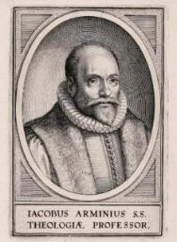
Hebrews 3:6, 14
Not an admonition to stay saved or prove one was saved to begin with
Believing audience – Heb. 3:1
Exhortation not to drift back into Judaism so as to avoid:
Immaturity – Heb. 5:11-14
Loss of rewards
Divine discipline – Heb. 12:5-11
Hell not mentioned

Slide 42
Passages from the General Letters & Revelation
Jas. 5:19-20
Heb. 3:6, 14
Heb. 5:9-10
Heb. 6:4-6
Heb. 10:26-30
Heb. 12:14
2 Pet. 1:10-11
2 Pet. 2:20-22
1 John 2:3
1 John 3:9
1 John 3:15
1 John 5:16
Rev. 3:5
Rev. 22:18-19

Slide 43
Hebrews 5:9-10 (NASB)
“⁹And having been made perfect, He became to all those who obey Him the source of eternal salvation, ¹⁰ being designated by God as a high priest according to the order of Melchizedek.”

Slide 44
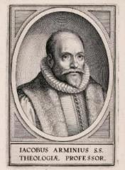
Hebrews 5:9-10
Believing audience – Heb. 3:1
Progressive sanctification
Obedience of the faith?
To obey is a synonym to believe
Rom. 1:5, 16; 2 Thess. 1:8-10; 1 Pet. 1:22-25
Or else a contradiction of Eph. 2:8-9

Slide 45
Hebrews 5:9-10
Believing audience – Heb. 3:1
Progressive sanctification
Obedience of the faith?
To obey is a synonym to believe
Rom. 1:5, 16; 2 Thess. 1:8-10; 1 Pet. 1:22-25
Or else a contradiction of Eph. 2:8-9

Slide 46
Hebrews 5:9-10
Believing audience – Heb. 3:1
Progressive sanctification
Obedience of the faith?
To obey is a synonym to believe
Rom. 1:5, 16; 2 Thess. 1:8-10; 1 Pet. 1:22-25
Or else a contradiction of Eph. 2:8-9

Slide 47
Three Tenses of Salvation
Phase | Justification | Sanctification | Glorification
Tense | Past | Present | Future
Saved from sin’s: | Penalty | Power | Presence
Scripture | Eph 2:8-9; Titus 3:5 | Philip 2:12 | Rom 5:10

Slide 48
Three Tenses of Salvation
Phase | Justification | Sanctification | Glorification
Tense | Past | Present | Future
Saved from sin’s: | Penalty | Power | Presence
Scripture | Eph 2:8-9; Titus 3:5 | Philip 2:12 | Rom 5:10

Slide 49
Three Tenses of Salvation
Phase | Justification | Sanctification | Glorification
Tense | Past | Present | Future
Saved from sin’s: | Penalty | Power | Presence
Scripture | Eph 2:8-9; Titus 3:5 | Philip 2:12 | Rom 5:10

Slide 50
Hebrews 5:9-10
Believing audience – Heb. 3:1
Progressive sanctification
Obedience of the faith?
To obey is a synonym to believe
Rom. 1:5, 16; 2 Thess. 1:8-10; 1 Pet. 1:22-25
Or else a contradiction of Eph. 2:8-9

Slide 51
Hebrews 5:9-10
Believing audience – Heb. 3:1
Progressive sanctification
Obedience of the faith?
To obey is a synonym to believe
Rom. 1:5, 16; 2 Thess. 1:8-10; 1 Pet. 1:22-25
Or else a contradiction of Eph. 2:8-9

Slide 52
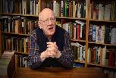
Obedience of the Faith?
“Does the phrase “them that obey Him” (Heb. 5:9) suggest that, if we do not obey Him, we may lose that eternal salvation? To “obey God” is the same as “to trust God,” as “them that obey Him” is a description of those who have put their faith in Jesus Christ. “A great company of the priests were obedient to the faith” (Acts 6:7). “But they have not all obeyed the Gospel” (Rom. 10:16). “Ye have purified your souls in obeying the truth” (1 Peter 1:22). Once we have put our faith in Jesus Christ, and thus obeyed His call, we experience His eternal salvation.”
Wiersbe, W. W. (1996). The Bible Exposition Commentary (Vol. 2, p. 294). Wheaton, IL: Victor Books.

Slide 53
Obedience of the Faith?
“The provision of salvation was achieved through the obedience of the Son to the Father at the cross, and the appropriation of salvation is accomplished through the obedience of the repentant sinner toward Christ. In this passage, obedience is synonymous with faith (acts 6:7; Romans 6:17; 10:16).”
Gromacki, Robert. (2001). Bold in Grace: An Exposition of Hebrews (p. 96). Reprint, The Woodlands, TX: Kress Christian Publications.

Slide 54
Hebrews 5:9-10
Believing audience – Heb. 3:1
Progressive sanctification
Obedience of the faith?
To obey is a synonym to believe
Rom. 1:5, 16; 2 Thess. 1:8-10; 1 Pet. 1:22-25
Or else a contradiction of Eph. 2:8-9

Slide 55
Hebrews 5:9-10
Believing audience – Heb. 3:1
Progressive sanctification
Obedience of the faith?
To obey is a synonym to believe
Rom. 1:5, 16; 2 Thess. 1:8-10; 1 Pet. 1:22-25
Or else a contradiction of Eph. 2:8-9

Slide 56
Passages From the General Letters & Revelation
Jas. 5:19-20
Heb. 3:6, 14
Heb. 5:9-10
Heb. 6:4-6
Heb. 10:26-30
Heb. 12:14
2 Pet. 1:10-11
2 Pet. 2:20-22
1 John 2:3
1 John 3:9
1 John 3:15
1 John 5:16
Rev. 3:5
Rev. 22:18-19

Slide 57
Hebrews 12:14 (NKJV)
“Pursue peace with all people, and holiness, without which no one will see the Lord.”

Slide 58
Hebrews 12:14
Holy life + faith to get to heaven
Others seeing the Lord though the believer's life and witness
Not seeing the Lord in heaven
Context = personal relationships with others (Heb. 12:14a, 15b)
Not requiring faith + holy life to get to heaven

Slide 59
Hebrews 12:14
Holy life + faith to get to heaven
Others seeing the Lord though the believer's life and witness
Not seeing the Lord in heaven
Context = personal relationships with others (Heb. 12:14a, 15b)
Not requiring faith + holy life to get to heaven

Slide 60
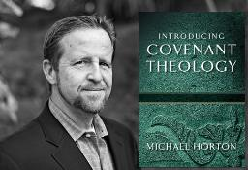
Without Personal Holiness No One Will See the Lord
“The New Testament lays before us a vast array of conditions for final salvation. Not only initial repentance and faith, but perseverance in both, demonstrated in love toward God and neighbor, are part of that holiness without which no one will see the lord (Hebrews 12:14)."
Horton, Michael. (2006). Introducing Covenant Theology (p. 182). Grand Rapids: Baker.

Slide 61
Hebrews 12:14
Holy life + faith to get to heaven
Others seeing the Lord though the believer's life and witness
Not seeing the Lord in heaven
Context = personal relationships with others (Heb. 12:14a, 15b)
Not requiring faith + holy life to get to heaven

Slide 62
Hebrews 12:14
Holy life + faith to get to heaven
Others seeing the Lord though the believer's life and witness
Not seeing the Lord in heaven
Context = personal relationships with others (Heb. 12:14a, 15b)
Not requiring faith + holy life to get to heaven

Slide 63
Hebrews 12:14
Holy life + faith to get to heaven
Others seeing the Lord though the believer's life and witness
Not seeing the Lord in heaven
Context = personal relationships with others (Heb. 12:14a, 15b)
Not requiring faith + holy life to get to heaven

Slide 64
Hebrews 12:14 (NKJV)
“¹⁴ Pursue peace with all people, and holiness, without which no one will see the Lord: looking carefully lest anyone fall short of the grace of God; lest any root of bitterness springing up cause trouble, and by this many become defiled.”

Slide 65
Hebrews 12:14
Holy life + faith to get to heaven
Others seeing the Lord though the believer's life and witness
Not seeing the Lord in heaven
Context = personal relationships with others (Heb. 12:14a, 15b)
Not requiring faith + holy life to get to heaven

Slide 66
CONCLUSION

Slide 67
Passages From the General Letters & Revelation
Jas. 5:19-20
Heb. 3:6, 14
Heb. 5:9-10
Heb. 6:4-6
Heb. 10:26-30
Heb. 12:14
2 Pet. 1:10-11
2 Pet. 2:20-22
1 John 2:3
1 John 3:9
1 John 3:15
1 John 5:16
Rev. 3:5
Rev. 22:18-19

