Slide 1
THE BIBLE AND VOTING Part 15
Dr. Andy Woods

Slide 2
Introductory Remarks
A stewardship issue (1 Cor. 4:2)
A biblical issue (2 Tim. 3:16)
Biblical principles rather than partisanship

Slide 3
The Bible and Voting
Economic issues
Social issues
Foreign affairs

Slide 4
The Bible and Voting
Economic issues
Social issues
Foreign affairs

Slide 5
Economic Issues
Ownership of private property? (Deut. 19:15)
Pursuit of economic self interest? (Gen. 8:21)
Proper definition of compassion? (2 Thess. 3:10)
Who provides charity? (1 Tim. 5:3-8)
Family is the building block of society? (Deut. 6:6-7)
Wealth retained within the family? (Prov. 13:22)
The earth experiences cyclical patterns? (Gen. 8:22)
Environmental stewardship rather than earth worship? (Rom. 1:22-23)
Opposition to runaway debt? (Prov. 22:7)
Limitations upon the government? (Acts 5:29)

Slide 6
The Bible and Voting
Economic issues
Social issues
Foreign affairs

Slide 7
Social Issues
Legal protection for the unborn? (Gen. 25:23)
Legal protection for the elderly? (Lev. 19:32)
Hetero-sexual monogamous marriage as the standard for society? (Gen. 2:18-25)
Advocacy capital punishment? (Gen. 9:6)
The right to restrict alcohol, pornography, & gambling? (Lev. 10:9; Matt. 5:27-28; Prov. 13:11)
Parental authority over children? (Eph. 6:4)
Public expressions of Christianity? (Mark 16:15)
Right to keep and bear arms? (Luke 22:36)

Slide 8
The Bible and Voting
Economic issues
Social issues
Foreign affairs

Slide 9
Foreign Affairs
Favor national sovereignty above global governance? (Gen. 11:1-9)
Favor the reality and enforceability of our national borders? (Acts 17:26)
Support for the nation of Israel? (Gen. 12:3)
Pursuit of peace though strength? (Jer. 17:9)

Slide 10
Foreign Affairs
Favor national sovereignty above global governance? (Gen. 11:1-9)
Favor the reality and enforceability of our national borders? (Acts 17:26)
Support for the nation of Israel? (Gen. 12:3)
Pursuit of peace though strength? (Jer. 17:9)

Slide 11
Foreign Affairs
Favor national sovereignty above global governance? (Gen. 11:1-9)
Favor the reality and enforceability of our national borders? (Acts 17:26)
Support for the nation of Israel? (Gen. 12:3)
Pursuit of peace though strength? (Jer. 17:9)

Slide 12
Foreign Affairs
Favor national sovereignty above global governance? (Gen. 11:1-9)
Favor the reality and enforceability of our national borders? (Acts 17:26)
Support for the nation of Israel? (Gen. 12:3)
Pursuit of peace though strength? (Jer. 17:9)

Slide 13
Foreign Affairs
Favor national sovereignty above global governance? (Gen. 11:1-9)
Favor the reality and enforceability of our national borders? (Acts 17:26)
Support for the nation of Israel? (Gen. 12:3)
Pursuit of peace though strength? (Jer. 17:9)

Slide 14
Overview
Terrorism’s false causes
Terrorism’s true causes
Ineffective deterrents of terrorism
Effective deterrents to terrorism
Going too far in deterring terrorism
Legitimate methods in deterring terrorism
Notes:
Outline

Slide 15
Overview
Terrorism’s false causes
Terrorism’s true causes
Ineffective deterrents of terrorism
Effective deterrents to terrorism
Going too far in deterring terrorism
Legitimate methods in deterring terrorism
Notes:
Outline

Slide 16
I. Terrorism’s False Causes
Poverty
Lack of education
American imperialism
Notes:
Outline

Slide 17
Overview
Terrorism’s false causes
Terrorism’s true causes
Ineffective deterrents of terrorism
Effective deterrents to terrorism
Going too far in deterring terrorism
Legitimate methods in deterring terrorism
Notes:
Outline

Slide 18
II. Terrorism’s True Causes
Depravity (Mark 7:20-23)
Radical ideology
Notes:
Outline

Slide 19
Overview
Terrorism’s false causes
Terrorism’s true causes
Ineffective deterrents of terrorism
Effective deterrents to terrorism
Going too far in deterring terrorism
Legitimate methods in deterring terrorism
Notes:
Outline

Slide 20
III. Terrorism’s Ineffective Deterrents
Military reduction
Appeasement
Dialogue
Treaties
Subsidies
Apology tours
Notes:
Outline

Slide 21
Ecclesiastes 8:11
“Because the sentence against an evil deed is not executed quickly, therefore the hearts of the sons of men among them are given fully to do evil.”

Slide 22
Overview
Terrorism’s false causes
Terrorism’s true causes
Ineffective deterrents of terrorism
Effective deterrents to terrorism
Going too far in deterring terrorism
Legitimate methods in deterring terrorism
Notes:
Outline

Slide 23
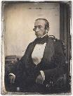
Robert Charles Winthrop
“All societies of men must be governed in some way or other. The less they may have of stringent State Government, the more they must have of individual self-government. The less they rely on public law or physical force, the more they must rely on private moral restraint. Men, in a word, must necessarily be controlled, either by a power within them, or by a power without them; either by the Word of God, or by the strong arm of man; either by the Bible, or by the bayonet. It may do for other countries and other governments to talk about the State supporting religion. Here, under our own free institutions, it is Religion which must support the State.”
Robert Winthrop, Addresses and Speeches on Various Occasions (Boston, MA: Little, Brown, 1852), 172. Speech to the Massachusetts Bible Society (1849-05-28).

Slide 24
Genesis 6:11
“Now the earth was corrupt in the sight of God, and the earth was filled with violence.”

Slide 25
Genesis 9:6
“Whoever sheds man’s blood, By man his blood shall be shed, For in the image of God He made man.”

Slide 26
Noahic vs. Abrahamic & Mosaic Covenants
Name | Noahic Covenant | Abrahamic Covenant | Mosaic Covenant
Human agent | Noah | Abraham | Moses
Scripture | Gen. 8‒9 | Gen. 12‒17 | Exod. 19‒40
Covenant (Berith) | Gen. 9:9 | Gen. 15:18 | Exod. 19:5
Party | World, humanity | Israel, Hebrews | Israel, Hebrews
Israel | Pre-Israel | Post-Israel | Post-Israel

Slide 27
Noahic vs. Abrahamic & Mosaic Covenants
 | Noahic Covenant | Abrahamic Covenant | Mosaic Covenant
Conditional or unconditional | Unconditional | Unconditional | Conditional
Promises | No more flood judgment, enduring earth, capital punishment | Ownership of land, seed, and blessing | Enjoyment or possession of land, seed, and blessing
Sign | Rainbow | Circumcision | Sabbath
Purpose | Restrain & preserve | Redemptive | Redemptive
Directly binding today? | Yes | No | No

Slide 28
Romans 13:3-5
“For rulers are not a cause of fear for good behavior, but for evil. Do you want to have no fear of authority? Do what is good and you will have praise from the same; for it is a minister of God to you for good. But if you do what is evil, be afraid; for it does not bear the sword for nothing; for it is a minister of God, an avenger who brings wrath on the one who practices evil.”

Slide 29
1 Peter 2:13-14
“Submit yourselves for the Lord’s sake to every human institution, whether to a king as the one in authority, or to governors as sent by him for the punishment of evildoers and the praise of those who do right.”

Slide 30
Deuteronomy 13:10-11
“So you shall stone him to death because he has sought to seduce you from the Lord your God who brought you out from the land of Egypt, out of the house of slavery. Then all Israel will hear and be afraid, and will never again do such a wicked thing among you.”

Slide 31
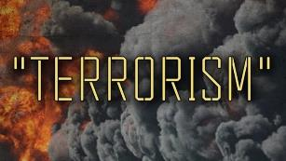
Answering Pacifism’s Arguments
Violence begets violence?
Trust God?
World court resolution?
Love your neighbor (Matt. 22:39)
Turn the other cheek (Matt. 5:39)
Thou shalt not kill? (Exod. 20:13)
Wayne Grudem, Politics According to the Bible, 390-94
Notes:
Outline

Slide 32
Overview
Terrorism’s false causes
Terrorism’s true causes
Ineffective deterrents of terrorism
Effective deterrents to terrorism
Going too far in deterring terrorism
Legitimate methods in deterring terrorism
Notes:
Outline

Slide 33
V. Going Too Far in Deterring Terrorism? Just War Principles
Just cause (Rev. 19:11)
Competent authority (Art. 1, sect. 8; Art II, sect. 2)
Comparative justice (Rom. 13:3)
Right intention (Prov. 21:2)
Last resort (Rom. 12:18)
Probability of success (Luke 14:31)
Proportionality of projected results (Rom. 12:21)
Right spirit (Ps. 68:30)
“War” in ESV Study Bible, 255
Notes:
Outline

Slide 34
V. Going Too Far in Deterring Terrorism? Just War Principles
Just cause (Rev. 19:11)
Competent authority (Art. 1, sect. 8; Art II, sect. 2)
Comparative justice (Rom. 13:3)
Right intention (Prov. 21:2)
Last resort (Rom. 12:18)
Probability of success (Luke 14:31)
Proportionality of projected results (Rom. 12:21)
Right spirit (Ps. 68:30)
“War” in ESV Study Bible, 255
Notes:
Outline

Slide 35
V. Going Too Far in Deterring Terrorism? Just War Principles
Just cause (Rev. 19:11)
Competent authority (Art. 1, sect. 8; Art II, sect. 2)
Comparative justice (Rom. 13:3)
Right intention (Prov. 21:2)
Last resort (Rom. 12:18)
Probability of success (Luke 14:31)
Proportionality of projected results (Rom. 12:21)
Right spirit (Ps. 68:30)
“War” in ESV Study Bible, 255
Notes:
Outline

Slide 36
V. Going Too Far in Deterring Terrorism? Just War Principles
Just cause (Rev. 19:11)
Competent authority (Art. 1, sect. 8; Art II, sect. 2)
Comparative justice (Rom. 13:3)
Right intention (Prov. 21:2)
Last resort (Rom. 12:18)
Probability of success (Luke 14:31)
Proportionality of projected results (Rom. 12:21)
Right spirit (Ps. 68:30)
“War” in ESV Study Bible, 255
Notes:
Outline

Slide 37
Romans 13:3-5
“For rulers are not a cause of fear for good behavior, but for evil. Do you want to have no fear of authority? Do what is good and you will have praise from the same; for it is a minister of God to you for good. But if you do what is evil, be afraid; for it does not bear the sword for nothing; for it is a minister of God, an avenger who brings wrath on the one who practices evil.”

Slide 38
V. Going Too Far in Deterring Terrorism? Just War Principles
Just cause (Rev. 19:11)
Competent authority (Art. 1, sect. 8; Art II, sect. 2)
Comparative justice (Rom. 13:3)
Right intention (Prov. 21:2)
Last resort (Rom. 12:18)
Probability of success (Luke 14:31)
Proportionality of projected results (Rom. 12:21)
Right spirit (Ps. 68:30)
“War” in ESV Study Bible, 255
Notes:
Outline

Slide 39
V. Going Too Far in Deterring Terrorism? Just War Principles
Just cause (Rev. 19:11)
Competent authority (Art. 1, sect. 8; Art II, sect. 2)
Comparative justice (Rom. 13:3)
Right intention (Prov. 21:2)
Last resort (Rom. 12:18)
Probability of success (Luke 14:31)
Proportionality of projected results (Rom. 12:21)
Right spirit (Ps. 68:30)
“War” in ESV Study Bible, 255
Notes:
Outline

Slide 40
V. Going Too Far in Deterring Terrorism? Just War Principles
Just cause (Rev. 19:11)
Competent authority (Art. 1, sect. 8; Art II, sect. 2)
Comparative justice (Rom. 13:3)
Right intention (Prov. 21:2)
Last resort (Rom. 12:18)
Probability of success (Luke 14:31)
Proportionality of projected results (Rom. 12:21)
Right spirit (Ps. 68:30)
“War” in ESV Study Bible, 255
Notes:
Outline

Slide 41
V. Going Too Far in Deterring Terrorism? Just War Principles
Just cause (Rev. 19:11)
Competent authority (Art. 1, sect. 8; Art II, sect. 2)
Comparative justice (Rom. 13:3)
Right intention (Prov. 21:2)
Last resort (Rom. 12:18)
Probability of success (Luke 14:31)
Proportionality of projected results (Rom. 12:21)
Right spirit (Ps. 68:30)
“War” in ESV Study Bible, 255
Notes:
Outline

Slide 42
V. Going Too Far in Deterring Terrorism? Just War Principles
Just cause (Rev. 19:11)
Competent authority (Art. 1, sect. 8; Art II, sect. 2)
Comparative justice (Rom. 13:3)
Right intention (Prov. 21:2)
Last resort (Rom. 12:18)
Probability of success (Luke 14:31)
Proportionality of projected results (Rom. 12:21)
Right spirit (Ps. 68:30)
“War” in ESV Study Bible, 255
Notes:
Outline

Slide 43
V. Going Too Far in Deterring Terrorism? How to Fight a Just War
Proportionality in the use of force (Deut. 20:10-12)
Discrimination between combatants & non-combatants (Deut. 20:13-14)
Avoidance of evil means
Good faith (Ps. 34:14)
“War” in ESV Study Bible, 255
Notes:
Outline

Slide 44
V. Going Too Far in Deterring Terrorism? How to Fight a Just War
Proportionality in the use of force (Deut. 20:10-12)
Discrimination between combatants & non-combatants (Deut. 20:13-14)
Avoidance of evil means
Good faith (Ps. 34:14)
“War” in ESV Study Bible, 255
Notes:
Outline

Slide 45
V. Going Too Far in Deterring Terrorism? How to Fight a Just War
Proportionality in the use of force (Deut. 20:10-12)
Discrimination between combatants & non- combatants (Deut. 20:13-14)
Avoidance of evil means
Good faith (Ps. 34:14)
“War” in ESV Study Bible, 255
Notes:
Outline

Slide 46
V. Going Too Far in Deterring Terrorism? How to Fight a Just War
Proportionality in the use of force (Deut. 20:10-12)
Discrimination between combatants & non-combatants (Deut. 20:13-14)
Avoidance of evil means
Good faith (Ps. 34:14)
“War” in ESV Study Bible, 255
Notes:
Outline

Slide 47
V. Going Too Far in Deterring Terrorism? How to Fight a Just War
Proportionality in the use of force (Deut. 20:10-12)
Discrimination between combatants & non-combatants (Deut. 20:13-14)
Avoidance of evil means
Good faith (Ps. 34:14)
“War” in ESV Study Bible, 255
Notes:
Outline

Slide 48
Overview
Terrorism’s false causes
Terrorism’s true causes
Ineffective deterrents of terrorism
Effective deterrents to terrorism
Going too far in deterring terrorism
Legitimate methods in deterring terrorism
Notes:
Outline

Slide 49
VI. What Legitimate Methods Can the Government Employ in Deterring Terrorism?
Proper label
Deterrence (Deut. 13:10-11)
Missile defense
Pre-emption
Invading other nations (Obadiah 11)
Holding nations accountable harboring terrorists
Spying (Josh. 2:1)
Enhanced interrogations (Prov. 13:24)
Notes:
Outline

Slide 50
VI. What Legitimate Methods Can the Government Employ in Deterring Terrorism?
Proper label
Deterrence (Deut. 13:10-11)
Missile defense
Pre-emption
Invading other nations (Obadiah 11)
Holding nations accountable harboring terrorists
Spying (Josh. 2:1)
Enhanced interrogations (Prov. 13:24)
Notes:
Outline

Slide 51
VI. What Legitimate Methods Can the Government Employ in Deterring Terrorism?
Proper label
Deterrence (Deut. 13:10-11)
Missile defense
Pre-emption
Invading other nations (Obadiah 11)
Holding nations accountable harboring terrorists
Spying (Josh. 2:1)
Enhanced interrogations (Prov. 13:24)
Notes:
Outline

Slide 52
Deuteronomy 13:10-11
“So you shall stone him to death because he has sought to seduce you from the Lord your God who brought you out from the land of Egypt, out of the house of slavery. Then all Israel will hear and be afraid, and will never again do such a wicked thing among you.”

Slide 53
VI. What Legitimate Methods Can the Government Employ in Deterring Terrorism?
Proper label
Deterrence (Deut. 13:10-11)
Missile defense
Pre-emption
Invading other nations (Obadiah 11)
Holding nations accountable harboring terrorists
Spying (Josh. 2:1)
Enhanced interrogations (Prov. 13:24)
Notes:
Outline

Slide 54
VI. What Legitimate Methods Can the Government Employ in Deterring Terrorism?
Proper label
Deterrence (Deut. 13:10-11)
Missile defense
Pre-emption
Invading other nations (Obadiah 11)
Holding nations accountable harboring terrorists
Spying (Josh. 2:1)
Enhanced interrogations (Prov. 13:24)
Notes:
Outline

Slide 55
VI. What Legitimate Methods Can the Government Employ in Deterring Terrorism?
Proper label
Deterrence (Deut. 13:10-11)
Missile defense
Pre-emption
Invading other nations (Obadiah 11)
Holding nations accountable harboring terrorists
Spying (Josh. 2:1)
Enhanced interrogations (Prov. 13:24)
Notes:
Outline

Slide 56
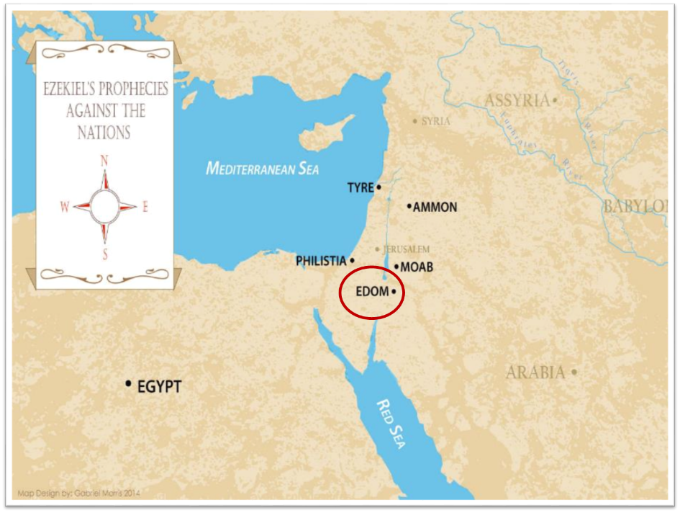

Slide 57
Obadiah 11
“On the day that you stood aloof, On the day that strangers carried off his wealth, And foreigners entered his gate And cast lots for Jerusalem—You too were as one of them.”

Slide 58
VI. What Legitimate Methods Can the Government Employ in Deterring Terrorism?
Proper label
Deterrence (Deut. 13:10-11)
Missile defense
Pre-emption
Invading other nations (Obadiah 11)
Holding nations accountable harboring terrorists
Spying (Josh. 2:1)
Enhanced interrogations (Prov. 13:24)
Notes:
Outline

Slide 59
VI. What Legitimate Methods Can the Government Employ in Deterring Terrorism?
Proper label
Deterrence (Deut. 13:10-11)
Missile defense
Pre-emption
Invading other nations (Obadiah 11)
Holding nations accountable harboring terrorists
Spying (Josh. 2:1)
Enhanced interrogations (Prov. 13:24)
Notes:
Outline

Slide 60
VI. What Legitimate Methods Can the Government Employ in Deterring Terrorism?
Proper label
Deterrence (Deut. 13:10-11)
Missile defense
Pre-emption
Invading other nations (Obadiah 11)
Holding nations accountable harboring terrorists
Spying (Josh. 2:1)
Enhanced interrogations (Prov. 13:24)
Notes:
Outline

Slide 61
Enhanced Interrogation Limitations
Immorality
Denial of medical treatment
Sadistic humiliation
Violation of religious convictions
Causing lasting physical damage
Wayne Grudem, Politics According to the Bible, 429
Notes:
Outline

Slide 62
Enhanced Interrogation Limitations
Immorality
Denial of medical treatment
Sadistic humiliation
Violation of religious convictions
Causing lasting physical damage
Wayne Grudem, Politics According to the Bible, 429
Notes:
Outline

Slide 63
Enhanced Interrogation Limitations
Immorality
Denial of medical treatment
Sadistic humiliation
Violation of religious convictions
Causing lasting physical damage
Wayne Grudem, Politics According to the Bible, 429
Notes:
Outline

Slide 64
Enhanced Interrogation Limitations
Immorality
Denial of medical treatment
Sadistic humiliation
Violation of religious convictions
Causing lasting physical damage
Wayne Grudem, Politics According to the Bible, 429
Notes:
Outline

Slide 65
Enhanced Interrogation Limitations
Immorality
Denial of medical treatment
Sadistic humiliation
Violation of religious convictions
Causing lasting physical damage
Wayne Grudem, Politics According to the Bible, 429
Notes:
Outline

Slide 66
Enhanced Interrogation Limitations
Immorality
Denial of medical treatment
Sadistic humiliation
Violation of religious convictions
Causing lasting physical damage
Wayne Grudem, Politics According to the Bible, 429
Notes:
Outline

Slide 67
Conclusion

Slide 68
Review
Terrorism’s false causes
Terrorism’s true causes
Ineffective deterrents of terrorism
Effective deterrents to terrorism
Going too far in deterring terrorism
Legitimate methods in deterring terrorism
Notes:
Outline

Slide 69
The Bible and Voting
Economic issues
Social issues
Foreign affairs

