Slide 1

Soteriology
Session 32
Dr. Andy Woods
Senior Pastor – Sugar Land Bible Church
Professor of Bible & Theology – College of Biblical Studies

Slide 2
Soteriology Overview
Definition
Election
Atonement
Salvation words
God’s one condition of salvation
Results of salvation
Eternal security
Faulty views of salvation

Slide 3
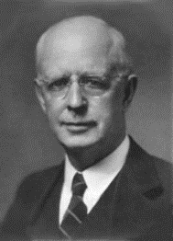
Soteriology Overview
This Session
VII. Eternal Security

Slide 4
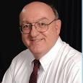
Definition of Eternal Security
“Eternal Security means that those who have been genuinely saved by God’s grace through faith alone in Christ alone shall never be in danger of God’s condemnation or loss of salvation but God’s grace and power keep them forever saved and secure.”
Dennis Rokser, Shall Never Perish Forever, p. 11

Slide 5
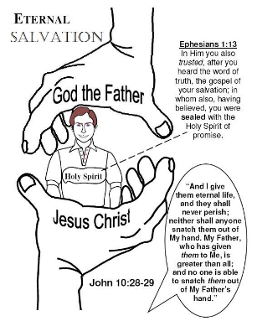
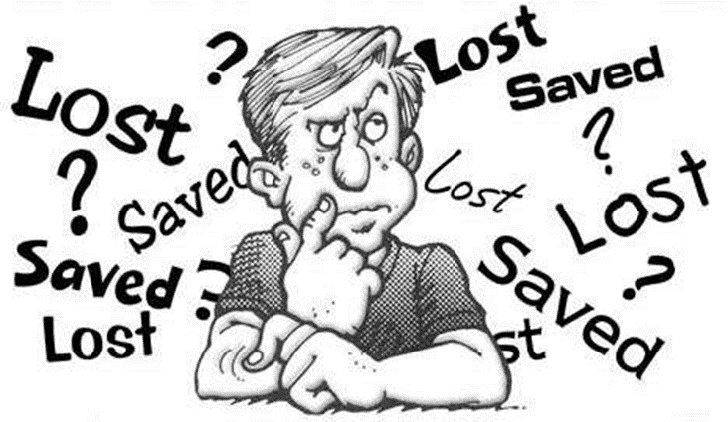
Eternal Security Outline
Eternal security arguments
Response to problem passages

Slide 6
Eternal Security Outline
Eternal security arguments
Response to problem passages

Slide 7
Evidence for Eternal Security
Because self-righteousness did not save us it is not a basis upon which salvation can be lost
Salvation is not given or maintained by works
If a believer can lose eternal life, then how can this life be eternal (John 3:16)?
The Bible’s promises guarantee security (John 10:28)
The assurance of salvation (1 John 5:14)
The believer is predestined for glory (Rom 8:29-30)
The Spirit’s seal cannot be broken (Eph 4:30)

Slide 8
Evidence for Eternal Security
God keeps us from falling (1 Pet 1:4-5)
Christ’s role as intercessor and advocate (John 17:11-12, 20)
Christ’s death perfectly dealt with all sins (Titus 2:14)
A believer cannot be removed from Christ’s body (1 Cor. 12:13)
The Bible does not specify which sins remove salvation
Believers with unfruitful lives still have salvation although lose rewards at the Bema Seat (1 Cor 3:15)

Slide 9
Eternal Security Outline
Eternal security arguments
Response to problem passages

Slide 10
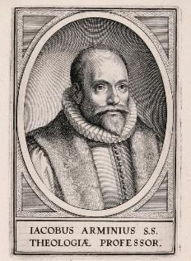
Introduction
Rejoice?
Jacob Arminius (1560‒1609)
Harmonization
The Bible cannot contradict itself
Biblical order

Slide 11
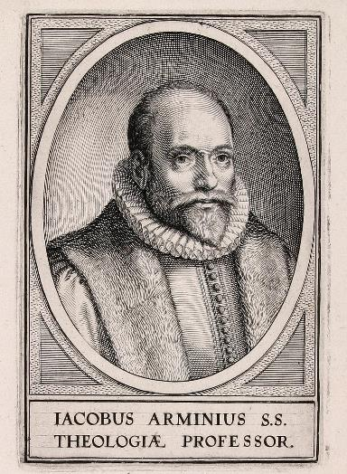
Response to Problem Passages
OT Passages
Passages from Matthew
Passages from John
Passages from Acts
Passages from Paul

Slide 12
Response to Problem Passages
Passages from James
Passages from Hebrews
Passages from 2 Peter
Passages from 1 John
Passages from Revelation
Miscellaneous argument

Slide 13
Response to Problem Passages
OT Passages
Passages from Matthew
Passages from John
Passages from Acts
Passages from Paul

Slide 14
1. OT Passages
Adam & Eve (Gen. 1‒3)
Nadab & Abihu (Lev. 10:1-2)
Korah’s rebellion (Num. 16)
Joshua 24:20
Saul (1 Sam. 16:14; 28; 1 Chron. 10:13-14)
Solomon (1 Kgs. 11)
David (Ps. 51:11)
Ezekiel 18:20

Slide 15
Response to Problem Passages
OT Passages
Passages from Matthew
Passages from John
Passages from Acts
Passages from Paul

Slide 16

2. Passages From Matthew
Matt. 6:14-15
Matt. 7:21-23
Matt. 8:11-12; 25:30
Matt. 10:32-33
Matt. 12:31-32
Matt. 24:13
Matt. 25:41

Slide 17
2. Passages From Matthew
Matt. 6:14-15
Matt. 7:21-23
Matt. 8:11-12; 25:30
Matt. 10:32-33
Matt. 12:31-32
Matt. 24:13
Matt. 25:41

Slide 18
2. Passages From Matthew
Matt. 6:14-15
Matt. 7:21-23
Matt. 8:11-12; 25:30
Matt. 10:32-33
Matt. 12:31-32
Matt. 24:13
Matt. 25:41

Slide 19
2. Passages From Matthew
Matt. 6:14-15
Matt. 7:21-23
Matt. 8:11-12; 25:30
Matt. 10:32-33
Matt. 12:31-32
Matt. 24:13
Matt. 25:41

Slide 20
2. Passages From Matthew
Matt. 6:14-15
Matt. 7:21-23
Matt. 8:11-12; 25:30
Matt. 10:32-33
Matt. 12:31-32
Matt. 24:13
Matt. 25:41

Slide 21
2. Passages From Matthew
Matt. 6:14-15
Matt. 7:21-23
Matt. 8:11-12; 25:30
Matt. 10:32-33
Matt. 12:31-32
Matt. 24:13
Matt. 25:41

Slide 22
2. Passages From Matthew
Matt. 6:14-15
Matt. 7:21-23
Matt. 8:11-12; 25:30
Matt. 10:32-33
Matt. 12:31-32
Matt. 24:13
Matt. 25:41

Slide 23
2. Passages From Matthew
Matt. 6:14-15
Matt. 7:21-23
Matt. 8:11-12; 25:30
Matt. 10:32-33
Matt. 12:31-32
Matt. 24:13
Matt. 25:41

Slide 24

Matthew 12:31-32 (NASB)
“Therefore I say to you, any sin and blasphemy shall be forgiven people, but blasphemy against the Spirit shall not be forgiven. Whoever speaks a word against the Son of Man, it shall be forgiven him; but whoever speaks against the Holy Spirit, it shall not be forgiven him, either in this age or in the age to come.”

Slide 25
Matthew 12:31-32
Context
Five key questions
Summary
Is suicide the unpardonable sin?
Notes:
Outline

Slide 26
Matthew 12:31-32
Context: (Matt 12:22-30)
Five key questions
Summary
Is suicide the unpardonable sin?
Notes:
Outline

Slide 27
Matthew 12:31-32
Context: (Matt 12:22-30)
Five key questions
Summary
Is suicide the unpardonable sin?
Notes:
Outline

Slide 28
II. Five Key Questions (Matt. 12:31-32)
What is the blasphemy against the Holy Spirit?
Who committed the blasphemy of this sin?
What did this sin reveal?
Why can’t this sin be forgiven?
Can this sin be committed today?
Dennis Rokser, Shall Never Perish, 227-236
Notes:
Outline

Slide 29
II. Five Key Questions (Matt. 12:31-32)
What is the blasphemy against the Holy Spirit?
Who committed the blasphemy of this sin?
What did this sin reveal?
Why can’t this sin be forgiven?
Can this sin be committed today?
Dennis Rokser, Shall Never Perish, 227-236
Notes:
Outline

Slide 30
II. Five Key Questions (Matt. 12:31-32)
What is the blasphemy against the Holy Spirit?
Who committed the blasphemy of this sin?
What did this sin reveal?
Why can’t this sin be forgiven?
Can this sin be committed today?
Dennis Rokser, Shall Never Perish, 227-236
Notes:
Outline

Slide 31
II. Five Key Questions (Matt. 12:31-32)
What is the blasphemy against the Holy Spirit?
Who committed the blasphemy of this sin?
What did this sin reveal?
  Their unbelief
  Their self righteousness
  Matt. 12:34-35
Why can’t this sin be forgiven?
Can this sin be committed today?
Dennis Rokser, Shall Never Perish, 227-236
Notes:
Outline

Slide 32
II. Five Key Questions (Matt. 12:31-32)
What is the blasphemy against the Holy Spirit?
Who committed the blasphemy of this sin?
What did this sin reveal?
Why can’t this sin be forgiven?
  Personally – They would not believe in the savior who could save them (John 3:18; 8:24; Acts 10:43)
  Nationally – They rejected the offer of the kingdom
Can this sin be committed today?
Dennis Rokser, Shall Never Perish, 227-236
Notes:
Outline

Slide 33
II. Five Key Questions (Matt. 12:31-32)
What is the blasphemy against the Holy Spirit?
Who committed the blasphemy of this sin?
What did this sin reveal?
Why can’t this sin be forgiven?
  Personally – They would not believe in the savior who could save them (John 3:18; 8:24; Acts 10:43)
  Nationally – They rejected the offer of the kingdom
Can this sin be committed today?
Dennis Rokser, Shall Never Perish, 227-236
Notes:
Outline

Slide 34
II. Five Key Questions (Matt. 12:31-32)
What is the blasphemy against the Holy Spirit?
Who committed the blasphemy of this sin?
What did this sin reveal?
Why can’t this sin be forgiven?
  Personally – They would not believe in the savior who could save them (John 3:18; 8:24; Acts 10:43)
  Nationally – They rejected the offer of the kingdom
Can this sin be committed today?
Dennis Rokser, Shall Never Perish, 227-236
Notes:
Outline

Slide 35
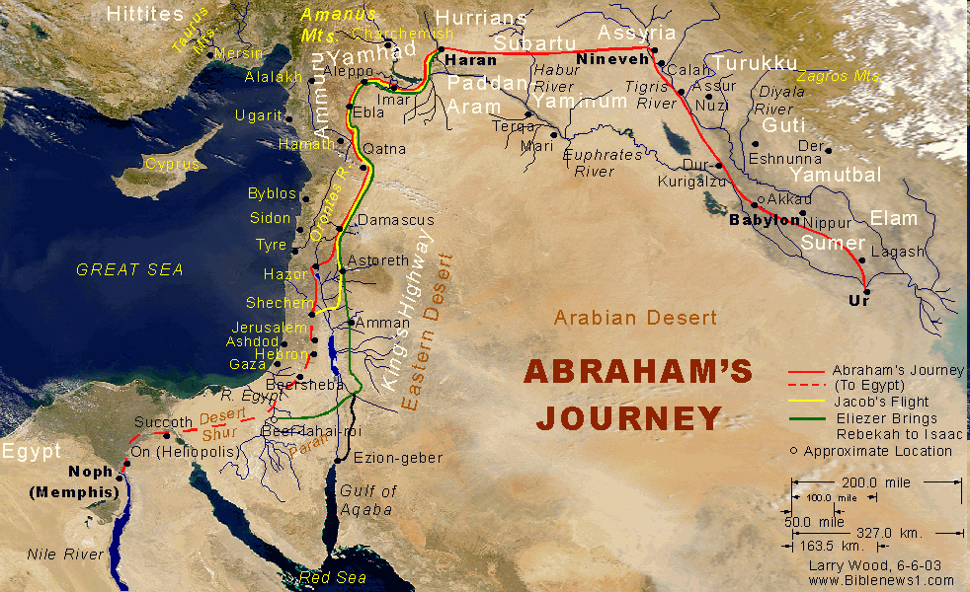

Slide 36


Slide 37
Evidence of Abrahamic Covenant’s Unconditional Nature
ANE covenant ratification ceremony (Gen 15)
No stated conditions for Israel’s obedience (Gen 15)
Covenant's eternality (Gen 17:7, 13, 19)
Covenant's immutability (Heb 6:13-18)
Trans-generational reaffirmation despite perpetual national disobedience (Jer. 31:35-37)
Walvoord, The Millennial Kingdom, 149-52

Slide 38
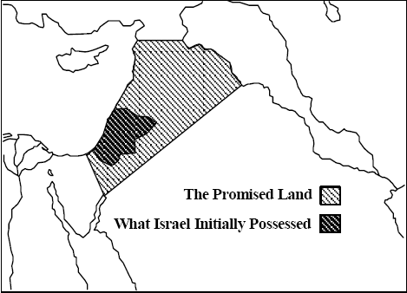
Thomas L. Constable, Notes on Numbers, p.99

Slide 39
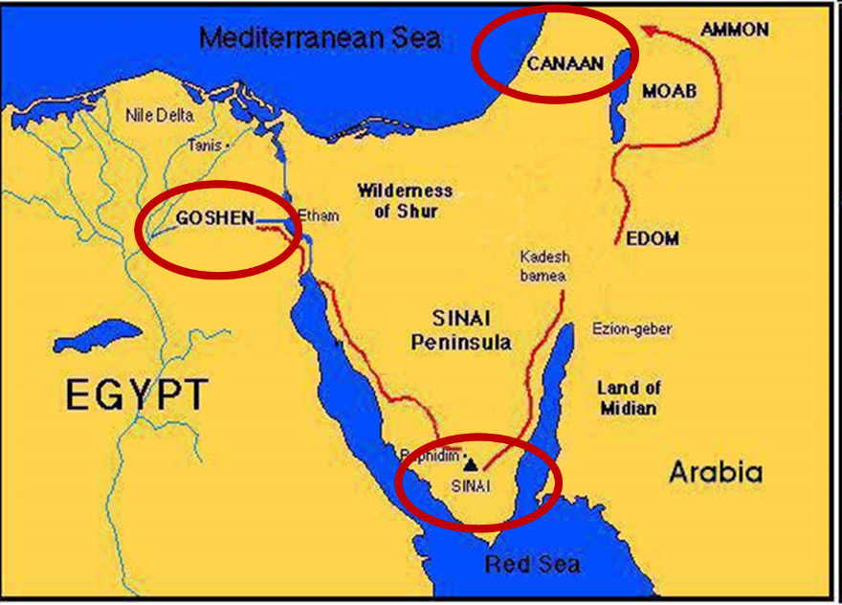

Slide 40

Exodus 19:5-6
“Now then, if you will indeed obey My voice and keep My covenant, then you shall be My own possession among all the peoples, for all the earth is Mine; and you shall be to Me a kingdom of priests and a holy nation.’ These are the words that you shall speak to the sons of Israel.”

Slide 41
Six Parts of a Suzerain-Vassal Treaty* in Deuteronomy
Preamble (1:1-5)
Prologue (1:6–4:40)
Covenant obligations (5–26)
  Deut 17:15
  John 5:39, 46
Storage and reading instructions (27:2-3; 31:9, 24, 26)
Witnesses (32:1)
Blessings and curses (28)
*Suzerainty–Vassal treaty, which Ancient Near Eastern kings made, were only with redeemed or conquered nations and never with individuals. (2007). Christian Apologetics Journal, 6.

Slide 42
Six Parts of a Suzerain-Vassal Treaty* in Deuteronomy
Preamble (1:1-5)
Prologue (1:6–4:40)
Covenant obligations (5–26)
  Deut 17:15
  John 5:39, 46
Storage and reading instructions (27:2-3; 31:9, 24, 26)
Witnesses (32:1)
Blessings and curses (28)
*Suzerainty–Vassal treaty, which Ancient Near Eastern kings made, were only with redeemed or conquered nations and never with individuals. (2007). Christian Apologetics Journal, 6.

Slide 43

Matthew and the Kingdom
Kingdom predicted (Isa 11:6-9)
Kingdom offered (Matt. 3:2; 4:17; 10:5-7)
Kingdom rejected (Matt. 12:24)
Judgment upon first – century national Israel (Deut. 28:49-50; Matt. 24:34-37; Luke 19:41-44; Acts 2:40-41)
Kingdom postponed (Matt. 13)
Interim program? (Matt. 16:18, 21; 28:18-20)
Kingdom ultimately accepted (Matt. 23:38-39; 24:14; 25:31)
Toussaint, Behold the King, 18-20

Slide 44
Matthew and the Kingdom
Kingdom predicted (Isa 11:6-9)
Kingdom offered (Matt. 3:2; 4:17; 10:5-7)
Kingdom rejected (Matt. 12:24)
Judgment upon first – century national Israel (Deut. 28:49-50; Matt. 24:34-37; Luke 19:41-44; Acts 2:40-41)
Kingdom postponed (Matt. 13)
Interim program? (Matt. 16:18, 21; 28:18-20)
Kingdom ultimately accepted (Matt. 23:38-39; 24:14; 25:31)
Toussaint, Behold the King, 18-20

Slide 45
OT PROPHETS DESCRIBE THE KINGDOM
Kingdom Characteristics
Is. 2:1-4; 11:6-9
  Jerusalem = center of world spiritual and political authority
  Perfect justice
  World peace
  Peace in the animal kingdom
  Universal spiritual knowledge.

Slide 46
Matthew and the Kingdom
Kingdom predicted (Isa 11:6-9)
Kingdom offered (Matt. 3:2; 4:17; 10:5-7)
Kingdom rejected (Matt. 12:24)
Judgment upon first – century national Israel (Deut. 28:49-50; Matt. 24:34-37; Luke 19:41-44; Acts 2:40-41)
Kingdom postponed (Matt. 13)
Interim program? (Matt. 16:18, 21; 28:18-20)
Kingdom ultimately accepted (Matt. 23:38-39; 24:14; 25:31)
Toussaint, Behold the King, 18-20

Slide 47
MESSENGERS OF THE KINGDOM
John the Baptist – 3:2
Jesus Christ – 4:17
12 Apostles – 10:5, 7
Toussaint, Behold the King, 18-20

Slide 48
Matthew 10:5-7 (NASB)
“These twelve Jesus sent out after instructing them: “Do not go in the way of the Gentiles, and do not enter any city of the Samaritans; ⁶ but rather go to the lost sheep of the house of Israel. ⁷ And as you go, preach, saying, ‘The kingdom of heaven is at hand.’”

Slide 49
Matthew and the Kingdom
Kingdom predicted (Isa 11:6-9)
Kingdom offered (Matt. 3:2; 4:17; 10:5-7)
Kingdom rejected (Matt. 12:24)
Judgment upon first – century national Israel (Deut. 28:49-50; Matt. 24:34-37; Luke 19:41-44; Acts 2:40-41)
Kingdom postponed (Matt. 13)
Interim program? (Matt. 16:18, 21; 28:18-20)
Kingdom ultimately accepted (Matt. 23:38-39; 24:14; 25:31)
Toussaint, Behold the King, 18-20

Slide 50
Matthew and the Kingdom
Kingdom predicted (Isa 11:6-9)
Kingdom offered (Matt. 3:2; 4:17; 10:5-7)
Kingdom rejected (Matt. 12:24)
Judgment upon first – century national Israel (Deut. 28:49-50; Matt. 24:34-37; Luke 19:41-44; Acts 2:40-41)
Kingdom postponed (Matt. 13)
Interim program? (Matt. 16:18, 21; 28:18-20)
Kingdom ultimately accepted (Matt. 23:38-39; 24:14; 25:31)
Toussaint, Behold the King, 18-20

Slide 51
Matthew and the Kingdom
Kingdom predicted (Isa 11:6-9)
Kingdom offered (Matt. 3:2; 4:17; 10:5-7)
Kingdom rejected (Matt. 12:24)
Judgment upon first – century national Israel (Deut. 28:49-50; Matt. 24:34-37; Luke 19:41-44; Acts 2:40-41)
Kingdom postponed (Matt. 13)
Interim program? (Matt. 16:18, 21; 28:18-20)
Kingdom ultimately accepted (Matt. 23:38-39; 24:14; 25:31)
Toussaint, Behold the King, 18-20

Slide 52
Matthew and the Kingdom
Kingdom predicted (Isa 11:6-9)
Kingdom offered (Matt. 3:2; 4:17; 10:5-7)
Kingdom rejected (Matt. 12:24)
Judgment upon first – century national Israel (Deut. 28:49-50; Matt. 24:34-37; Luke 19:41-44; Acts 2:40-41)
Kingdom postponed (Matt. 13)
Interim program? (Matt. 16:18, 21; 28:18-20)
Kingdom ultimately accepted (Matt. 23:38-39; 24:14; 25:31)
Toussaint, Behold the King, 18-20

Slide 53
Transition from Public to Private Ministry
 | PUBLIC | PRIVATE
Scripture | 1–12 | 13–28
Focus | Nation | Remnant
Miracles | Proof to nation | Training for remnant
Offer | Prominent | Disappears
Teaching | Discourse | Parabolic
Interim program | Not mentioned | Prominent
Toussaint, Behold the King, 18-20

Slide 54


Slide 55
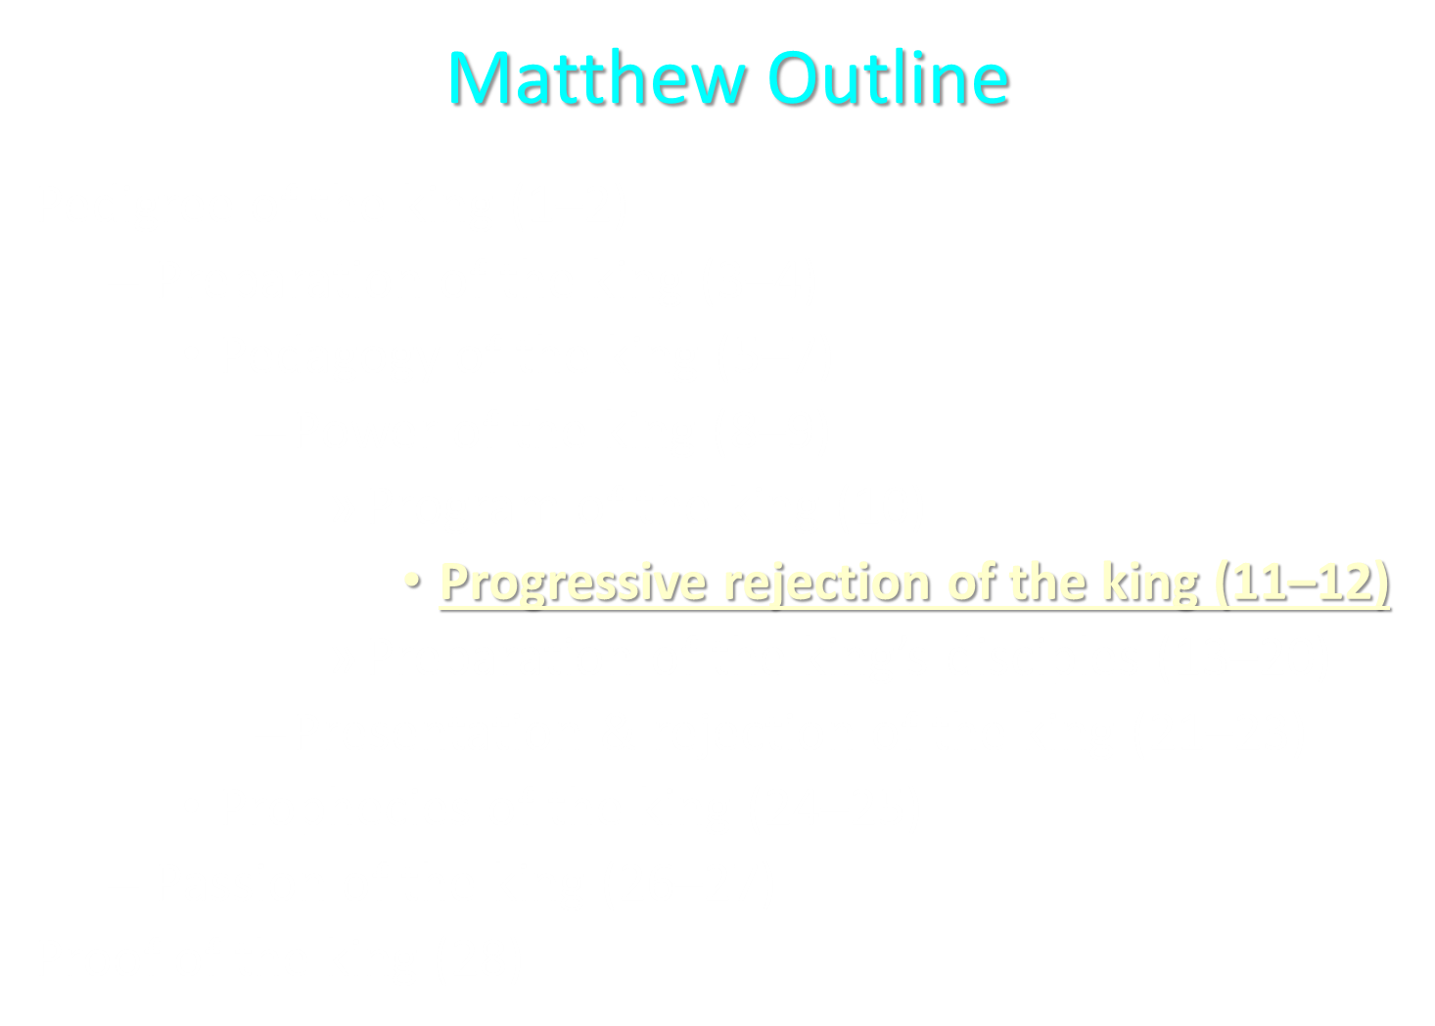

Slide 56
Matthew and the Kingdom
Kingdom predicted (Isa 11:6-9)
Kingdom offered (Matt. 3:2; 4:17; 10:5-7)
Kingdom rejected (Matt. 12:24)
Judgment upon first – century national Israel (Deut. 28:49-50; Matt. 24:34-37; Luke 19:41-44; Acts 2:40-41)
Kingdom postponed (Matt. 13)
Interim program? (Matt. 16:18, 21; 28:18-20)
Kingdom ultimately accepted (Matt. 23:38-39; 24:14; 25:31)
Toussaint, Behold the King, 18-20

Slide 57
II. Five Key Questions (Matt. 12:31-32)
What is the blasphemy against the Holy Spirit?
Who committed the blasphemy of this sin?
What did this sin reveal?
Why can’t this sin be forgiven?
Can this sin be committed today?
  Personally?
    No – loss of salvation
    Yes – dying in unbelief
  Nationally? – No
Dennis Rokser, Shall Never Perish, 227-236
Notes:
Outline

Slide 58
II. Five Key Questions (Matt. 12:31-32)
What is the blasphemy against the Holy Spirit?
Who committed the blasphemy of this sin?
What did this sin reveal?
Why can’t this sin be forgiven?
Can this sin be committed today?
  Personally?
    No – loss of salvation
    Yes – dying in unbelief
  Nationally? – No
Dennis Rokser, Shall Never Perish, 227-236
Notes:
Outline

Slide 59
II. Five Key Questions (Matt. 12:31-32)
What is the blasphemy against the Holy Spirit?
Who committed the blasphemy of this sin?
What did this sin reveal?
Why can’t this sin be forgiven?
Can this sin be committed today?
  Personally?
    No – loss of salvation
    Yes – dying in unbelief
  Nationally? – No
Dennis Rokser, Shall Never Perish, 227-236
Notes:
Outline

Slide 60
Committing Blasphemy Against the Holy Sprit Today?
No commands in the epistles against blasphemy against the Holy Spirit
Epistolary commands involving the Spirit
  Do not lie to the Spirit (Acts 5:3)
  Do not grieve the Spirit (Eph. 4:30)
  Do not quench the Sprit (1 Thess. 5:19)
  Walk according to the Spirit (Gal. 5:16)
  Be filled with the Spirit (Eph. 5:18)

Slide 61
II. Five Key Questions (Matt. 12:31-32)
What is the blasphemy against the Holy Spirit?
Who committed the blasphemy of this sin?
What did this sin reveal?
Why can’t this sin be forgiven?
Can this sin be committed today?
  Personally?
    No – loss of salvation
    Yes – dying in unbelief
  Nationally? – No
Dennis Rokser, Shall Never Perish, 227-236
Notes:
Outline

Slide 62
II. Five Key Questions (Matt. 12:31-32)
What is the blasphemy against the Holy Spirit?
Who committed the blasphemy of this sin?
What did this sin reveal?
Why can’t this sin be forgiven?
Can this sin be committed today?
  Personally?
    No – loss of salvation
    Yes – dying in unbelief
  Nationally? – No
Dennis Rokser, Shall Never Perish, 227-236
Notes:
Outline

Slide 63
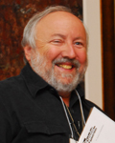
Arnold Fruchtenbaum, Israelology, pg. 617
“In verses 30–37, He pronounced a judgment on the Jewish generation of that day. That generation had committed the unpardonable sin: the blasphemy of the Holy Spirit. The unpardonable sin was not an individual sin but a national sin. It was committed by that generation of Israel in Jesus’ day and cannot be applied to subsequent Jewish generations. The content and definition of the unpardonable sin is the national rejection of the Messiahship of Jesus by Israel while He was physically present on the basis that He was demon possessed. This sin was unpardonable, and judgment was set.”

Slide 64
“The judgment came in the year A.D. 70 with the destruction of Jerusalem and the Temple and the world-wide dispersion of the Jewish people. It was a national sin committed by the generation of Jesus’ day, and for that generation the sin was unpardonable. From this point on a special emphasis is placed on this generation in the gospels, for it was guilty of a very unique sin. At this point, His offer of the Messianic Kingdom was rescinded. It will not now be established in their day because of the unpardonableness of that sin.”
Arnold Fruchtenbaum, Israelology, pg. 617

Slide 65
Matthew 12:31-32
Context
Five key questions
Summary
Is suicide the unpardonable sin?
Notes:
Outline

Slide 66
III. Summary
Pharisees attributed Christ’s miracles to Satan
Pharisees did not believe in Christ as their Messiah
A person must believe in Jesus to be saved
The sin committed by the unbelieving Pharisees marks the nation’s official rejection of the kingdom offer
This sin is a one-time sin that cannot be replicated in subsequent generations or today
The offer is then withdrawn as Christ announces His soon death and coming church (Matt. 16:18, 21)
There is no loss of salvation because the Pharisees were never saved to begin with
Dennis Rokser, Never Perish, 234-35
Notes:
Outline

Slide 67
Matthew 12:31-32
Context
Five key questions
Summary
Is suicide the unpardonable sin?
Notes:
Outline

Slide 68
Seven Suicides of the Bible
Abimelech (Judges 9:54)
Samson (Judges 16:26-31)
Saul’s armor bearer (1 Sam. 31:5)
Saul (1 Sam. 31:3-6)
Ahithophel (2 Sam. 17)
Zimri (1 Kgs. 16:18)
Judas (Matt. 27:4-5)

Slide 69
Seven Suicides of the Bible
Abimelech (Judges 9:54)
Samson (Judges 16:26-31)
Saul’s armor bearer (1 Sam. 31:5)
Saul (1 Sam. 31:3-6)
Ahithophel (2 Sam. 17)
Zimri (1 Kgs. 16:18)
Judas (Matt. 27:4-5)

Slide 70
Seven Suicides of the Bible
Abimelech (Judges 9:54)
Samson (Judges 16:26-31) – Heb. 11:32
Saul’s armor bearer (1 Sam. 31:5)
Saul (1 Sam. 31:3-6) – 1 Sam. 28:19
Ahithophel (2 Sam. 17)
Zimri (1 Kgs. 16:18)
Judas (Matt. 27:4-5)

Slide 71
Romans 8:38-39 (NASB)
“For I am convinced that neither death, nor life, nor angels, nor principalities, nor things present, nor things to come, nor powers, ³⁹ nor height, nor depth, nor any other created thing, will be able to separate us from the love of God, which is in Christ Jesus our Lord.”

Slide 72
Romans 8:38-39 (NASB)
“For I am convinced that neither death, nor life, nor angels, nor principalities, nor things present, nor things to come, nor powers, ³⁹ nor height, nor depth, nor any other created thing, will be able to separate us from the love of God, which is in Christ Jesus our Lord.”

Slide 73
CONCLUSION

Slide 74
2. Passages From Matthew
Matt. 6:14-15
Matt. 7:21-23
Matt. 8:11-12; 25:30
Matt. 10:32-33
Matt. 12:31-32
Matt. 24:13
Matt. 25:41

