Slide 1
Soteriology Session 17
Dr. Andy Woods
Senior Pastor – Sugar Land Bible Church
Professor of Bible & Theology – College of Biblical Studies

Slide 2
Soteriology Overview
Definition
Election
Atonement
Salvation words
God’s one condition of salvation
Results of salvation
Eternal security
Faulty views of salvation

Slide 3
Soteriology Overview
This Session
VI. Results of Salvation, (cont’d)

Slide 4
Results of Salvation
Sonship/adoption (Gal 4:5-7; Rom 8:14-17)
Eternal life (John 3:16)
Regeneration (John 3:5; Titus 3:5)
Justification (Rom 8:33-34)
Forgiveness of all pre-cross sins (Acts 17:30; Rom 3:25)
Good works (Eph 2:8-10)
Sanctification (John 17:17)
Glorification (Rom 8:30)
End of the Law (Rom 10:4)
Miscellaneous privileges (Philip 3:20; 1 Pet 2:5, 9; Rev 19:7; 1 Pet 1:4; Rom 5:1)

Slide 5
Sanctification
Kodesh, hagiazo
Three tenses
Past – 1 Cor. 1:2
Present – John 17:17
Future – 1 Thess. 3:13; 5:23
Sanctifier: Trinity
Father – John 17:17
Son – 1 Cor. 1:2
Spirit – 1 Pet. 1:2
Means of sanctification
Past: Christ’s body & blood (Heb. 9:13-14; 10:10, 14
Present: Word (John 17:17; Acts 20:32; 2 Tim 3:16-17) & Holy Spirit (Gal 5:16)

Slide 6
Three Tenses of Salvation
Phase | Justification | Sanctification | Glorification
Tense | Past | Present | Future
Saved from sin’s: | Penalty | Power | Presence
Scripture | Eph 2:8-9; Titus 3:5 | Philip 2:12 | Rom 5:10

Slide 7
Three Tenses of Salvation
Phase | Justification | Sanctification | Glorification
Tense | Past | Present | Future
Saved from sin’s: | Penalty | Power | Presence
Scripture | Eph 2:8-9; Titus 3:5 | Philip 2:12 | Rom 5:10

Slide 8
Sanctification
Kodesh, hagiazo
Three tenses
Past – 1 Cor. 1:2
Present – John 17:17
Future – 1 Thess. 3:13; 5:23
Sanctifier: Trinity
Father – John 17:17
Son – 1 Cor. 1:2
Spirit – 1 Pet. 1:2
Means of sanctification
Past: Christ’s body & blood (Heb. 9:13-14; 10:10, 14
Present: Word (John 17:17; Acts 20:32; 2 Tim 3:16-17) & Holy Spirit (Gal 5:16)

Slide 9
Results of Salvation
Sonship/adoption (Gal 4:5-7; Rom 8:14-17)
Eternal life (John 3:16)
Regeneration (John 3:5; Titus 3:5)
Justification (Rom 8:33-34)
Forgiveness of all pre-cross sins (Acts 17:30; Rom 3:25)
Good works (Eph 2:8-10)
Sanctification (John 17:17)
Glorification (Rom 8:30)
End of the Law (Rom 10:4)
Miscellaneous privileges (Philip 3:20; 1 Pet 2:5, 9; Rev 19:7; 1 Pet 1:4; Rom 5:1)

Slide 10
Three Tenses of Salvation
Phase | Justification | Sanctification | Glorification
Tense | Past | Present | Future
Saved from sin’s: | Penalty | Power | Presence
Scripture | Eph 2:8-9; Titus 3:5 | Philip 2:12 | Rom 5:10

Slide 11
Three Tenses of Salvation
Phase | Justification | Sanctification | Glorification
Tense | Past | Present | Future
Saved from sin’s: | Penalty | Power | Presence
Scripture | Eph 2:8-9; Titus 3:5 | Philip 2:12 | Rom 5:10

Slide 12
Romans 8:29–30
²⁹ For those whom He foreknew, He also predestined to become conformed to the image of His Son, so that He would be the firstborn among many brethren; ³⁰ and these whom He predestined, He also called; and these whom He called, He also justified; and these whom He justified, He also glorified. (NASB95)

Slide 13
Results of Salvation
Sonship/adoption (Gal 4:5-7; Rom 8:14-17)
Eternal life (John 3:16)
Regeneration (John 3:5; Titus 3:5)
Justification (Rom 8:33-34)
Forgiveness of all pre-cross sins (Acts 17:30; Rom 3:25)
Good works (Eph 2:8-10)
Sanctification (John 17:17)
Glorification (Rom 8:30)
End of the Law (Rom 10:4)
Miscellaneous privileges (Philip 3:20; 1 Pet 2:5, 9; Rev 19:7; 1 Pet 1:4; Rom 5:1)

Slide 14
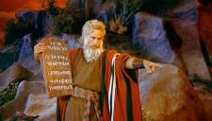
End of the Law
Stated – Romans 10:4
Justification–Acts 13:39; 15:10-11; Gal. 3:23-25; Rom. 3:20
Sanctification
Law was only for Israel’s sanctification – Ps. 147:19-20; Exod. 19:1ff; Gal 3:13 (curse of the Law)
Gal. 5:22-23; 2 Cor. 3:6-11
Why are 9 of the 10 commandments repeated in the NT? (Rom. 13:9; 1 Pet. 1:16)
Improper solution – Civil, ceremonial, and moral division of the Law-1. artificial 2. all or nothing (Jas. 2:10)
Proper solution – We are under a similar yet different system

Slide 15
Exodus 14:30-31
³⁰ Thus the Lord saved Israel that day from the hand of the Egyptians, and Israel saw the Egyptians dead on the seashore. ³¹ When Israel saw the great power which the Lord had used against the Egyptians, the people feared the Lord, and they believed in the Lord and in His servant Moses.”

Slide 16
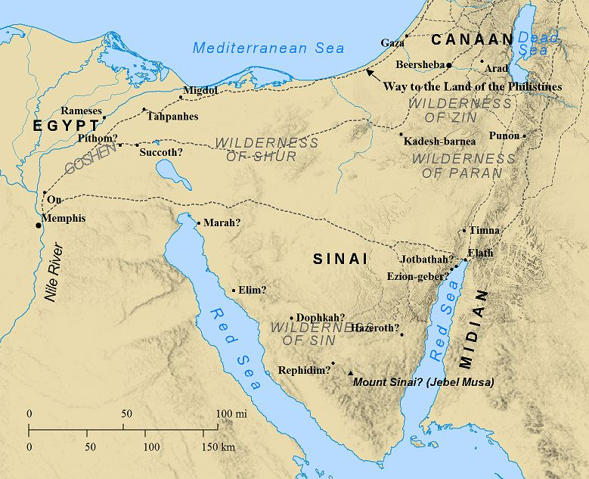

Slide 17
End of the Law
Stated – Romans 10:4
Justification–Acts 13:39; 15:10-11; Gal. 3:23-25; Rom. 3:20
Sanctification
Law was only for Israel’s sanctification – Ps. 147:19-20; Exod. 19:1ff; Gal 3:13 (curse of the Law)
Gal. 5:22-23; 2 Cor. 3:6-11
Why are 9 of the 10 commandments repeated in the NT? (Rom. 13:9; 1 Pet. 1:16)
Improper solution – Civil, ceremonial, and moral division of the Law-1. artificial 2. all or nothing (Jas. 2:10)
Proper solution – We are under a similar yet different system

Slide 18
Contrasts Between the Old and New Covenants (2 Cor. 3:6-11)
Verse | Old Covenant | New Covenant
6 | Old | New
6 | Letter | Spirit
6 | Death | Life
7 | Stone | Spirit
7, 8, 10 | Some glory | Greater glory
9 | Condemnation | Righteousness
11 | Temporary | Permanent

Slide 19
End of the Law
Stated – Romans 10:4
Justification–Acts 13:39; 15:10-11; Gal. 3:23-25; Rom. 3:20
Sanctification
Law was only for Israel’s sanctification – Ps. 147:19-20; Exod. 19:1ff; Gal 3:13 (curse of the Law)
Gal. 5:22-23; 2 Cor. 3:6-11
Why are 9 of the 10 commandments repeated in the NT? (Rom. 13:9; 1 Pet. 1:16)
Improper solution – Civil, ceremonial, and moral division of the Law-1. artificial 2. all or nothing (Jas. 2:10)
Proper solution – We are under a similar yet different system

Slide 20
Similar Yet Different System
Texas v. California example
Differences:
Ceremonial & civil
Punitive (Num. 15:32-36)
Empowerment (Gal 5:16)
NT system given a different name
Law of Christ (Gal. 6:2)
Law of the Spirit (Rom. 8:2)

Slide 21
Results of Salvation
Sonship/adoption (Gal 4:5-7; Rom 8:14-17)
Eternal life (John 3:16)
Regeneration (John 3:5; Titus 3:5)
Justification (Rom 8:33-34)
Forgiveness of all pre-cross sins (Acts 17:30; Rom 3:25)
Good works (Eph 2:8-10)
Sanctification (John 17:17)
Glorification (Rom 8:30)
End of the Law (Rom 10:4)
Miscellaneous privileges (Philip 3:20; 1 Pet 2:5, 9; Rev 19:7; 1 Pet 1:4; Rom 5:1)

Slide 22
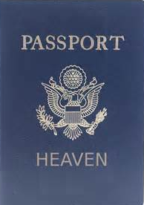
Miscellaneous Privileges
Heavenly citizenship – Philip. 3:20
Membership in a priesthood – Rev. 1:6
Engaged & soon to be married – Eph. 5:22-33; Rev. 19:7
Inheritance – 1 Pet. 1:4
Peace – Rom 5:1, 8; 8:1

Slide 23
CONCLUSION

Slide 24
Soteriology Overview
Definition
Election
Atonement
Salvation words
God’s one condition of salvation
Results of salvation
Eternal security
Faulty views of salvation

Slide 25
Soteriology Overview
Next Session
VII. Eternal security

