Slide 1


Slide 2


Slide 3
2 Timothy Introduction
The Call to Christian Perseverance

Slide 4
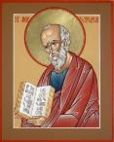
Answering Nine Questions
Who wrote it? – Paul
What do we know about the author? – An Apostle
To whom was it written? – Timothy
When was it written? - A.D. 67
Where was it written from? – Rome
Why was it written? – Timothy’s timidity
What is it about? – Perseverance
What is inside (outline)? – 4 part outline
What makes the book different? – Paul’s final word

Slide 5
Four Part Structure
General call to faithful endurance in the ministry (chapter 1)
Ten metaphors describing what faithful endurance looks like (chapter 2)
What to do in the midst of the coming apostasy (3:1–4:8)
How God met six needs in Paul’s life (4:9-22)

Slide 6
Four Part Structure
General call to faithful endurance in the ministry (chapter 1)
Ten metaphors describing what faithful endurance looks like (chapter 2)
What to do in the midst of the coming apostasy (3:1–4:8)
How God met six needs in Paul’s life (4:9-22)

Slide 7
Four Part Structure
General call to faithful endurance in the ministry (chapter 1)
Ten metaphors describing what faithful endurance looks like (chapter 2)
What to do in the midst of the coming apostasy (3:1–4:8)
How God met six needs in Paul’s life (4:9-22)

Slide 8
2 Timothy 2
Ten Metaphors Illustrating Endurance

Slide 9

Ten Metaphors
Teacher (2:2)
Soldier (2:3-4)
Athlete (2:5)
Farmer (2:6)
Christ (2:7-8)
Paul (2:9-10)
Trustworthy statement (2:11-13)
Workman (2:14-18)
Vessel (2:19-23)
Servant (2:24-26)

Slide 10
Four Part Structure
General call to faithful endurance in the ministry (chapter 1)
Ten metaphors describing what faithful endurance looks like (chapter 2)
What to do in the midst of the coming apostasy (3:1–4:8)
How God met six needs in Paul’s life (4:9-22)

Slide 11
THE LAST DAYS APOSTASY OF THE CHURCH
Dr. Andy Woods

Slide 12

Definition of Apostasy
apos = away from
histēmi = to stand
Apostasy = to stand away from
Apostasy = a departure from known (or previously embraced) truth

Slide 13
2 Timothy 3:1‒4:8
What to Do in the
Midst of the Apostasy

Slide 14
Apostasy (3:1‒4:8)
The Apostasy (3:1-9)
  The evil (3:1-7)
  The examples (3:8-9)
The Antidote (3:10‒4:8)
  Paul’s example (3:10-13)
  Preach the Word (3:14‒4:8)

Slide 15
Apostasy (3:1‒4:8)
The Apostasy (3:1-9)
  The evil (3:1-7)
  The examples (3:8-9)
The Antidote (3:10‒4:8)
  Paul’s example (3:10-13)
  Preach the Word (3:14‒4:8)

Slide 16
Apostasy (3:1‒4:8)
The Apostasy (3:1-9)
  The evil (3:1-7)
  The examples (3:8-9)
The Antidote (3:10‒4:8)
  Paul’s example (3:10-13)
  Preach the Word (3:14‒4:8)

Slide 17
Apostasy (3:1‒4:8)
The Apostasy (3:1-9)
  The evil (3:1-7)
  The examples (3:8-9)
The Antidote (3:10‒4:8)
  Paul’s example (3:10-13)
  Preach the Word (3:14‒4:8)

Slide 18
Apostasy (3:1‒4:8)
The Apostasy (3:1-9)
  The evil (3:1-7)
  The examples (3:8-9)
The Antidote (3:10‒4:8)
  Paul’s example (3:10-13)
  Preach the Word (3:14‒4:8)

Slide 19
Apostasy (3:1‒4:8)
The Apostasy (3:1-9)
  The evil (3:1-7)
  The examples (3:8-9)
The Antidote (3:10‒4:8)
  Paul’s example (3:10-13)
  Preach the Word (3:14‒4:8)

Slide 20

B. Paul’ Example (3:10-13)
Paul’s ministry (10a)
Paul’s character (10b)
Paul’s difficulties (11-13)

Slide 21
B. Paul’ Example (3:10-13)
Paul’s ministry (10a)
Paul’s character (10b)
Paul’s difficulties (11-13)

Slide 22
1. Paul’ Ministry (3:10a)
Teaching
Conduct
Purpose

Slide 23
1. Paul’ Ministry (3:10a)
Teaching
Conduct
Purpose

Slide 24
1. Paul’ Ministry (3:10a)
Teaching
Conduct
Purpose

Slide 25
Ephesians 4:1
Therefore…
1-3
4-6

Slide 26
Ephesians: What Is Inside?
1–3 | 4–6
Relationship | Responsibility
No imperatives | 35 imperatives
Orthodoxy | Orthopraxy
Knowledge | Wisdom
Belief | Behavior
Position | Practice
Privileges | Responsibility

Slide 27
Romans 12:1
Therefore…
1-11
12-16

Slide 28
Galatians 5:1
Therefore…
1-4
5-6

Slide 29
1. Paul’ Ministry (3:10a)
Teaching
Conduct
Purpose

Slide 30
B. Paul’ Example (3:10-13)
Paul’s ministry (10a)
Paul’s character (10b)
Paul’s difficulties (11-13)

Slide 31
2. Paul’ Character (3:10b)
Faith
Patience
Love
Perseverance

Slide 32
2. Paul’ Character (3:10b)
Faith
Patience
Love
Perseverance

Slide 33

Galatians 5:22-23 (NASB)
“But the fruit of the Spirit is love, joy, peace, patience, kindness, goodness, faithfulness, gentleness, self-control; against such things there is no law..”

Slide 34
2. Paul’ Character (3:10b)
Faith
Patience
Love
Perseverance

Slide 35
Galatians 5:22-23 (NASB)
“But the fruit of the Spirit is love, joy, peace, patience, kindness, goodness, faithfulness, gentleness, self-control; against such things there is no law..”

Slide 36
2. Paul’ Character (3:10b)
Faith
Patience
Love
Perseverance

Slide 37
Galatians 5:22-23 (NASB)
“But the fruit of the Spirit is love, joy, peace, patience, kindness, goodness, faithfulness, gentleness, self-control; against such things there is no law..”

Slide 38
2. Paul’ Character (3:10b)
Faith
Patience
Love
Perseverance

Slide 39
James 1:2-4 (NASB)
“Consider it all joy, my brethren, when you encounter various trials, knowing that the testing of your faith produces endurance. And let endurance have its perfect result, so that you may be perfect and complete, lacking in nothing.”

Slide 40
B. Paul’ Example (3:10-13)
Paul’s ministry (10a)
Paul’s character (10b)
Paul’s difficulties (11-13)

Slide 41
3. Paul’ Sufferings (3:11-13)
Persecutions (11a)
Sufferings (11b)
1. An example (11c)
2. A promise (12)
3. A reason (13)

Slide 42
3. Paul’ Sufferings (3:11-13)
Persecutions (11a)
Sufferings (11b)
1. An example (11c)
2. A promise (12)
3. A reason (13)

Slide 43
3. Paul’ Sufferings (3:11-13)
Persecutions (11a)
Sufferings (11b)
1. An example (11c)
2. A promise (12)
3. A reason (13)

Slide 44
3. Paul’ Sufferings (3:11-13)
Persecutions (11a)
Sufferings (11b)
1. An example (11c)
2. A promise (12)
3. A reason (13)

Slide 45
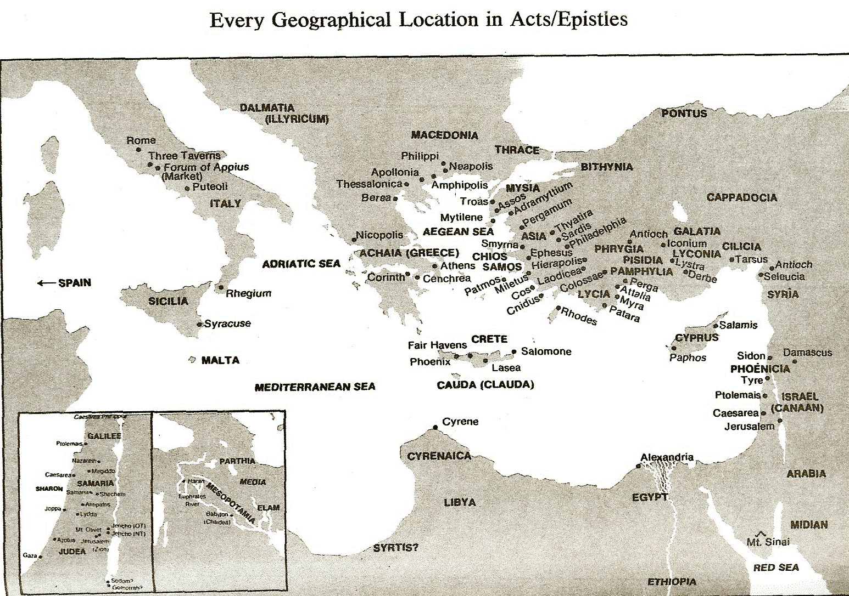

Slide 46
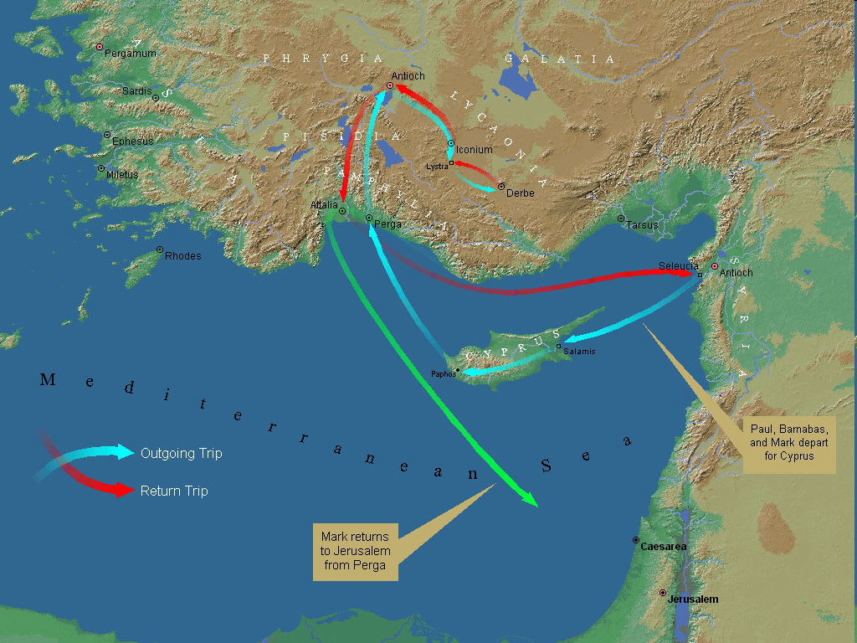
First Missionary Journey

Slide 47
3. Paul’ Sufferings (3:11-13)
Persecutions (11a)
Sufferings (11b)
1. An example (11c)
2. A promise (12)
3. A reason (13)

Slide 48
3. Paul’ Sufferings (3:11-13)
Persecutions (11a)
Sufferings (11b)
1. An example (11c)
2. A promise (12)
3. A reason (13)

Slide 49

4. Alpha Privitives (2-3)
Disobedient to parents (2)
Ungrateful (2)
Unholy (2)
Unloving (3)
Irreconcilable (3)
Break up-Malicious gossips (3)
Without self control (3)
Brutal (3)
Haters of good (3)

Slide 50
Conclusion

Slide 51
B. Paul’ Example (3:10-13)
Paul’s ministry (10a)
Paul’s character (10b)
Paul’s difficulties (11-13)

Slide 52
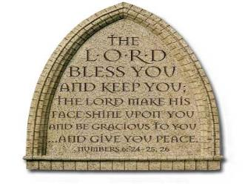
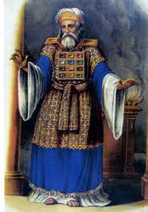
“The Lord bless you and keep you; the Lord make his face shine on you and be gracious to you; the Lord turn his face toward you and give you peace.” (NIV)

