Slide 1
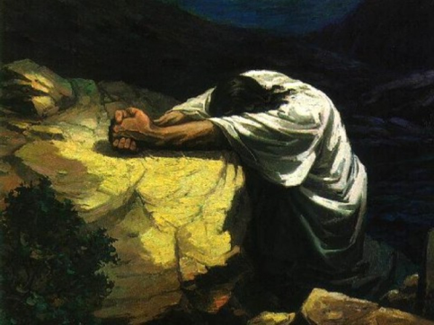
The priority of prayer
Colossians 4:2-4

Slide 2
The priority of Prayer
Intro – Priority of Prayer
Outline of Colossians (with a focus on 4:2 – 4)
Four characteristics of Prayer
Conclusion
Outline adapted from James P Sweeney, “The Priority of Prayer in Colossians 4:2-4,” Bibliotheca Sacra 159, no. 635 (July 2002): 318–33.

Slide 3
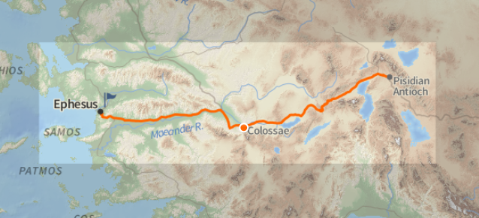
Colossae
Image Source: Logos Bible Software

Slide 4
“Although the Colossians had not yet succumbed, an encroaching heresy was threatening the predominantly gentile Colossian church. The nature of the heresy can only be deduced from Paul’s incidental references to it in his refutation. It was apparently a religious system that combined elements from Greek speculation, Jewish legalism, and Oriental mysticism. It involved a low view of the body and probably nature as a whole. Circumcision, dietary regulations, and ritual observances were included in this system, which utilized asceticism, worship of angels as intermediaries, and mystical experiences as an approach to the spiritual realm. Any attempt to fit Christ into such a system would undermine His person and redemptive work.”
Bruce Wilkinson and Kenneth Boa, Talk Thru the Bible (Nashville, TN: Thomas Nelson Publishers, 1980), 412.

Slide 5
Outline of Colossians
Introduction 1:1 – 14
Paul’s Greeting 1:1 – 2
Paul’s Thanksgiving 1:3 – 8
Paul’s Prayer 1:9 – 14
The Preeminence of Christ
Warning Against False Philosophy 2:4 – 23
Position of the Believer – Christ is our life 3:1 – 4
The Practice of the Believer
Conclusion 4:7 – 18
Outline adapted from Bruce Wilkinson and Kenneth Boa, Talk Thru the Bible, 415.

Slide 6
Outline of Colossians
Introduction 1:1 – 14
The Preeminence of Christ
In Creation 1:15 – 18
In Redemption 1:19 – 23
In the Church 1:24 – 2:3
Warning Against False Philosophy 2:4 – 23
Position of the Believer – Christ is our life 3:1 – 4
The Practice of the Believer
Conclusion 4:7 – 18
Outline adapted from Bruce Wilkinson and Kenneth Boa, Talk Thru the Bible, 415.

Slide 7
Outline of Colossians
Introduction 1:1 – 14
The Preeminence of Christ
Warning Against False Philosophy 2:4 – 23
Against Enticing Words 2:4 – 7
Against Vain Philosophy 2:8 – 10
Against Judgment of Men 2:11 – 17
Against Improper Worship 2:18 – 19
Against Doctrine of Men 2:20 – 23
Position of the Believer – Christ is our life 3:1 – 4
The Practice of the Believer
Conclusion 4:7 – 18
Outline adapted from Bruce Wilkinson and Kenneth Boa, Talk Thru the Bible, 415.

Slide 8
Outline of Colossians
Introduction 1:1 – 14
The Preeminence of Christ
Warning Against False Philosophy 2:4 – 23
Position of the Believer – Christ is our life 3:1 – 4
The Practice of the Believer
Conclusion 4:7 – 18
Outline adapted from Bruce Wilkinson and Kenneth Boa, Talk Thru the Bible, 415.

Slide 9
Outline of Colossians
Introduction 1:1 – 14
The Preeminence of Christ
Warning Against False Philosophy 2:4 – 23
Position of the Believer – Christ is our life 3:1 – 4
The Practice of the Believer
Private Life
Put Off the Old Man 3:5 – 11
Put On the New Man 3:12 – 17
Public Life
Personal Commands for Holiness
In Family Life 3:18 – 21
In Work 3:22 – 4:1
In Prayer 4:2 – 4
Conclusion 4:7 – 18
Outline adapted from Bruce Wilkinson and Kenneth Boa, Talk Thru the Bible, 415.

Slide 10
Outline of Colossians
Introduction 1:1 – 14
The Preeminence of Christ
Warning Against False Philosophy 2:4 – 23
Position of the Believer – Christ is our life 3:1 – 4
The Practice of the Believer
Private Life
Put Off the Old Man 3:5 – 11
Put On the New Man 3:12 – 17
Public Life
Personal Commands for Holiness
In Family Life 3:18 – 21
In Work 3:22 – 4:1
In Prayer 4:2 – 4
Conclusion 4:7 – 18
Outline adapted from Bruce Wilkinson and Kenneth Boa, Talk Thru the Bible, 415.

Slide 11
Priority of Prayer

Slide 12
Colossians 4:2
Devote yourselves to prayer, keeping alert in it with an attitude of thanksgiving…

Slide 13
Acts 2:42
They were continually devoting themselves to the apostles’ teaching and to fellowship, to the breaking of bread and to prayer.

Slide 14
Structure of Colossians 4: 2 – 4
Devote yourselves to prayer,
by keeping alert in it with thanksgiving, [and]
by praying at the same time for us as well
[namely] that God will open up to us a door [of opportunity] for the word,
that we may speak forth the mystery of Christ
for which [mystery] I have also been imprisoned;
that I might make it [the mystery] clear in the way I ought to [or, must] speak [it].

Slide 15
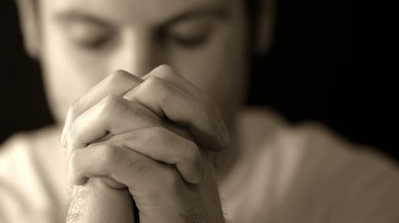
4 Characteristics of Prayer
Persistence

Slide 16
4 Characteristics of Prayer
Persistence
Vigilance

Slide 17
4 Characteristics of Prayer
Persistence
Vigilance
Thankfulness

Slide 18
4 Characteristics of Prayer
Persistence
Vigilance
Thankfulness
Focus

Slide 19
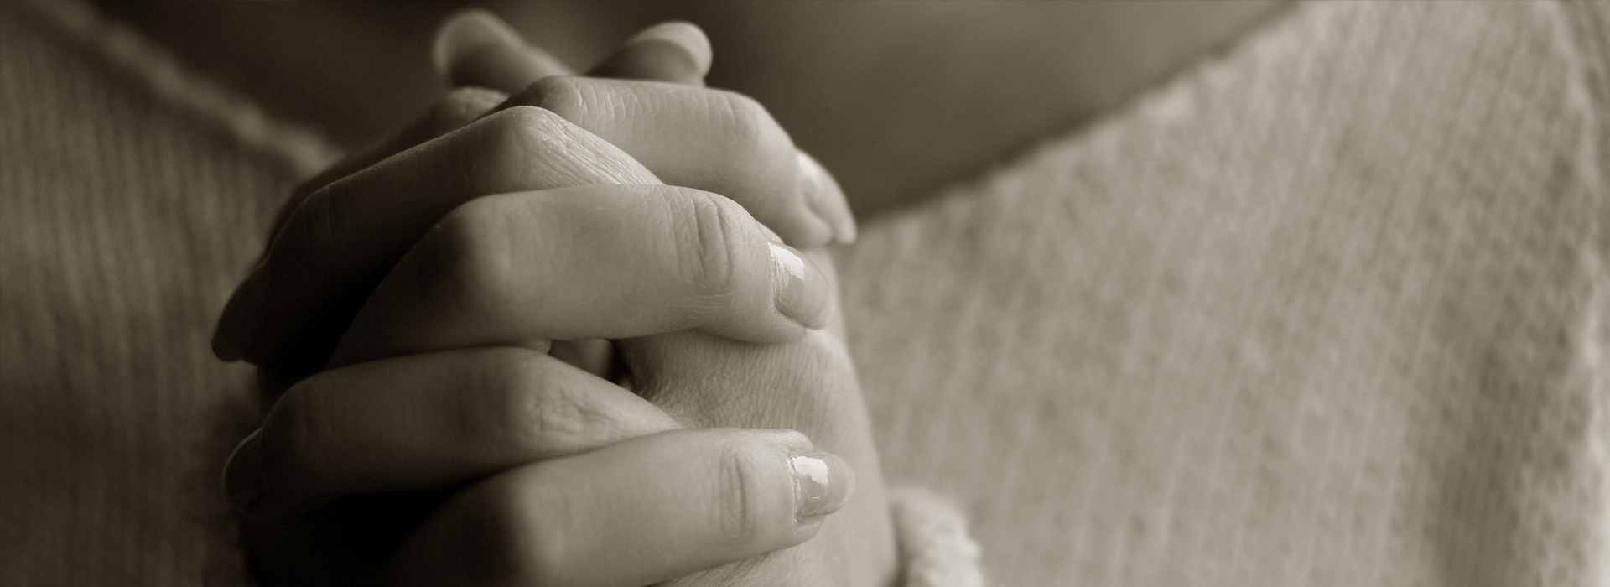
Conclusion

Slide 20
The priority of prayer
Colossians 4:2-4

