Slide 1
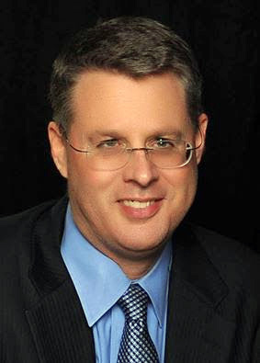
Soteriology Session 5
Dr. Andy Woods
Senior Pastor – Sugar Land Bible Church
Professor of Bible & Theology – College of Biblical Studies

Slide 2
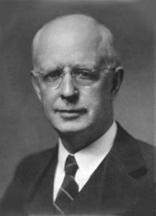
Soteriology Overview
This Session
V. God’s One Condition of Salvation

Slide 3
Soteriology Overview
Definition
Election
Atonement
Salvation words
God’s one condition of salvation
Results of salvation
Eternal security
Faulty views of salvation

Slide 4
God’s One Condition of Salvation
Misconceptions – multiple steps, poor word choices
Around 200 passages teach that justification is conditioned on faith alone
Why God has conditioned salvation on faith alone
What saving faith is – trust
What saving faith is not – Jas 2:19
Content of saving faith – John 8:24; 20:30-31; 1 Cor 15:1-4
An evangelistic model
Response to problem passages

Slide 5
God’s One Condition of Salvation
Misconceptions – multiple steps, poor word choices
Around 200 passages teach that justification is conditioned on faith alone
Why God has conditioned salvation on faith alone
What saving faith is – trust
What saving faith is not – Jas 2:19
Content of saving faith – John 8:24; 20:30-31; 1 Cor 15:1-4
An evangelistic model
Response to problem passages

Slide 6
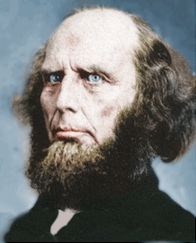
Poor Word Choices
ABC method – Admit, Believe, Confess
Miscellaneous poor word choices – confess, deny, yield, surrender, sorrow, make, ask, forsake, receive, accept, invite
Negative influence of Charles Finney

Slide 7
Poor Word Choices
ABC method – Admit, Believe, Confess
Miscellaneous poor word choices – confess, deny, yield, surrender, sorrow, make, ask, forsake, receive, accept, invite
Negative influence of Charles Finney

Slide 8
Poor Word Choices
ABC method – Admit, Believe, Confess
Miscellaneous poor word choices – confess, deny, yield, surrender, sorrow, make, ask, forsake, receive, accept, invite
Negative influence of Charles Finney

Slide 9
Poor Word Choices
ABC method – Admit, Believe, Confess
Miscellaneous poor word choices – confess, deny, yield, surrender, sorrow, make, ask, forsake, receive, accept, invite
Negative influence of Charles Finney

Slide 10
God’s One Condition of Salvation
Misconceptions – multiple steps, poor word choices
Around 200 passages teach that justification is conditioned on faith alone
Why God has conditioned salvation on faith alone
What saving faith is – trust
What saving faith is not – Jas 2:19
Content of saving faith – John 8:24; 20:30-31; 1 Cor 15:1-4
An evangelistic model
Response to problem passages

Slide 11
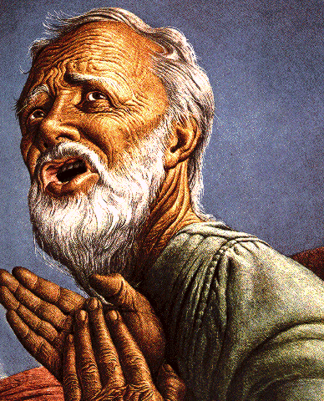
Passage Conditioning Salvation on Faith Alone (Sola Fide)
Genesis 15:6
John 3:16; 5:24; 6:28-29, 47; 16:8-9; 20:30-31
Acts 16:30-31
Romans 1:16; Ephesians 2:8-9
Hebrews 11:6

Slide 12
Passage Conditioning Salvation on Faith Alone (Sola Fide)
Genesis 15:6
John 3:16; 5:24; 6:28-29, 47; 16:8-9; 20:30-31
Acts 16:30-31
Romans 1:16; Ephesians 2:8-9
Hebrews 11:6

Slide 13
Belief – God’s One Condition for Justification
Gen 15:6
Then he believed in the LORD; and He reckoned it to him as righteousness.
John 3:16
For God so loved the world, that He gave His only begotten Son, that whoever believes in Him shall not perish, but have eternal life.
Acts 16:30-31
"Sirs, what must I do to be saved?" They said, "Believe in the Lord Jesus, and you will be saved..."

Slide 14
Passage Conditioning Salvation on Faith Alone (Sola Fide)
Genesis 15:6
John 3:16; 5:24; 6:28-29, 47; 16:8-9; 20:30-31
Acts 16:30-31
Romans 1:16; Ephesians 2:8-9
Hebrews 11:6

Slide 15
Belief – God’s One Condition for Justification
Gen 15:6
Then he believed in the LORD; and He reckoned it to him as righteousness.
John 3:16
For God so loved the world, that He gave His only begotten Son, that whoever believes in Him shall not perish, but have eternal life.
Acts 16:30-31
"Sirs, what must I do to be saved?" They said, "Believe in the Lord Jesus, and you will be saved..."

Slide 16
John 5:24 (NASB)
“Truly, truly, I say to you, he who hears My word, and believes Him who sent Me, has eternal life, and does not come into judgment, but has passed out of death into life.”

Slide 17
Passage Conditioning Salvation on Faith Alone (Sola Fide)
Genesis 15:6
John 3:16; 5:24; 6:28-29, 47; 16:8-9; 20:30-31
Acts 16:30-31
Romans 1:16; Ephesians 2:8-9
Hebrews 11:6

Slide 18
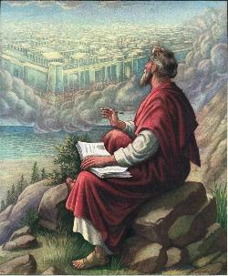
John 20:30-31
“Therefore many other signs Jesus also performed in the presence of the disciples, which are not written in this book; but these have been written so that you may believe that Jesus is the Christ, the Son of God; and that believing you may have life in His name.”

Slide 19
Passage Conditioning Salvation on Faith Alone (Sola Fide)
Genesis 15:6
John 3:16; 5:24; 6:28-29, 47; 16:8-9; 20:30-31
Acts 16:30-31
Romans 1:16; Ephesians 2:8-9
Hebrews 11:6

Slide 20
Belief – God’s One Condition for Justification
Gen 15:6
Then he believed in the LORD; and He reckoned it to him as righteousness.
John 3:16
For God so loved the world, that He gave His only begotten Son, that whoever believes in Him shall not perish, but have eternal life.
Acts 16:30-31
"Sirs, what must I do to be saved?" They said, "Believe in the Lord Jesus, and you will be saved..."

Slide 21
Passage Conditioning Salvation on Faith Alone (Sola Fide)
Genesis 15:6
John 3:16; 5:24; 6:28-29, 47; 16:8-9; 20:30-31
Acts 16:30-31
Romans 1:16; Ephesians 2:8-9
Hebrews 11:6

Slide 22
Passage Conditioning Salvation on Faith Alone (Sola Fide)
Genesis 15:6
John 3:16; 5:24; 6:28-29, 47; 16:8-9; 20:30-31
Acts 16:30-31
Romans 1:16; Ephesians 2:8-9
Hebrews 11:6

Slide 23
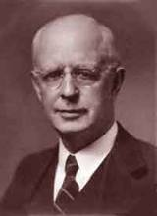
Lewis Sperry Chafer, vol. 7, Systematic Theology^{b} (Grand Rapids, MI: Kregel Publications, 1993), 265-66.
Belief-God’s One Condition for Justification
“…because upwards of 150 passages of Scripture condition salvation upon believing only (cf. John 3:16; Acts 16:31).”

Slide 24
God’s One Condition of Salvation
Misconceptions – multiple steps, poor word choices
Around 200 passages teach that justification is conditioned on faith alone
Why God has conditioned salvation on faith alone
What saving faith is – trust
What saving faith is not – Jas 2:19
Content of saving faith – John 8:24; 20:30-31; 1 Cor 15:1-4
An evangelistic model
Response to problem passages

Slide 25
Why Has God Designed
Justification by Faith Alone?
Faith in non-meritorious (Isa. 64:6; Rom. 4:4-5)
Faith is by grace and not works (Rom. 11:6)
Faith maintains God’s glory (Isa. 42:8)
Faith eliminates boasting (Rom. 3:27; Eph. 2:8-9)
Faith maintains the Gospel’s offense (Gal. 5:11)

Slide 26
Why Has God Designed
Justification by Faith Alone?
Faith in non-meritorious (Isa. 64:6; Rom. 4:4-5)
Faith is by grace and not works (Rom. 11:6)
Faith maintains God’s glory (Isa. 42:8)
Faith eliminates boasting (Rom. 3:27; Eph. 2:8-9)
Faith maintains the Gospel’s offense (Gal. 5:11)

Slide 27
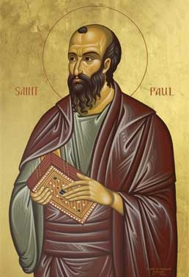
Romans 4:4-5
“ Now to the one who works, his wage is not credited as a favor, but as what is due. But to the one who does not work, but believes in Him who justifies the ungodly, his faith is credited as righteousness.”

Slide 28
Why Has God Designed
Justification by Faith Alone?
Faith in non-meritorious (Isa. 64:6; Rom. 4:4-5)
Faith is by grace and not works (Rom. 11:6)
Faith maintains God’s glory (Isa. 42:8)
Faith eliminates boasting (Rom. 3:27; Eph. 2:8-9)
Faith maintains the Gospel’s offense (Gal. 5:11)

Slide 29
Romans 11:6
“But if it is by grace, it is no longer on the basis of works, otherwise grace is no longer grace.”

Slide 30
Why Has God Designed
Justification by Faith Alone?
Faith in non-meritorious (Isa. 64:6; Rom. 4:4-5)
Faith is by grace and not works (Rom. 11:6)
Faith maintains God’s glory (Isa. 42:8)
Faith eliminates boasting (Rom. 3:27; Eph. 2:8-9)
Faith maintains the Gospel’s offense (Gal. 5:11)

Slide 31
Why Has God Designed
Justification by Faith Alone?
Faith in non-meritorious (Isa. 64:6; Rom. 4:4-5)
Faith is by grace and not works (Rom. 11:6)
Faith maintains God’s glory (Isa. 42:8)
Faith eliminates boasting (Rom. 3:27; Eph. 2:8-9)
Faith maintains the Gospel’s offense (Gal. 5:11)

Slide 32
Ephesians 2:8-9
"For by grace you have been saved through faith; and that not of yourselves, it is the gift of God; not as a result of works, so that no one may boast."
Notes:
To what does “that” or “this” refer? Since it is a neuter pronoun it evidently does not refer to “grace” or “faith” both of which are feminine in gender in the Greek text. Probably it refers to the whole preceding clause that describes salvation (cf. 1:15; 3:1). Salvation is the gift of God. Constable, T. (2003). Tom Constable’s Expository Notes on the Bible (Eph 2:8). Galaxie Software.
More plausible is the…view, viz., that τοῦτο refers to the concept of a grace-by-faith salvation. As we have seen, τοῦτο regularly takes a conceptual antecedent. Whether faith is seen as a gift here or anywhere else in the NT is not addressed by this.⁵³
(⁵³ On an exegetical level, I am inclined to agree with Lincoln that “in Paul’s thinking faith can never be viewed as a meritorious work because in connection with justification he always contrasts faith with works of the law (cf. Gal 2:16; 3:2–5, 9, 10; Rom 3:27, 28)” (A. T. Lincoln, Ephesians [WBC] 111). If faith is not meritorious, but is instead the reception of the gift of salvation, then it is not a gift per se. Such a view does not preclude the notion that for faith to save, the Spirit of God must initiate the conversion process. Wallace, D. B. (1996). Greek Grammar beyond the Basics: An Exegetical Syntax of the New Testament (p. 335). Grand Rapids, MI: Zondervan.)

Slide 33
Why Has God Designed
Justification by Faith Alone?
Faith in non-meritorious (Isa. 64:6; Rom. 4:4-5)
Faith is by grace and not works (Rom. 11:6)
Faith maintains God’s glory (Isa. 42:8)
Faith eliminates boasting (Rom. 3:27; Eph. 2:8-9)
Faith maintains the Gospel’s offense (Gal. 5:11)

Slide 34
Galatians 5:11
"But I, brethren, if I still preach circumcision, why am I still persecuted? Then the stumbling block of the cross has been abolished."
Notes:
To what does “that” or “this” refer? Since it is a neuter pronoun it evidently does not refer to “grace” or “faith” both of which are feminine in gender in the Greek text. Probably it refers to the whole preceding clause that describes salvation (cf. 1:15; 3:1). Salvation is the gift of God. Constable, T. (2003). Tom Constable’s Expository Notes on the Bible (Eph 2:8). Galaxie Software.
More plausible is the…view, viz., that τοῦτο refers to the concept of a grace-by-faith salvation. As we have seen, τοῦτο regularly takes a conceptual antecedent. Whether faith is seen as a gift here or anywhere else in the NT is not addressed by this.⁵³
(⁵³ On an exegetical level, I am inclined to agree with Lincoln that “in Paul’s thinking faith can never be viewed as a meritorious work because in connection with justification he always contrasts faith with works of the law (cf. Gal 2:16; 3:2–5, 9, 10; Rom 3:27, 28)” (A. T. Lincoln, Ephesians [WBC] 111). If faith is not meritorious, but is instead the reception of the gift of salvation, then it is not a gift per se. Such a view does not preclude the notion that for faith to save, the Spirit of God must initiate the conversion process. Wallace, D. B. (1996). Greek Grammar beyond the Basics: An Exegetical Syntax of the New Testament (p. 335). Grand Rapids, MI: Zondervan.)

Slide 35
God’s One Condition of Salvation
Misconceptions – multiple steps, poor word choices
Around 200 passages teach that justification is conditioned on faith alone
Why God has conditioned salvation on faith alone
What saving faith is – trust
What saving faith is not – Jas 2:19
Content of saving faith – John 8:24; 20:30-31; 1 Cor 15:1-4
An evangelistic model
Response to problem passages

Slide 36
“Believe” Defined
pisteuō…“to believe,” also “to be persuaded of,” and hence, “to place confidence in, to trust,” signifies, in this sense of the word, reliance upon, not mere credence. It is most frequent in the writings of the apostle John, especially the Gospel. He does not use the noun…Of the writers of the Gospels…uses of the verb…John ninety-nine.
W. E. Vine, Merrill F. Unger, and William White, Vine's Complete Expository Dictionary of the Old and New Testament Words (Nashville: Nelson, 1996), 61.

Slide 37
God’s One Condition of Salvation
Misconceptions – multiple steps, poor word choices
Around 200 passages teach that justification is conditioned on faith alone
Why God has conditioned salvation on faith alone
What saving faith is – trust
What saving faith is not – Jas 2:19
Content of saving faith – John 8:24; 20:30-31; 1 Cor 15:1-4
An evangelistic model
Response to problem passages

Slide 38
God’s One Condition of Salvation
Misconceptions – multiple steps, poor word choices
Around 200 passages teach that justification is conditioned on faith alone
Why God has conditioned salvation on faith alone
What saving faith is – trust
What saving faith is not – Jas 2:19
Content of saving faith – John 8:24; 20:30-31; 1 Cor 15:1-4
An evangelistic model
Response to problem passages

Slide 39
What Saving Faith is Not
Not merely intellectual assent (Jas. 2:19)
Illustrations
Charles Blondin
George Washington
Airplane boarding

Slide 40
What Saving Faith is Not
Not merely intellectual assent (Jas. 2:19)
Illustrations
Charles Blondin
George Washington
Airplane boarding

Slide 41
James 2:19 (NASB)
“You believe that God is one. You do well; the demons also believe, and shudder.”

Slide 42
Matthew 8:28-29 (NASB)
“When He came to the other side into the country of the Gadarenes, two men who were demon-possessed met Him as they were coming out of the tombs. They were so extremely violent that no one could pass by that way. ²⁹ And they cried out, saying, “What business do we have with each other, Son of God? Have You come here to torment us before the time?”

Slide 43
Acts 19:15 (NASB)
“And the evil spirit answered and said to them, “I recognize Jesus, and I know about Paul, but who are you?”

Slide 44
What Saving Faith is Not
Not merely intellectual assent (Jas. 2:19)
Illustrations
Charles Blondin
George Washington
Airplane boarding

Slide 45
What Saving Faith is Not
Not merely intellectual assent (Jas. 2:19)
Illustrations
Charles Blondin
George Washington
Airplane boarding

Slide 46
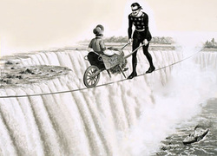

Slide 47
What Saving Faith is Not
Not merely intellectual assent (Jas. 2:19)
Illustrations
Charles Blondin
George Washington
Airplane boarding

Slide 48
What Saving Faith is Not
Not merely intellectual assent (Jas. 2:19)
Illustrations
Charles Blondin
George Washington
Airplane boarding

Slide 49
God’s One Condition of Salvation
Misconceptions – multiple steps, poor word choices
Around 200 passages teach that justification is conditioned on faith alone
Why God has conditioned salvation on faith alone
What saving faith is – trust
What saving faith is not – Jas 2:19
Content of saving faith – John 8:24; 20:30-31; 1 Cor 15:1-4
An evangelistic model
Response to problem passages

Slide 50
John 8:24
“Therefore I said to you that you will die in your sins; for unless you believe that I am He, you will die in your sins.”

Slide 51
John 20:30-31
“Therefore many other signs Jesus also performed in the presence of the disciples, which are not written in this book; but these have been written so that you may believe that Jesus is the Christ, the Son of God; and that believing you may have life in His name.”

Slide 52
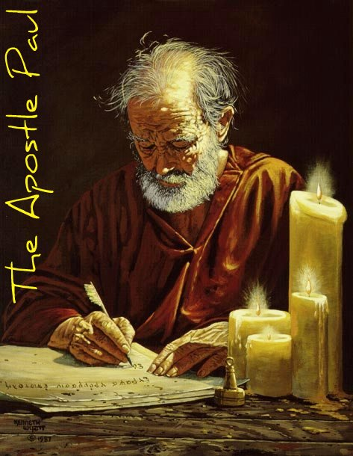
1 Cor. 15:3-4
“Now I make known to you, brethren, the gospel which I preached to you, which also you received, in which also you stand, ² by which also you are saved, if you hold fast the word which I preached to you, unless you believed in vain.³ For I delivered to you as of first importance what I also received, that Christ died for our sins according to the Scriptures, ⁴ and that He was buried, and that He was raised on the third day according to the Scriptures.”

Slide 53
God’s One Condition of Salvation
Misconceptions – multiple steps, poor word choices
Around 200 passages teach that justification is conditioned on faith alone
Why God has conditioned salvation on faith alone
What saving faith is – trust
What saving faith is not – Jas 2:19
Content of saving faith – John 8:24; 20:30-31; 1 Cor 15:1-4
An evangelistic model
Response to problem passages

Slide 54
An Evangelistic Model
Bad News #1: You are a sinner before a holy God – Rom 3:23
Bad News #2: The penalty for your sin is death – Gen 2:17; Romans 6:23; criminal illustration
Good News #1: God in His infinite love provided His Son Jesus Christ who died for you and paid your sin penalty – Rom 5:8
Good News #2: You can be saved from hell by depending upon Jesus Christ alone to save you – Eph 2:8-9; explain: grace, faith, gift, and not of works; chair illustration
Good News #3: God wants you to know FOR SURE that you are saved and have eternal life – John 5:24; 6:47; 1 John 5:13

Slide 55
An Evangelistic Model
Bad News #1: You are a sinner before a holy God – Rom 3:23
Bad News #2: The penalty for your sin is death – Gen 2:17; Romans 6:23; criminal illustration
Good News #1: God in His infinite love provided His Son Jesus Christ who died for you and paid your sin penalty – Rom 5:8
Good News #2: You can be saved from hell by depending upon Jesus Christ alone to save you – Eph 2:8-9; explain: grace, faith, gift, and not of works; chair illustration
Good News #3: God wants you to know FOR SURE that you are saved and have eternal life – John 5:24; 6:47; 1 John 5:13

Slide 56
An Evangelistic Model
Bad News #1: You are a sinner before a holy God – Rom 3:23
Bad News #2: The penalty for your sin is death – Gen 2:17; Romans 6:23; criminal illustration
Good News #1: God in His infinite love provided His Son Jesus Christ who died for you and paid your sin penalty – Rom 5:8
Good News #2: You can be saved from hell by depending upon Jesus Christ alone to save you – Eph 2:8-9; explain: grace, faith, gift, and not of works; chair illustration
Good News #3: God wants you to know FOR SURE that you are saved and have eternal life – John 5:24; 6:47; 1 John 5:13

Slide 57
An Evangelistic Model
Bad News #1: You are a sinner before a holy God – Rom 3:23
Bad News #2: The penalty for your sin is death – Gen 2:17; Romans 6:23; criminal illustration
Good News #1: God in His infinite love provided His Son Jesus Christ who died for you and paid your sin penalty – Rom 5:8
Good News #2: You can be saved from hell by depending upon Jesus Christ alone to save you – Eph 2:8-9; explain: grace, faith, gift, and not of works; chair illustration
Good News #3: God wants you to know FOR SURE that you are saved and have eternal life – John 5:24; 6:47; 1 John 5:13

Slide 58
An Evangelistic Model
Bad News #1: You are a sinner before a holy God – Rom 3:23
Bad News #2: The penalty for your sin is death – Gen 2:17; Romans 6:23; criminal illustration
Good News #1: God in His infinite love provided His Son Jesus Christ who died for you and paid your sin penalty – Rom 5:8
Good News #2: You can be saved from hell by depending upon Jesus Christ alone to save you – Eph 2:8-9; explain: grace, faith, gift, and not of works; chair illustration
Good News #3: God wants you to know FOR SURE that you are saved and have eternal life – John 5:24; 6:47; 1 John 5:13

Slide 59
An Evangelistic Model
Bad News #1: You are a sinner before a holy God – Rom 3:23
Bad News #2: The penalty for your sin is death – Gen 2:17; Romans 6:23; criminal illustration
Good News #1: God in His infinite love provided His Son Jesus Christ who died for you and paid your sin penalty – Rom 5:8
Good News #2: You can be saved from hell by depending upon Jesus Christ alone to save you – Eph 2:8-9; explain: grace, faith, gift, and not of works; chair illustration
Good News #3: God wants you to know FOR SURE that you are saved and have eternal life – John 5:24; 6:47; 1 John 5:13

Slide 60
CONCLUSION

Slide 61
God’s One Condition of Salvation
Misconceptions – multiple steps, poor word choices
Around 200 passages teach that justification is conditioned on faith alone
Why God has conditioned salvation on faith alone
What saving faith is – trust
What saving faith is not – Jas 2:19
Content of saving faith – John 8:24; 20:30-31; 1 Cor 15:1-4
An evangelistic model
Response to problem passages

Slide 62
Soteriology Overview
Next Session
V. God’s One Condition of Salvation
(Response to Problem Passages)

